Slide 1
Retro + Realm
Neha Shah

Slide 2

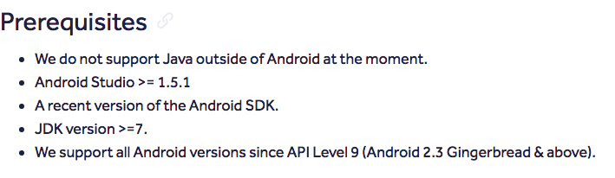
What is Realm
Realm is a mobile database that is built from the ground-up and run directly inside the phones, tabs and wearable..
It is Better, faster and simple than SQLite and Java-native.

Slide 3
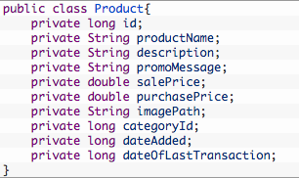
Realm over SQLite

Slide 4
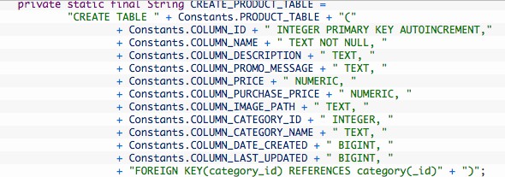
Realm over SQLite

Slide 5
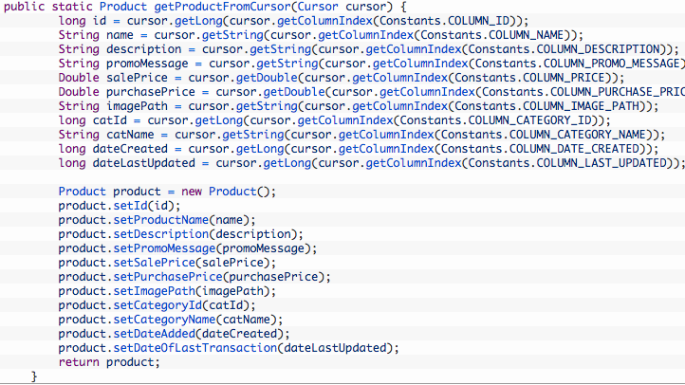
Realm over SQLite

Slide 6
All this can be replaced by Realm
Using few of lines of code.
Simple and Easy to manage.

Slide 7
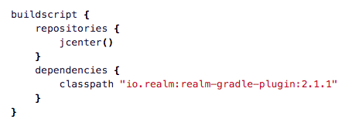
To Start with ……
Add Class path dependency to the project level build.gradle

Slide 8

To Start with ……
Apply the “realm-android” plugin to the top of application level build.gradle

Slide 9
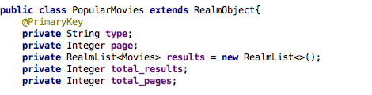
Defining the model Classes
Extend your current Model class with RealmObject.
You can also add primary keys to it.

Slide 10
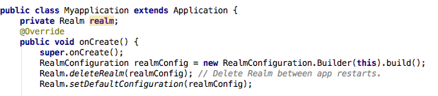
Configure Realm
In Your Application.java, configure realm Instance
Don’t forget to close realm instance, every time you open it or it will result in OutOfmemexception.

Slide 11


Annoying restrictions!!! ☹
RealmList currently can only contain RealmObject.
So we need to wrap the Strings/Integers.
This is not allowed
This is allowed

Slide 12

TypeAdapter to talk to GSON
GSON doesn’t know that RealmInteger/RealmString is just a wrapper class
So we need a TypeAdapter to make it work

Slide 13
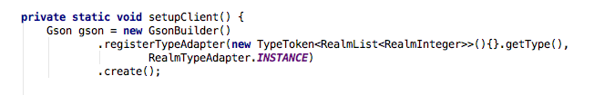
Registering the TypeAdapter
Now register the TyperAdapter when building the GSON instance, in Client.java (retrofit)

Slide 14

Fetching the data from Backend
Our RealmObject can be persisted, after fetching them from the backend.

Slide 15
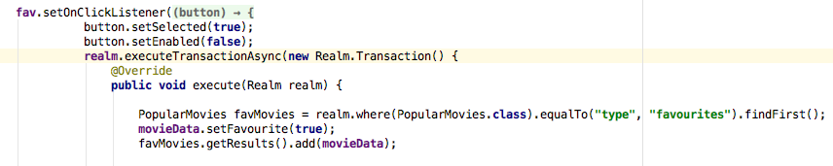
Writing to Realm
Writing operations can be performed by wrapping it inside a Realm Transaction.

Slide 16
Realm Browser
Download package for Realm Browser
Run your app in the simulator
Open Android Device Monitor
Click the File Explorer tab.
Navigate the Following path: Data->Data-> Package Name->files->Default.Realm
Highlight the file, click on the Disk Icon in the upper area
Save it to the location.
Click on the file and it will open in the Realm Browser.

Slide 17
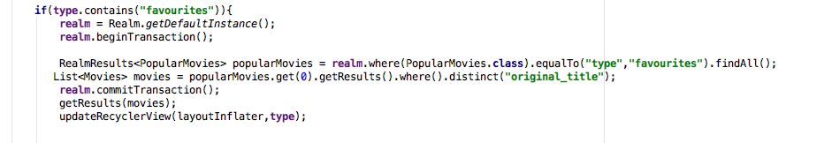
Access the data using Realm’s Query /Results

Slide 18
Things to keep in mind when choosing Realm for project
It is optimized mainly for reading.
We need to be careful about closing the realm connection, or it can easily lead to OutOfMemoryExceptions.
They will bloat the size of your app my few MBs.

Slide 19
Reference
http://valokafor.com/realm-database-tutorial-android/
https://realm.io/docs/java/latest/#getting-started
http://stackoverflow.com/questions/28465706/how-to-find-my-realm-file?rq=1

Slide 20
My GitHub Profile ☺
https://github.com/nehas510/Stage1_Popular_Movies

Slide 21
That’s all Folks!!
Thank you for your time.
☺ ☺ ☺

