Slide 1


COMPUTER GRAPHICS LABORATORY
Mini project synopsis On
2D TRANSFORMATION
DEPARTMENT OF COMPUTER SCIENCE AND ENGINEERING

Slide 2

CONTENTS :-
INTRODUCTION
PROBLEM STATEMENT
AIM AND SCOPE
OBJECTIVES
REQUIREMENTS
METHODOLOGY
SNAPSHOT
REFERENCES
3

Slide 3

INTRODUCTION
The 2D transformation is a process of modifying and re-positioning the existing graphics in 2 dimension. It refers to the process of transmitting and displaying two-dimensional graphical data. It plays a vital role in rendering images, displaying user interfaces, and conveying visual information in various digital applications.

Slide 4
PROBLEM STATEMENT
Implementation of 2D transformation for translation, rotation, and scaling using GLUT and OpenGL. It defines three shapes: circle, rectangle, and triangle.

Slide 5
AIM AND SCOPE
AIM:-
The 2D transmission of translation, rotation, and scaling in various shapes, such as circles, rectangles, and triangles, is to accurately and efficiently represent and manipulate these geometric objects in a two-dimensional space.
SCOPE :-
The scope is to use the basic primitives defined in openGL library creating complex objects. We make use of different concepts such as pushmatrix(), popmatrix(), translate(), swapbuffer().
5

Slide 6
OBJECTIVES:-
The objective of the project is
To understand the basic objectives and scope of computer graphics.
To identify computer graphics application.
To understand the basic structures of 2D graphics systems.
To understand the evolution of graphics programming environments.
6

Slide 7
REQUIREMENT SPECIFICATIONS
Hardware requirements:
Processor : intel core i3 or i5 processor
Ram : 4GB or more
Software requirements:
Operating System : Ubuntu
Language tool : OpenGL
Editor : vi editor or gedit
Code language : C++

Slide 8
METHODOLOGY:-
Menu selection
Select object in menu
Translation
Rotation
Rotation
Scaling

Slide 9
SNAPSHOT

Slide 10
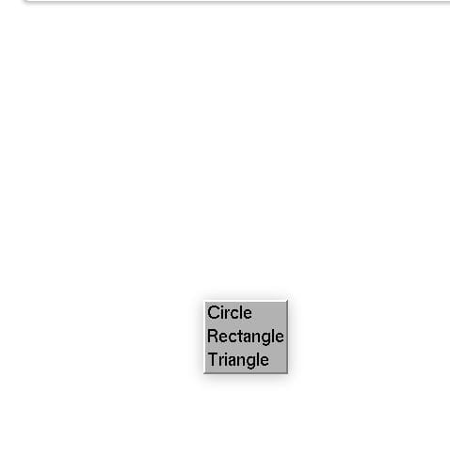
MENU SELECTION

Slide 11
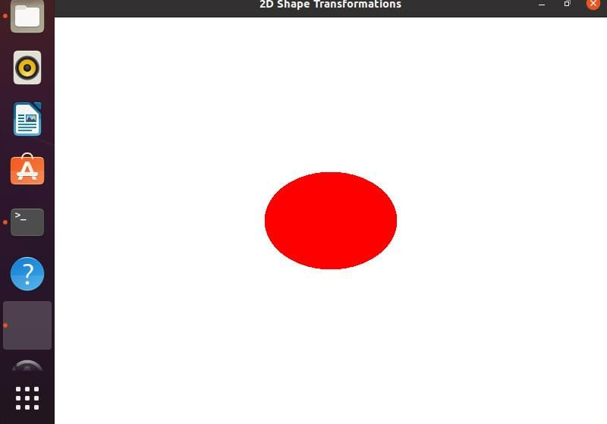
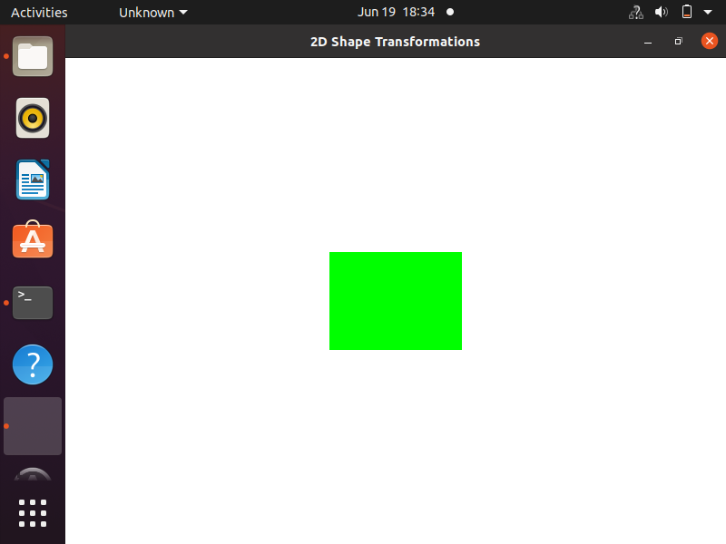
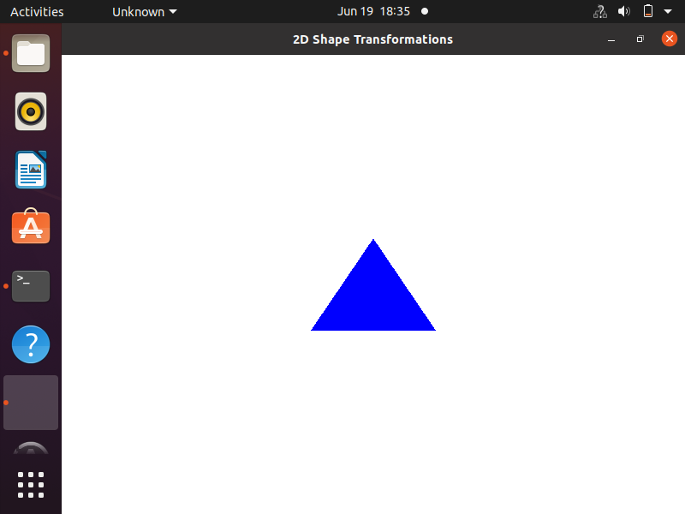
SELECT OBJECT IN MENU

Slide 12
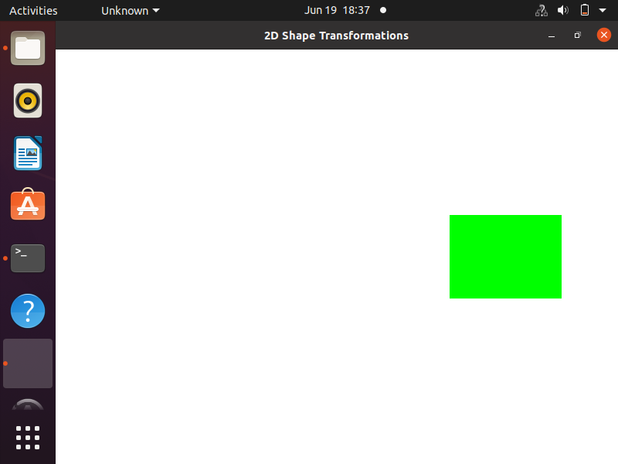
TRANSLATION

Slide 13
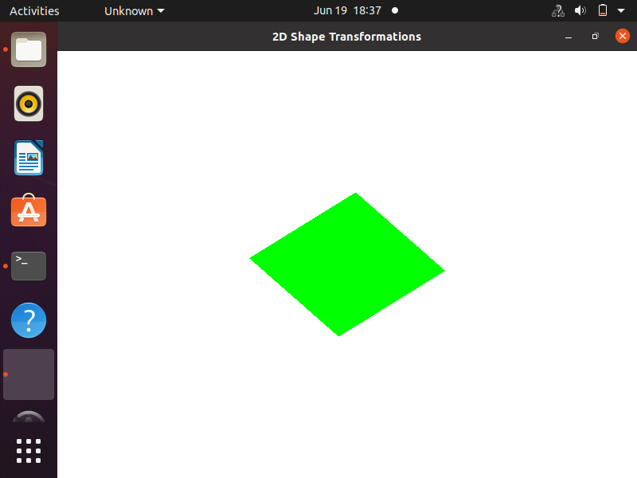
ROTATION

Slide 14
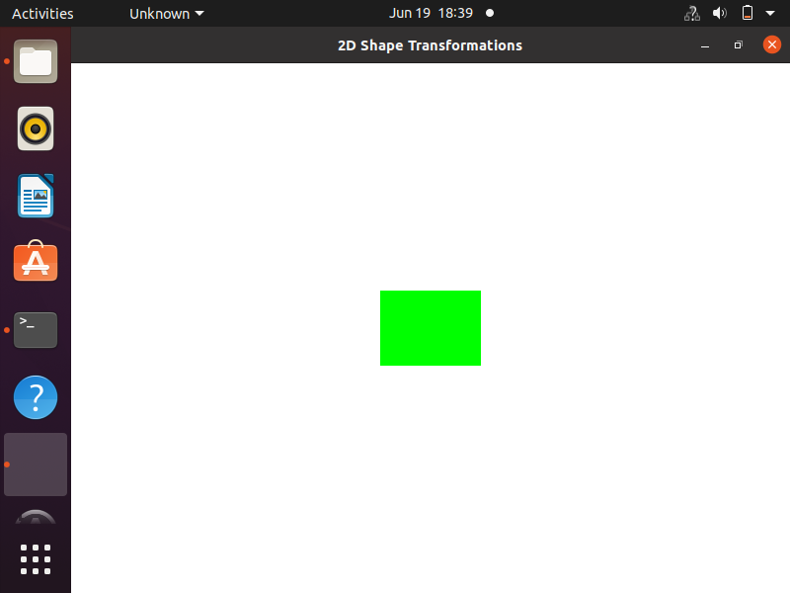
SCALING

Slide 15
REFERENCES
https://www.opengl.org.
https://www.opengl.org.examples.zip.
https://www.google.com/.
Introduction to Computer Graphics and the Vulkan API Third Edition
11

Slide 16
THANKS!

