Slide 1
Visualizing population genomic data across a landscape
Neha Savant
Monday, April 30, 2018

Slide 2
the “problem”
More and more researchers are using genomics to answer conservation questions
Need an easy way to communicate genetic patterns across a landscape to conservation practitioners and managers

Slide 3
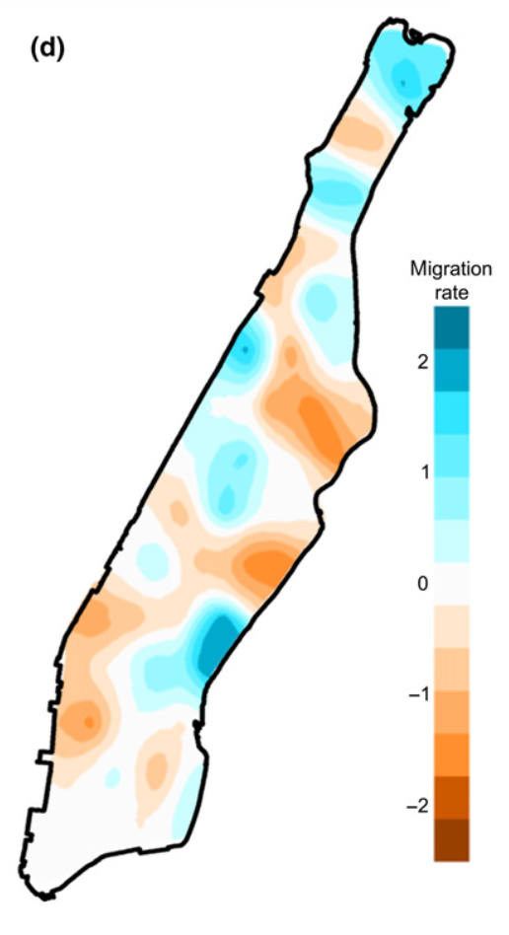
the tools
Jupyter notebooks, ipython, R
ipyrad, using the API and CLI
EEMS package in R
Estimated Effective Migration Surfaces (EEMS) is a new method of using genomic data to illustrate barriers in the landscape (Petkova et al. 2016)
Spatial genetic patterns of rats across Manhattan
59th st
14th st

Slide 4
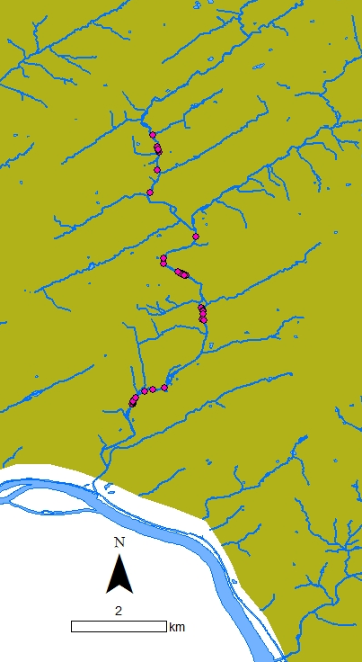
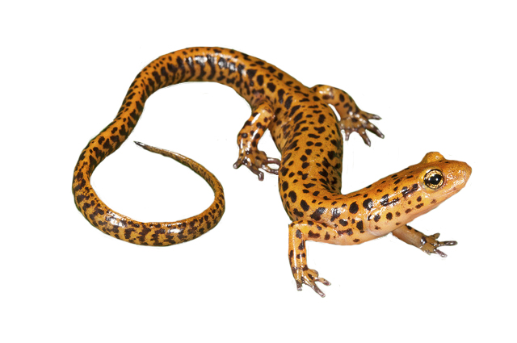
the data
Case study
A threatened species lives near streams where a pipeline is planned to be built
Paired-end ddRAD data from 46 long-tail salamanders (Eurycea longicauda)
Need to visualize genetic structure of salamanders for state biologists to inform the permitting process

Slide 5
the goal
Create a workflow in Jupyter notebooks that illustrates how to take raw genomic data and sampling locations to a visualization of genetic population structure across a landscape
Can provide other researchers a roadmap to visualize their raw genomic data

Slide 6
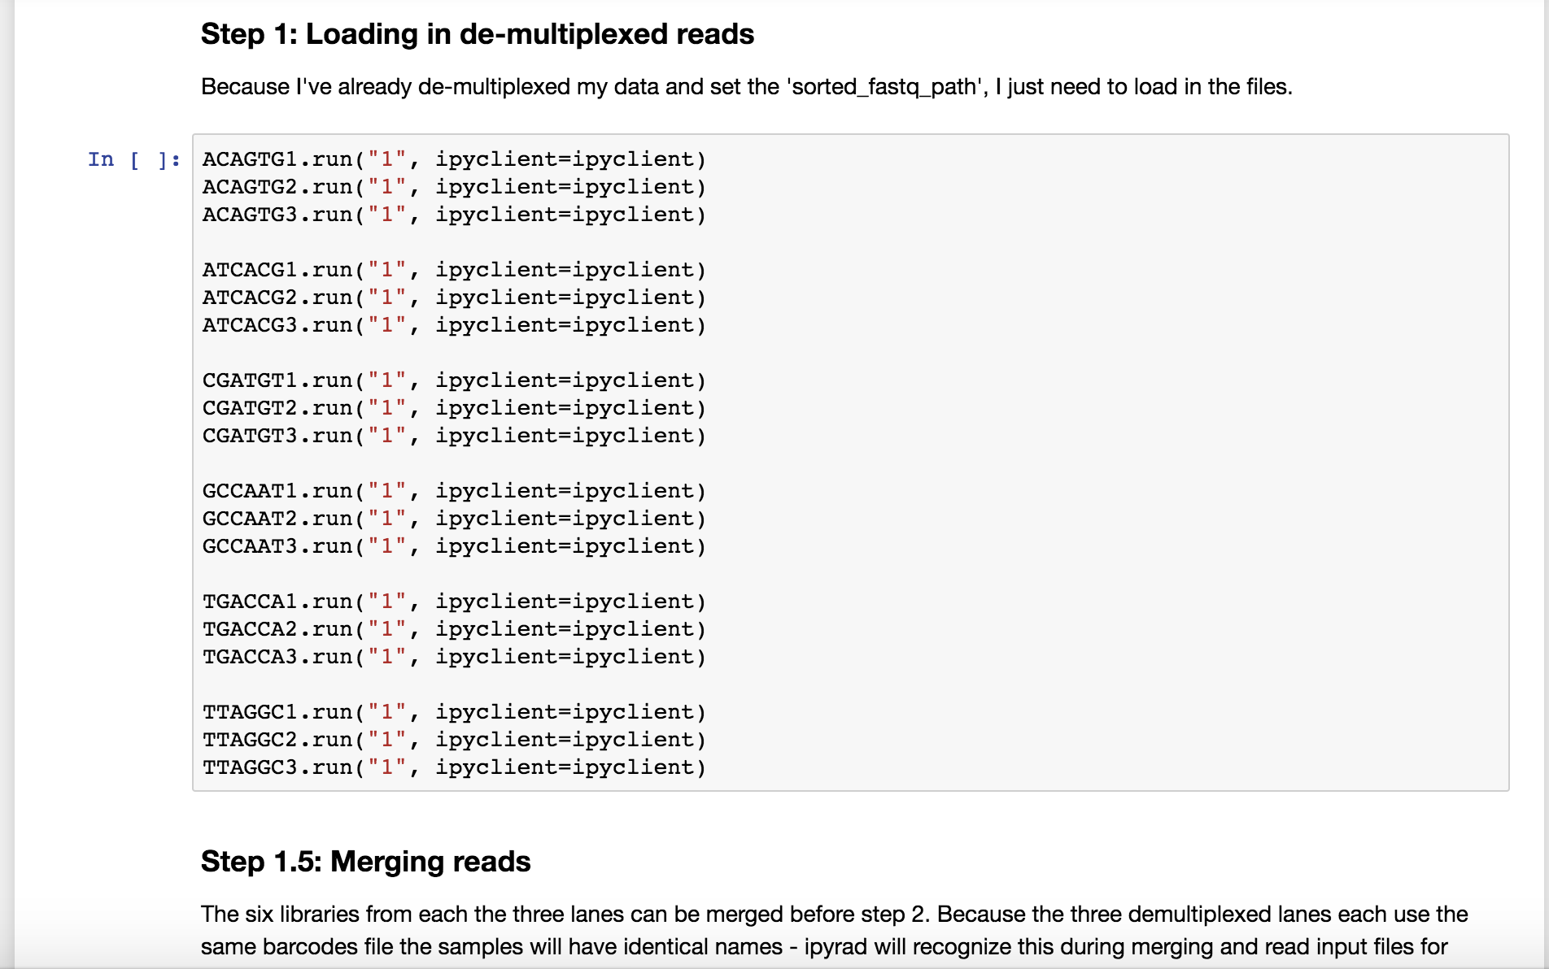
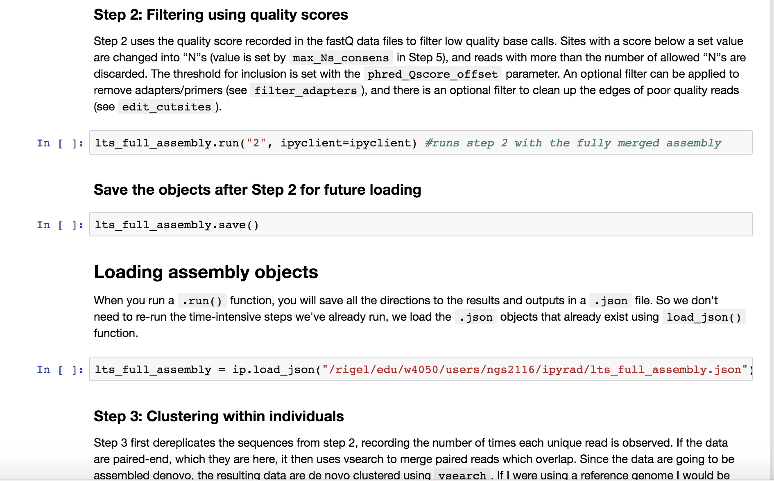
progress
Notes:
Currently running ipyrad through all the samples using both the CLI and the API

Slide 7
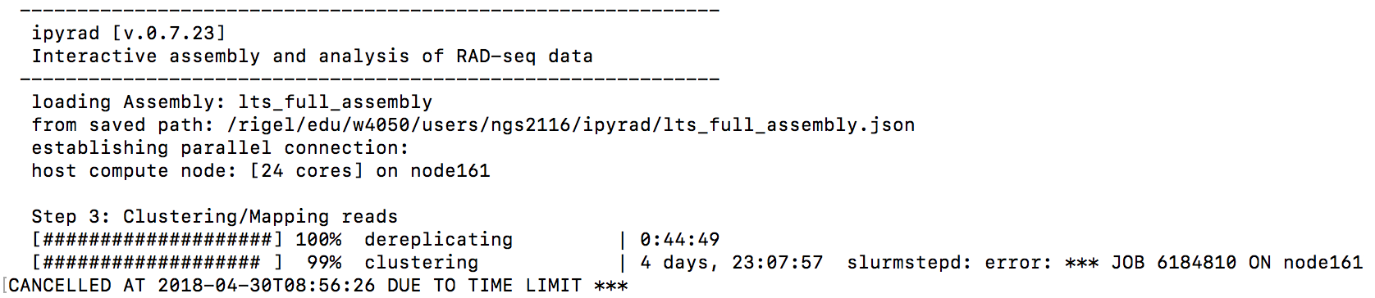
roadblocks
Notes:
I’ve been using the habanero cluster to process samples, but going to try to run the process on an MPI to use 72 cores.

Slide 8
next steps
Finish running ipyrad
Use R within jupyter notebooks to transform genomic data in proper format to run in EEMS
pairwise genetic dissimilarity matrix
Sample coordinates
Habitat coordinates

