Slide 1
DECISION TREE
GCIS 523 Statistical Computing
Guide and Advisor :
Dr. Liu
By Neha Shaik and
Anwar Shaik Mohammed

Slide 2

What is a Decision Tree?
Decision tree is a predictive model which maps an observation about an item to its conclusions about item’s target value. It is one of the predictive modelling approaches used in statistics, data mining and machine learning.
In this tree structure, leaves represent class labels and branches represent conjunctions of features that lead to those class labels.
Types of Decision trees:
Classification Tree
Regression Tree.

Slide 3
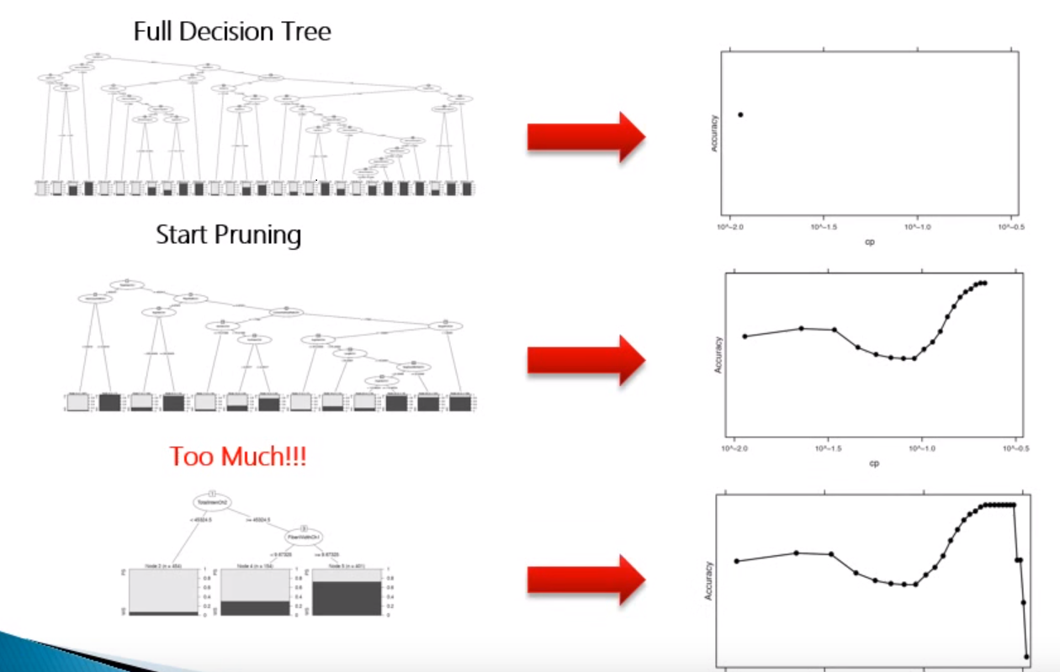
Decision Trees- Pruning

Slide 4
Classification Tree
This modelling approach is used to determine outcomes in a categorical nature.
This could be a variable with a outcome ( Yes/No or 0/1) or with multiple category levels (High/Medium/low).

Slide 5
Packages Used (Classification) :
ISLR #Book’s Library.
Tree # To Fit Decision Tree.
Dataset Used is Carseats.
Basically you have three data sets: Training, Testing and Validation.

Slide 6
Classification tree R code.
install.packages(c("ISLR", "tree"))
library(ISLR) ##Book’s library
library(tree) ## To fit decision trees
attach (Carseats) ## Dataset to use
head (Carseats)
## Start data manipulation
range(Sales)
## Create Categorial Variables bases on sales
High = ifelse(Sales >--8 , "Yes","No")
length(High)
dim(Carseats)

Slide 7
Dataset and Testing , Training sets
##Appends Vector High to previous Carseat dataset and now our dataset will be ready.(Overriding the previous carseat dataset)
Carseats = data.frame(Carseats , High)
names(Carseats)
Carseats = Carseats[,-1]
names(Carseats)
## Splitting data into testing and training sets using-
set.seed(2)
train = sample(1:nrow(Carseats),nrow(Carseats)/2)
test= -train
training_data = Carseats[train,]
testing_data= Carseats[test,]
testing_High =High[test]

Slide 8
## Fit the Tree Model using Training Data.
tree_model = tree(High~., training_data)
plot(tree_model)
text(tree_model, pretty =0)
## Check How The Model Is doing Using Test Data.
tree_pred = predict(tree_model,testing_data, type='class')
mean(tree_pred != testing_High)
##Cross Validation To Check Where To Stop Pruning.
set.seed(3)
cv_tree = cv.tree(tree_model, FUN = prune.misclass)
names(cv_tree)
plot(cv_tree$size , cv_tree$dev, type = 'b')

Slide 9
##Prune The Tree
pruned_model = prune.misclass(tree_model, best=9)
plot(pruned_model)
text(pruned_model, pretty=0)
tree_pred = predict(pruned_model,testing_data, type='class')
mean(tree_pred != testing_High)

Slide 10
Regression Tree
This modelling approach is used to determine outcomes in a continuous nature.
This could be a dependent variable with a range of values from – to + infinity value.

Slide 11
Packages Used (Regression):
library(MASS) #Book’s library.
attach(Boston) #dataset used.
library(tree)
set.seed(1)
train = sample(1:nrow(Boston),)
train = sample(1:nrow(Boston),+ nrow(Boston)/2)
test = -train
training_data = Boston[train,]
testing_data = Boston[test,]
testing_medv = medv[test]
head(Boston)

Slide 12
## fit a tree based on training data
tree_model = tree(medv~., training_data)
tree_model
plot(tree_model)
text(tree_model)
##prune the tree to size 4
pruned_model = prune.tree(tree_model, best = 4)
plot(pruned_model)
text(pruned_model)

Slide 13
References
https://lagunita.stanford.edu/c4x/HumanitiesandScience/StatLearning/asset/ch8.html
https://www.youtube.com/watch?v=GOJN9SKl_OE
https://www.youtube.com/watch?v=LziT4fJDB4I
https://www.youtube.com/watch?v=OByOgGXq76A
http://www.statmethods.net/advstats/cart.html

Slide 14
Thank You

