Slide 1

MICROSOFT ENGAGE 2022
PROJECT NAME: KYCENGINE
PROJECT MADE BY: NEHA SINGH

Slide 2

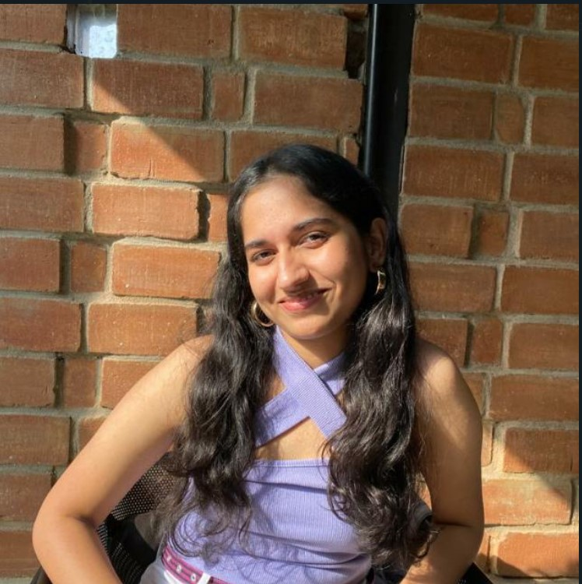
I am Neha Singh
Currently pursuing B.Tech in IT from VIT, Vellore.
My interests mainly lie in Web Development, competitive coding and machine learning.
I enjoy solving puzzles and maths.
Apart from this in my free time I dance, paint, read books, etc.

Slide 3
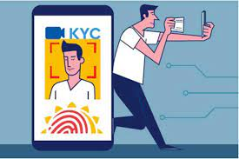
What is kyc?
How is it done online?
KYC means Know Your Customer and sometimes Know Your Client.
KYC or KYC check is the mandatory process of identifying and verifying the client's identity when opening a bank account.
Client requests to open an account.
The software captures the client’s photo as part of the account registration and eKYC process, and scans a government-issued ID
Then the user is verified using facial recognition technology.

Slide 4
KYCENGINE
User is asked to upload their government issued ID’s(Aadhar and pan) along with a passport size photograph.
KYCENGINE verifies whether the user is the same person as the photograph or not using face recognition
It even verifies the PAN card number using image recognition
Once the above two verifications are successful, the user is allowed to proceed.

Slide 5
Sign up(user uploads their Aadhar, PAN and passport size photograph)
Photo verification
Shows an error and asks to try again
Not verified
successful
PAN verification
Shows an error and asks to try again
Not verified
successful
SUCCESSFUL

