Slide 1

BLUESTOCK
Mutual Fund Analytics Capstone
Final Project Report & Findings
End-to-end ETL, SQL analytics, performance & risk modelling, and an interactive Power BI dashboard across 40 Indian mutual fund schemes
Nehasree Uma Tadikonda
BSc (Hons), IIT Guwahati • Data Analytics Internship, Bluestock Fintech • July 2026

Slide 2
AGENDA
What this report covers
01
02
03
Methodology
Data & ETL
EDA Highlights
6-day workflow: ingestion → cleaning → EDA → performance → dashboard → advanced analytics
10 raw datasets, live AMFI NAV feed, SQLite star schema
AUM, SIP, folios, demographics, sectors — 15+ charts
04
05
06
Performance & Risk
Dashboard & Advanced Analytics
Findings & Recommendations
Sharpe, Sortino, Alpha/Beta, VaR/CVaR, fund scorecard
4-page Power BI dashboard, cohorts, recommender, Monte Carlo
Key takeaways and next steps
Introduction
BlueStock Mutual Fund Analytics Capstone

Slide 3
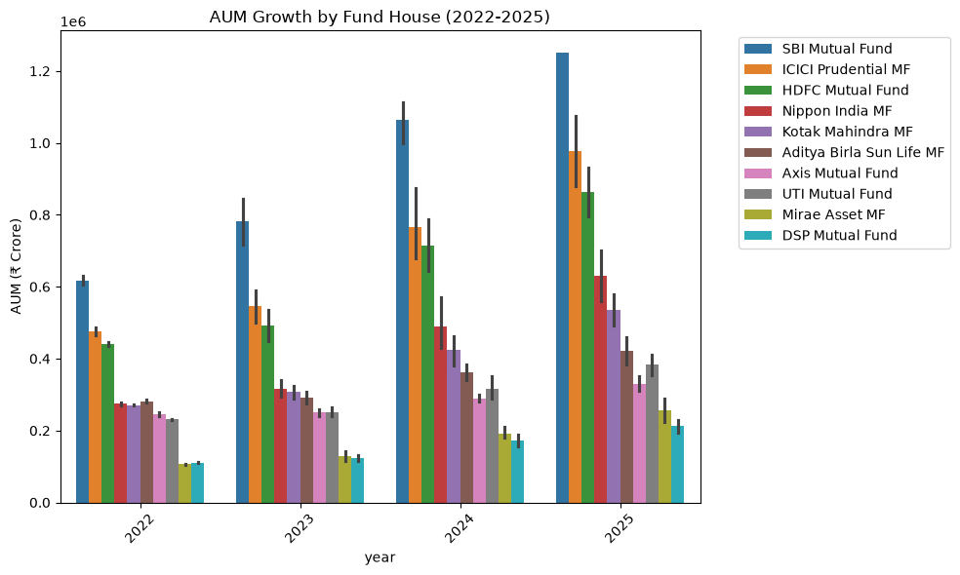
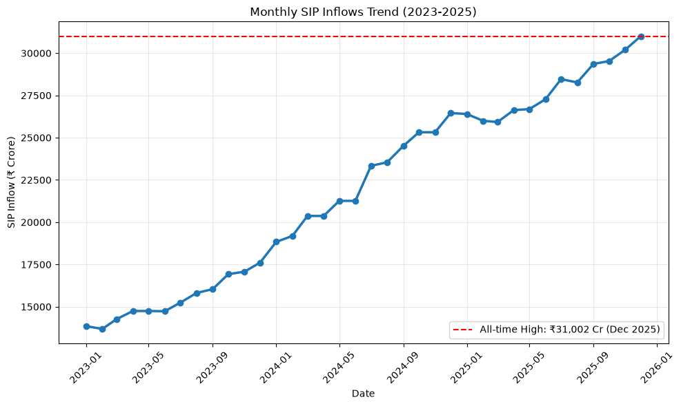
EXECUTIVE SUMMARY
The industry, in numbers
All figures are computed directly from the project's cleaned datasets and processed outputs (Dec 2025 snapshot) — not illustrative placeholders.
Rs 62.74L Cr
Rs 31,002 Cr
26.12 Cr
40 / 10
Total AUM tracked, Dec 2025 (from Rs 30.18L Cr in Mar 2022)
All-time-high monthly SIP inflow, Dec 2025 (+17.2% YoY)
Investor folios, Dec 2025 (up from 13.26 Cr in Jan 2022)
Schemes analysed across fund houses (AMCs)
Executive Summary
BlueStock Mutual Fund Analytics Capstone

Slide 4
METHODOLOGY
A six-day, end-to-end workflow
Day 1
Data Ingestion
Loaded 10 raw CSVs + live AMFI NAV feed (mfapi.in); validated AMFI codes
Day 2
Cleaning & SQL
Star schema in SQLite (6 tables); 10 analytical SQL queries; data dictionary
Day 3
EDA
15+ charts: AUM, SIP, folios, demographics, sectors, correlations
Day 4
Performance Analytics
CAGR, Sharpe, Sortino, Alpha/Beta, max drawdown, composite scorecard
Day 5
Power BI Dashboard
4-page interactive dashboard with slicers & drill-through
Day 6
Advanced Analytics
VaR/CVaR, rolling Sharpe, cohorts, recommender, HHI, Monte Carlo (bonus)
Methodology
BlueStock Mutual Fund Analytics Capstone

Slide 5
DATA INGESTION & CLEANING
10 datasets, cleaned and warehoused
40 schemes across 10 AMCs — SBI, ICICI Prudential, HDFC, Nippon India, Kotak Mahindra, Aditya Birla Sun Life, Axis, UTI, Mirae Asset, DSP
Live NAV pulled from the AMFI-backed mfapi.in API for HDFC Top 100 Direct + 5 benchmark schemes
NAV history: parsed dates, forward-filled holidays/weekends, de-duplicated, validated NAV > 0
32,778 transactions across 5,000 investors — 92% Verified KYC, 8% Pending
14 of 40 schemes carry an expense ratio below 1% (policy band: 0.10%–2.50%)
Star Schema (SQLite)
dim_fund
dim_date
fact_nav
fact_transactions
fact_performance
fact_aum
Data & ETL
BlueStock Mutual Fund Analytics Capstone

Slide 6
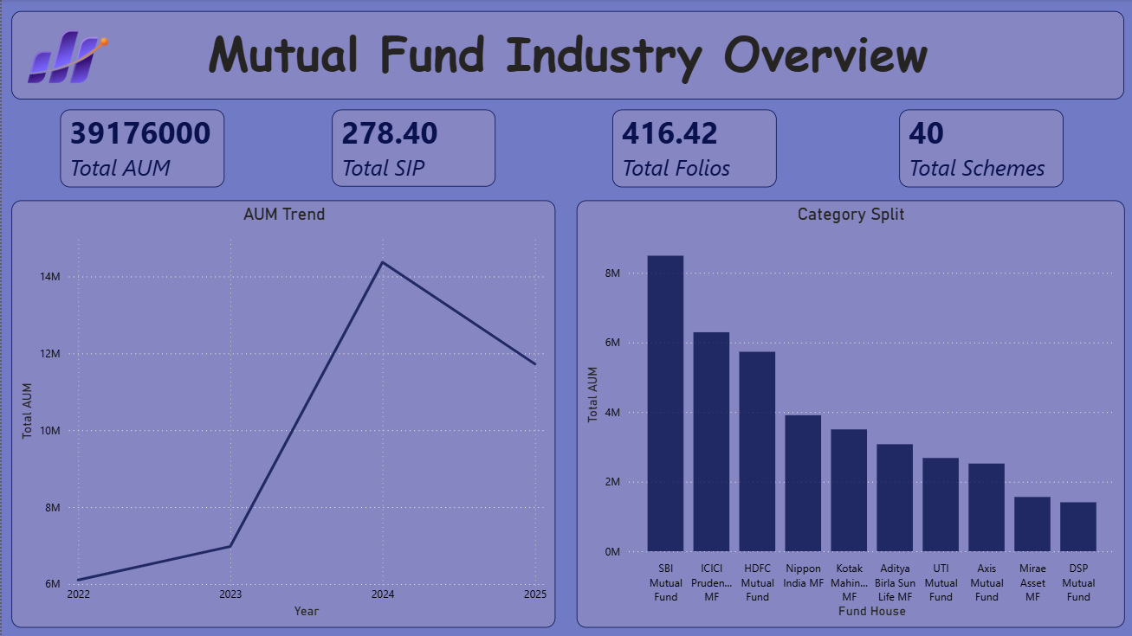
EXPLORATORY ANALYSIS
Industry overview
EDA
BlueStock Mutual Fund Analytics Capstone

Slide 7
EXPLORATORY ANALYSIS
AUM growth & SIP inflows
SBI Mutual Fund leads at Rs 12.50L Cr AUM (Dec 2025), more than doubling since 2022. SIP inflows hit an all-time high of Rs 31,002 Cr in Dec 2025.
EDA
BlueStock Mutual Fund Analytics Capstone

Slide 8
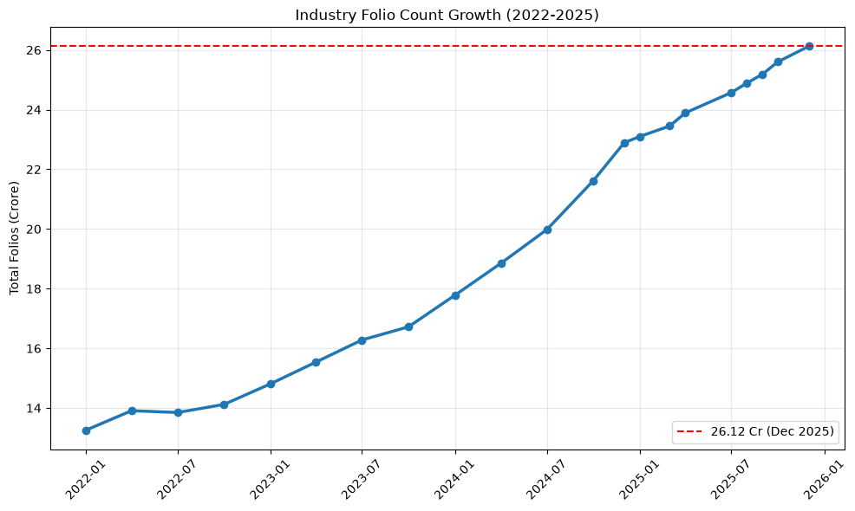
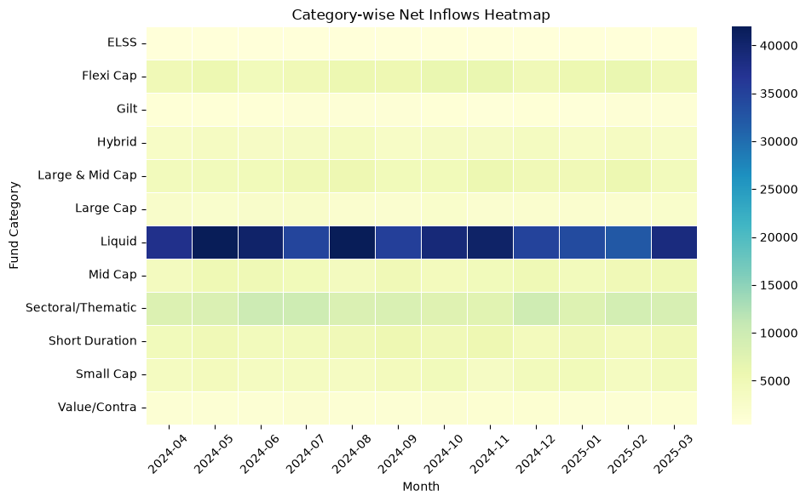
EXPLORATORY ANALYSIS
Investor folio growth & category inflows
Folios nearly doubled — 13.26 Cr (Jan 2022) to 26.12 Cr (Dec 2025). Liquid funds dominate category-wise net inflows month over month.
EDA
BlueStock Mutual Fund Analytics Capstone

Slide 9
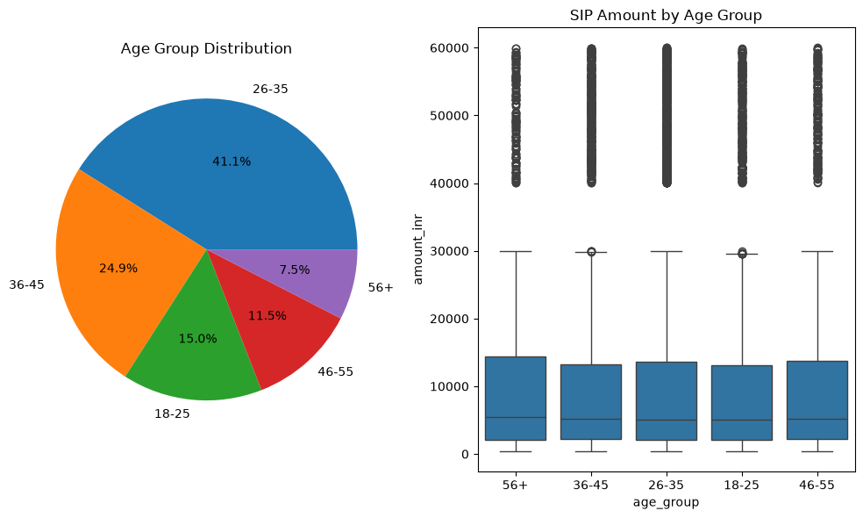
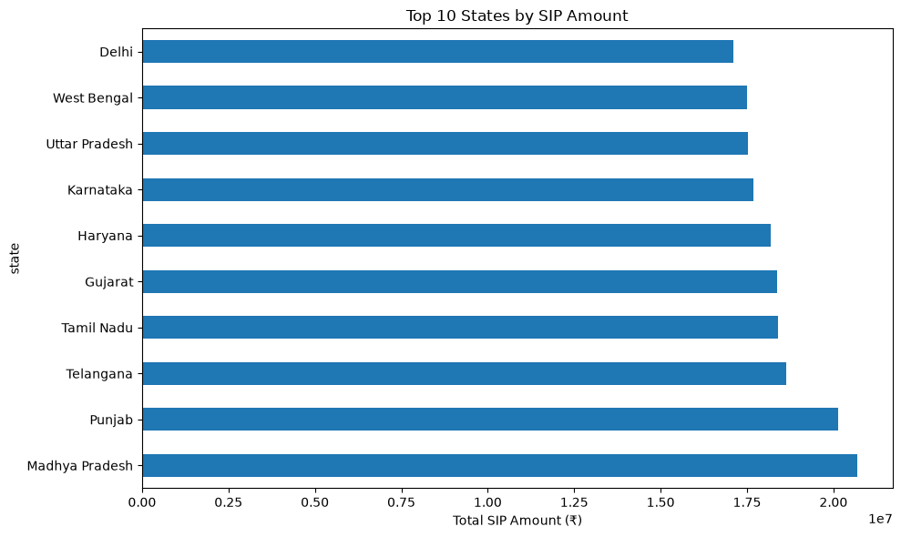
EXPLORATORY ANALYSIS
Investor demographics & geography
Investors aged 26–35 drive ~41% of transactions. T30 cities generate roughly 2x the transaction volume of B30 cities.
EDA
BlueStock Mutual Fund Analytics Capstone

Slide 10
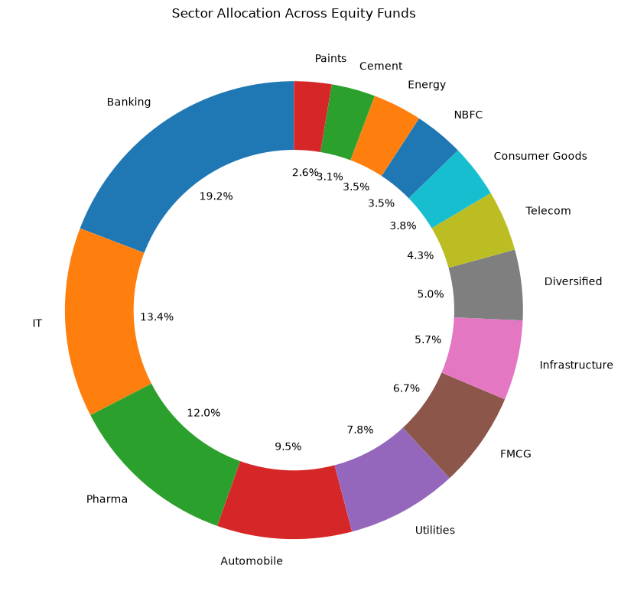
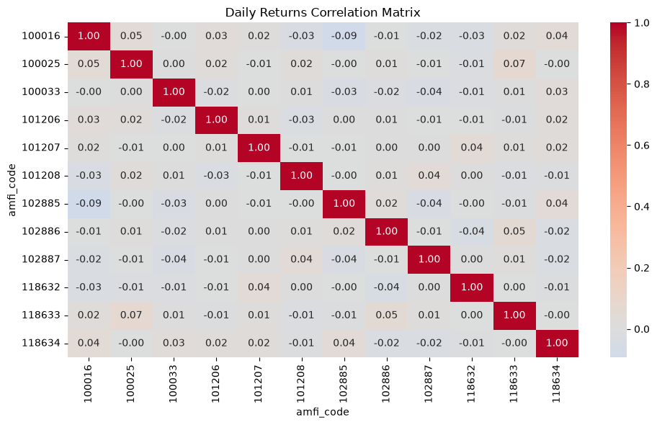
EXPLORATORY ANALYSIS
Return correlation & sector allocation
Banking (19.2%), IT (13.4%) and Pharma (12.0%) are the largest sector exposures across equity fund holdings.
EDA
BlueStock Mutual Fund Analytics Capstone

Slide 11
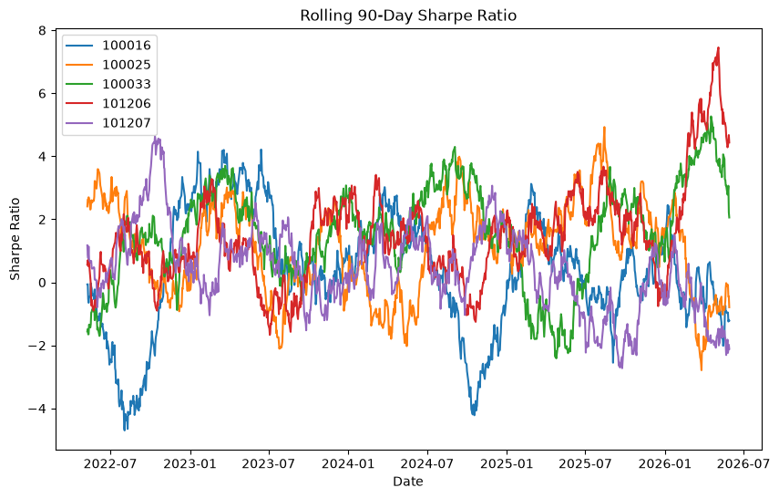
PERFORMANCE ANALYTICS
Risk-adjusted return: Sharpe ratio
Rf = 6.5% (RBI repo-rate proxy); Sortino uses downside deviation only
Liquid/debt funds top Sharpe due to very low volatility (~0.5% ann.), not high returns
ICICI Pru Liquid Fund: Sharpe 7.68 • Kotak Liquid: 6.18 • ABSL Liquid: 5.14
Small-cap equity funds post the highest raw 3yr CAGR (22–24%) with moderate Sharpe (0.84–0.94)
Performance
BlueStock Mutual Fund Analytics Capstone

Slide 12
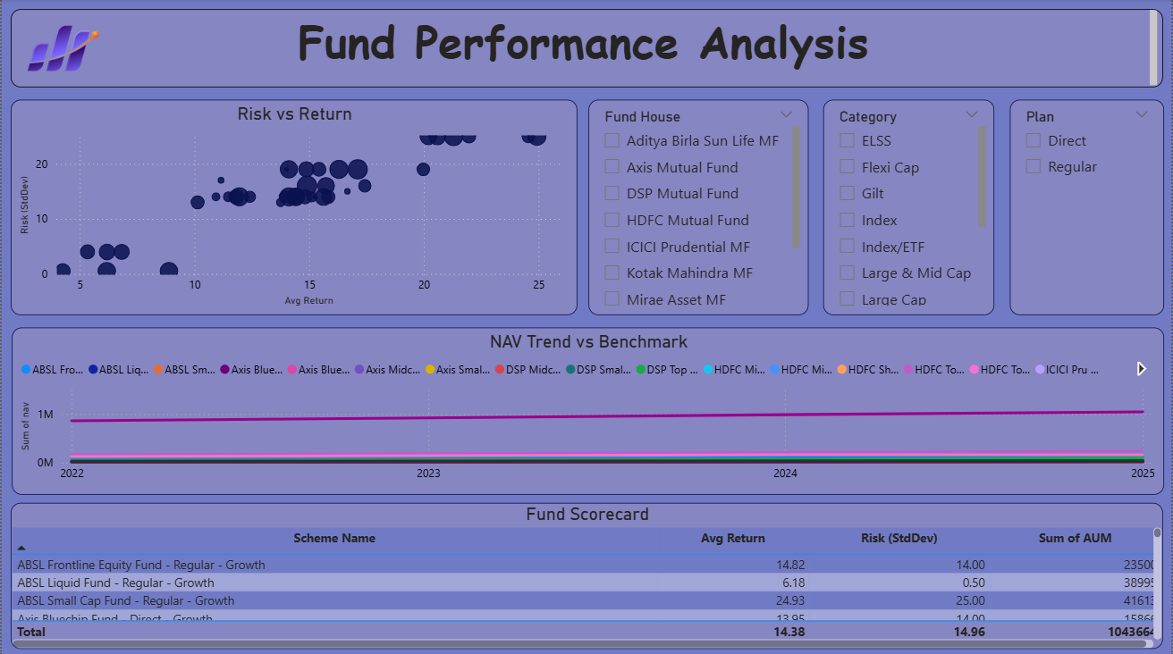
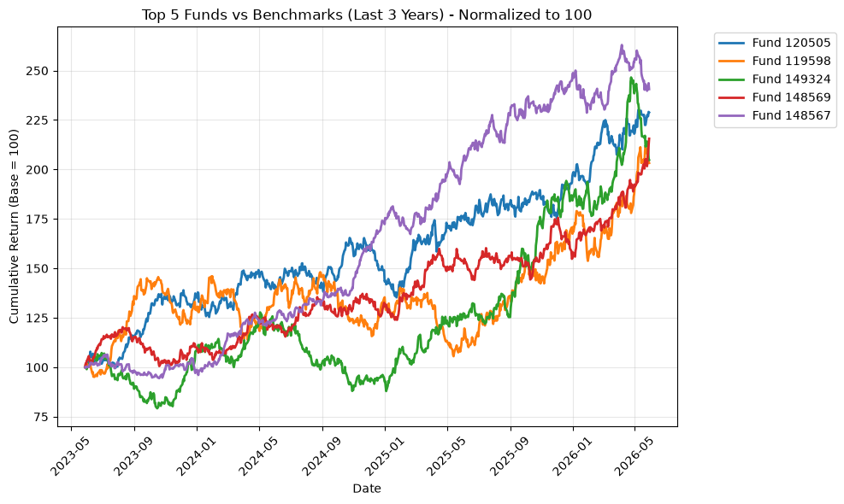
PERFORMANCE ANALYTICS
Fund scorecard & benchmark comparison
Composite score = 30% 3yr-return + 25% Sharpe + 20% Alpha + 15% expense ratio (inv.) + 10% max-DD (inv.). Scores range 12.4–84.75 (mean 46.1); top scorers are low-cost debt/gilt funds.
Performance
BlueStock Mutual Fund Analytics Capstone

Slide 13
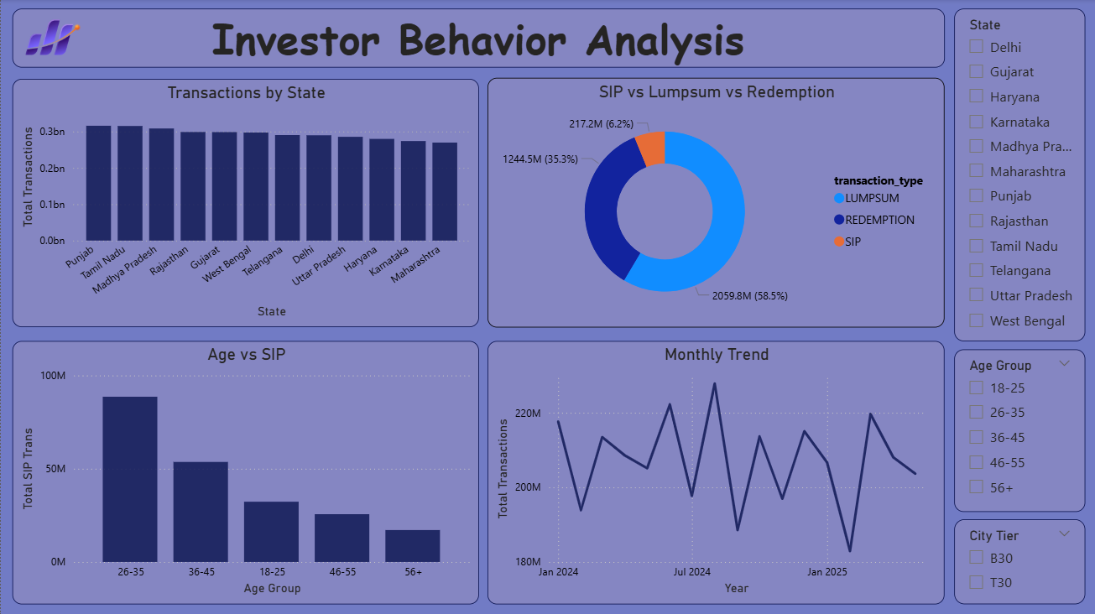
POWER BI DASHBOARD
4-page interactive dashboard
1 · Industry Overview
2 · Fund Performance
3 · Investor Analytics
4 · SIP & Market Trends
KPI cards (AUM, SIP, Folios, Schemes), industry AUM trend, AUM by AMC
Return vs risk scatter, sortable scorecard, NAV vs benchmark, slicers
Transactions by state, SIP/Lumpsum/Redemption split, age vs SIP, monthly volume
Dual-axis SIP vs Nifty 50, category heatmap, top categories FY25
Drill-through from fund table → NAV detail page • Tooltips on all charts • Bluestock colour theme & logo • Exported to .pbix, Dashboard.pdf, page-level PNGs
Dashboard
BlueStock Mutual Fund Analytics Capstone

Slide 14
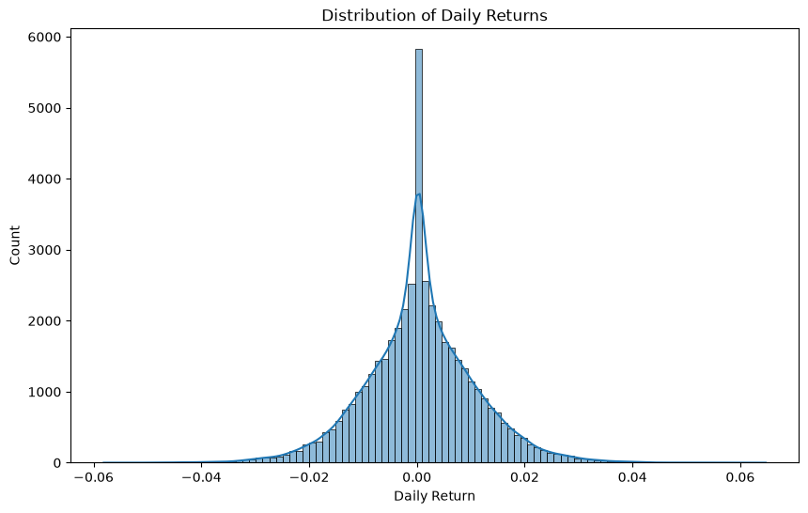
ADVANCED ANALYTICS
Risk (VaR/CVaR) & investor behaviour
95% historical VaR ranges from -0.02% (liquid funds) to -2.69% (SBI Small Cap Direct) — the highest single-day loss risk in the sample, as expected for small-cap equity.
SIP continuity: investors with 6+ SIPs and >35-day average gaps are flagged "at-risk" for retention outreach.
Advanced Analytics
BlueStock Mutual Fund Analytics Capstone

Slide 15
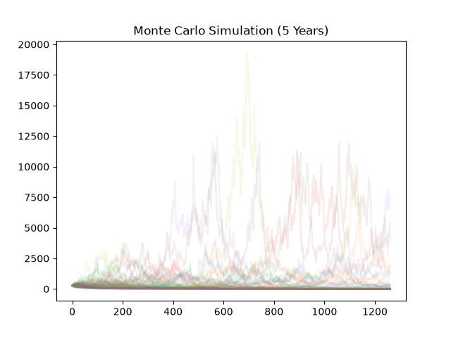
ADVANCED ANALYTICS
Fund recommender & Monte Carlo simulation (bonus)
Recommender (recommender.py): input risk appetite (Low / Moderate / High) → top 3 funds by Sharpe within matching risk grade
Monte Carlo simulation projects 5-year NAV paths from each fund's historical return mean/std-dev
Produces a fan of simulated outcomes and percentile-based uncertainty bands around the median projection
Sector HHI (concentration): mean 0.140, range 0.107–0.206 across 34 equity schemes; Axis Bluechip most concentrated
Advanced Analytics
BlueStock Mutual Fund Analytics Capstone

Slide 16
FINDINGS
Key findings
Industry AUM grew at a ~20% CAGR (2022–2025), reaching Rs 62.74L Cr; SIP inflows nearly doubled
Risk-adjusted (Sharpe) and raw-return (CAGR) rankings favour very different fund types — liquid/debt vs. small-cap equity
The composite scorecard's cost/drawdown weighting favours low-cost debt funds over higher-return equity funds
Small-cap equity funds show materially higher VaR/CVaR than the rest of the universe
26–35 age group and T30 cities dominate transaction volume; Banking/IT/Pharma dominate sector exposure
SIP continuity analysis identifies an actionable "at-risk" investor segment for retention
Findings
BlueStock Mutual Fund Analytics Capstone

Slide 17
RECOMMENDATIONS
What we'd do next
Segment recommendations by investor objective (preservation vs. growth) rather than one blended score
Surface VaR/CVaR directly on the dashboard's Fund Performance page, next to return
Trigger a retention workflow from the SIP continuity "at-risk" flag before investors fully lapse
Automate the mfapi.in NAV refresh via the proposed weekday 8 PM cron job (Bonus B1) to keep the dashboard current
Recommendations
BlueStock Mutual Fund Analytics Capstone

Slide 18
DELIVERABLES
All 7 deliverables + 2 bonus challenges completed
D1
ETL pipeline (.py / .ipynb)
D2
PostgreSQL DB + star schema
D3
EDA notebook, 15+ charts
D4
Performance metrics + CSVs
D5
Power BI dashboard (4 pages)
D6
Advanced analytics notebook
D7
Final report (this deck + PDF)
B1
Scheduled ETL (cron, bonus)
B3
Monte Carlo simulation (bonus)
Thank you
Full repository: ETL scripts, notebooks, PostgreSQL DB, dashboard (.pbix) and this report are available in the project folder.
Deliverables
BlueStock Mutual Fund Analytics Capstone

