Slide 1

TITLE :TRACKING DEVELOPER PRODUCTIVITY AND PERFORMACE
Student Name: Nehasree Padamati
Student ID: 2520030174
Cluster:02
Section: 06
Under the Guidance
of
Supervisor Name: Y.ASHOK
Assistant Professor
Department of CSE

Slide 2
OUTLINE
Abstract
Existing System
Proposed System
System Architecture
Project Modules
Objectives
Co’s Attainments - DSA
Co1
Co2 …….. 5. Co5
Screen Shots for FWD & DSA
Conclusion
Geo-Tagged Photos

Slide 3
Abstract
DevTrack is a Developer Productivity and Performance Tracking System that demonstrates the practical application of Data Structures and Algorithms. Developer records are stored and managed using a Singly Linked List. A Hash Table with Division Method and Separate Chaining enables fast lookup by Employee ID. A Stack maintains the activity log using LIFO, a Queue manages pending tasks using FIFO, and a Max Heap ranks top performers by review score. Searching is performed using Linear Search and Binary Search, while records are sorted using Bubble Sort, Selection Sort, and Insertion Sort.

Slide 4
Existing System
Characteristics
Developer data stored in spreadsheets or documents
Information managed manually by managers
Difficult to maintain large employee records
Limited accessibility and data organization
Problems in Existing System
Manual data entry increases human errors
No centralized interface to manage developers
Difficult to track developer performance or information
Data retrieval takes more time
Lack of structured reporting or dashboard view

Slide 5
Proposed System
Features of Proposed System
Web-based interface for managing developer data
Dashboard for viewing developer information
Individual developer profile details
Data stored using browser localStorage
Simple and user-friendly interface
Benefits
Faster data access
Organized developer records
Easy navigation between modules
Persistent storage using browser memory

Slide 6
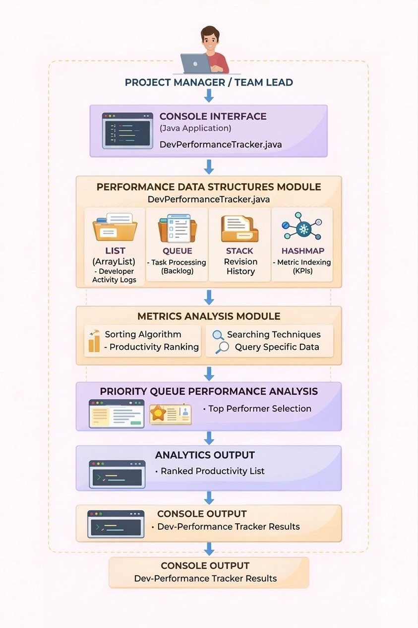
System Architecture

Slide 7
Project Modules
1. Login Module
Allows manager/user authentication
Verifies login credentials
Stores logged-in user information
2. Dashboard Module
Displays overview of developers
Provides quick navigation to developer profiles
Shows summary information and reports
3. Developer Details Module
Displays detailed developer profiles
Shows skills, role, and other information
Allows viewing developer data in structured format
4. Data Storage Module
Uses localStorage to store application data
Stores developer information, registered users, and login sessions
Data persists across browser sessions

Slide 8
Objectives
The main objectives of the DevTrack system are:
To create a web-based developer tracking system
To manage developer information efficiently
To provide a simple dashboard for monitoring developer data
To store application data using client-side storage
To provide an easy-to-use interface for managers

Slide 9

Co’s Attainments - DSA
CO1 — Searching & Sorting
linearSearchByName() — scans the array for a developer by name
binarySearchById() — sorts by ID first, then binary searches
bubbleSortByName() — A→Z alphabetical sort
selectionSortByScore() — highest review score first
insertionSortByHours() — fewest hours/week to most

Slide 10
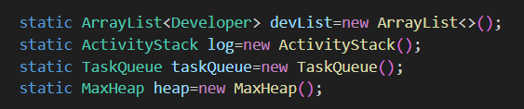
Co’s Attainments - DSA
CO2 — Singly Linked List
insertAtTail() — adds developers one by one
deleteById() — removes node by ID with pointer relinking
traverse() — walks every node and prints it
toArray() — converts the list to an array for CO1 operations

Slide 11


Co’s Attainments - DSA
CO3 — Stack, Circular Queue, Max Heap
ActivityStack — array-based LIFO stack with push/pop for action logging
TaskQueue — circular array FIFO queue with front/rear wrapping
MaxHeap — heapifyUp() on insert, heapifyDown() on extract, displays top N performers

Slide 12

Co’s Attainments - DSA
CO4 — Hash Table
Hash function: h(id) = sum(ASCII of id) % N
Separate chaining via LinkedList[] buckets
Insert, Search, Delete all supported, with live load factor printed after every operation

Slide 13
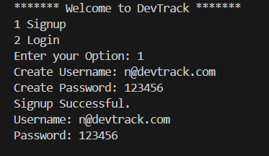
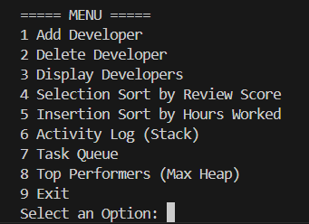
Screenshots for DSA

Slide 14
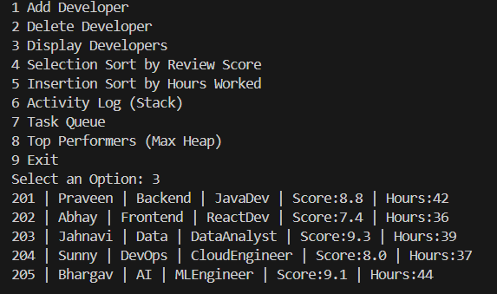
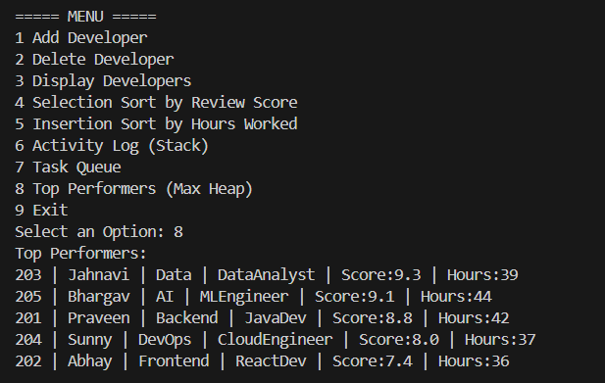
Screenshots for DSA

Slide 15
Conclusion
The Developer Management System (DevTrack) is a simple application designed to manage and track developer information efficiently. It allows users to add, delete, and display developer details while also analyzing their performance. The project uses different data structures such as ArrayList, Stack, Queue, and Max Heap to organize and process data effectively. Sorting algorithms like Selection Sort and Insertion Sort are used to arrange developers based on review scores and hours worked. The stack is used to maintain an activity log of system actions, while the queue helps manage tasks in an organized order. Additionally, the max heap helps identify the top-performing developers quickly. Overall, this project demonstrates how basic data structures and algorithms can be applied to create a structured system for managing developer performance and activities

Slide 16
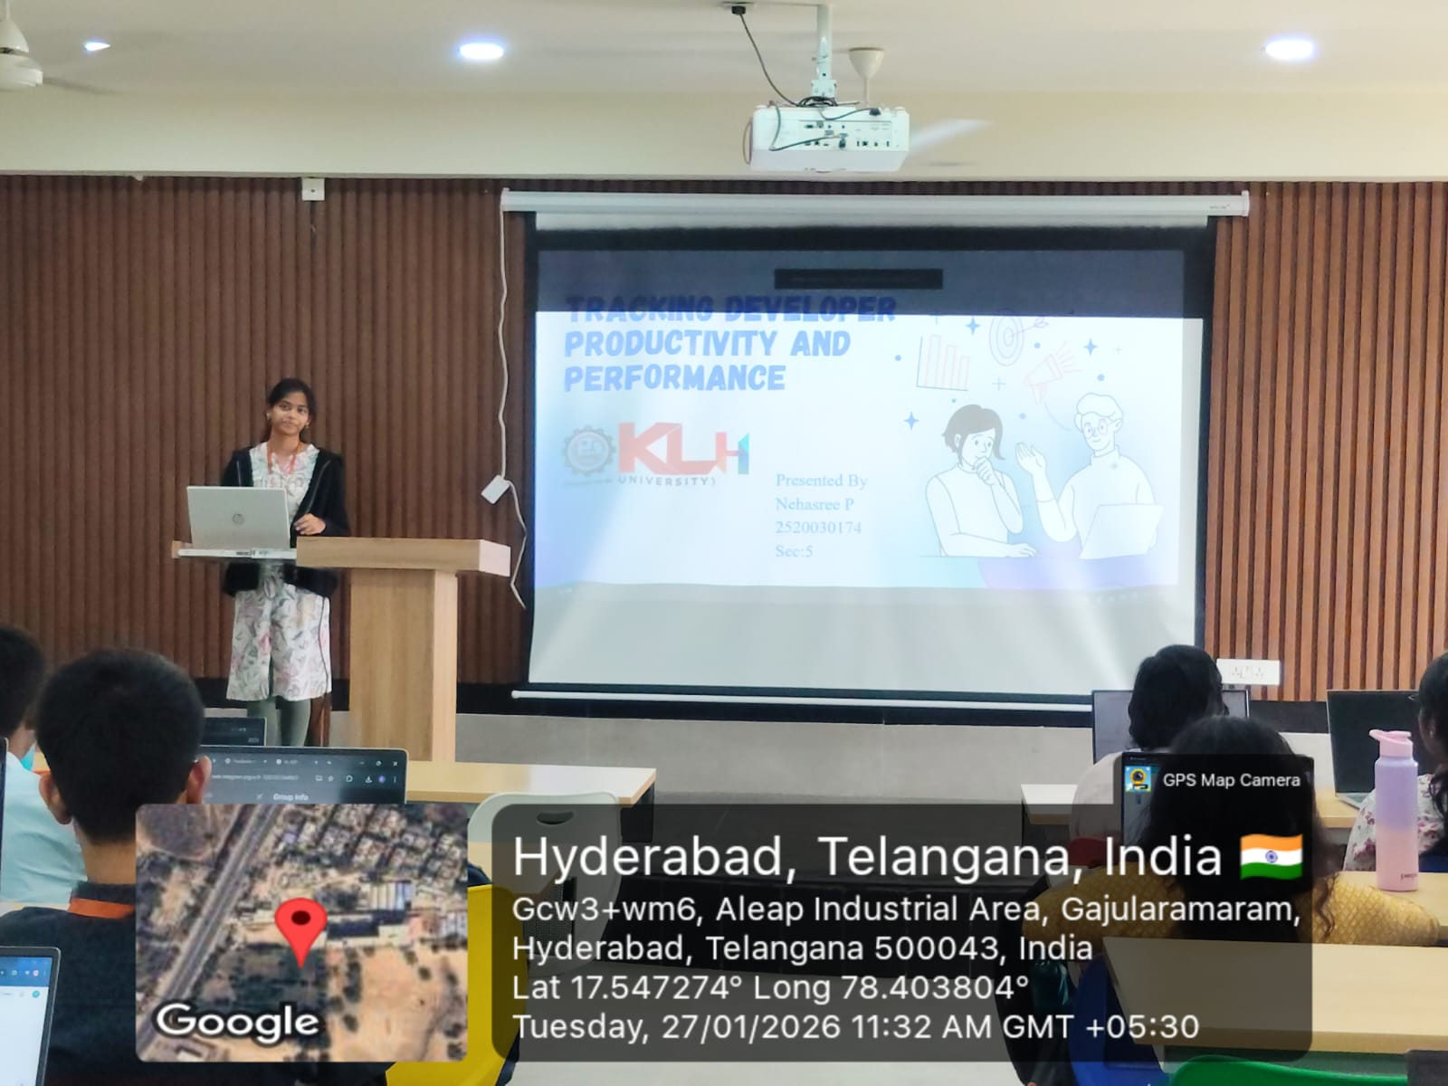
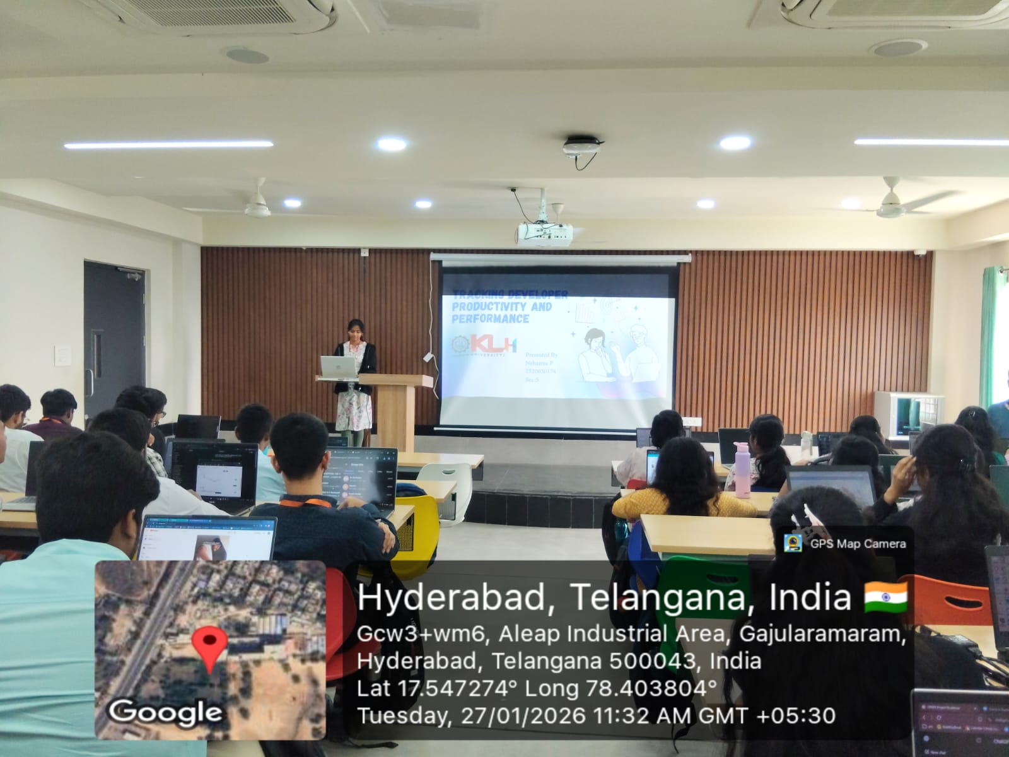
Geo- Tag Photos

Slide 17
THANK YOU

