Slide 1
INSTRUCTIONS
Use Font size 22 to 28 and Font Style Times New Roman (body)
Do not change the Template: Heading / Title of the slides
Do not change font style or colours
Do not copy paste paragraphs: use only Bullet Points
Maximum slide Limit is 20 only
As per the number of supervisor allotted adopt slide-2 or slide-3
Please display the required meaningful Content or images or tables
Change the footer accordingly using insert tab then click on header & footer tab and edit it
Save the PPT with Register No, Dept and Review no, example: 23xxxxxxxxx_CSE

Slide 2

TITLE :TRACKING DEVELOPER PRODUCTIVITY AND PERFORMACE
Student Name: Nehasree Padamati
Student ID: 2520030174
Cluster:02
Section: 06
Under the Guidance of
Supervisor Name: Ms. N. M. Deepika
Assistant Professor
Department of CSE

Slide 3
OUTLINE
Abstract
Existing System
Proposed System
System Architecture
Project Modules
Objectives
Co’s Attainments - FWD
Co1
Co2 …….. 5. Co5
Screen Shots for FWD & DSA
Conclusion
Geo-Tagged Photos

Slide 4
Abstract
This project focuses on tracking developer productivity and performance using Core Java. The system records task start and end times, task types, and overlapping tasks to monitor how work is executed throughout the day. It calculates key metrics such as active time, idle periods, task completion and multitasking overload, providing an accurate picture of how developers spend their time. From this data, it analyzes how much time is spent productively, how consistent task execution is, and whether too many tasks are being handled at the same time.
The system generates clear and easy-to-understand reports that show trends and patterns over days, weeks, and months.By analyzing these patterns, developers can organize and plan their work more effectively, make informed decisions to reduce wasted time, and improve overall productivity and performance. The system provides actionable, uses actual recorded information insights that help developers track their progress, plan tasks strategically, and maintain consistent performance over time.

Slide 5
Existing System
Characteristics
Developer data stored in spreadsheets or documents
Information managed manually by managers
Difficult to maintain large employee records
Limited accessibility and data organization
Problems in Existing System
Manual data entry increases human errors
No centralized interface to manage developers
Difficult to track developer performance or information
Data retrieval takes more time
Lack of structured reporting or dashboard view

Slide 6
Proposed System
Features of Proposed System
Web-based interface for managing developer data
Dashboard for viewing developer information
Individual developer profile details
Data stored using browser localStorage
Simple and user-friendly interface
Benefits
Faster data access
Organized developer records
Easy navigation between modules
Persistent storage using browser memory

Slide 7
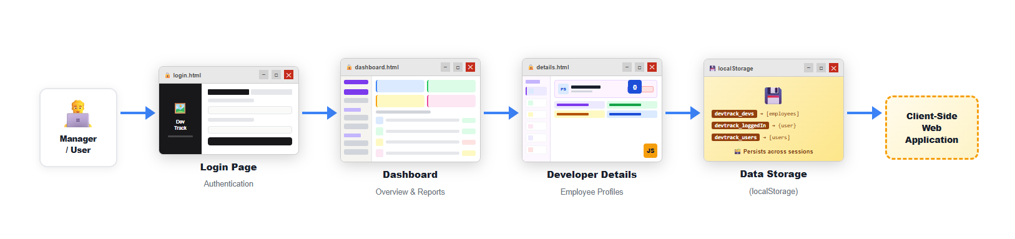
System Architecture

Slide 8
Project Modules
Login Module
Allows manager/user authentication
Verifies login credentials
Stores logged-in user information
Dashboard Module
Displays overview of developers
Provides quick navigation to developer profiles
Shows summary information and reports
Developer Details Module
Displays detailed developer profiles
Shows skills, role, and other information
Allows viewing developer data in structured format
Data Storage Module
Uses localStorage to store application data
Stores developer information, registered users, and login sessions
Data persists across browser sessions

Slide 9
Objectives
The main objectives of the DevTrack system are:
To create a web-based developer tracking system
To manage developer information efficiently
To provide a simple dashboard for monitoring developer data
To store application data using client-side storage
To provide an easy-to-use interface for managers

Slide 10
Co’s Attainments - FWD
CO1 – Web Fundamentals HTML structure, Tags, Divs, Links, Images, Tables
CO2 – CSS Layouts & Styling Flexbox, Grid, Box Model, Colors, Responsive Design, Media Queries
CO3 – HTML Forms & Semantic Content Login Form, Signup Form, Input Types, Validation
CO4 – JavaScript Programming Fundamentals Variables, Arrays, Functions, Loops, DOM Manipulation, Event Handling
CO5 – JavaScript Interactivity & Web Deployment localStorage Dynamic Rendering, Routing between pages

Slide 11
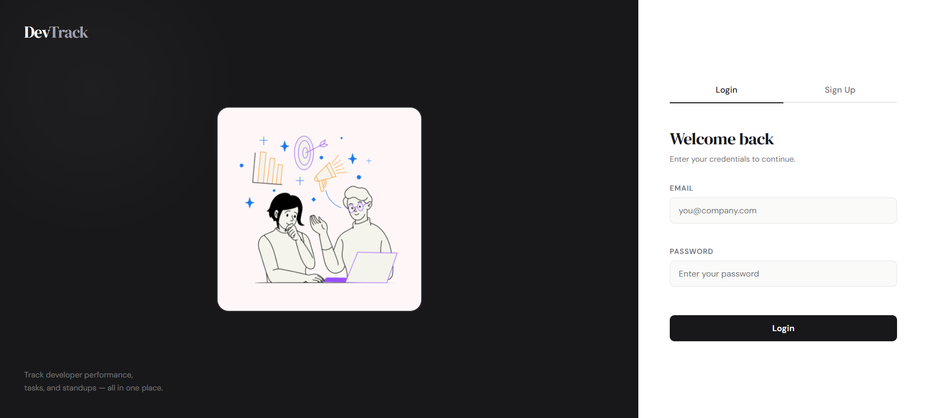
Screenshots for FWD

Slide 12
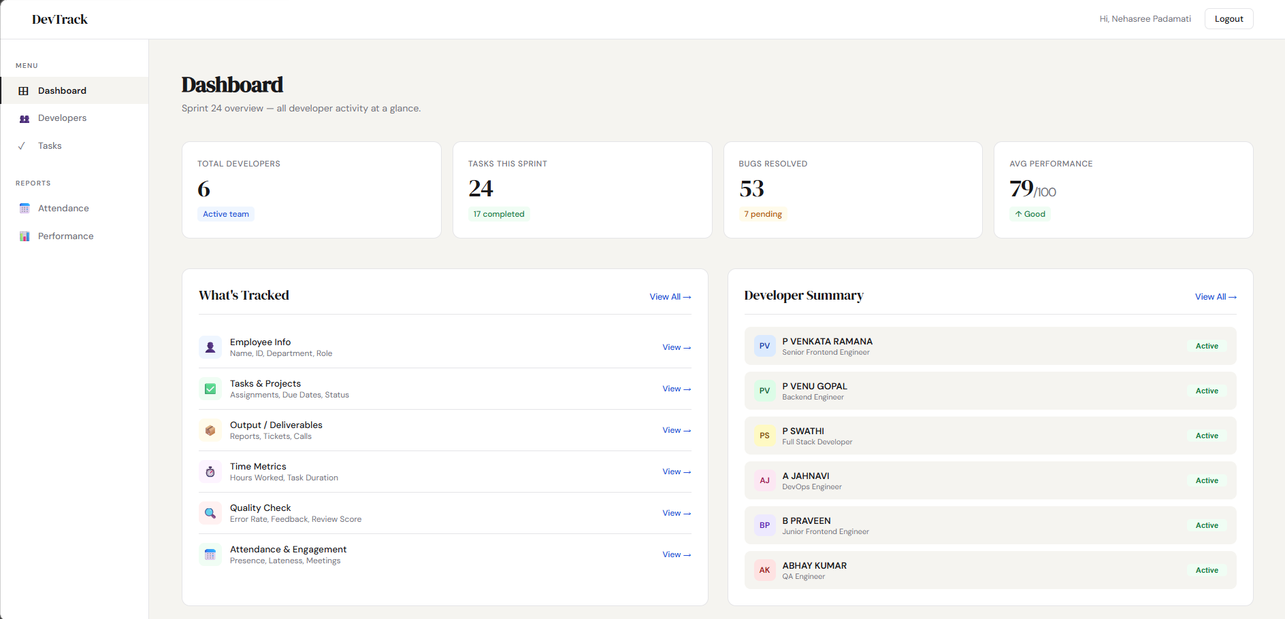
Screenshots for FWD

Slide 13
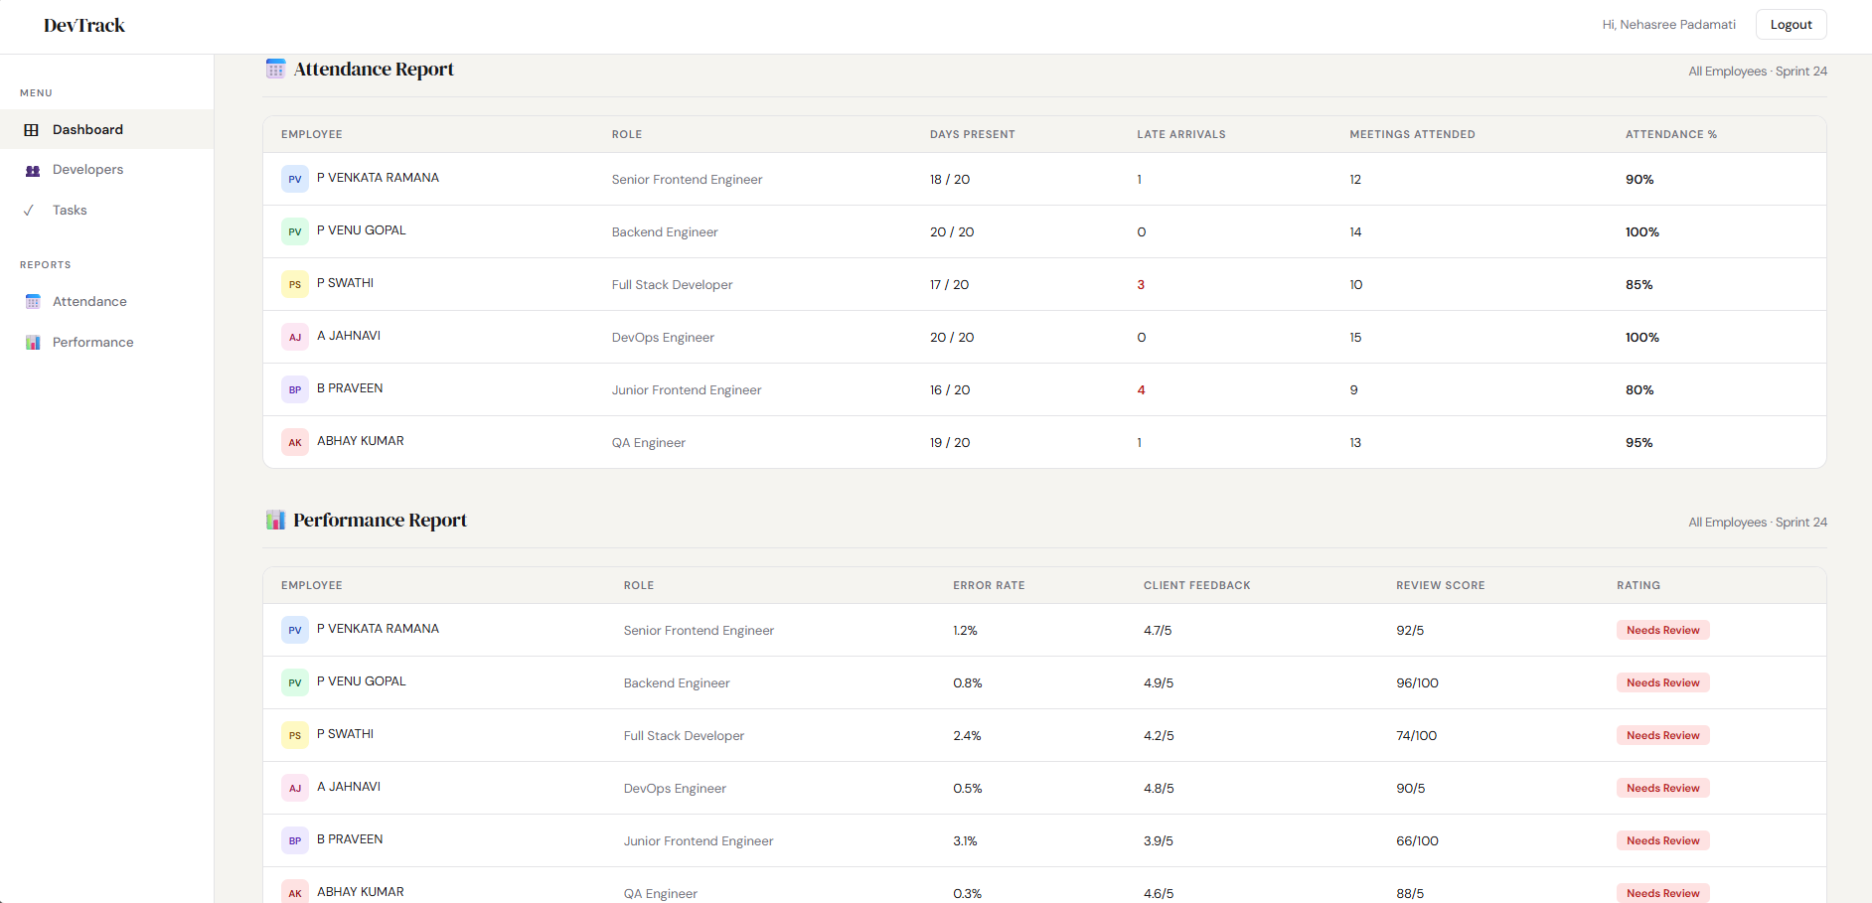
Screenshots for FWD

Slide 14
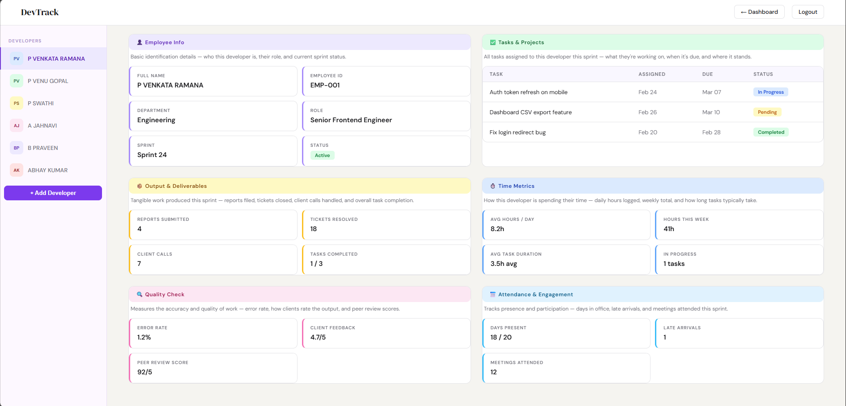
Screenshots for FWD

Slide 15
Conclusion
The DevTrack system provides a simple and efficient solution for managing developer information using a client-side web application.
The system demonstrates how HTML, CSS, and JavaScript can be used to build an interactive web application with localStorage for persistent data storage.
This project improves data organization, simplifies developer management, and provides a structured interface for viewing and managing developer information.

Slide 16
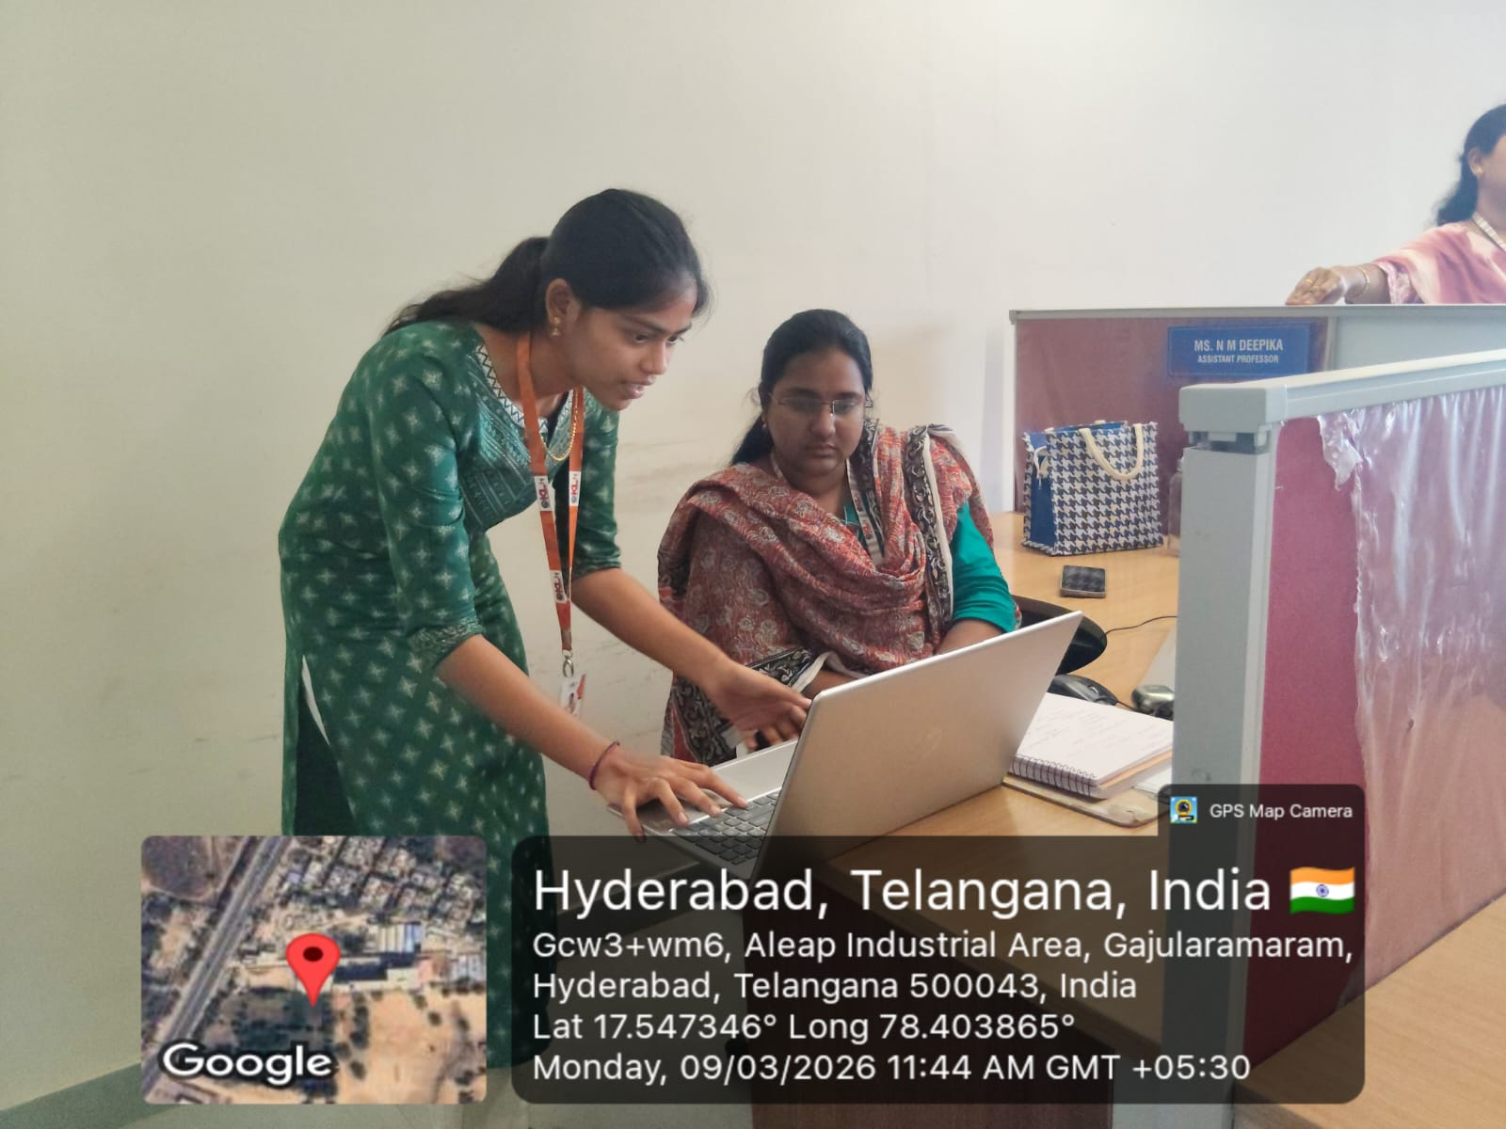
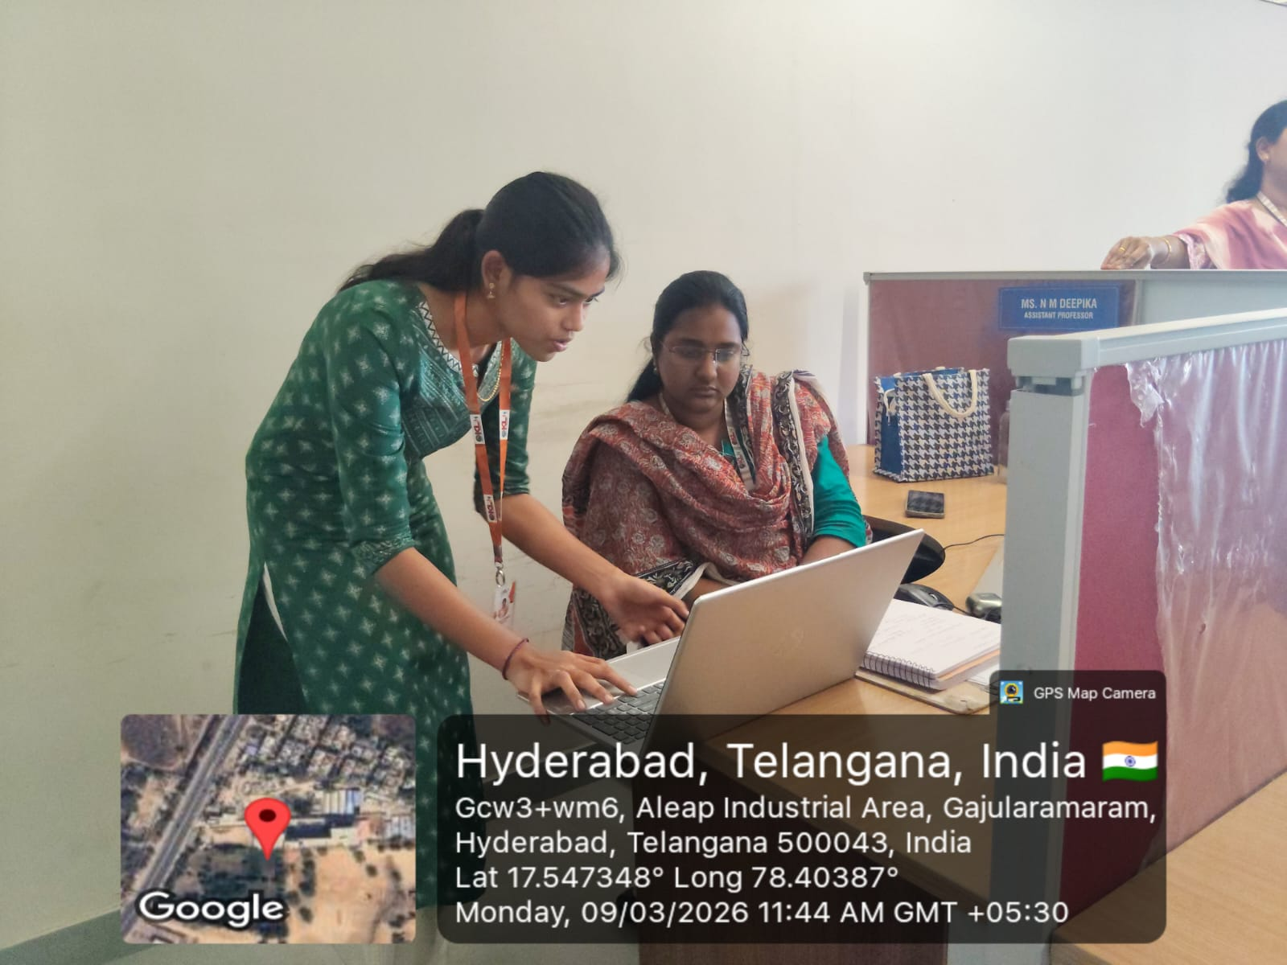
Geo- Tag Photos

Slide 17
THANK YOU

