Slide 1
Data Structures and Algorithms -3 (25CS2103E)
DNA Sequence Analysis Tool
Team Members
G Boomika Sre -- 2520030010
P. Nehasree -- 2520030174
P Hasini -- 2520030282
Under the Esteemed Guidance of
Dr. CH Anuradha

Slide 2
Contents
Abstract
Introduction
Literature survey
Problem Statement and Objectives
Hardware and Software requirements
Results
Conclusion
Future Scope

Slide 3
Abstract
The DNA Sequence Analysis Tool is a Java-based application that searches a genome sequence, loaded from a FASTA file or generated synthetically, for one or more DNA motifs and reports every matching position.
Six exact string-matching algorithms are implemented in plain Java: Naive, KMP, Rabin–Karp, Z-function, Aho–Corasick and Suffix Array. The user can pick any of them at run time.
The tool displays the number of matches, the 0-based positions and the execution time. It also supports reverse-complement search, CSV export, a benchmark comparing the algorithms, and longest-repeated-region detection using a suffix array with an LCP array.

Slide 4
Introduction
DNA is represented using four symbols:
A → Adenine, C → Cytosine, G → Guanine, T → Thymine
A DNA sequence is a long sequence consisting of A, C, G and T (N marks an unknown base).
Ex: ACGTACGTGACCTG
A motif is a short, contiguous stretch of DNA that may have biological significance, e.g. ATG (start codon), TATAAA (TATA box), GAATTC (EcoRI site).
Motif searching can help identify possible biological or gene-related regions.
Genomes can be millions of bases long, so efficient string-matching algorithms are needed to find motifs quickly.
This project implements and compares six such algorithms on DNA data.

Slide 5
Literature Survey
Paper / Work | Method Used | Key Contribution
Knuth, Morris & Pratt (1977) | KMP Algorithm | Linear-time O(n+m) matching using a failure/prefix function to avoid re-scanning the text.
Karp & Rabin (1987) | Rabin-Karp Algorithm | Rolling hash that lets pattern-sized windows be compared efficiently.
Aho & Corasick (1975) | Aho-Corasick Algorithm | Searches many patterns at once in a single pass using a Trie and failure links.
Gusfield (1997) | Z-function (Z-algorithm) | Z-array of P + separator + T gives every occurrence in O(n+m).
Manber & Myers (1990); Kasai et al. (2001) | Suffix Array + LCP array | Sorted suffix index searched by binary search; LCP built in linear time to find repeats.
Our implementation covers all of these approaches to compare different string-matching methods for DNA motif searching.

Slide 6
Problem Statement and Objectives
Problem Statement:
Searching for specific motifs in large DNA sequences can require a large amount of computation when simple searching methods are used.
Therefore, an efficient DNA sequence analysis tool is required to locate motifs accurately and compare the performance of different string-matching algorithms.

Slide 7
Problem Statement and Objectives
Objectives:
Search for motifs in DNA sequences (FASTA files or generated genomes).
Support multiple DNA motifs, on the forward and reverse-complement strands.
Report accurate match locations and counts (0-based positions, CSV export).
Implement Naive, KMP, Rabin–Karp, Z-function, Aho–Corasick and Suffix Array algorithms.
Compare the performance of the algorithms using a benchmark and scaling tests.
Validate matching correctness on generated genomes up to 1,000,000 bases.
Find the longest repeated region using a suffix array and LCP array.
Demonstrate the application of string-matching algorithms in bioinformatics.

Slide 8
Flow Chart
Input: load a FASTA file or generate a synthetic genome
Program menu (actual output)
==============================
DNA SEQUENCE ANALYSIS TOOL
==============================
Current genome: TestGenome (16 bases)
1. Load DNA Genome from FASTA
2. Generate Synthetic Genome
3. Search DNA Motifs
4. Compare Algorithms (Benchmark)
5. Find Longest Repeated Region
6. Save Genome as FASTA
7. Exit
Validate genome (A, C, G, T, N) and motifs; drop duplicate motifs
Optional: add the reverse complement of each motif (--rc)
Select algorithm:
Aho–Corasick | KMP | Rabin–Karp | Z | Naive | Suffix Array
Search the genome for all motifs
Option 1: genome loaded and checked
Loaded 'TestGenome': 16 bases | A=4 C=3 G=6 T=3 N=0 | GC content 56.25%
Store match positions (0-based start index)
Display count, positions and time; export CSV

Slide 9
Hardware and Software requirements
Hardware Requirements
Software Requirements
Requirement | Specification
Processor | Intel Core i3 or equivalent/higher
RAM | Minimum 4 GB
Storage | At least 200 MB free
Display | Any (console / terminal based)
Input | Keyboard (menu-driven console)
Requirement | Specification
Operating System | Windows / Linux / macOS
Programming Language | Java (no external libraries)
JDK | JDK 8 or above (tested: JDK 21)
Runtime | JVM
Data Structures | Arrays, Trie, Queue, Hash, Suffix Array

Slide 10
Results
Algorithm | Technique | Time complexity | Multiple motifs
Naive | Brute-force window comparison | O(n·m) worst case | One scan per motif
KMP | Failure (LPS) table | O(n+m) | One scan per motif
Rabin–Karp | Double rolling hash + verification | O(n+m) average | One scan per motif
Z-function | Z-array of P + separator + T | O(n+m) | One scan per motif
Aho–Corasick | Trie + failure + dictionary links | O(n + total|P| + matches) | All motifs in one pass
Suffix Array | Prefix doubling + binary search | O(n log n) build, O(m log n) query | Build once, query each motif
Expected observation:
KMP: Uses the LPS table to avoid unnecessary comparisons during single-pattern matching.
Rabin–Karp: Uses rolling hash values to compare pattern-sized windows efficiently.
Aho–Corasick: Searches multiple motifs simultaneously using a Trie and failure links.
Suffix Array: Built once, then every motif is found by binary search; also used for repeat analysis.

Slide 11
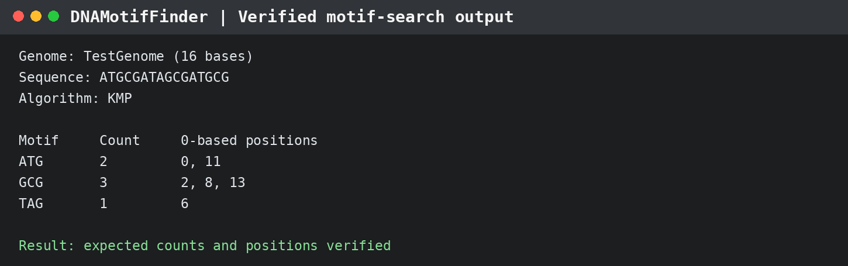
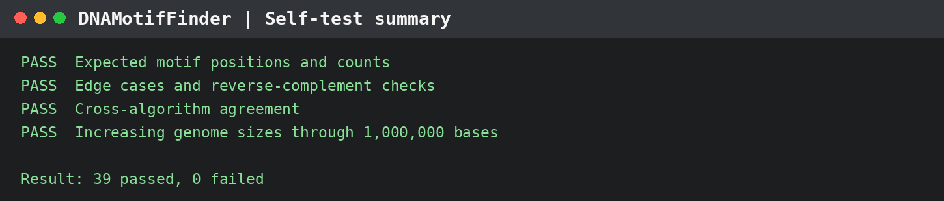
Results
Test genome: ATGCGATAGCGATGCG | Length: 16 bases
39 passed • 0 failed
Self-test result
The expected positions and counts were verified. Positions are 0-based start indexes.

Slide 12
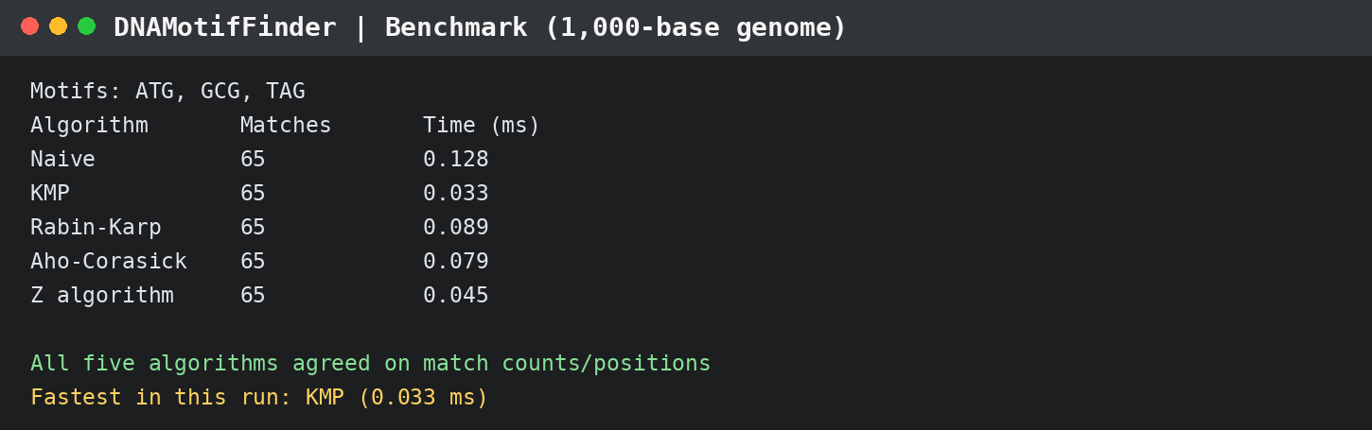
Results
Benchmark: 1,000-base synthetic genome | Motifs: ATG, GCG, TAG
Longest repeated region (Suffix Array + LCP)
KMP was fastest in this run
Length: 21 bases | 0-based positions: 19 and 212
Input: 1,000-base synthetic genome
0.033 ms; all five timed algorithms found 65 matches with identical positions.
Console panels are formatted from verified run outputs; timings depend on input and machine.

Slide 13
Conclusion
The DNA Sequence Analysis Tool is a Java application for DNA motif searching using Naive, KMP, Rabin–Karp, Z-function, Aho–Corasick and Suffix Array approaches. The verified self-test run reported 39 passed and 0 failed. In the recorded 1,000-base benchmark with three motifs, all five timed algorithms returned 65 matches at identical positions; KMP was fastest in that run (0.033 ms). The suffix-array/LCP feature found a 21-base repeated region at 0-based positions 19 and 212 in a 1,000-base synthetic genome. These measurements apply to the tested inputs and are not universal performance rankings.

Slide 14
Future Scope
Future Improvements:
Wildcard / IUPAC symbol support (N, R, Y ...) inside motifs
Approximate matching and mutation detection (k mismatches, edit distance)
Graphical User Interface with charts
GenBank file support and per-record results for multi-record FASTA
Position-weight-matrix scoring of motifs
Parallel / GPU processing for very large genomes

Slide 15
Thank you

