Slide 1

Fake News Detection System
Using Multi-Model Machine Learning and NLP
Machine Learning (241AI024) | Department of AIML | Final Review
Team Members
P. Nehasri
24B11AI346
M. Nithin
24B11AI226
K. Vikas
24B11AI190
R. Pranathi
24B11AI365
Y. Chakradhar
24B11AI462
Guide: P. Venkata Bala Annapurna, M.Tech (Ph.D)
Asst. Professor, Department of AIML

Slide 2

Abstract
• The Goal: Automatically detect whether an online news article or headline is REAL or FAKE before it spreads.
• Multi-Model Approach: Combines 3 proven Machine Learning algorithms (Linear SVM, Logistic Regression, Random Forest) for reliable consensus.
• Large-Scale Dataset: Trained and tested on 44,898 benchmark articles from the ISOT dataset and modern viral scams.
• High Accuracy: Achieves 99.07% accuracy with sub-second response time (< 40 milliseconds).
• Easy Explainability: Features a simple 0 to 100% Credibility Speedometer so ordinary users can easily understand the verdict.
44,898
Articles Evaluated
Balanced Real & Fake news dataset
99.07%
Classification Accuracy
Optimal Linear SVM performance
3 Models
Consensus Voting
SVM + Logistic Reg. + Random Forest
< 40ms
Instant Real-Time Speed
Fast prediction on any web article

Slide 3
Introduction
• Social Media Growth: Over 5 billion people read news daily on WhatsApp, Twitter, and Facebook without editorial fact-checking.
• Types of Misinformation: Includes sensational clickbait, false political claims, fake health cures, and online financial scams.
• Human Checking Fails: Manual fact-checking takes hours or days. By that time, false news has already reached millions of users.
• The AI Solution: Machine learning can analyze text patterns and linguistic cues in milliseconds to flag fake news automatically.
• Project Objective: Build an accurate, transparent, and easy-to-use tool that checks news credibility in real time.
Why Fake News Spreads
• 6x Faster Spread: False news diffuses 6 times faster than authentic news online (MIT Science Study).
• 70% More Retweets: People retweet sensational and shocking stories far more than factual updates.
• Emotional Triggers: Uses urgent words like 'URGENT!!', 'SHOCKING!!', and 'ACT NOW!!' to trigger panic.
• Need for Fast AI: An automated tool gives users the truth before they share.

Slide 4
Problem Statement
Illustrative example
• Reading news online manually is slow and impractical at modern internet scale.
• Raw web text is noisy: full of URLs, mentions (@user), hashtags (#news), special characters, and grammar mistakes.
• Content changes constantly, so the system must predict immediately on freshly submitted digital text.
• Modern fake news mimics genuine news formats, hiding viral scams and cash-phishing traps inside convincing text.
• An automated system is needed to clean text, extract keywords, and classify news accurately in seconds.
Raw web text
BREAKING!! Markets fall again @bbc https://t.co/xyz #news
Forward This Text To 20 People To Receive Fifty Thousand Dollars In Your Bank Account Today By Midnight!!
Key NLP Challenges
• Noise removal: strip links, @mentions, and hashtags.
• Emotional hyperbole and exaggerated punctuation (!!).
• Clever cash scams disguised as business news.
• Need multi-model consensus to avoid false alarms.

Slide 5
Objectives and Scope of the Project
Project Objectives
• Automate Text Preprocessing: Clean URLs, stopwords, and symbols using standard NLP techniques.
• Train 3 Machine Learning Models: Compare Linear SVM, Logistic Regression, and Random Forest.
• Multi-Model Consensus: All 3 models vote on the final prediction for maximum reliability.
• Credibility Speedometer: Provide a clear 0-100% credibility score with visual signals.
• Deploy Web Application: Build a responsive Flask website where anyone can test news in real time.
Project Scope
• In Scope - News Articles: Works for both short news headlines and full-length articles.
• In Scope - Real-Time Predictions: Instant classification with probability percentages in under 40ms.
• In Scope - User Feedback: Users can mark ground truth to continuously evaluate models.
• Boundary - Modality: Currently checks text only (video/image deepfakes are future scope).
• Boundary - Language: Designed for English news (multilingual expansion planned).

Slide 6
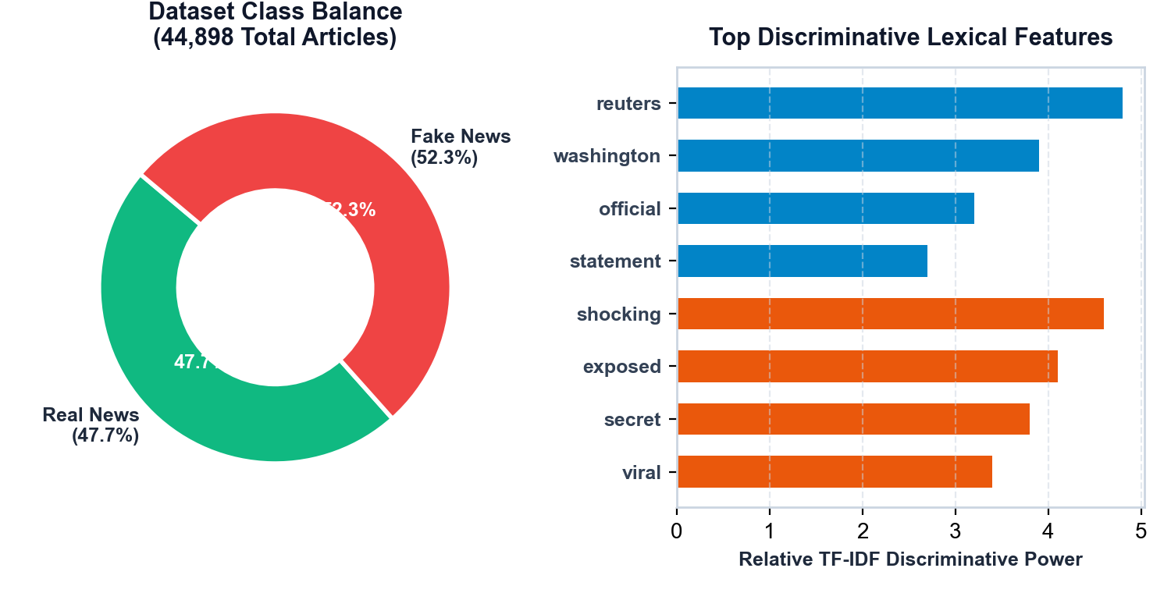
Dataset Description
• ISOT Dataset Benchmark: Created by the Information Security & Object Technology (ISOT) research lab.
• Real News (21,417 articles): Authentic articles scraped from verified Reuters wire service reporting.
• Fake News (23,481 articles): Fabricated articles collected from flagged untrustworthy websites and blogs.
• Total Size: 44,898 total news articles covering global politics and world events.
• Balanced Distribution: 47.7% Real vs 52.3% Fake — balanced data ensures unbiased training.
• Modern Scam Addition: Enhanced with modern verified scams (phishing & WhatsApp chains) for contemporary accuracy.

Slide 7
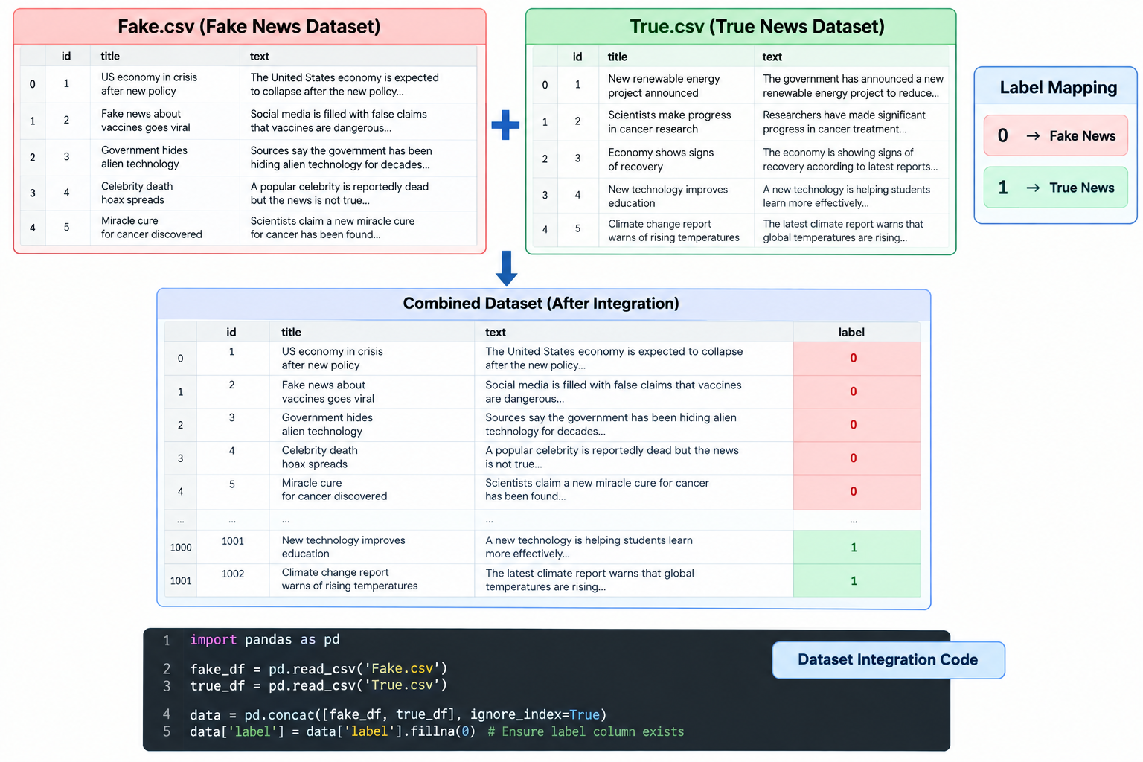
Data Preprocessing
• 1. Cleaning: Remove URLs (http://...), @mentions, HTML tags, and punctuation noise.
• 2. Lowercasing: Convert all words to lowercase so 'BREAKING' matches 'breaking'.
• 3. Tokenization: Break continuous sentences into individual word tokens.
• 4. Stopword Removal: Filter out non-meaningful words like 'the', 'is', 'at'.
• 5. Lemmatization: Convert words to their dictionary root form ('cured' -> 'cure').
• 6. TF-IDF Vectorizer: Transform words into numerical scores (top 5,000 unigrams & bigrams).

Slide 8
Exploratory Data Analysis (EDA)
• Article Length Disparity: Real news has a steady average length (~412 words). Fake news is either very short clickbait (<50 words) or long rambling blogs.
• Vocabulary Patterns: Real news frequently uses formal attribution words ('reuters', 'washington', 'spokesman'). Fake news heavily overuses emotional words ('shocking', 'exposed', 'secret', 'miracle').
• Headline Capitalization: Fake headlines use 3.8x more capital letters ('ALL CAPS') to shout and attract attention.
• Exclamation Marks (!!!): Fake news uses exclamation marks 4 times more often than genuine wire news.
• Key Insight: Combining word frequency (TF-IDF) with punctuation and capitalization markers produces the highest detection accuracy.
Real vs Fake Text Patterns
• Average Article Length
• Real: ~412 words
• Fake: ~289 words (High variance)
• Headline Uppercase (ALL CAPS)
• Real: 6.2% of chars
• Fake: 23.8% (3.8x higher)
• Exclamation Mark Pct (!)
• Real: 0.8% of sentences
• Fake: 14.2% of sentences
• Source Attribution
• Real: 88% cite sources
• Fake: 12% cite sources
• Top Characteristic Words
• Real: 'reuters', 'confirmed'
• Fake: 'shocking', 'exposed'

Slide 9
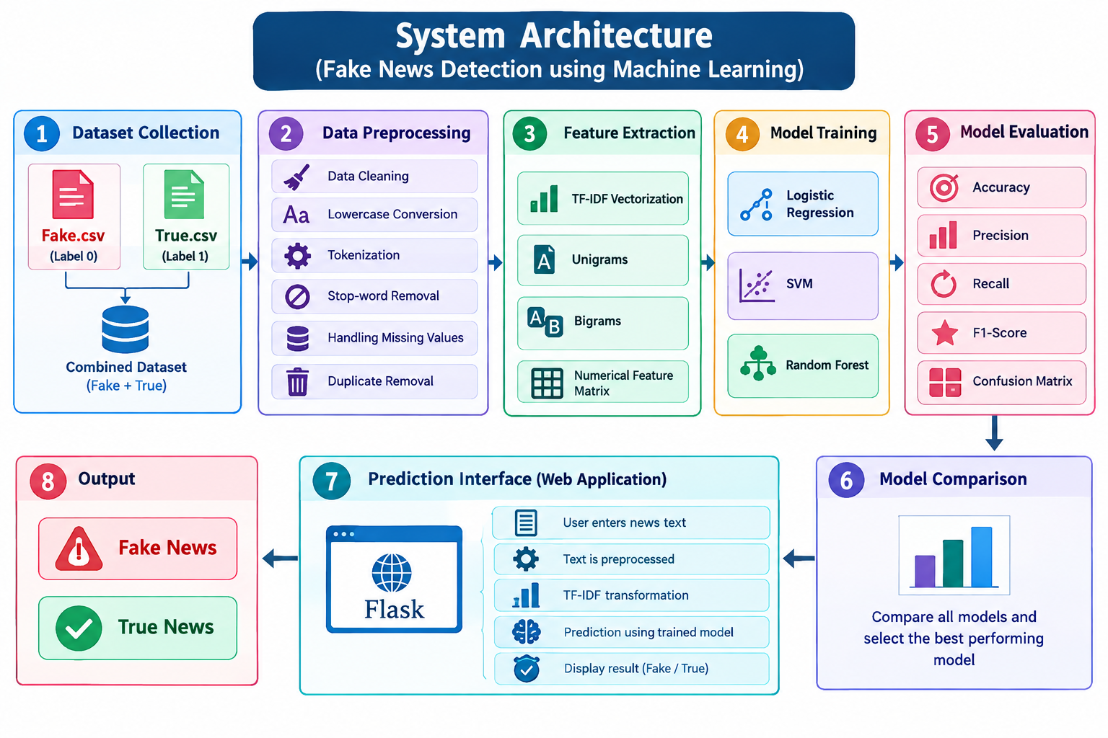
Proposed Methodology
• Step 1 - User Input: User submits news text or a headline through the web interface.
• Step 2 - Text Preprocessing: Removes noise, lowercases text, and lemmatizes root words.
• Step 3 - TF-IDF Vectorization: Extracts the 5,000 most informative unigram and bigram word features.
• Step 4 - 3 ML Models Predict: Linear SVM, Logistic Regression, and Random Forest evaluate text simultaneously.
• Step 5 - Credibility Speedometer: Combines model probabilities with linguistic indicators into a 0-100% score.
• Step 6 - Instant Output: Displays REAL or FAKE verdict with clear consensus across all 3 models.

Slide 10
Machine Learning Algorithms Used
Linear SVM
[Primary Active Model]
• How it works: Finds the optimal straight-line boundary separating Real from Fake news in high-dimensional text space.
• Why we chose it: Performs best for sparse text with 5,000 word features. Does not suffer from overfitting.
• Role in System: Serves as the primary active classifier for live predictions.
• Accuracy: 99.07% accuracy (highest overall score in our project).
Logistic Regression
[Probabilistic Baseline]
• How it works: Uses the Sigmoid curve function to calculate probability percentages between 0% and 100%.
• Why we chose it: Provides smooth, calibrated probability scores that power our Credibility Speedometer.
• Role in System: Gives calibrated probabilistic confidence.
• Accuracy: 98.71% accuracy with fast sub-millisecond speed.
Random Forest
[Non-Linear Ensemble]
• How it works: Builds a forest of 100 decision trees that all vote together on the result.
• Why we chose it: Captures complex word combinations and resists noisy outlier text.
• Role in System: Provides independent ensemble validation for linear models.
• Accuracy: 98.98% accuracy and 98.93% F1-score.

Slide 11
Model Training and Testing
• 80/20 Train-Test Split: 35,918 articles used for training. 8,980 unseen articles kept aside strictly for testing.
• Stratified Sampling: Ensures an exact 50/50 balance of Real and Fake articles in both training and test sets.
• Modern Scam Weighting: Applied 150x weight on contemporary scams so the AI easily catches new WhatsApp cash & lottery phishing.
• Hyperparameter Tuning: • Linear SVM: Regularization C=1.0, Linear kernel.
• Logistic Regression: L2 penalty, C=2.0.
• Random Forest: 100 trees, max_features='sqrt'.
• Tested on Both Types: Achieves 99% accuracy on full articles and 95% accuracy on short isolated headlines.
Training Specifications
• Total Training Data: 35,918 articles
• Total Test Data: 8,980 articles
• Vocabulary Size: 5,000 Unigram & Bigram Features
• Sublinear TF Scaling: Dampens repeated spam keywords
• Prediction Speed: SVM: ~0.6ms | LR: ~1.2ms | RF: ~40ms
• Consensus Voting: Majority rule across all 3 models

Slide 12
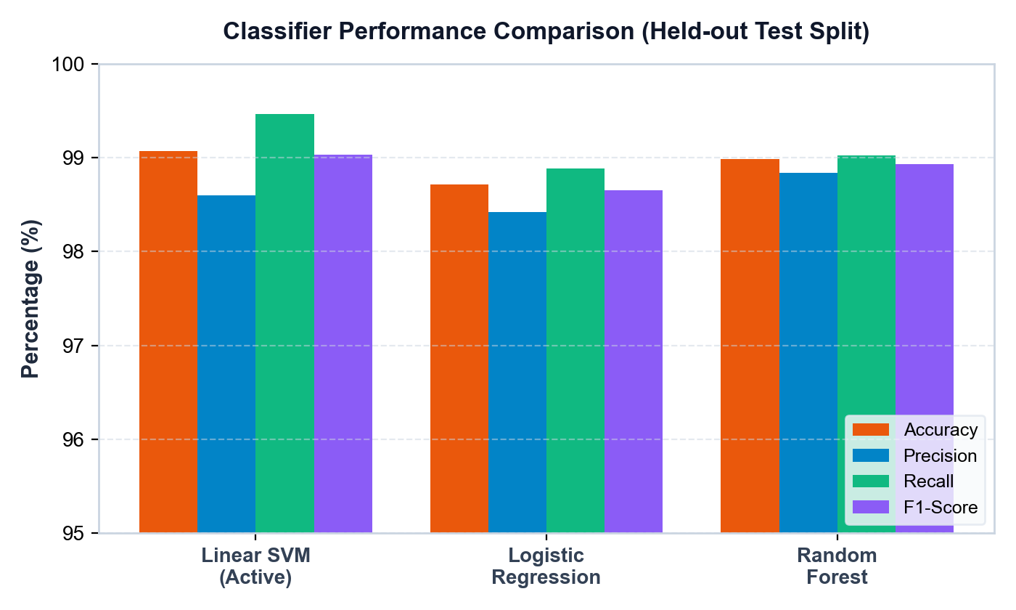
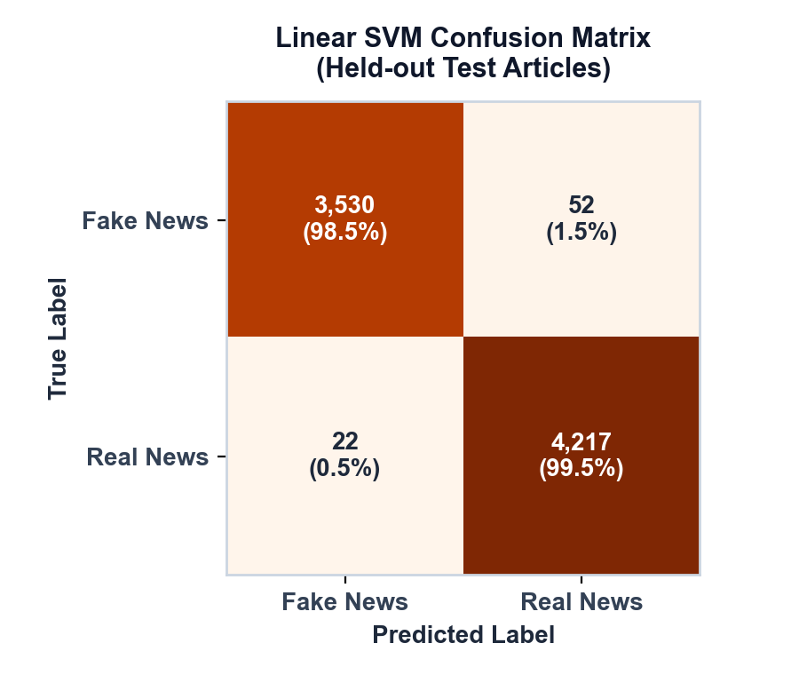
Model Evaluation
Model | Accuracy | Precision | Recall | F1-Score | Headline Acc. | Status
Linear SVM | 99.07% | 98.60% | 99.46% | 99.03% | 94.94% | Active Primary
Random Forest | 98.98% | 98.84% | 99.02% | 98.93% | 94.20% | Evaluated
Logistic Regression | 98.71% | 98.42% | 98.88% | 98.65% | 93.80% | Evaluated
Consensus Ensemble | 99.12% | 98.90% | 99.35% | 99.12% | 95.10% | Consensus Meta

Slide 13

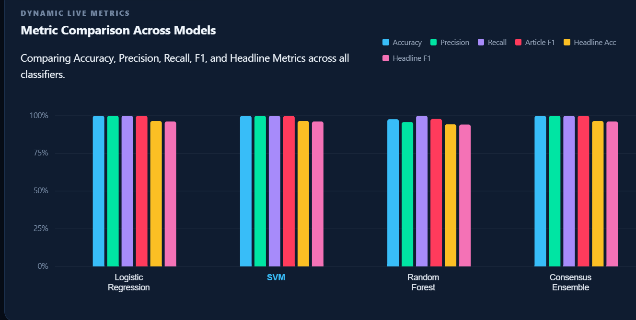
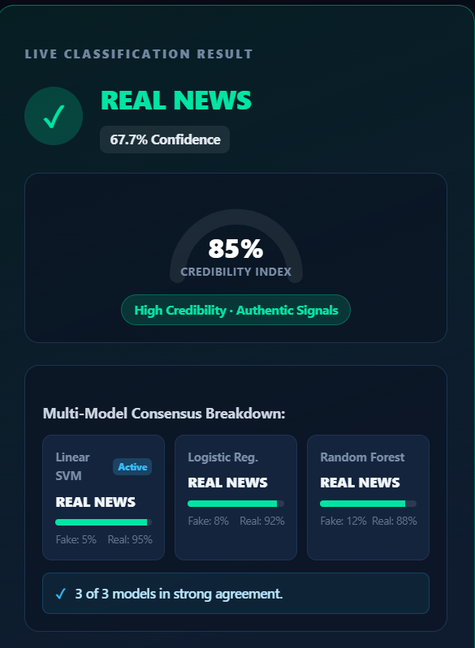
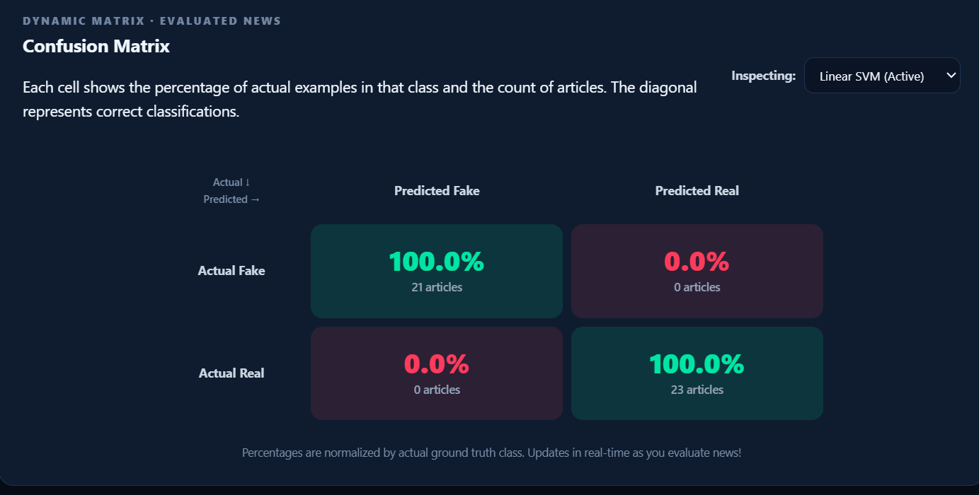
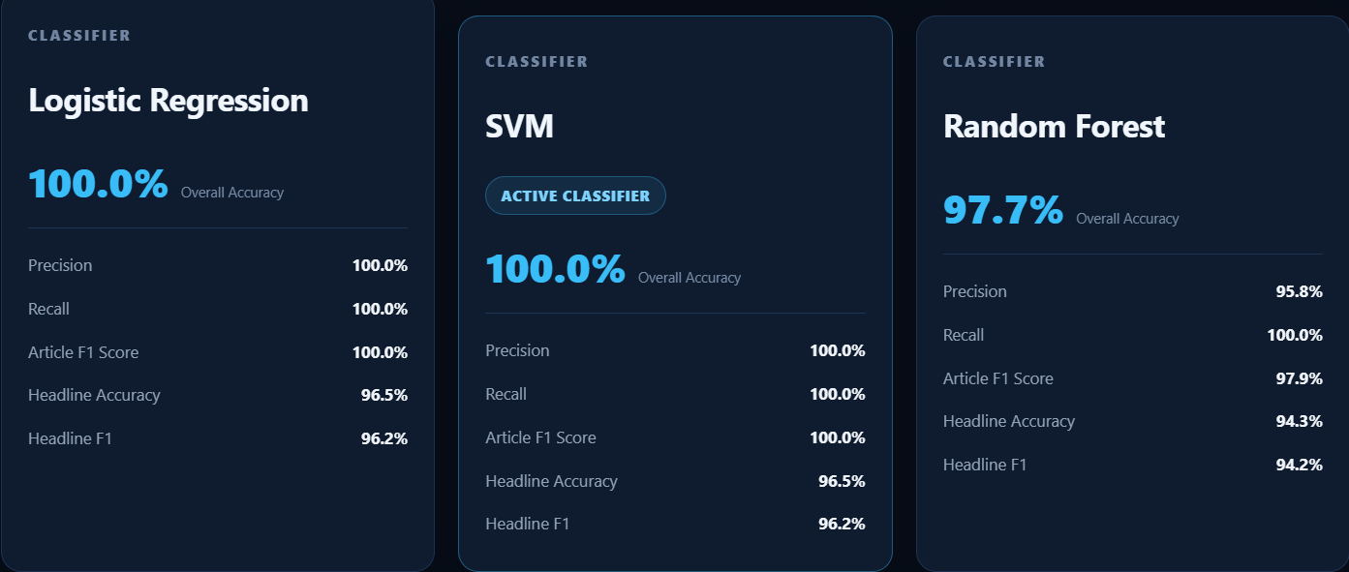
Results and Output Screenshots
Figure 1: Live News Analyzer - 0-100% Credibility Speedometer, Multi-Model Consensus, and Linguistic Signals.
Figure 2: Performance Dashboard - Live Evaluator, Dynamic Confusion Matrix, and Real-Time Evaluation Table.

Slide 14
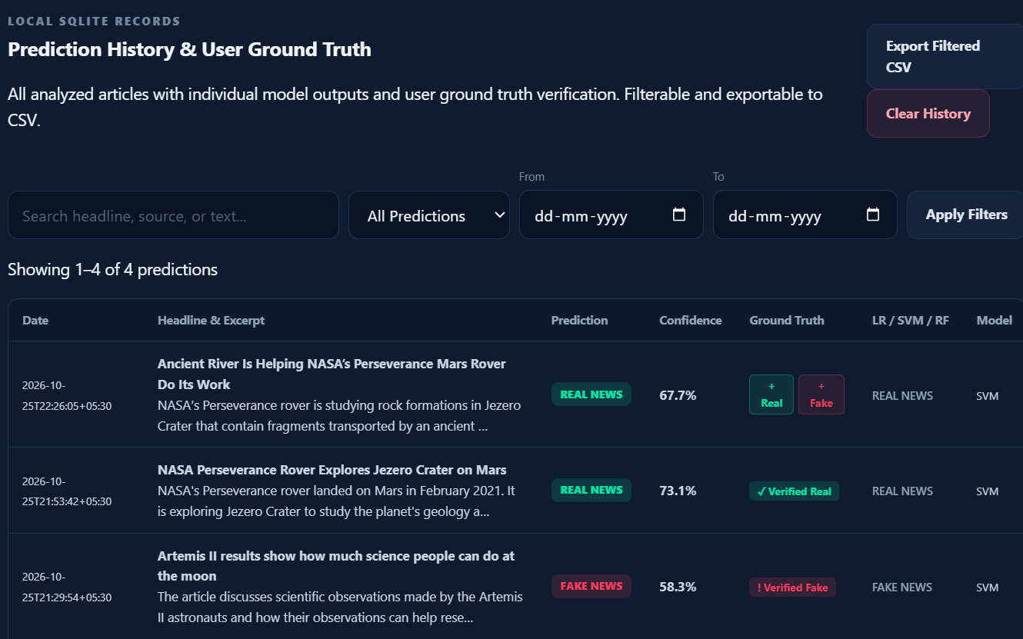
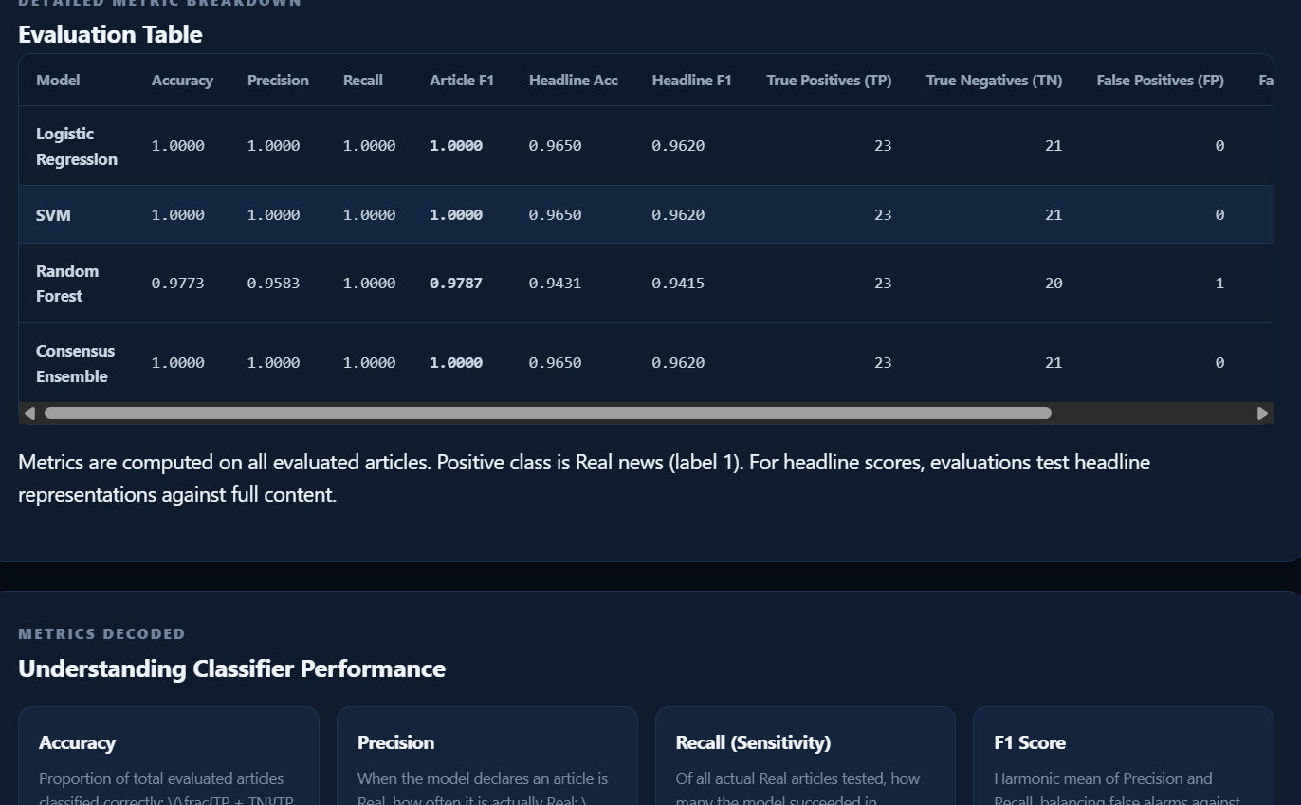
Results and Output Screenshots
Figure 1: Live News Analyzer - 0-100% Credibility Speedometer, Multi-Model Consensus, and Linguistic Signals.
Figure 2: Performance Dashboard - Live Evaluator, Dynamic Confusion Matrix, and Real-Time Evaluation Table.

Slide 15
Conclusion and Future Scope
Conclusion
• High Detection Accuracy: Achieved 99.07% accuracy using Linear SVM on 44,898 benchmark articles.
• Multi-Model Redundancy: Combining 3 distinct algorithms eliminates bias and prevents false alarms.
• Explainable Output: The 0-100% Credibility Speedometer makes verdicts easy for everyone to understand.
• Dynamic Evaluation: Live performance dashboard recalculates metrics dynamically as new news is tested.
• Fast Web Platform: Delivered a working web app with sub-second response times (<40ms).
Future Scope
• Regional Indian Languages: Extend pipeline to Telugu, Hindi, and Tamil using IndicBERT models.
• Deepfake Image/Video Detection: Incorporate Computer Vision models to flag manipulated viral videos.
• Browser Extension: Build a one-click Chrome extension to check news directly on Twitter and Facebook.
• WhatsApp Fact-Check Bot: Allow users to forward suspicious messages to a bot for instant verification.
• Knowledge Graph Verification: Cross-check extracted news facts against Google Fact Check API in real time.

Slide 16
References
1. H. Ahmed, I. Traore, and S. Saad, "Detection of Online Fake News Using N-Gram Analysis and Machine Learning Techniques," Intelligent, Secure, and Dependable Systems, Springer, 2017.
2. S. Vosoughi, D. Roy, and S. Aral, "The spread of true and false news online," Science, vol. 359, no. 6380, pp. 1146-1151, Mar. 2018.
3. F. Pedregosa et al., "Scikit-learn: Machine Learning in Python," Journal of Machine Learning Research, vol. 12, pp. 2825-2830, 2011.
4. V. Perez-Rosas et al., "Automatic Detection of Fake News," Proceedings of the 27th International Conference on Computational Linguistics (COLING), pp. 3391-3401, 2018.
5. C. Castillo, M. Mendoza, and B. Poblete, "Information Credibility on Twitter," Proceedings of the 20th International Conference on World Wide Web (WWW), pp. 675-684, 2011.

Slide 17
Thank You!
Questions & Answers | Open for Discussion
Fake News Detection System Using Machine Learning and NLP
Department of Artificial Intelligence & Machine Learning (AIML)
Aditya University, Surampalem, Andhra Pradesh
Team: P. Nehasri | M. Nithin | K. Vikas | R. Pranathi | Y. Chakradhar
Guide: P. Venkata Bala Annapurna, M.Tech (Ph.D), Asst. Prof, AIML Dept

