Slide 1


Electrocardiogram Arrhythmia Classification Using Convolutional Neural Network
Submitted By,
Neha Surendran
Student ID : B00895082
Supervised By,
Prof. Raymond Bond

Slide 2
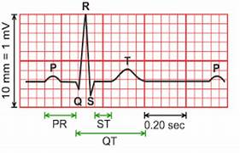
INTRODUCTION
ECG (Electrocardiogram) signal represents the electrical activity of the heart
The signal consists of various waves and segments representing the functions of atria and ventricles
Cardiac Arrhythmias : Detected by assessing the ECG waveform variations
Manual analysis of ECG by cardiologists is a tedious and time-consuming process

Slide 3
INTRODUCTION
WHO reports that cardiovascular diseases are the leading cause of global death [1]
Early detection of cardiovascular diseases through deep learning -based ECG classification
Automatic interpretation of ECG signal by computers
The proposed work develops a 2-D Convolutional Neural Network (CNN) to classify ECG signal into Normal Sinus Rhythm (NSR), Atrial Fibrillation (AF), Alternative Rhythm (AR) and noisy signal
[1] ‘Cardiovascular diseases (CVDs)’, Who.int. [Online]. Available: https://www.who.int/news-room/fact-sheets/detail/cardiovascular-diseases-(cvds). [Accessed: 01-Sep-2023]

Slide 4
RECENT WORKS
C. H. Hsieh et al. (2020) [2]
Used 1 dimensional Convolutional Neural Network (CNN) to detect Atrial Fibrillation
Physionet Computing in Cardiology challenge 2017 dataset
F1 score : 0.782
Batch normalization layer improved the F1 score by 1.6%
2) P. Rajpurkar et al. (2017) [3]
Detected cardiac arrhythmia using CNN with single lead ECG
14 classes including 12 arrhythmias, sinus rhythm and noise
F1 score : 0.776
3) S. Nurmaini et al. (2020) [4]
Proposed an ECG classification task by coupling Discrete Wavelet Transform and 1-D CNN using 4 datasets
3 class problem (NSR, AF and NAF)
F1 score : 0.9748
[2] C. H. Hsieh, Y.-S. Li, B.-J. Hwang, and C.-H. Hsiao, ‘Detection of atrial fibrillation using 1D convolutional neural network’, Sensors (Basel), vol. 20, no. 7, p. 2136, 2020.
[3] P. Rajpurkar, A. Y. Hannun, M. Haghpanahi, C. Bourn, and A. Y. Ng, ‘Cardiologist-level arrhythmia detection with convolutional neural networks’, arXiv [cs.CV], 2017.
[4] S. Nurmaini et al., ‘Robust detection of atrial fibrillation from short-term electrocardiogram using convolutional neural networks’, Future Gener. Comput. Syst., vol. 113, pp. 304–317, 2020.

Slide 5
Dataset Description
Physionet Computing in Cardiology 2017 challenge dataset [5]
Dataset consists of 8528 ECG recordings collected using an Alivecor hand-held device
Each single lead ECG recording is sampled at 300 Hz and of varying length between 9 seconds and 61 seconds
Corresponding to each recording, there is a .mat file containing the ECG data and a header file containing the waveform information
[5] ‘PhysioNet/CinC challenge 2017: Training sets’, Physionet.org. [Online]. Available: https://archive.physionet.org/physiobank/database/challenge/2017/. [Accessed: 04-Sep-2023]

Slide 6
METHODOLOGY
PRE-PROCESSING
DENOISING
BASELINE WANDER REMOVAL
NORMALIZATION
RESAMPLING
ECG DATA
PRE-PROCESSED DATA

Slide 7
PRE-PROCESSING
DENOISING
Mains noise interference is commonly found in ECG recordings [6]
Main noise interference occurs at a frequency of 50Hz (EU) or 60Hz (US), depending on where it is recorded
Notch filter with band stop frequency of 50 Hz applied on the raw ECG data
BASELINE WANDER
REMOVAL
Baseline is a flat reference signal of ECG that represents the potential of the heart when there is no specific cardiac activity
Butterworth high pass filter with order 2 and cutoff frequency 0.1 is applied on the denoised signal to remove baseline wander
[6] A. Mulligan, ‘Why electrodes matter: ECG artifacts’, PulseAI, 18-Aug-2020. [Online]. Available: https://www.pulseai.io/blog/why-electrode-matter. [Accessed: 05-Sep-2023].

Slide 8
PRE-PROCESSING
NORMALIZATION
Normalization is used to scale the amplitude of the ECG signal into a standard range
Normalized signals allow for more meaningful comparisons between multiple ECG recordings and more accurate classification of various cardiac diseases based on consistent feature magnitudes
Here signal values of ECG data are normalized to the range [-1,1]
RESAMPLING
Resampling technique make use of interpolation and decimation techniques to vary the number of data points ​
Number of datapoints in the majority of dataset is 9000. So, if the data is of length less than 9000, interpolation technique is employed and if greater than 9000, decimation method is used

Slide 9
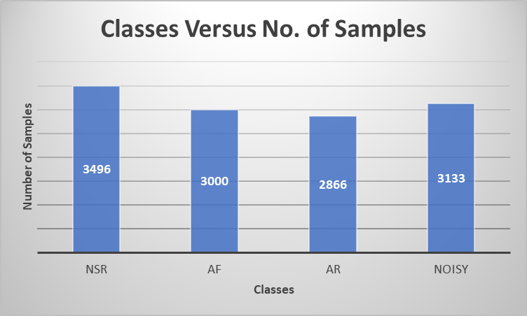
DATA AUGMENTATION
The highly imbalanced training data would affect the model performance
Data augmentation to deal with class imbalance problem
Up sampling and down sampling methods

Slide 10
SPECTROGRAM CONVERSION
Spectrogram represents the visual representation of frequencies of a signal [7]
The main steps involved in spectrogram computation are windowing, Fast Fourier Transform, Power calculation and finally mapping to intensity
Window size:256 and Overlap :128
129×69 spectrogram image
[7] Wikipedia contributors, ‘Spectrogram’, Wikipedia, The Free Encyclopedia, 21-Aug-2023. [Online]. Available: https://en.wikipedia.org/w/index.php?title=Spectrogram&oldid=1171568868.

Slide 11
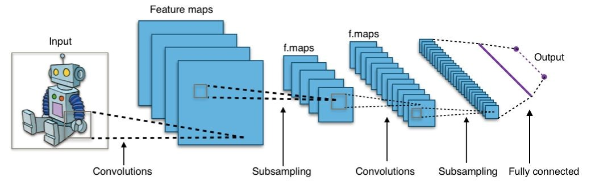
CLASSIFICATION USING CNN
Classification of ECG signals into Normal Rythm, Atrial Fibrillation, Alternative Rythms and noise is performed using CNN (Convolutional Neural Network)
CNN: Deep learning model specifically designed for processing grid like data such as images [9]
Effective in extracting relevant features from ECG signals and classifying them into normal sinus rhythm, atrial fibrillation, Other arrhythmias, and noisy signal
CNN is comprised of several layers performing specific functions as feature extraction, reduction and classification
[9] Wikipedia contributors, ‘Convolutional neural network’, Wikipedia, The Free Encyclopedia, 03-Sep-2023. [Online]. Available: https://en.wikipedia.org/w/index.php?title=Convolutional_neural_network&oldid=1173687463.

Slide 12
CNN ARCHITECTURE
Convolutional layer
Performs convolution operation by sliding kernels over the input data [10]
Captures local patterns and features from the data
3 layers each with 32 filters of size 3×3
Pooling layer
Down sample the spatial dimension of the data retaining the relevant features [10]
Two kinds of pooling : max pooling and average pooling
3 layers of max pooling
12 | 8
5 | 8
Max pooling
12 | 2 | 4 | 6
2 | 4 | 6 | 8
3 | 5 | 7 | 2
2 | 2 | 3 | 8
0 | 0 | 0 | 1 | 0
0 | 1 | 1 | 2 | 1
1 | 1 | 1 | 1 | 1
2 | 1 | 1 | 2 | 1
2 | 2 | 1 | 0 | 0
1 | 0 | 1
0 | 1 | 0
1 | 0 | 1
3
5 | 6
3 | 5
Average pooling
KERNEL
FEATURE MAP
INPUT IMAGE
[10] ‘CNN architecture - detailed explanation’, InterviewBit, 10-Jun-2022. [Online]. Available: https://www.interviewbit.com/blog/cnn-architecture/. [Accessed: 05-Sep-2023].

Slide 13
CNN ARCHITECTURE
FULLY CONNECTED LAYER
Conventional artificial neural network
Each neuron is connected to all the neurons in the previous layer
Responsible for final classification and prediction
X1
AF
X2
NSR
X3
.
AR
.
NOISY
Xn

Slide 14
TRAINING PARAMETERS AND VALUES
Parameters | Values
No. of Convolutional layers | 3
No. of Kernels | 32
Kernel size | 3×3
No. of pooling layers | 3
Kernel size | 2×2
Learning rate | 0.01
Dropout rate | 0.5
No. of epochs | 10
Batch size | 32

Slide 15
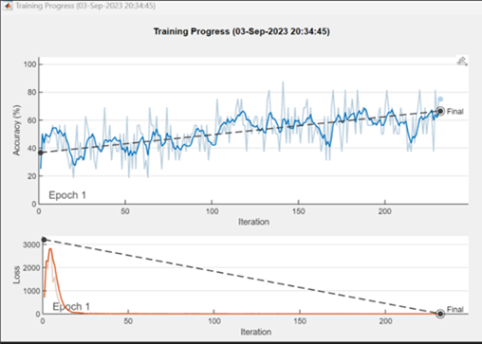
TRAINING STRATEGY
Adam optimization algorithm
Dropout layer and Batch normalization layer
Cross-entropy loss function
ReLU (Rectified Linear Unit) activation function
Training and test data in the ratio 70:30
Programming environment: MATLAB R2023a
Trained for 10 epochs with learning rate 0.01

Slide 16
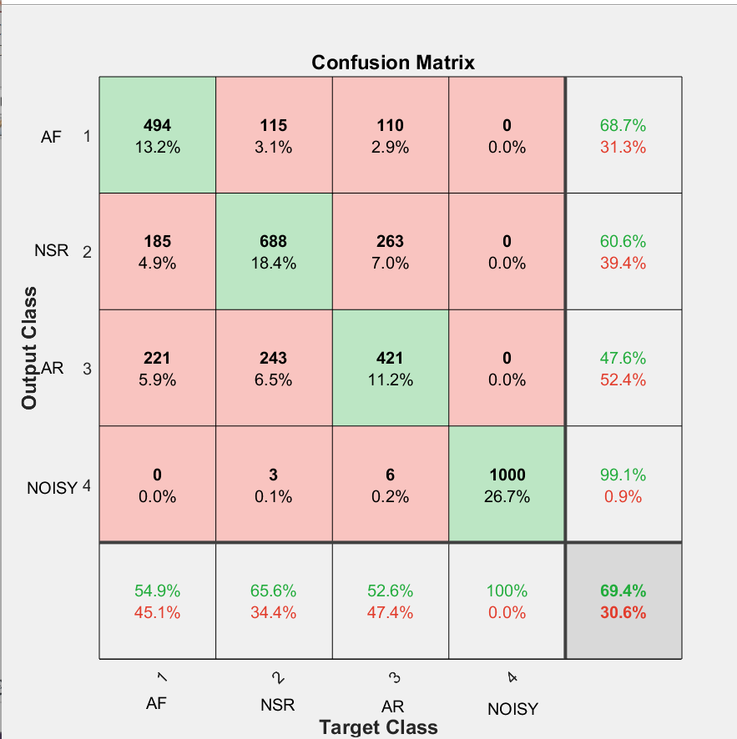
RESULTS AND DISCUSSIONS
Overall classification accuracy on test data: 69.4%
The class accuracies of AF, NSR, AR and noisy signal are 54.9%, 65.6%, 52.6% and 100% respectively
False Negatives for AF is 45.1 % and for AR is 47.4%
AF is mostly misclassified as AR whereas AR is mostly misclassified as NSR
On performing Chi-square test on data Chi-square statistic of 3.9531 and p-value of 0.046785 is obtained
Significance level of the test : 0.05

Slide 17
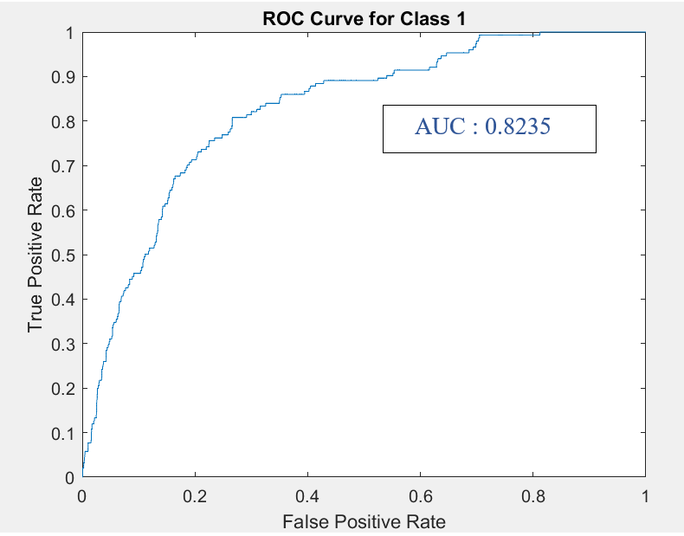
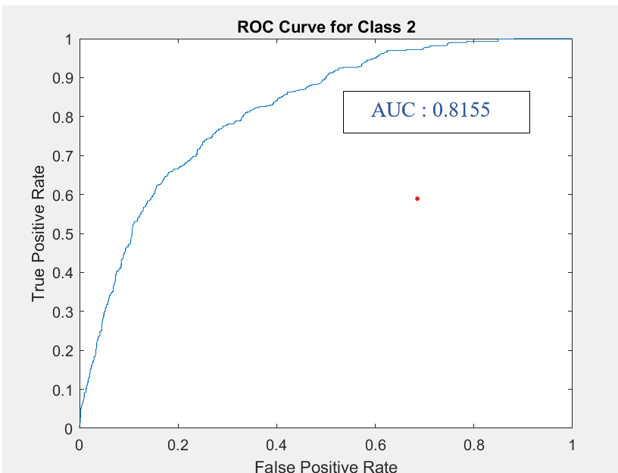
RESULTS AND DISCUSSIONS
ROC Curve for AF
ROC Curve for NSR

Slide 18
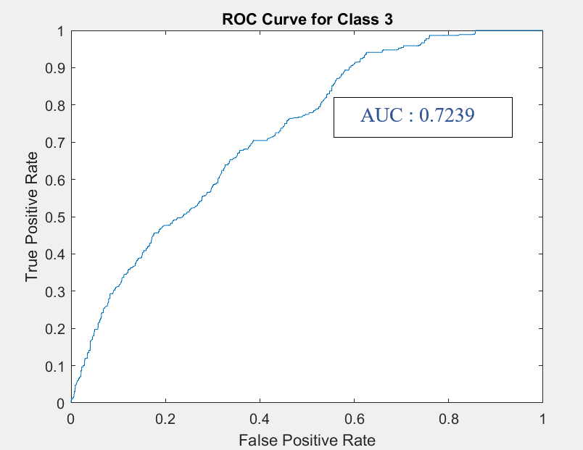
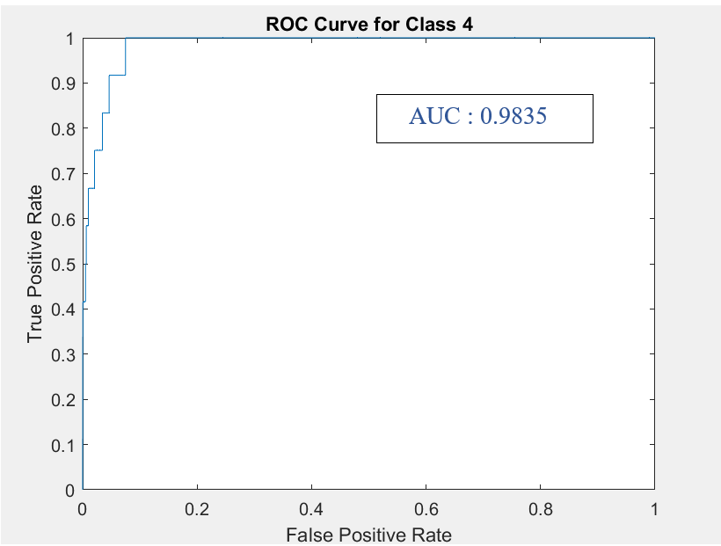
RESULTS AND DISCUSSIONS
ROC Curve for AR
ROC Curve for noisy signal

Slide 19
RESULTS AND DISCUSSIONS
Precision: Measures how accurately the model predicts positive values
Recall: Measures how well the model predicts all relevant instances from the positive class
F1 score: Harmonic mean of precision and recall
Two class classification to detect AF from Normal rhythm : F1 score of 0.76
CLASS | PRECISION | RECALL | F1 SCORE
AF | 0.75422 | 0.61375 | 0.67677
NSR | 0.67471 | 0.72596 | 0.6994
AR | 0.52074 | 0.565 | 0.54197
NOISY | 0.99751 | 1 | 0.99875

Slide 20
LIMITATIONS
FUTURE WORK
Less amount of ECG data with high class imbalance
Patient demographics and environment while recording the signal can impact the data and thereby lead to misclassifications
Data augmentation could not improve the performance of the model
Black box nature of CNN
More complex data augmentation techniques can be used
Pre-trained model can be used and tuned to classify the application task
Model performance can be validated in real world clinical scenario by collaborating with cardiologists

Slide 21
CONCLUSION
The proposed work effectively created a 2-D CNN model to classify ECG signals into normal sinus rhythm, atrial fibrillation, alternative rhythm and noisy signal
Deep learning model is a possible solution for ECG analysis if required amount of data and sources are available
Achieved a test accuracy of 69.4% and AUCs for AF, NSR,AR and noisy signal as 0.8235, 0.8155, 0.7239 and 0.9835 respectively
The class on which model perform best is noisy signal and least is Alternative Rhythm
AF and AR has False Negative percentage of 45.1 and 47.4 respectively
Considering AF and NSR classification, an F1 score of 0.76 is obtained
The performance of the model could be improved with more available data

Slide 22
THANK YOU

