Slide 1

GREEN TAXI
TEAM: Kasturi Nikharge
Madhura Bartakke
Neha Tayade
Vrinda Mathur

Slide 2
Preprocessing
Drop Columns
Ehail fee and store and forward flag.
Added columns
Speed
Outlier Removal
Total amount > 2.5$
1 > Passenger count > 6
Duration
Holidays, integrated with US Federal calendar
Trip distances > 0.5

Slide 3
Research Question 1:
Which attribute is most profitable for the drivers on the basis of location, type of ride and time?

Slide 4
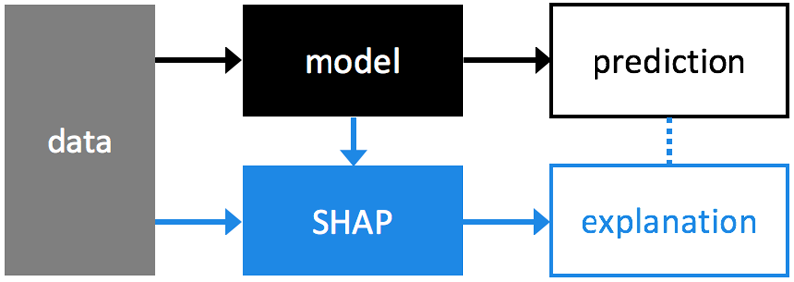
SHapley Additive exPlanations (SHAP)
SHAP
Kernal SHAP
Tree SHAP
TreeSHAP, efficient estimation approach for tree-based models
Prediction of importance of features through shap values
Values based on magnitude of feature attributions.

Slide 5
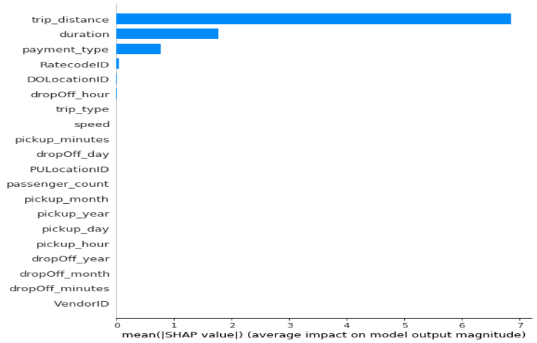
SHAP Feature Importance plot
This summary plot depicts the global importance of every feature on the output variable 'total amount'
Shap values based on Random Forest Tree Regressor Model
Accuracy : 89.55 %

Slide 6
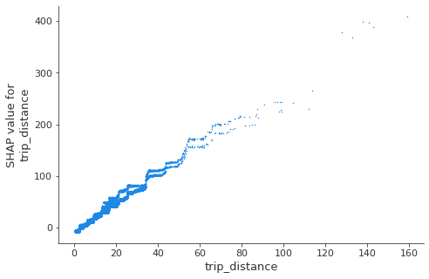
Shap Dependence Plot

Slide 7
Research Question 2: Predict spikes in revenue based on Holidays

Slide 8
Features
Revenue time series data
Pick up date
Holiday vs Non-holiday

Slide 9
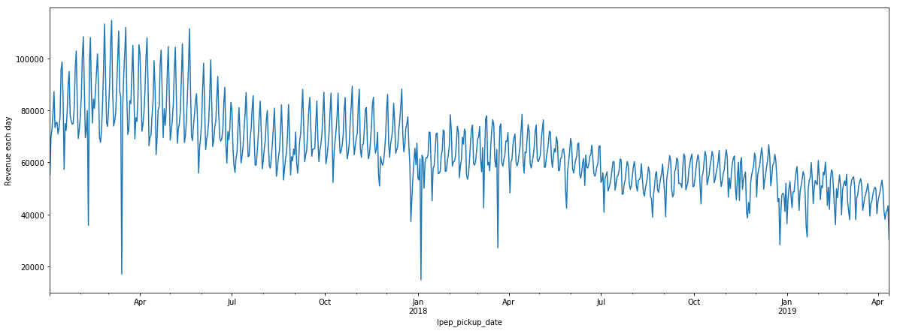
Total Revenue vs Time (Jan-2017:Apr-2019) plot

Slide 10
Time series Models
Auto Regressive Integrated Moving Averages
Long Short-Term Memory

Slide 11
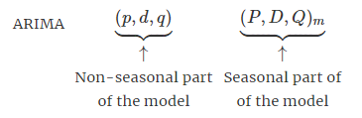
Autoregressive Integrated Moving Average-ARIMA Time Series Forecasting
AR : Evolving variable regressed on prior values
I : Creates stationarity (i.e., current - lagged values)
MA : Regression error

Slide 12
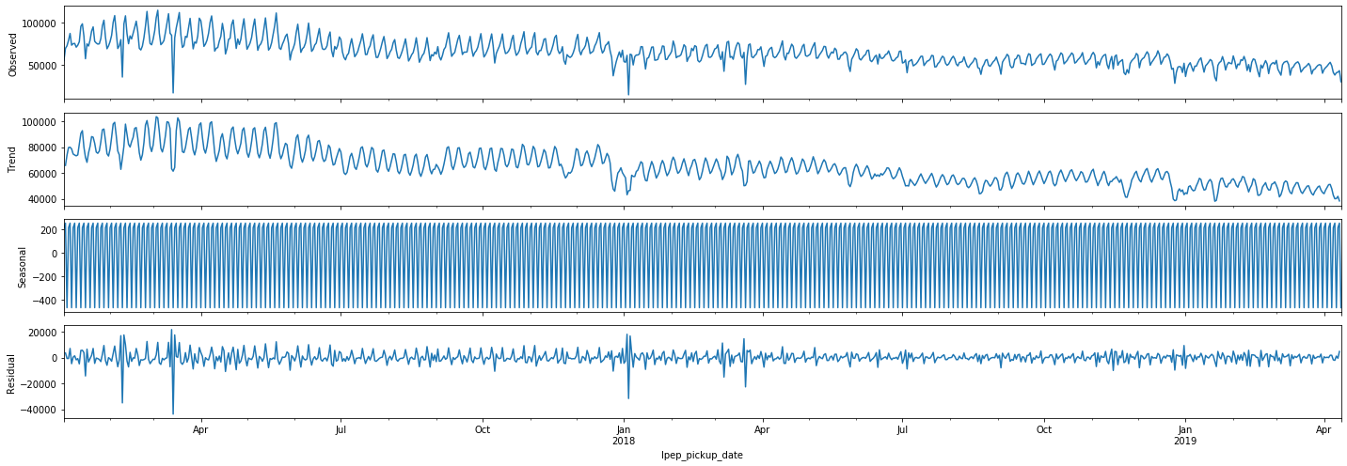
Seasonal decomposition components

Slide 13
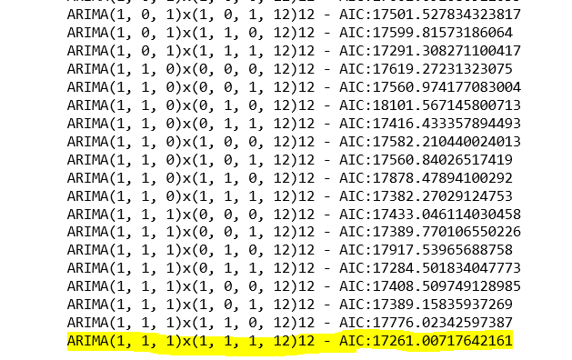
Akaike Information Criterion

Slide 14
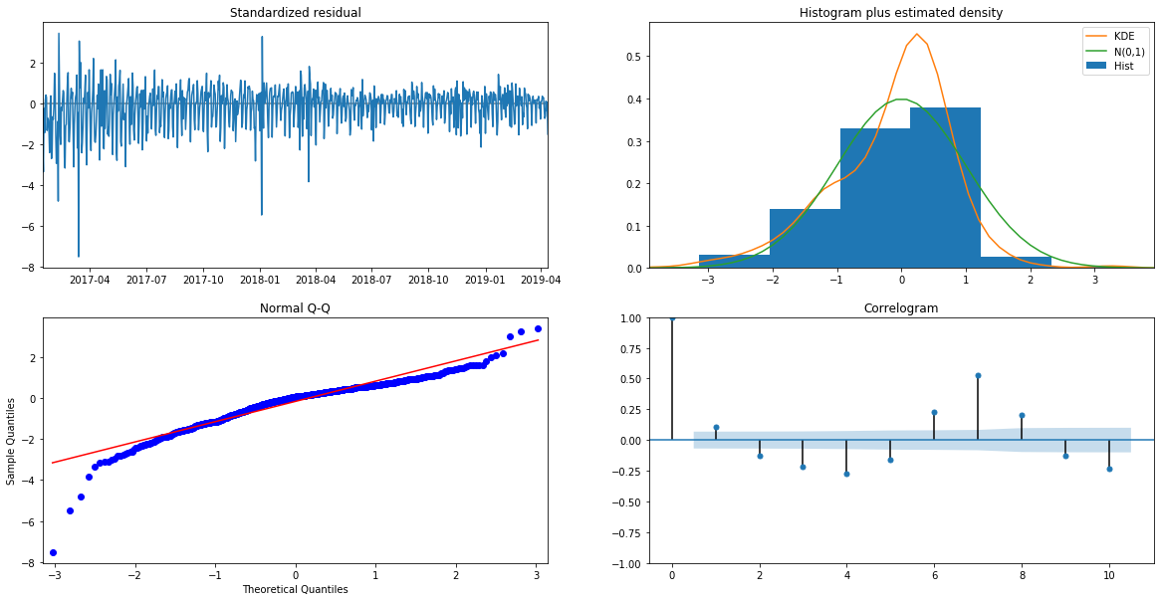
Residual plots in ARIMA model

Slide 15
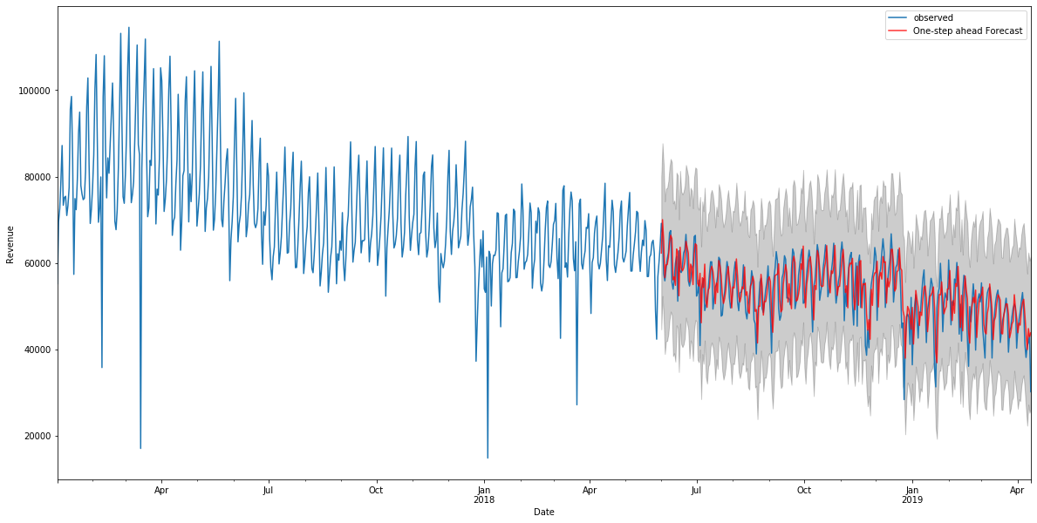
Forecast plot on existing data(Jun-2018 onwards)

Slide 16
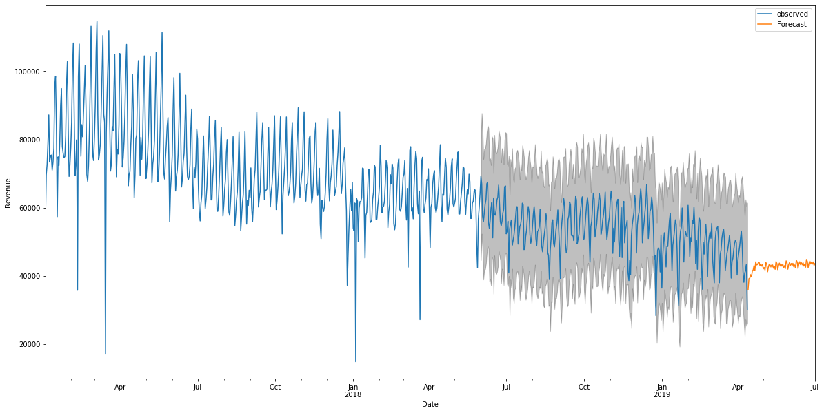
Forecasting on future time series(Jun-2019 onwards)

Slide 17
Research Question 3: Detection of Traffic? Analyzing distribution of rides during the day according to trip distance.

Slide 18
Quantile Regression
Extension of linear regression
Estimates for different ranges in data
No assumptions about distribution of residuals

Slide 19
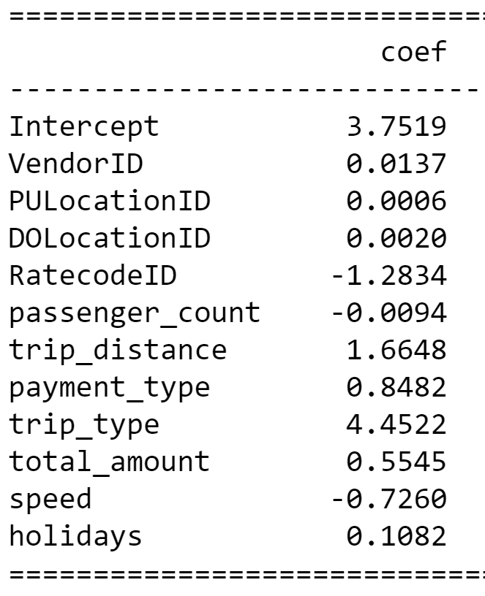
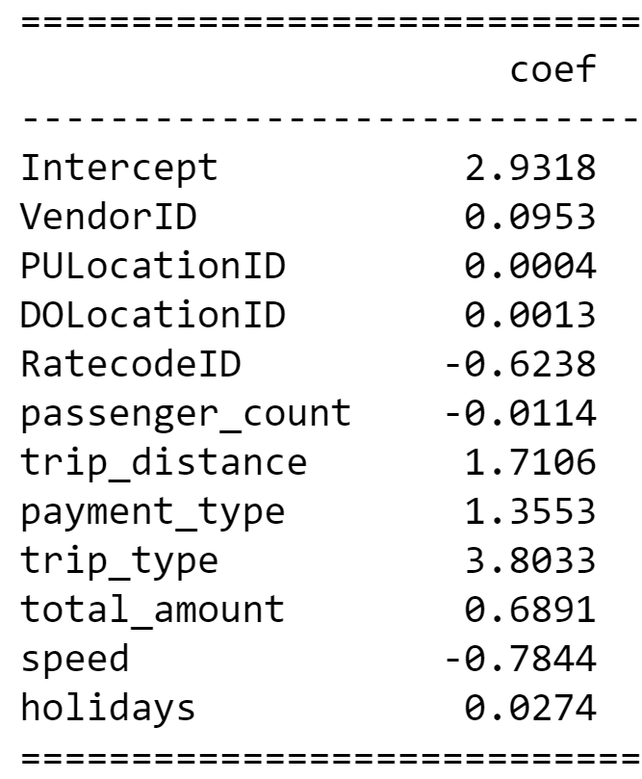
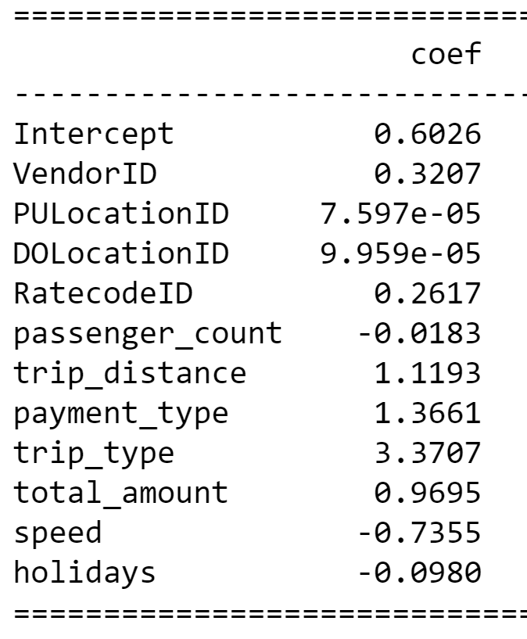
Quantiles
.25 | .50 | .75

Slide 20
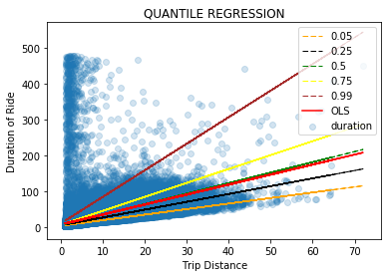
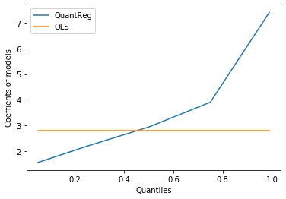
Quantile regression of different ranges

Slide 21
Thank you!

