Slide 1


ISM4930
Python for Analytics
Pima Indians Diabetes Dataset
By
Neha Thota

Slide 2
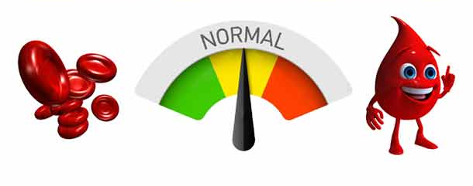
Introduction
Diabetes is a chronic health condition that causes due to the increase of sugar in blood
If the blood sugar level is normal or below, an individual is not considered diabetic (type 0)
However, if the blood sugar level is more than normal, an individual is considered diabetic (type 1)

Slide 3

Research Question
I want to predict whether a person has diabetes or not based on different diagnostic factors

Slide 4
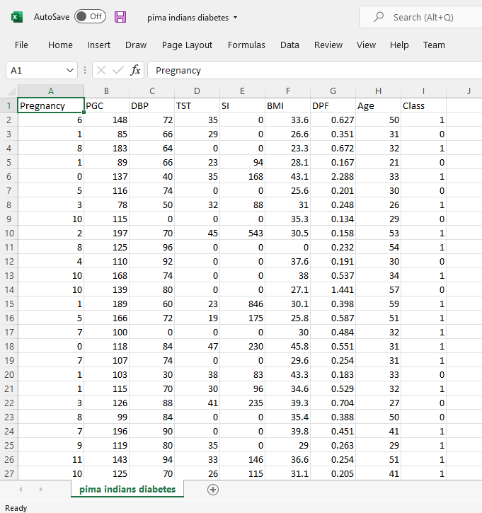
My dataset

Slide 5
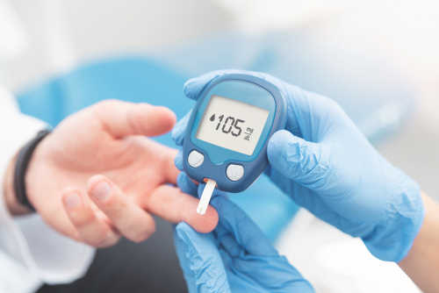
Factors affecting diabetes (independent variables)
Number of times pregnant (x₁)
Plasma glucose concentration a 2 hours in an oral glucose tolerance test (x₂)
Diastolic blood pressure (mm Hg) (x₃)
Triceps skinfold thickness (mm) (x₄)
2-Hour serum insulin (mu U/ml) (x₅)
Body mass index (weight in kg/(height in m)^2) (x₆)
Diabetes pedigree function (x₇)
Age (years) (x₈)

Slide 6
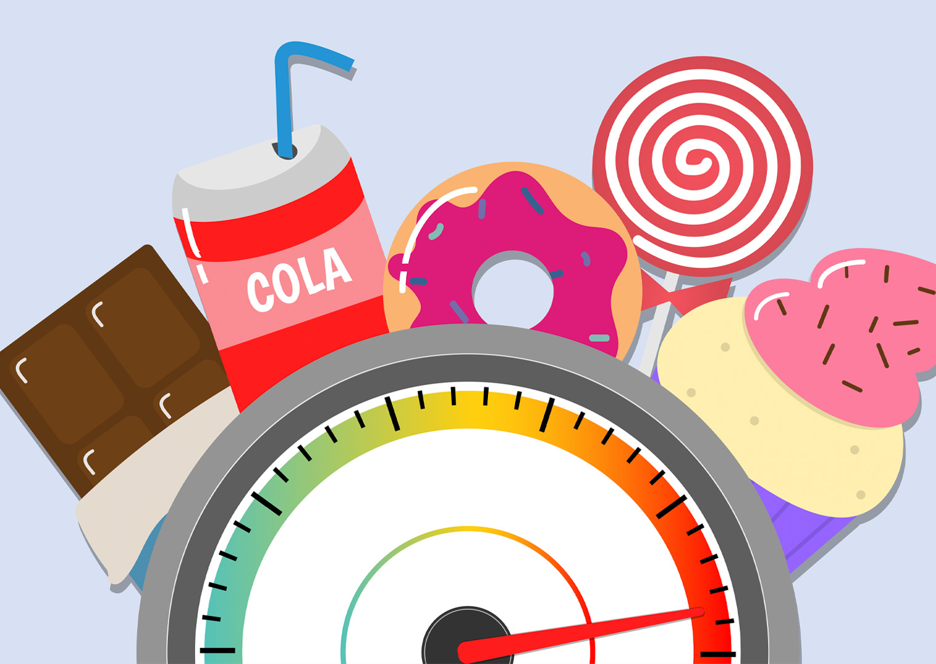
Dependent variable
Class variable (y)- Depending on the factors, diabetes is classified into either class 0 (non-diabetic) or class 1 (diabetic)

Slide 7
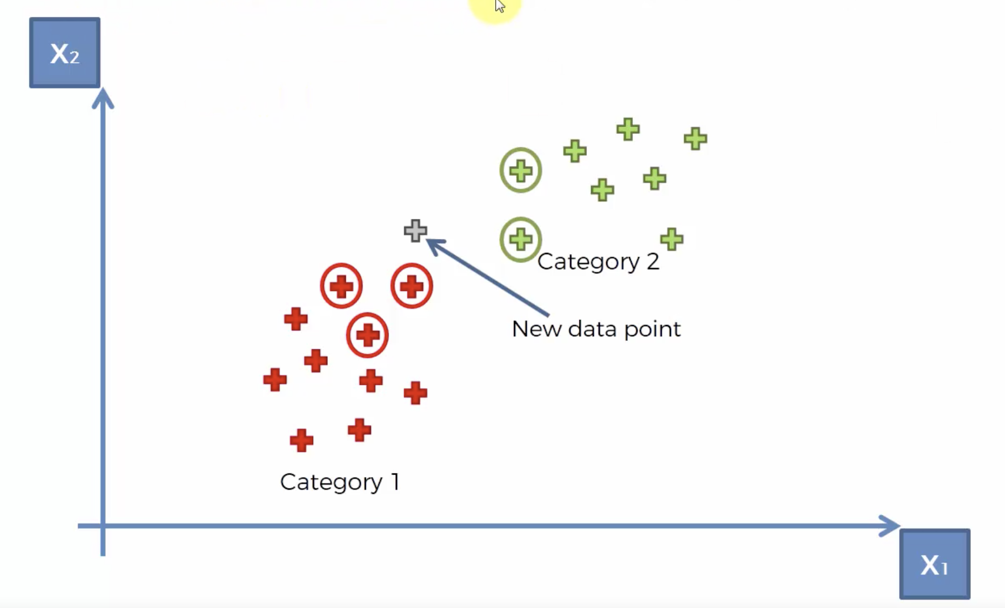
My approach
Using K-nearest neighbors
Machine learning algorithm
Classification model- classifies data based on how similar they are

Slide 8
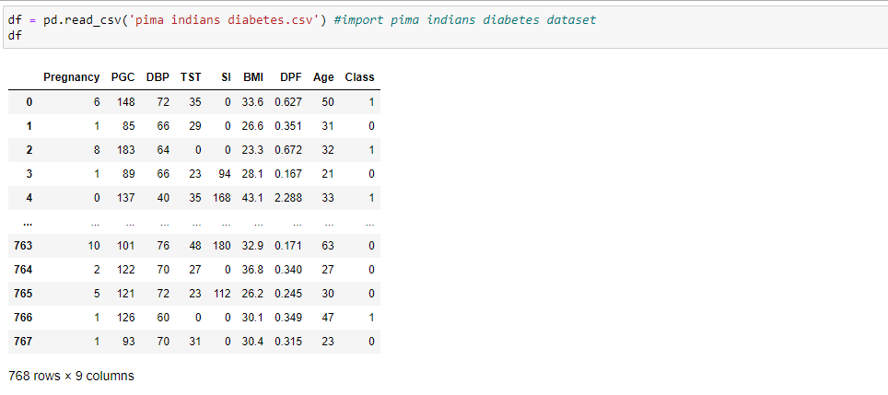
Importing dataset
Imported the dataset file on Jupyter using pandas

Slide 9
Pairplot
Used pairplot to see the distribution of all the variables and the relationships between each other

Slide 10
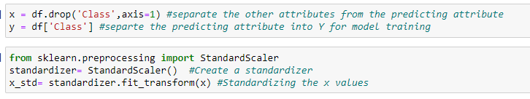
Separating attributes and standardizing
Separated attributes into x and y for model training
Standardized the x values

Slide 11
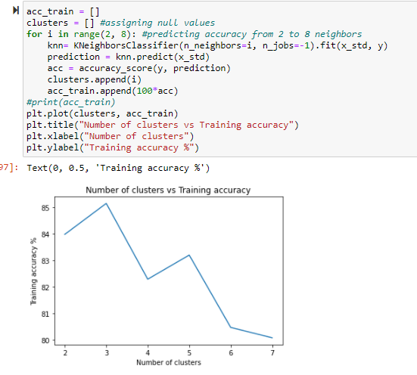
Checking the training accuracy
Checked the training accuracy based on the number of clusters

Slide 12
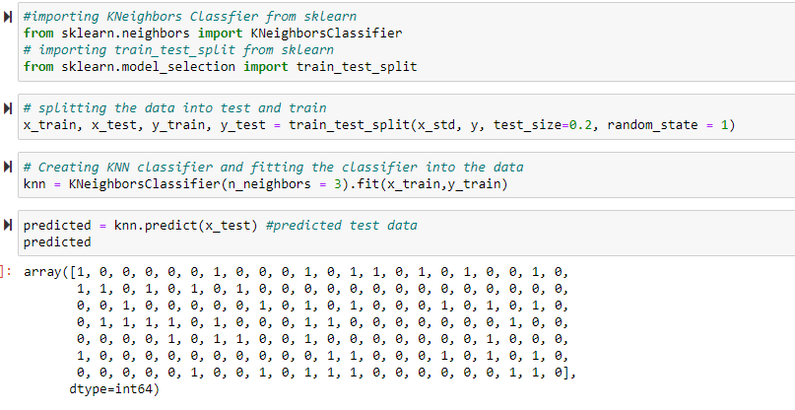
Train_test_split and K-nearest neighbors
Split the data into train and test
Used K-nearest neighbors to train each classifier with 3 neighbors

Slide 13
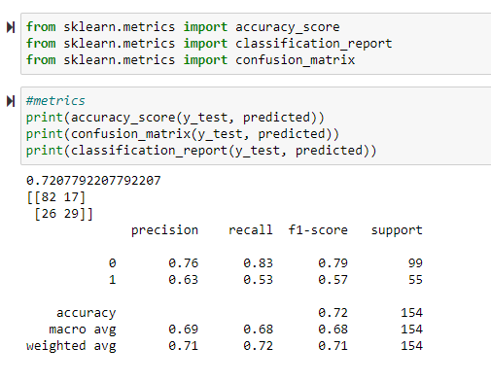
Metrics (Analyses)
Metrics for the predicted model

Slide 14
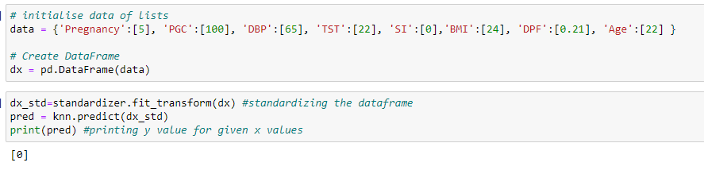
Predicting class
Predicting the class (y value), depending on the factors (x values)
Created a dataframe and inputted x values
Standardized and fit the model to the dataframe
Printed predicted values

Slide 15
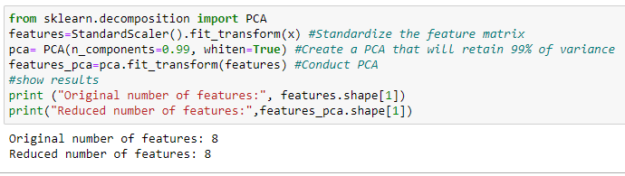
PCA
Used principal components to reduce the number of features

Slide 16

My major takeaway
Visualization of data
Analysis of data
Model Prediction and Machine Learning

Slide 17
Thank You

