Slide 1
Amazon Sales Analytics Dashboard
Business Analytics Project
Prepared By
Neha Yadav
MBA in Business Analytics
Amity University Online
Tools Used
Microsoft Excel
SQL (PostgreSQL)
Microsoft Power BI

Slide 2
Project Overview
N
Project Objective
To analyze Amazon sales data using Excel, SQL, and Power BI to identify sales trends, customer behavior, order performance, and business opportunities through an interactive dashboard.
Business Problem
The company generates a large number of orders every day, making it difficult to monitor sales performance, courier status, B2B and B2C orders, and top-performing products. Business users need a centralized dashboard to make faster and better decisions based on data.
Project Scope
Data Cleaning using Microsoft Excel
Data Analysis using SQL (PostgreSQL)
KPI Creation and Performance Analysis
Interactive Dashboard Development in Power BI
Business Insights and Recommendations
Expected Outcome
Analyze overall sales performance
Track monthly sales trends
Monitor courier status
Compare B2B and B2C orders
Identify top revenue-generating products
Support data-driven business decision-making

Slide 3
Dataset Information
Dataset Name
Amazon Sales Dataset
Data Source
Amazon Sales Order Data
Dataset Size
Total Records: 128,976
Total Columns: 24
Project Tools
Microsoft Excel
SQL (PostgreSQL)
Microsoft Power BI

Slide 4
Dataset Fields
The Amazon Sales dataset contains different types of information that help analyze sales performance, order processing, products, and customer delivery.
Order Details
Order ID
Order Date
Order Status
Fulfilment
Product Details
Category
SKU
Quantity
Sales Amount
Shipping Details
Ship State
Ship Service Level
Courier Status
Customer Information
B2B Order Type

Slide 5
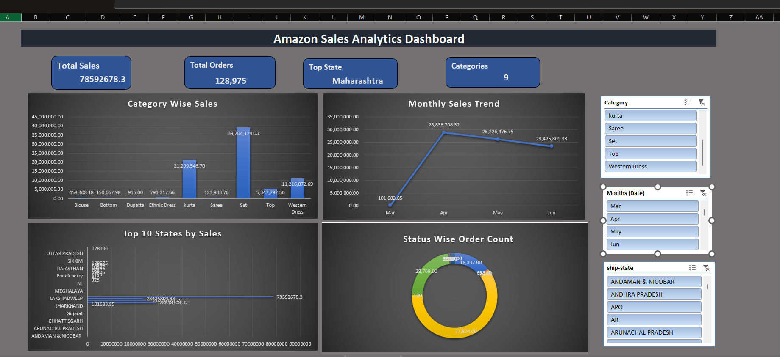
Excel – Data Preparation
Data Preparation
Removed blank records
Removed duplicate values
Standardized data format
Created Calendar Table
Prepared clean dataset for SQL analysis

Slide 6
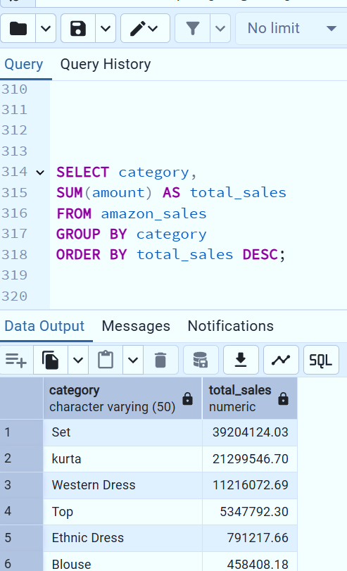
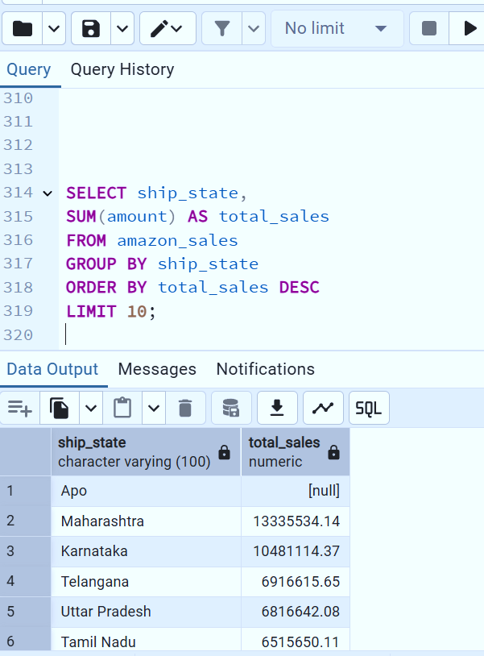
SQL – Data Analysis
Data Analysis
Created database tables
Imported cleaned dataset
Performed data exploration
Wrote KPI analysis queries
Analyzed sales and order performance

Slide 7
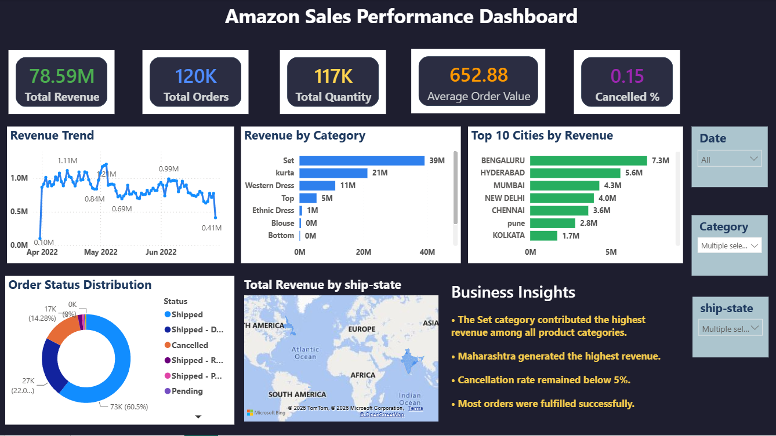
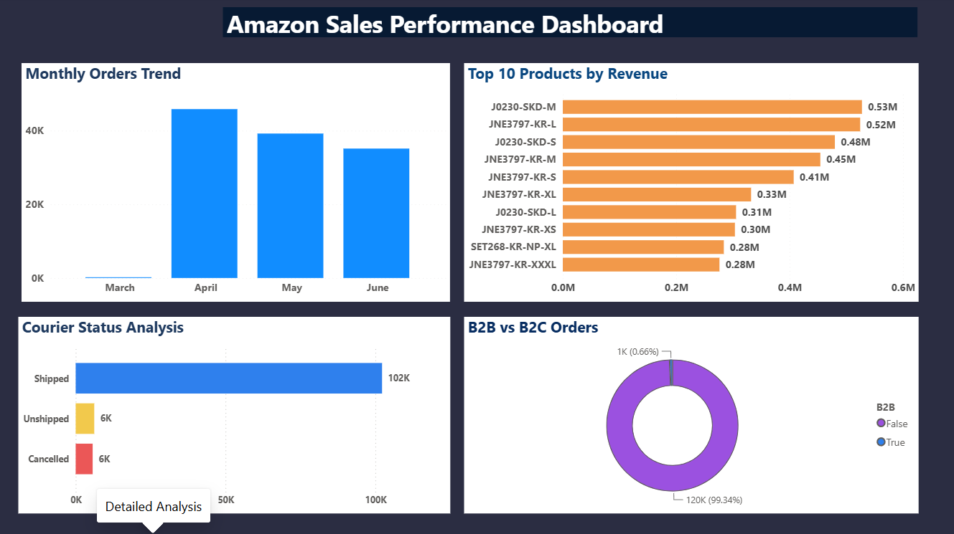
Power BI Dashboard
Key Features
KPI Cards
Interactive Slicers
Sales Trend Analysis
Product Performance
State-wise Sales Analysis

Slide 8
Key Business Insights
Sales Insights
• Revenue is concentrated in a few states.
• B2C orders are significantly higher than B2B orders.
• Clothing products generate the highest number of orders.
Operational Insights
• Most orders are delivered successfully.
• Courier status helps monitor delivery performance.
• Monthly sales show fluctuations across different periods.

Slide 9
Business Recommendations
Sales Recommendations
• Increase marketing in high-performing states.
• Promote low-selling product categories.
• Focus on customer retention strategies.
Operational Recommendations
• Improve courier performance for delayed orders.
• Increase inventory for high-demand products.
• Monitor monthly sales trends for better planning.

Slide 10
Conclusion
Project Summary
Successfully analyzed Amazon sales data.
Built an interactive Power BI dashboard.
Identified key business insights.
Suggested practical business recommendations.
Skills Applied
Microsoft Excel
SQL (PostgreSQL)
Power BI
Data Analysis
Thank You

