Slide 1
BPMN
Class extension to DSML4PTM

Slide 2
PerformPhysicalAdmission
Added as instances too
ReleasePatientRecord
OpenPatientCase
PerformTransfer
CloseTransferCaseRecord
CreateTransferCaseRecord
Activity
ServiceTask
PrepareRehabAdmission
ManualTask
ConductFirstAssessment
Task
FinalizeKoGu
UserTask
BusinessRuleTask
ReapplyDefRehaCriteria
ConfirmTransfer
ChooseRehabClinic
ReleaseTransferCase
ApplyDefRehaCriteria
MakeDispositionOfCase
PrepareKoGu
PrepareRehabAdmission
PrepareMedicalRecordAdmission

Slide 3
MedicalDO
AdministrativeDO
CareStatusDO
AcuteHospital
ProcessProgressDO
RehabilitationClinic
DataInput
HospitalizationDO
DataObject
HealthInsurance
Pool
KoGuDO
KoGuStroke
TransferalManager
KoGuPsychiatric
KoGuOrthopedic
AcutePhysician
Nurse
KoGuPediatric
PatientDisposition
RehabilitationPhysician

Slide 4
TransferCompleted
PatientAdmissionAvilable
Old
StandardEnd
StandardStart
KoGuAccepted
MessageEvent
CatchingIntermediateME
Event
PatientInRehab
StandardStart
48-24 HoursBeforeTransfer
TimerEvent
NoneEvent
CatchingIntermediate
StandardEnd
ThrowingIntermediate
TransferDate
TransferConfirmed

Slide 5
Updated
ConditionalStartEvent
PatientAdmissionAvilable
TimerStartEvent
MessageStartEvent
TransferDate
48-24 HoursBeforeTransfer
StartEvent
Event
CatchingTimerIntermediateEvent
TimerIntermediateEvent
ErrorEndEvent
EndEvent
IntermediateEvent
ConditionalIntermediateEvent
TerminateEndEvent
MessageEndEvent
ErrorIntermediateEvent
MessageIntermediateEvent
TransferCompleted
ThrowingIntermediateEvent
TransferConfirmed
CatchingMessageIntermediateEvent
PatientInRehab
KoGuAccepted

Slide 6
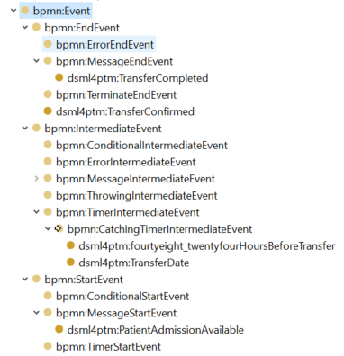

Slide 7
