Slide 1
Bayesian Longitudinal Integrative Analysis and Prediction with Application to the ABCD Study
Aidan Neher

Slide 2
Intro: Bayesian Integrative Analysis and Prediction with Application to Atherosclerosis Cardiovascular Disease (Chekouo and Safo 2020)
Authors integrate clinical, demographic, and multi-omics data to ID genetic factors involved in artherosclerosis cardiovascular disease (ASCVD).
Frequentist joint integrative analysis and prediction methods exist e.g. Safo et al. 2019 combine CCA and linear discriminant analysis, “encourag[ing] predictors that are connected and behave similarly to be selected or neglected together”.
Authors leverage Bayesian hierarchical factor analysis models for variable selection and prediction.

Slide 3
Motivation: Extension to Longitudinal Data Analysis
Adolescent Brain and Cognitive Development (ABCD) Study: Trajectories are of interest and have lifelong implications.

Slide 4
ABCD Study: Sample Demographics

Slide 5
ABCD Study: Sample Demographics

Slide 6
ABCD Study: Missingness

Slide 7
ABCD Study: Clinical Outcomes

Slide 8
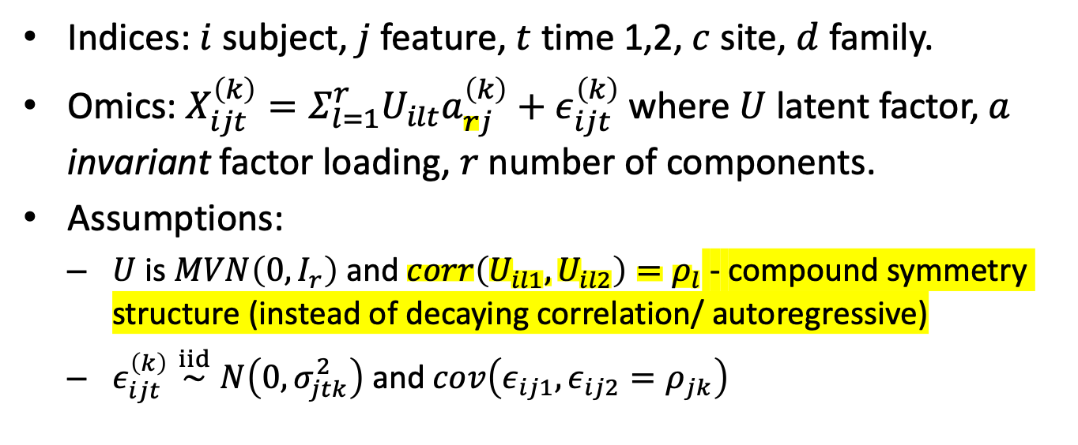
Model Formulation: Integrating Multiple Data Types
Indices: $i$ subject, $j$ feature, $t$ time 1,2, $c$ site, $d$ family.
Omics: $X_{ijt}^{\left(k\right)}=Σ_{l=1}^{r}U_{ilt}a_{rj}^{\left(k\right)}+ε_{ijt}^{\left(k\right)}$ where $U$ latent factor, $a$ invariant factor loading, $r$ number of components.
Assumptions:
$U$ is $MVN\left(0,I_{r}\right)$ and $corr\left(U_{il1},U_{il2}\right)=ρ_{l}$ - compound symmetry structure (instead of decaying correlation/ autoregressive)
$ε_{ijt}^{\left(k\right)}\overset{iid}{∼}N\left(0,σ_{jtk}^{2}\right)$ and $cov\left(ε_{ij1},ε_{ij2}=ρ_{jk}\right)$

Slide 9
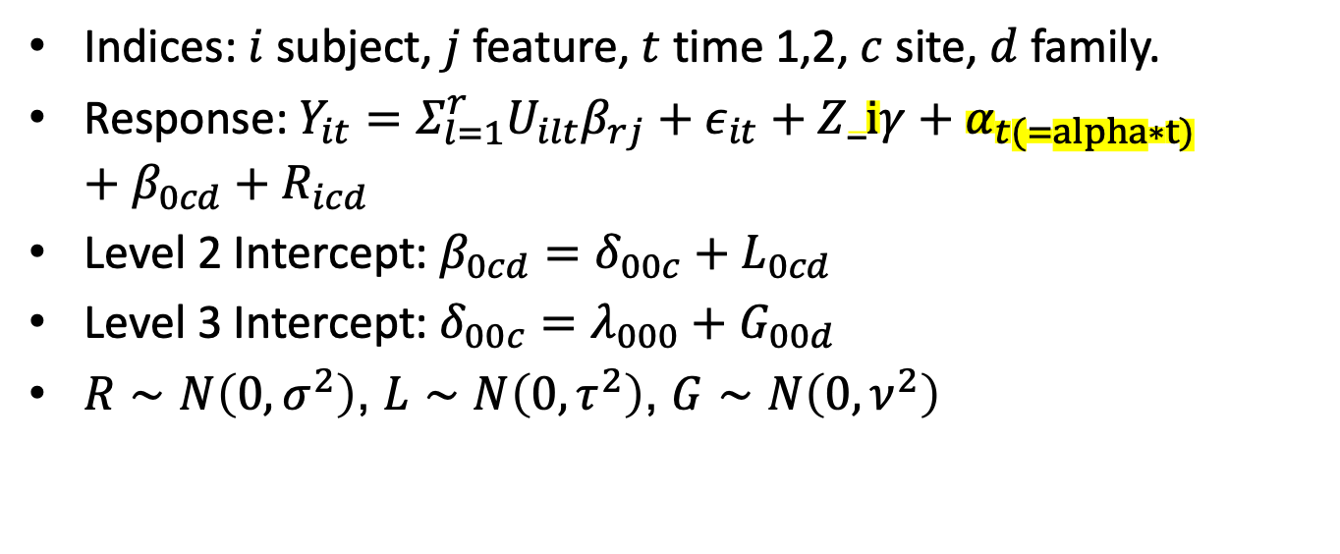
Model Formulation: Incorporating Longitudinal and Mixed Effects
Indices: $i$ subject, $j$ feature, $t$ time 1,2, $c$ site, $d$ family.
Response: $Y_{it}=Σ_{l=1}^{r}U_{ilt}β_{rj}+ε_{it}+Z_iγ+α_{t(=alpha∗t)}+β_{0cd}+R_{icd}$
Level 2 Intercept: $β_{0cd}=δ_{00c}+L_{0cd}$
Level 3 Intercept: $δ_{00c}=λ_{000}+G_{00d}$
$R∼N\left(0,σ^{2}\right)$, $L∼N\left(0,τ^{2}\right)$, $G∼N\left(0,ν^{2}\right)$

Slide 10
Proposed Next Steps
Implement in R and C++
Simulation studies
Impute missing data

Slide 11
Acknowledgements

