Slide 1
Microbench tool 2 for testing Data Observatory
Submitted by Neha Gupta

Slide 2
Requirements
MyTool
Input webpage
Webpage 1
Webpage 2
Webpage 3
Webpage n

Slide 3
Requirements
Take input html using any parsers like OpenWPM/ BeautifulSoup/ Python html parsers..
Modify any random attribute of this input html and render it as a different webpage.
Number of modifications to each webpage should be configurable.
Modification to any webpage thus generated should be completely random

Slide 4
Requirements
The input URL should be user configurable.
It should be possible to add and also remove these random elements
Also, store the differences between the webpages.
Write unit tests for the module.

Slide 5
Step 1
Build a web scraping tool that given a URL, scrapes all the links, images and text from the webpage and stores them.
This was quite enjoyable using the python beautifulsoup library. It gives ample playground for common features.
Other features, need to workaround or write helper functions

Slide 6
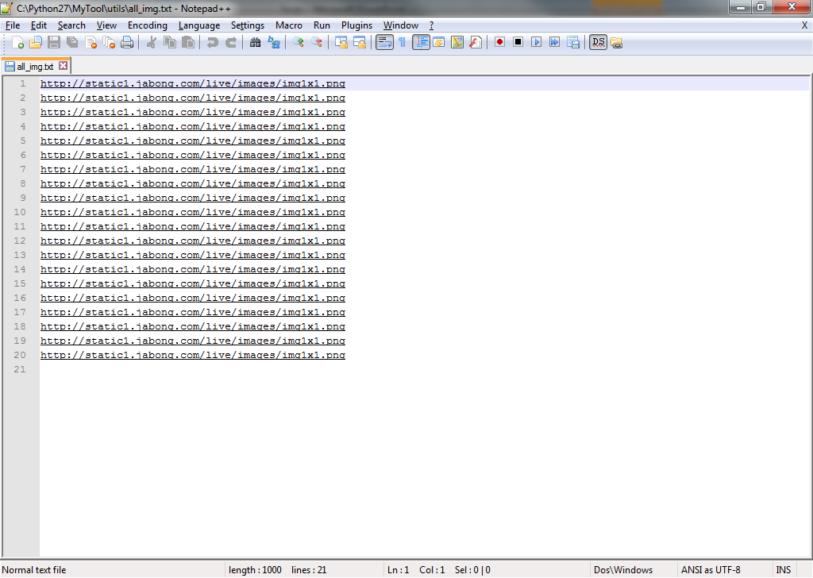
Step 1 - results

Slide 7
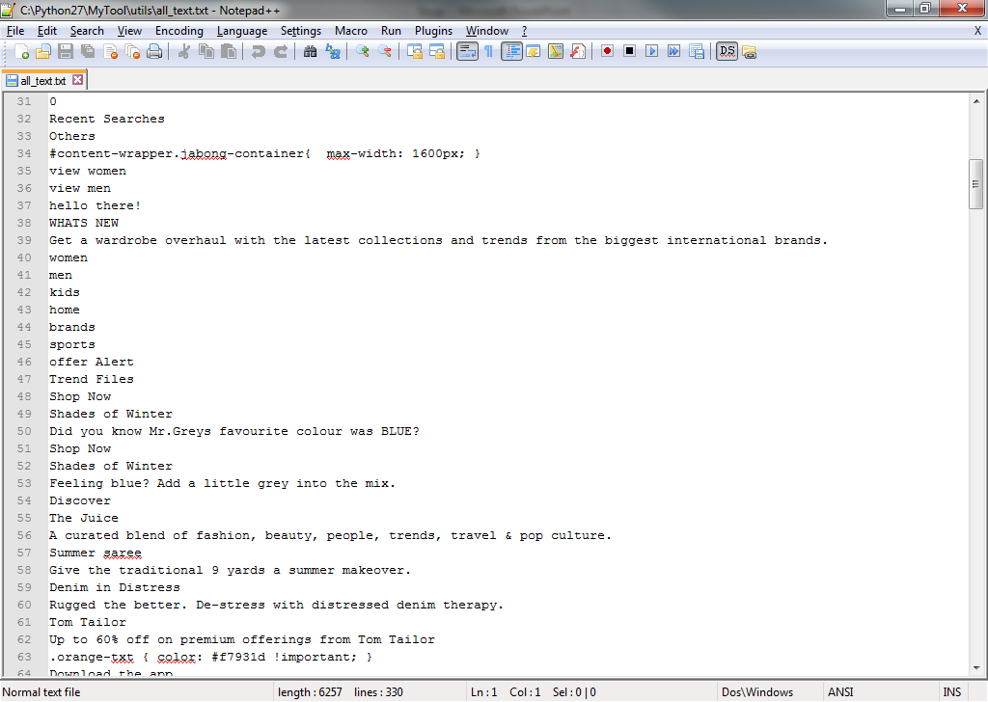
Step 1 results

Slide 8
Step 2
Generate random mutations of the webpage by
Adding new text elements in the html structure
Adding new images
Removing text
Removing image
O(2^n) possible permutations with known data
Infinite possible combinations of new data

Slide 9
Findings
Studied OpenWPM tool provided by Princeton and found that they parse all the URLs in a given webpage but do not store any data from those webpages. The corresponding table xpath is empty.
So, turned to BeautifulSoup.
Add/ remove text and image operations were time taking but making them completely random took a lot more time in fact most of the time!

Slide 10
Findings
Interesting find: Beautiful soup simply returns <None Type> object if the object is wrapped under a lot of tags e.g.
markup = '<a href="http://example.com/">I linked to <i>example.com</i></a>‘
So workaround: iterate through all elements and check against them for the required tag.

Slide 11
Findings
To print the items extracted from a webpage to console or file, we must use encoding(latin1) or such
To print html soup objects, we must use unicode utf-8. Python supports this through libraries unicode dammit.
Basic browser functions provided by using webbrowser.py to display html generated from beautifulsoup directly onto a browser.

Slide 12
Descoped
Had to descope the following:
Unit test for
lack of time
OpenWPM for taking input webpages for both:
lack of time and
little difference in the results we get. (OpenWPM uses advanced browser features like recording browser sessions as well as browser profiles, cookies, browser logging etc)

Slide 13
Test results
Demo
Can generate as many different webpages we want to test the data observatory.
All user configurable requirements are met.
All modifications in the results are completely random.
Dynamic pages are rendered in a much better way than static pages eg. www.jabong.com

Slide 14
Questions?

Slide 15
Thank You

