Slide 1
CMPE 255 | DATA MINING
When AI Groups Time Series, Can It Explain Why?
An illustrated short story on explainable deep clustering
Clustering finds groups.
Explainability helps us understand the pattern behind them.
Presented for CMPE 255 • November 2026
Survey: Schlegel, Tavares & Seidl (2025) | TempXAI Workshop at ECML-PKDD 2025
01
Notes:
Hello everyone. In this short story, I want to investigate a question that is simple to ask but surprisingly difficult to answer: when an AI system groups time-series data into clusters, can it explain why those groups exist?
My starting point is the paper *Towards Explainable Deep Clustering for Time Series Data* by Schlegel, Tavares, and Seidl. It is a 2025 survey accepted at the TempXAI Workshop at ECML-PKDD. I will connect that survey to the original studies it discusses, compare their architectures and metrics, and share my own view of what the field still needs.
The key idea is that clustering performance and explanation quality are not the same thing.

Slide 2
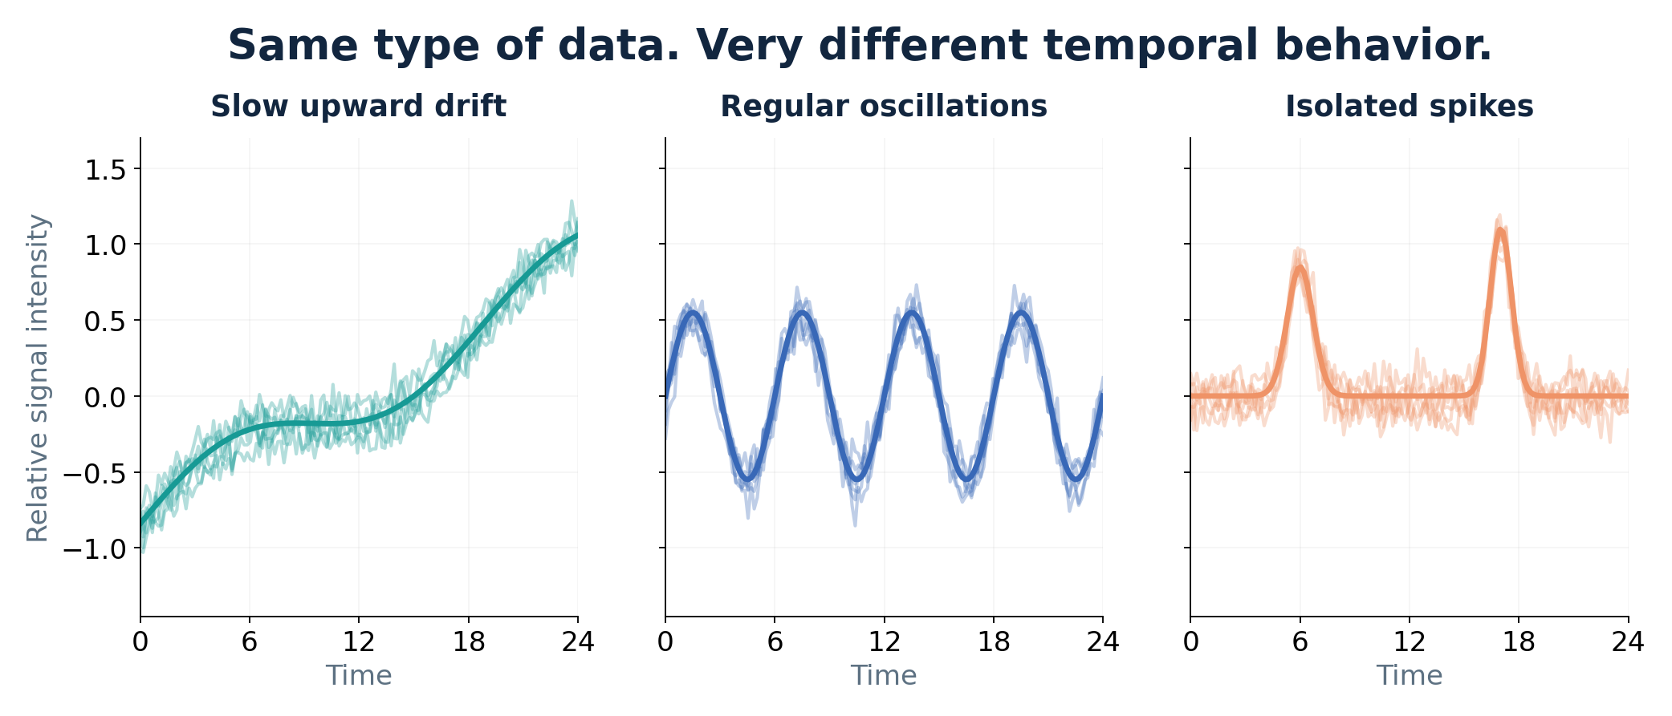
MOTIVATION
A cluster ID is not an explanation
Imagine ICU monitoring
A model separates patient histories into groups.
The clinician still needs to know which trends or events distinguish them.
Source: Schlegel et al. (2025), arXiv:2507.20840
02
Notes:
Imagine that we have time-series measurements from a hospital. Every patient has a sequence of measurements recorded over time. A model identifies three groups. That sounds useful, but what should the clinician actually do with cluster one, cluster two, and cluster three?
The three plots on this slide are synthetic examples, not real patient data. One increases over time, one oscillates, and another contains short spikes. Humans can identify those differences immediately when the patterns are simple.
The real challenge appears when we have hundreds of measurements, multiple sensors, and noisy signals. A cluster label alone gives us no explanation of what characteristic caused the grouping, or whether that characteristic matters clinically.

Slide 3
DATA MINING PROBLEM
Why time series are harder than static data
Temporal order
High dimensionality
Unknown labels
Identical averages can hide different spikes, trends, frequencies, and transitions.
Multiple sensors, noisy readings, irregular sampling, and variable-length sequences.
Clustering must discover structure without predefined ground-truth class identities.
Key challenge: learn useful groups without losing human meaning.
Source: Schlegel et al. (2025), arXiv:2507.20840
03
Notes:
Time-series clustering is an unsupervised data-mining problem. We are not giving the algorithm a ready-made set of category names during training. We want it to discover structure by comparing sequences.
Time series have special properties. Their order and timing matter. Two recordings may have the same average value but completely different bursts, frequencies, and changes in direction. Real recordings can also vary in length and include missing measurements or many channels from different sensors.
Classical tools such as dynamic time warping, or DTW, help compare sequences when similar events are slightly shifted in time. However, learning meaningful groups from complex multivariate signals remains hard. Deep learning can help discover patterns, but it introduces its own interpretability problem.

Slide 4
SURVEY CONTEXT
What the 2025 survey actually contributes
• A structured review of explainable deep clustering methods
• A comparison of architectures and explanation stages
• Use cases in healthcare, finance, IoT, and climate research
• Six open research opportunities
Research integrity
Accepted at the TempXAI Workshop at ECML-PKDD 2025.
This is a survey, not a newly benchmarked model or ablation study.
Source: Schlegel et al. (2025), arXiv:2507.20840
04
Notes:
Before discussing individual algorithms, I want to clarify what the main paper actually contributes. The paper is a survey. It gathers existing research on explainable deep clustering for time series, organizes those methods, compares their explanation strategies, and examines applications in healthcare, finance, the Internet of Things, and other domains.
The authors also propose six research opportunities that could make the field more trustworthy.
It was accepted at the TempXAI Workshop at ECML-PKDD 2025. That distinction matters because it is not a new architecture paper presenting an experimental ablation table of its own. For empirical results, I will refer to the original methods studied in the survey. This way, the source of each claim stays clear.

Slide 5
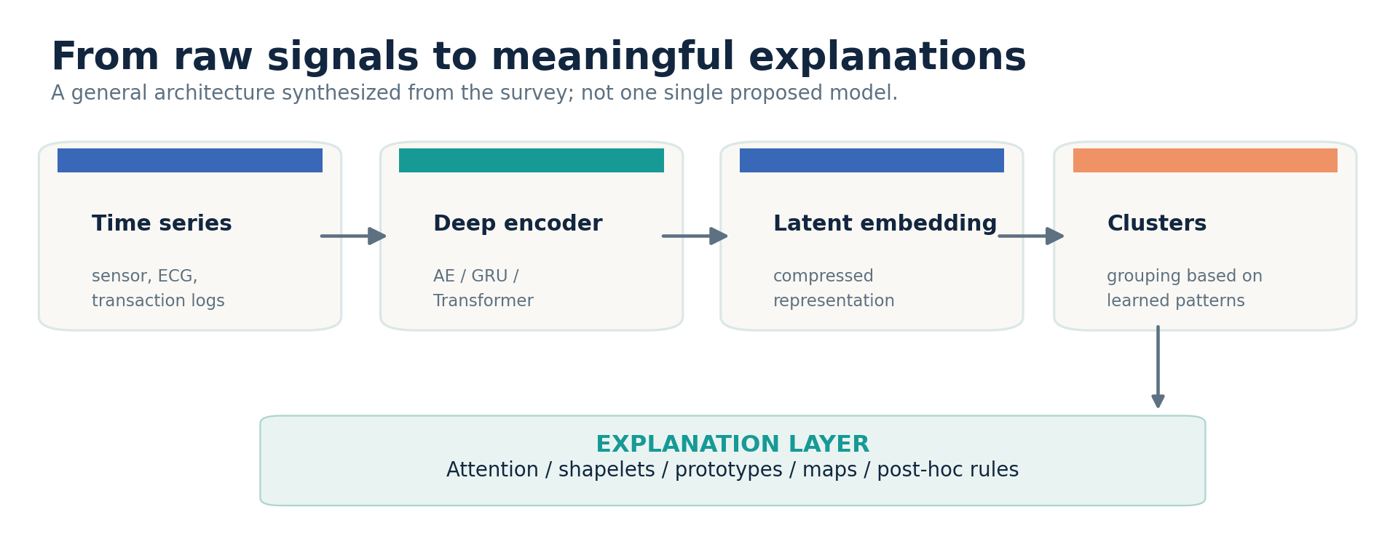
ARCHITECTURE
The generic deep-clustering pipeline
Encoder → latent representation → clustering → a separately evaluated explanation
Source: Schlegel et al. (2025), arXiv:2507.20840
05
Notes:
The diagram shows a general deep-clustering pipeline. We start with raw temporal data, like ECG sequences, activity readings, or transaction histories. An encoder compresses these sequences into a latent embedding, a smaller numerical representation that hopefully preserves important patterns.
A clustering algorithm then groups similar embeddings. Some systems optimize the representation and clusters jointly, while others learn representations first and refine them afterward.
But there is a missing bridge. A latent vector might help separate two kinds of sequences without giving a human a meaningful description of that separation. Explanation mechanisms try to build this bridge, using attention, representative subsequences called shapelets, prototype states, self-organizing maps, or post-hoc rules.

Slide 6
TAXONOMY
Explainability can enter at three stages
PRE-CLUSTERING
IN-CLUSTERING
POST-HOC
Select understandable features or shapelets before assigning groups.
Example: Time2Feat; CDPS.
Embed an interpretable structure in the learning pipeline.
Example: SOM-VAE; T-DPSOM.
Explain assignments after the model is trained.
Example: decision-tree surrogate, prototypes, visualization.
Source: Schlegel et al. (2025), arXiv:2507.20840
06
Notes:
The survey presents explainability through a three-stage taxonomy. First is pre-clustering explainability. Here we choose human-readable features or shapelets before grouping the data, so the eventual cluster structure has a more understandable foundation.
Second is in-clustering explainability. We design the model so that interpretable components, such as attention or a self-organizing map, are part of the clustering process itself.
Third is post-hoc explainability. We analyze the outputs of a completed model, perhaps by extracting a decision rule or visualizing representative examples.
I do not think one stage is always sufficient. An effective system could combine meaningful inputs, interpretable architecture, and external validation of the generated explanation.

Slide 7
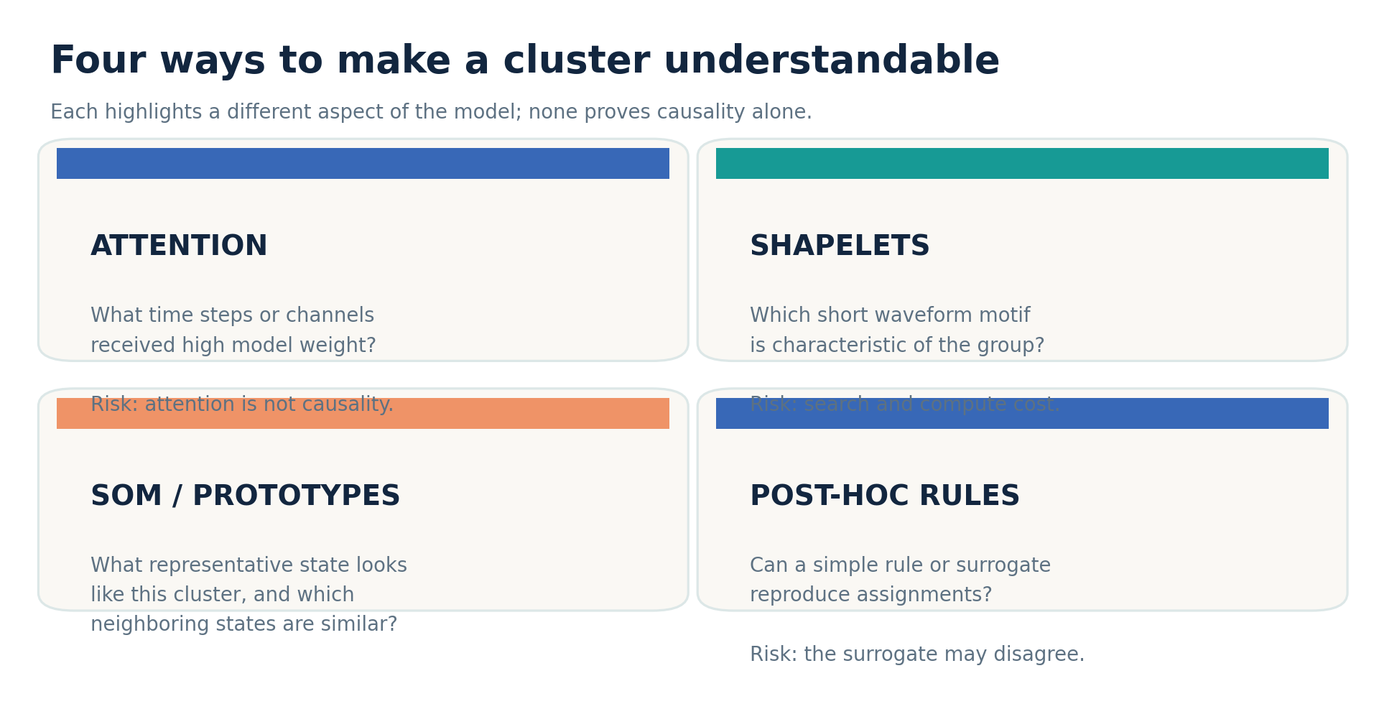
TECHNIQUES
Four explanation mechanisms, four different questions
Source: Schlegel et al. (2025), arXiv:2507.20840
07
Notes:
Here are four useful ways to look inside a cluster. Attention asks which time steps or channels received the greatest weight. Shapelets identify short, recognizable waveform patterns that distinguish a group. Self-organizing maps and prototypes show what a typical cluster state looks like and how groups are related. Finally, post-hoc rules or surrogate models turn complex assignments into simpler conditions.
They answer different questions. A highlighted signal window tells us something different from a representative waveform or a decision-tree rule.
My caution is that visualization should not be confused with proof. An attractive attention heatmap, for example, does not automatically establish that the highlighted interval caused the cluster assignment.

Slide 8
METHOD 1
DeTSEC: attention + recurrent autoencoder
Architecture
What the ablation tests
1. A forward/backward attentive GRU autoencoder learns embeddings.
2. A clustering-refinement objective improves group separation.
3. Attention weights show candidate important intervals.
The original paper evaluates variants without the gating mechanism and without the backward recurrent path.
These ablations test components of clustering performance — not proof of explanation faithfulness.
Source: Ienco & Interdonato (2020), PAKDD — DeTSEC
08
Notes:
Now I want to focus on a specific deep-learning method: DeTSEC, presented by Ienco and Interdonato in 2020. DeTSEC first creates an embedding using an attentive gated recurrent autoencoder. The original system processes time-series information in forward and backward directions and uses gating to combine it. A subsequent clustering-refinement objective encourages better group separation in the embedding space.
That is an important architecture because it explicitly combines sequence modeling and clustering. The paper also conducts ablation studies by removing the gating mechanism or removing the backward recurrent branch. Those variants help researchers see how much each component contributes to clustering performance.
However, an improvement in clustering score is not the same as proof that attention provides a faithful explanation. That requires a different kind of test.

Slide 9
METHOD 2
Shapelets and Time2Feat put meaning closer to input
CDPS • shapelets
Time2Feat • interpretable features
Learn recognizable subsequences that describe each cluster.
Expert must-link and cannot-link constraints help guide the representation.
Benefit: explanations remain recognizable waveforms.
Extract within-signal and between-signal statistics.
Select a compact feature subset before clustering.
Study: 18 multivariate benchmarks; ablation supports feature selection.
Sources: El Amouri et al. (2023), Pattern Recognition; Bonifati et al. (2022), PVLDB
09
Notes:
Two other approaches make the interpretation closer to the original signals. The first is CDPS, which learns shapelets: short waveform motifs that experts can inspect directly. It can also use must-link and cannot-link constraints, meaning that a person can indicate pairs of examples that should or should not be grouped together.
The second is Time2Feat, which extracts understandable statistical features from multiple signals and selects a smaller, more useful subset before clustering. It also permits limited expert supervision. Its study spans eighteen multivariate benchmarks.
I find the contrast interesting. One method seeks meaningful small subsequences, while the other seeks meaningful feature descriptions. Both remind us that more hidden dimensions do not necessarily mean better explanations for humans.

Slide 10
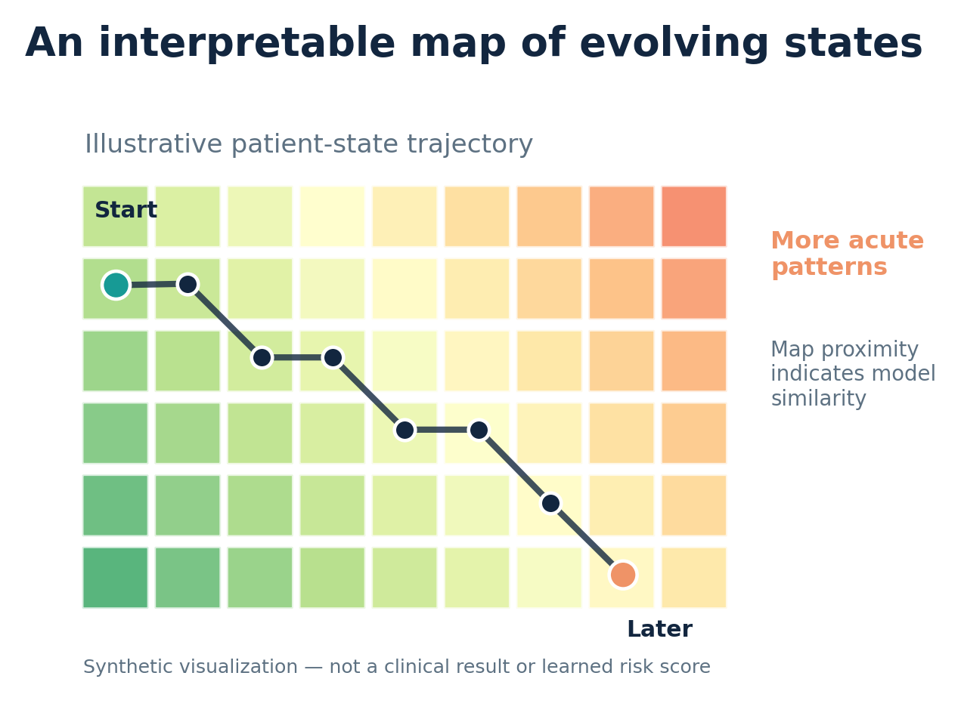
METHOD 3
SOM-VAE and T-DPSOM: explaining state trajectories
What the map adds
Nearby cells represent similar learned prototype states.
T-DPSOM connects patient-state trajectories and uncertainty.
Illustration at left is synthetic.
Sources: Fortuin et al. (2019), ICLR; Manduchi et al. (2021), ACM CHIL | Synthetic map
10
Notes:
Another family uses self-organizing maps, which arrange related prototype states in a two-dimensional grid. SOM-VAE combines this idea with deep representation learning, while T-DPSOM extends it with probabilistic clustering and temporal dynamics.
The visual on this slide is synthetic. It represents the intuition behind the approach, not a real learned medical model. We can imagine following a patient's trajectory across prototype states as their condition changes. The original T-DPSOM study uses ICU data and shows how such maps can highlight clinical characteristics and uncertainty.
I find this much more communicative than a list of numeric cluster IDs. Still, a clean map can hide model errors or uncertainty, so experts should treat it as decision support rather than a clinical diagnosis.

Slide 11
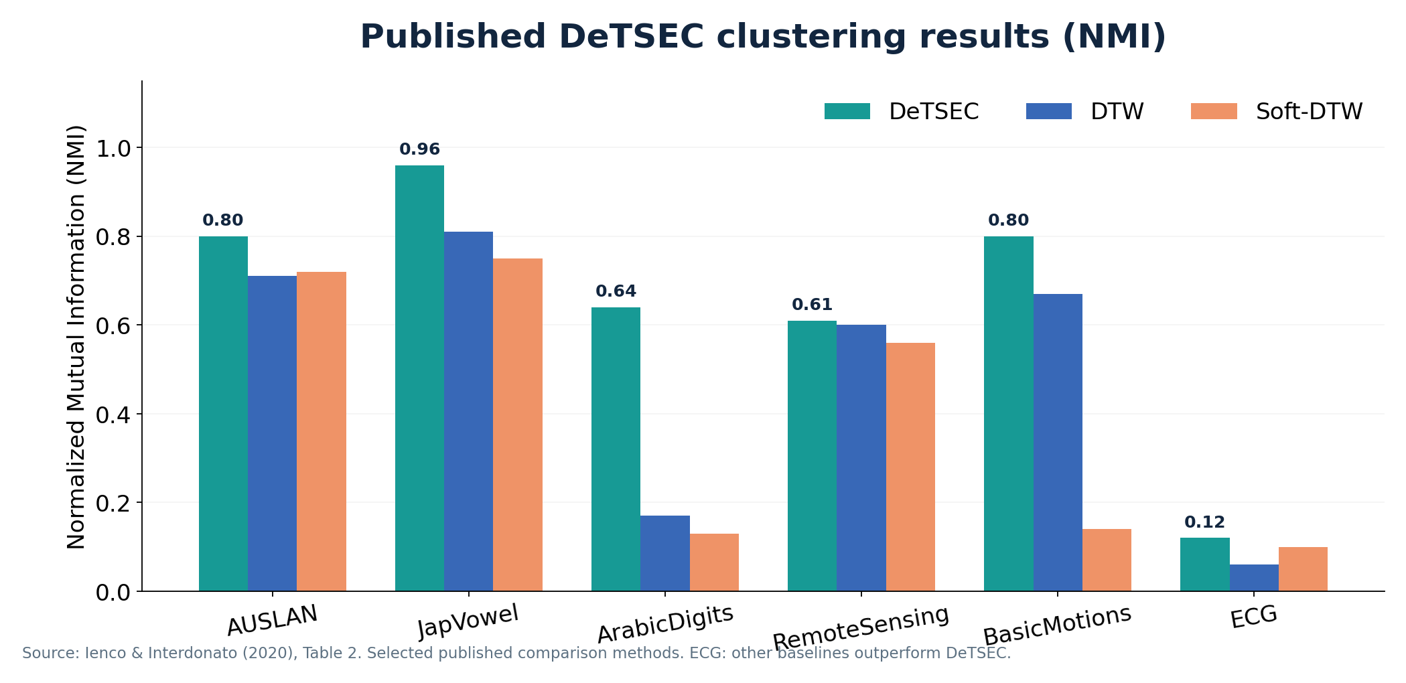
PUBLISHED RESULTS
Clustering quality: example from DeTSEC
Published dataset-specific NMI scores. They do not measure explainability.
Source: Ienco & Interdonato (2020), original DeTSEC paper, Table 2 (selected NMI scores)
11
Notes:
This chart summarizes selected NMI results from Table 2 of the original DeTSEC paper. NMI, or normalized mutual information, measures how closely cluster assignments correspond to reference labels used for evaluation. Higher is better on these benchmarks.
On AUSLAN, DeTSEC achieves an NMI of 0.80, compared with 0.71 for DTW and 0.72 for soft-DTW. On ArabicDigits, DeTSEC reaches 0.64 while DTW reaches 0.17. Its performance is strong on several other datasets too.
But notice the ECG result. DeTSEC is not the best approach in that benchmark. This is important: no algorithm wins everywhere, and the right method depends on data characteristics.
Also, these are clustering-quality numbers, not measurements of how accurate or faithful an explanation is. They were published by DeTSEC's authors; I did not reproduce their training experiments.

Slide 12
ABLATION STUDIES
An ablation asks: what happens without a component?
DeTSEC ablation
Time2Feat ablation
Compare the full architecture with variants excluding gating or the backward path.
Question: which neural components improve clustering?
Compare performance with and without feature selection.
Finding: fewer features generally improve compactness, efficiency, and often AMI.
Ablation ≠ explanation validation.
Sources: Ienco & Interdonato (2020), DeTSEC; Bonifati et al. (2022), Time2Feat
12
Notes:
An ablation study removes or changes one part of a system and examines what happens. In DeTSEC, the ablations investigate components such as gating and the backward recurrent path. They help tell us whether those neural choices matter for grouping quality.
Time2Feat asks a different ablation question. What happens if we remove feature selection? The authors find that feature selection substantially reduces the number of features, often improves adjusted mutual information, and helps efficiency and interpretability across tested datasets. That is a more direct analysis of a design choice related to understandable features.
My own conclusion is that a strong future ablation should go further: remove the explanation component and measure both clustering performance and explanation faithfulness. Otherwise, we know what helps prediction or grouping, but not whether the reported explanation is trustworthy.

Slide 13
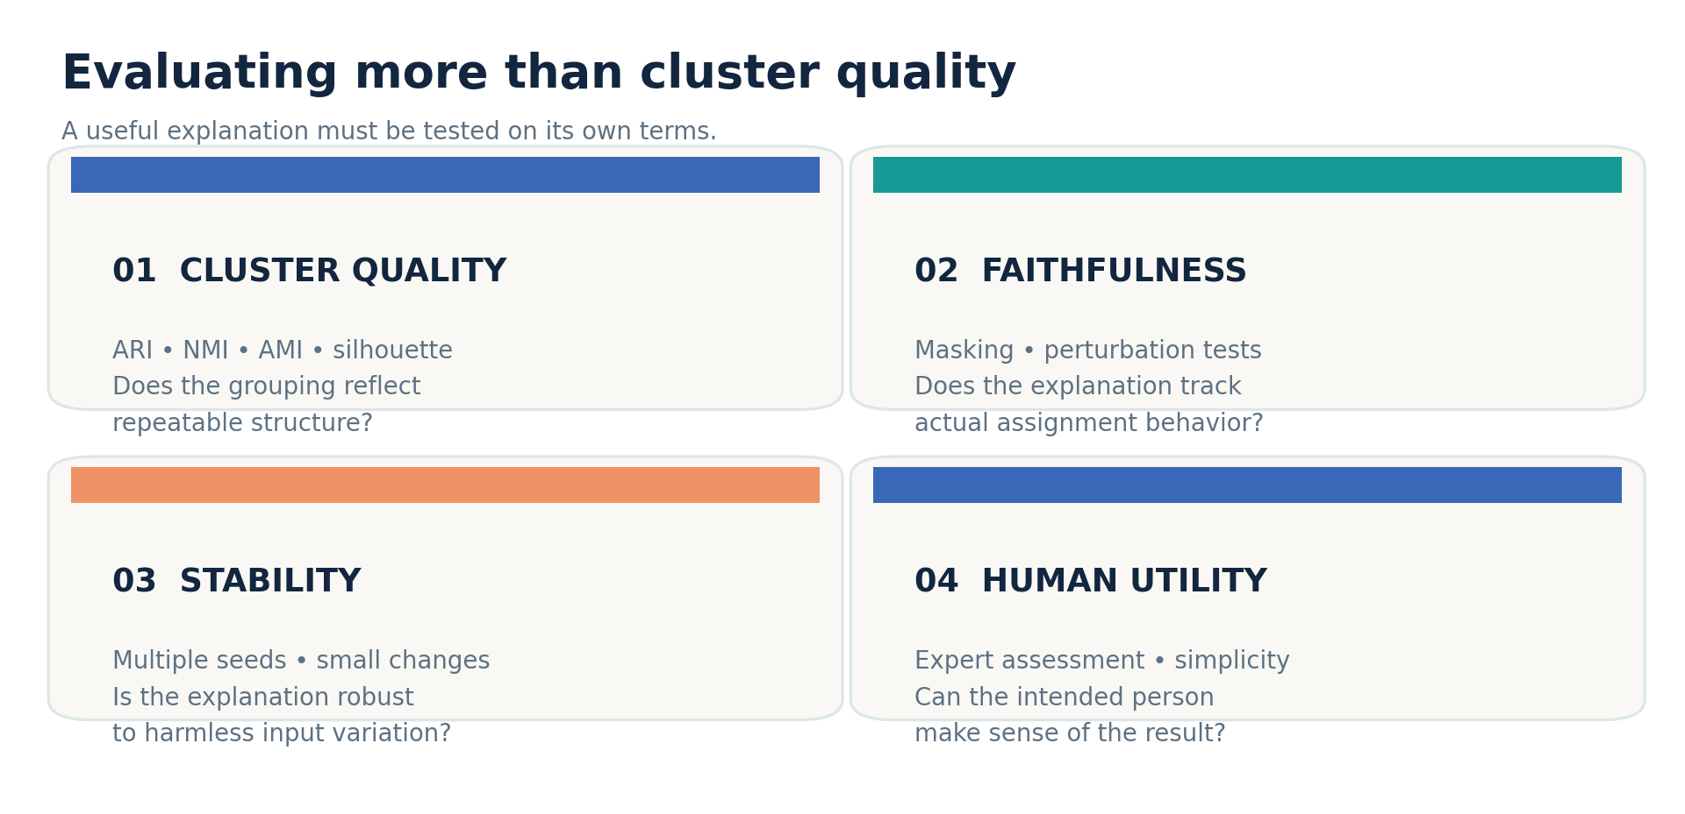
EVALUATION
How to test explanation quality as well as clusters
Source: Schlegel et al. (2025), arXiv:2507.20840
13
Notes:
The survey identifies explanation evaluation as a major open problem. In clustering, we often do not know the true reasons that groups exist. Even benchmark labels do not provide a ground-truth explanation.
I would evaluate four separate dimensions. First, grouping quality, measured with NMI, ARI, AMI, or internal metrics such as silhouette. Second, faithfulness: if I remove a supposedly important interval, does the model's assignment actually change? Third, stability: do small harmless changes produce wildly different explanations? Fourth, human usefulness: can the intended user understand and act on the explanation?
This multi-part evaluation is the core of my critique. A model should not be called explainable just because someone can plot its latent vectors or attention weights.

Slide 14
APPLICATIONS
The right explanation depends on the audience
Healthcare
Finance
Patient-state maps, waveform motifs, uncertainty.
Transaction-history rhythms; auditable segment rules.
Industrial IoT
Climate & mobility
Vibration signatures, anomalous sensor patterns.
Seasonal, environmental, and traffic flow regimes.
Application overview: Schlegel et al. (2025) | Examples summarized illustratively
14
Notes:
These ideas matter in several domains. In healthcare, clinicians may want patient-state trajectories or recognizable waveforms. In banking, analysts may want a rule explaining why transaction histories fall into the same behavioral segment. In industrial IoT, engineers may want characteristic vibration signatures or sensor patterns. In climate and traffic analysis, researchers may care about seasonal variation and evolving operating regimes.
The finance and engineering descriptions here are illustrative scenarios, not experimental claims from this presentation.
The common question is: explainable to whom? A doctor, engineer, and risk analyst are unlikely to prefer the same form of explanation. I think explanation quality has to be measured with the user and the domain in mind.

Slide 15
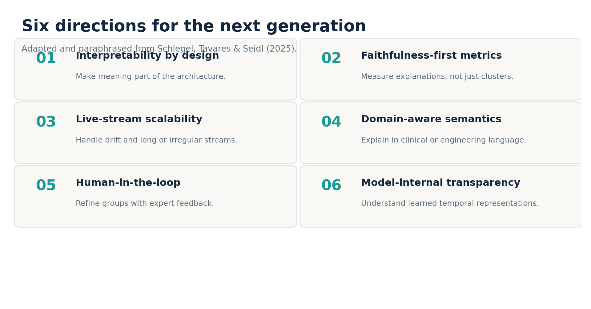
FUTURE RESEARCH
Six gaps the survey asks the field to solve
Source: Schlegel et al. (2025), arXiv:2507.20840
15
Notes:
The survey closes with six research directions. First, build interpretability into high-performing architectures instead of attaching it afterward. Second, create reliable faithfulness metrics for unsupervised explanations. Third, make explanation systems work on large and streaming datasets, including changing data distributions. Fourth, use domain knowledge so explanations speak the language of real practitioners. Fifth, include human feedback during clustering. Sixth, investigate the meaning of the internal features that deep models learn.
My proposed future experiment would hold an encoder and dataset fixed, then compare attention-only, prototype-only, and hybrid explanations. I would report NMI or ARI, perturbation faithfulness, stability, explanation length, and expert preference. That design would let us assess what each explanation strategy really adds.

Slide 16
CONCLUSIONS
A good cluster should tell a testable story
• Deep embeddings can reveal hidden temporal structure.
• Shapelets, attention, prototypes and maps explain different facets.
• Good clustering scores do not automatically imply faithful explanations.
• Next step: benchmark explanation usefulness, stability and cost.
Thank you • Questions?
Sources: Schlegel et al. (2025); Ienco & Interdonato (2020); Bonifati et al. (2022); Fortuin et al. (2019); Manduchi et al. (2021); El Amouri et al. (2023)
16
Notes:
To conclude, deep clustering is about discovering structure in unlabeled sequential data. Explainable deep clustering adds a second requirement: the discovered structure should make sense to humans, and we should be able to test whether the explanation is faithful.
DeTSEC illustrates expressive recurrent representations. CDPS provides interpretable shapelets. SOM-VAE and T-DPSOM provide structured maps and trajectories. Time2Feat shows the value of selecting compact, meaningful features.
The paper's most useful contribution, in my opinion, is to push us beyond the idea that a high clustering score and a good visualization are enough. Trustworthy time-series analytics need meaningful groups, reliable explanations, and evaluation across both.
Thank you for listening. I am happy to take questions.

