Slide 1
Data-Driven
Investment Strategies
BS-CS-26-141
Literature Review
Dec 2025
Risk-Adjusted Performance Measures & a Novel Exponential-Fit Approach
Nehoray Sade & Aviv Asraf
Advisor: Dr. Dvir Roos
SCE — Sami Shamoon College of Engineering

Slide 2
Project at a Glance
What We're Building
Data & Technology
A data-driven tool that computes, visualizes, and compares risk-adjusted performance metrics for any stock — and introduces a new exponential-fit metric that measures the consistency of compounding returns.
Yahoo Finance API
Real-time & historical price data
The 5 Classical Ratios Covered:
Python / Pandas
Data processing & ratio computation
Sharpe
Sortino
Treynor
Information
Calmar
Log-Linear Regression
Novel Approach — Exponential-Fit Metric
Exponential-fit stability metric
By fitting a log-linear regression to historical price data, we measure how consistently an asset compounds returns over time. High R² = stable compounding. This complements classical ratios by capturing structural stability, not just volatility.
Streamlit App
Interactive web dashboard

Slide 3
The App
Stock Risk / Return Ratio Dashboard
Select any stock or ETF ticker
Choose time period & rolling window
Pick one or all 5 risk-adjusted ratios
Compare two stocks side by side
Manual calculation inputs shown
risk-return-ratio.streamlit.app

Slide 4
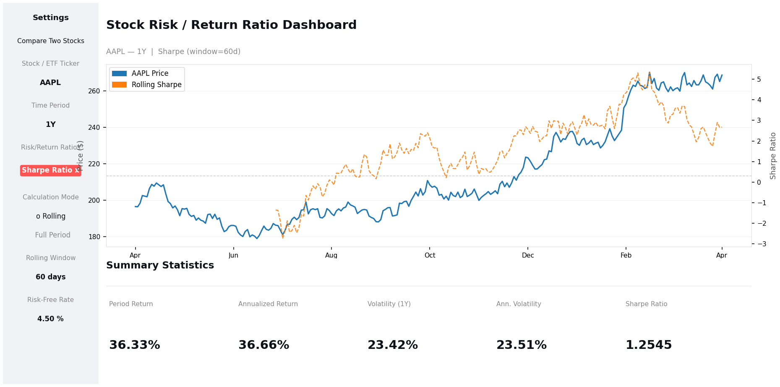
Single Stock Analysis
What You See
Price line
Solid blue line tracks the stock's historical price
Rolling ratio
Dotted orange = rolling Sharpe (60-day window)
Summary stats
Period return, volatility & full-period ratio at a glance
Inputs panel
Formula variables shown for full transparency
Example: AAPL — 1Y — Rolling Sharpe (window=60d)

Slide 5
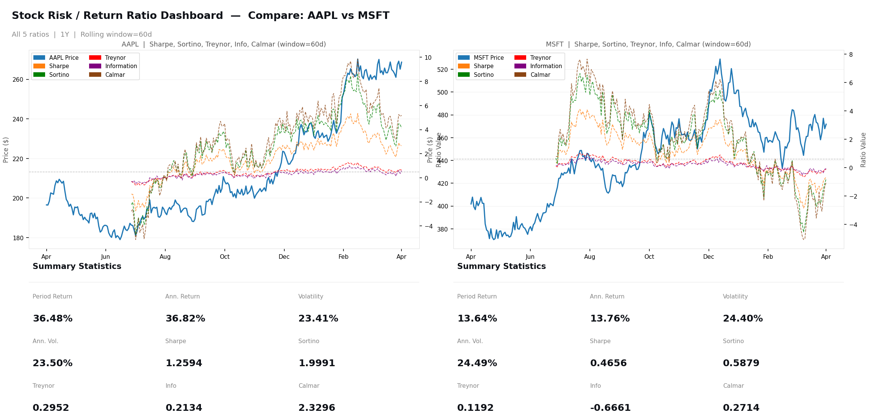
Compare Two Stocks — All Ratios
All 5 ratios plotted simultaneously — enabling direct comparison of Sharpe, Sortino, Treynor, Information & Calmar across any two assets over any time period.

Slide 6
Summary & Next Steps
Try the App
Built a full interactive dashboard for risk-adjusted performance analysis
risk-return-ratio
.streamlit.app
5 classical ratios implemented: Sharpe, Sortino, Treynor, Information, Calmar
Rolling and full-period calculation modes with customizable parameters
Live Demo
Side-by-side stock comparison with all ratios simultaneously
Next: empirical validation of the novel exponential-fit metric
Nehoray Sade & Aviv Asraf | Advisor: Dr. Dvir Roos | SCE, 2025

