Slide 1
Data-Driven
Investment Strategies
Risk-Adjusted Performance Measures & a Novel Exponential-Fit Approach
Nehoray Sade & Aviv Asraf
Advisor: Dr. Dvir Roos
SCE — Sami Shamoon College of Engineering

Slide 2
Project at a Glance
What We're Building
Data & Technology
A data-driven tool that computes, visualizes, and compares risk-adjusted performance metrics for any stock — and introduces a new exponential-fit metric that measures the consistency of compounding returns.
yfinance
Live & historical data from Yahoo Finance
The 5 Classical Ratios Covered:
pandas + numpy
Rolling ratio computation on price Series
Sharpe
Sortino
Treynor
Information
Calmar
Plotly
Novel Approach — Exponential-Fit Metric
Interactive dual-axis charts (price + ratio)
By fitting a log-linear regression to historical price data, we measure how consistently an asset compounds returns over time. High R² = stable compounding. This complements classical ratios by capturing structural stability, not just volatility.
Streamlit
Web dashboard — sidebar controls & metrics

Slide 3
The App
Stock Risk / Return Ratio Dashboard
Select any stock or ETF ticker
Choose time period
Pick one or all 5 risk-adjusted ratios
Compare two stocks side by side
Manual calculation inputs shown
risk-return-ratio.streamlit.app

Slide 4
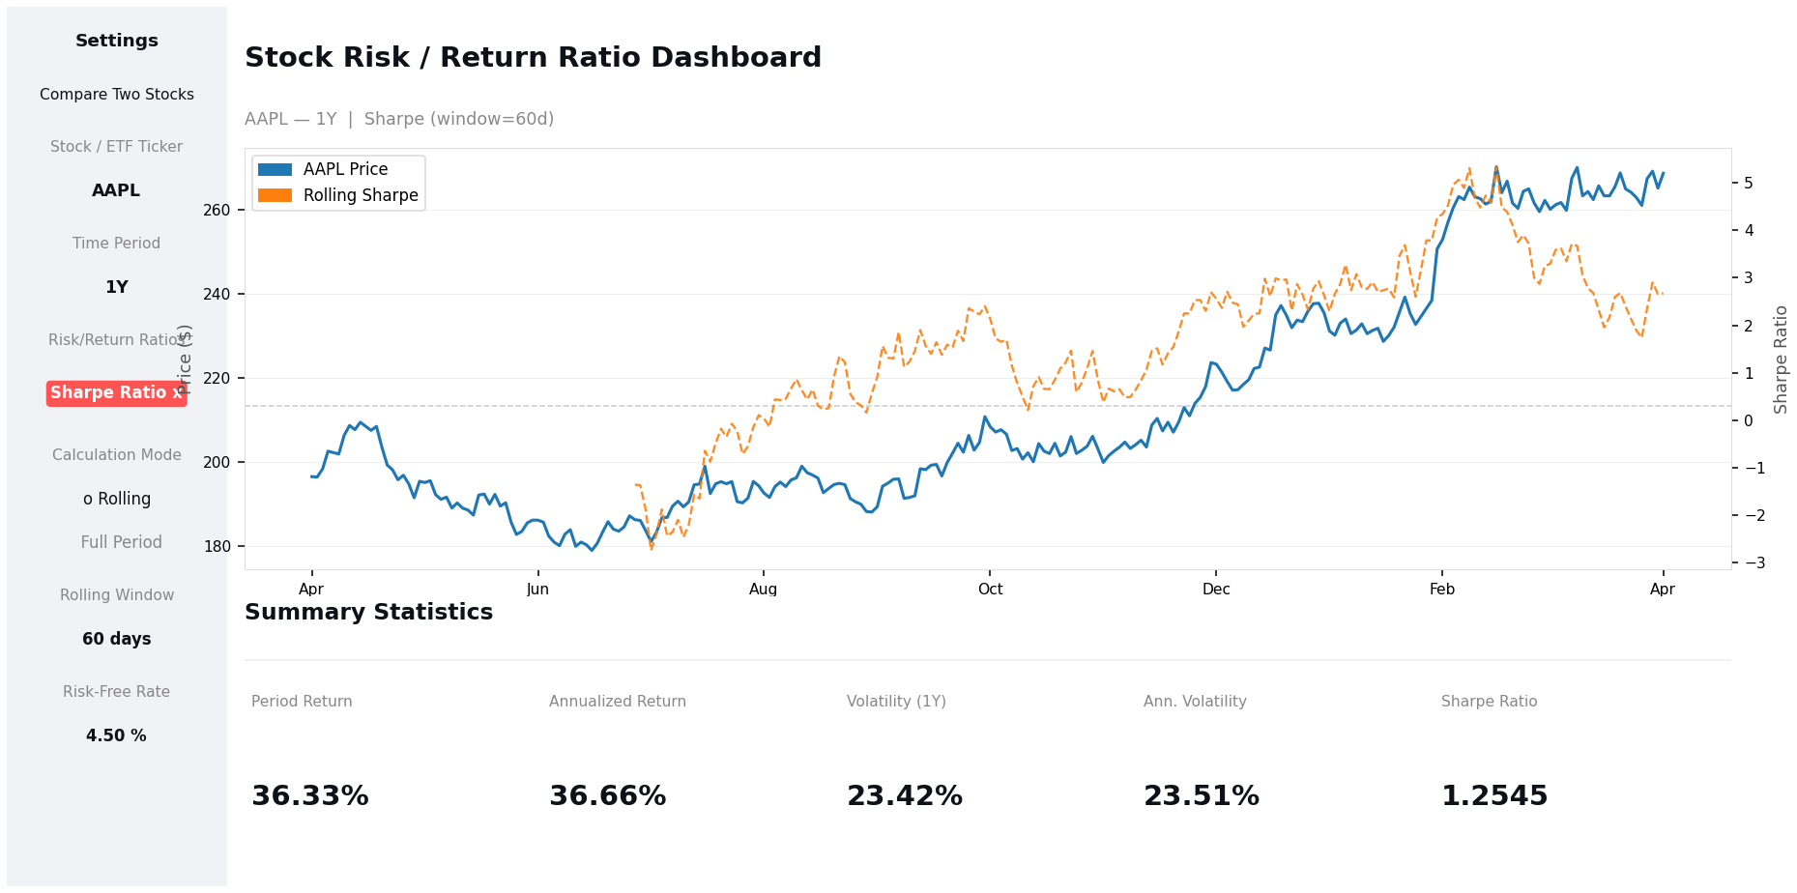
Single Stock Analysis
What You See
Price line
Solid blue line tracks the stock's historical price
Rolling ratio
Dotted orange = rolling Sharpe (60-day window)
Summary stats
Period return, volatility & full-period ratio at a glance
Inputs panel
Formula variables shown for full transparency
Example: AAPL — 1Y — Rolling Sharpe (window=60d)

Slide 5
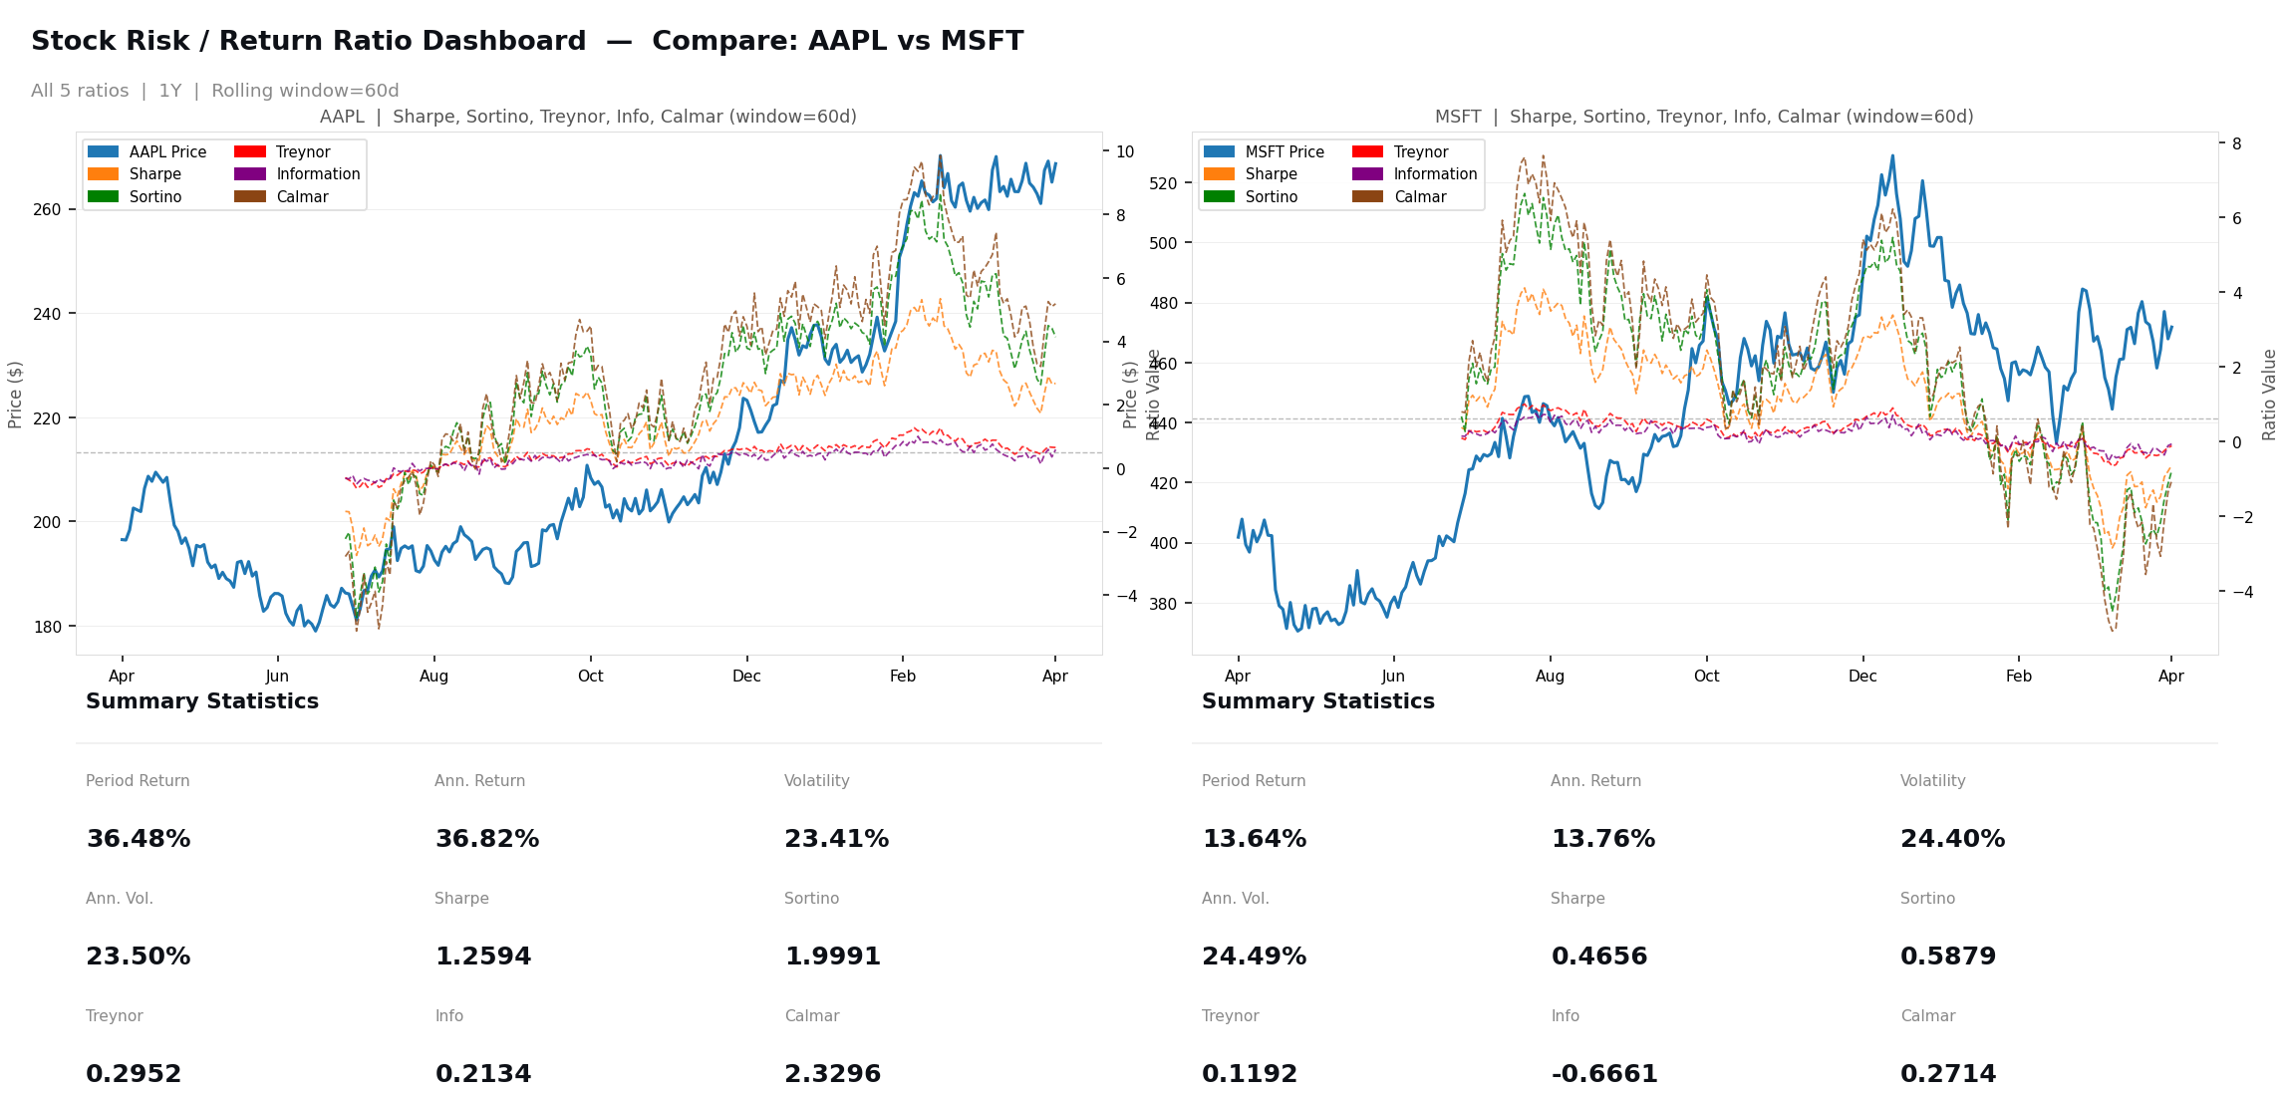
Compare Two Stocks — All Ratios
All 5 ratios plotted simultaneously — enabling direct comparison of Sharpe, Sortino, Treynor, Information & Calmar across any two assets over any time period.

Slide 6
Summary & Next Steps
Try the App
Built a full interactive dashboard for risk-adjusted performance analysis
risk-return-ratio
.streamlit.app
5 classical ratios implemented: Sharpe, Sortino, Treynor, Information, Calmar
Rolling and full-period calculation modes with customizable parameters
Live Demo
Side-by-side stock comparison with all ratios simultaneously
Nehoray Sade & Aviv Asraf | Advisor: Dr. Dvir Roos | SCE, 2025

Slide 7
So, What’s next?
risk-return-ratio.streamlit.app

