Slide 1
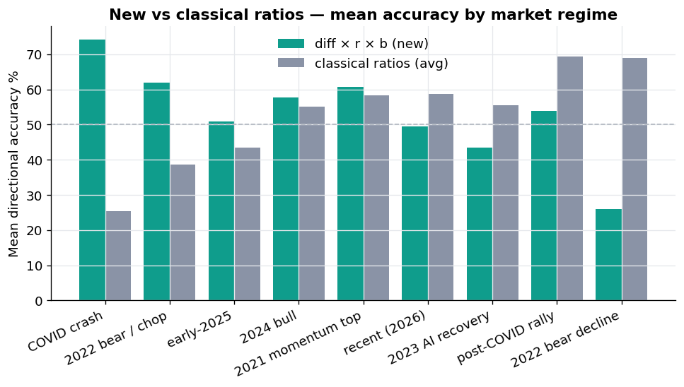
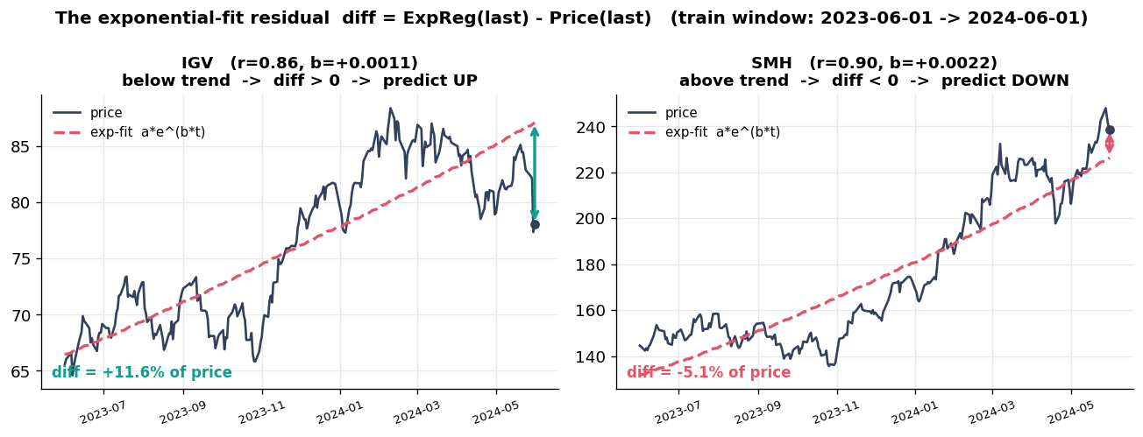

Computer Sciences
Screen number: 2
Students: Nehoray Sade & Aviv Asraf
Advisor: Dr. Dvir Ross
Data-Driven
Risk-Adjusted
Performance Analysis
1
Introduction
3
Methodology & Experiment
4
Results
This project studies five classical risk-adjusted ratios and proposes a complementary structural metric, diff × r × b, based on exponential regression of asset prices. The goal is to examine whether this new metric captures information that the classical ratios miss, and to identify the market conditions in which each approach performs better.
Fit ln(P) = a + b·t on the training window to get three factors:
diff = trend − price → mean-reversion signal
r = exp-fit quality (Pearson corr.)
b = log-growth slope → direction
2
The Ratios & New Score
Mean directional accuracy of the new score (teal) versus the average of the five classical ratios (grey) for each market era. The dashed line marks the 50% coin-flip baseline
Sharpe excess return / total volatility
Sortino excess return / downside risk
5
Conclusion & Future Work
Treynor excess return / market beta
No single metric wins everywhere. The mean-reversion score and classical ratios are complementary — the market regime decides which to trust.
Information active return / tracking error
Calmar annual excess return / max drawdown
diff = how far price sits from its exponential trend — the core directional signal.
• Add transaction costs & slippage to P&L
• Multi-factor regression scoring (vs. product)
• Regime detector to auto-switch metric
New score: Score = diff × r × b
Exp-regression factors on the train window; the score's sign predicts UP or DOWN (zero → FLAT).
180
configurations
100
ETFs
9
market eras
Scan to try it
Live tool: risk-return-ratio.streamlit.app

