Slide 1
Risk-Adjusted Performance Analysis Based on Data
Research project — summary report for a Bachelor of Science (B.Sc.) degree
Nehorai Sadeh and Aviv Asraf | Supervised by Dr. Dvir Ross | Department of Computer Science, Sami Shamoon College of Engineering, Be'er Sheva | 02/06/2026

Slide 2
Abstract
The project examines the Sharpe, Treynor, Calmar, Sortino, and Information ratios, and proposes a new metric: \text{diff} \times r \times b. The metric is derived from an exponential regression on the asset price.
diff
r
b
Distance of the current price from the trend line
Correlation coefficient — quality of fit to the trend
Daily growth slope
Across 100 ETFs over 9 market regimes, the new metric acts as a mean-reversion signal, while the classical ratios behave as momentum signals. Combining them according to the market regime outperforms each one individually.

Slide 3
The Five Classic Ratios
Each ratio highlights a different aspect of risk and is suited to different market conditions:
Sharpe (1966)
Excess return per unit of total volatility
Sortino (1994)
Excess return per unit of downside volatility only
Treynor (1965)
Excess return per unit of systematic risk (β)
Information (1989)
Consistency of outperformance versus benchmark
Calmar (1991)
Annual return relative to max drawdown

Slide 4


The new metric: \text{diff} \times r \times b
We fit an exponential model y = a \cdot e^{bt} to the historical price (OLS regression on log-price):
r — Fit quality
b — Growth slope
\text{diff} — Price deviation
Pearson correlation between log-price and time (|r| \leq 1)
Daily growth rate (log-growth rate)
ExpReg(last) − Price(last): signed distance from the trend
Price below the trend + positive trend → positive score → predicted UP (mean reversion)

Slide 5

Experiment Design
Step 1: Training Window
Step 3: Evaluation
Compute the 6 metrics on 100 funds.
Directional accuracy and long/short portfolio return.
Step 2: Test Window
Observe direction and realize returns.
The experiment includes a systematic scan of 180 configurations (9 periods × 5 training windows × 4 test windows) across 100 exchange-traded funds (ETFs). Each metric is converted into a directional forecast: a positive score predicts an increase, and a negative score predicts a decrease. In addition, a dollar-neutral long/short portfolio is constructed (10 assets on each side, weights proportional to |score|, with a strict cap on the short side).

Slide 6
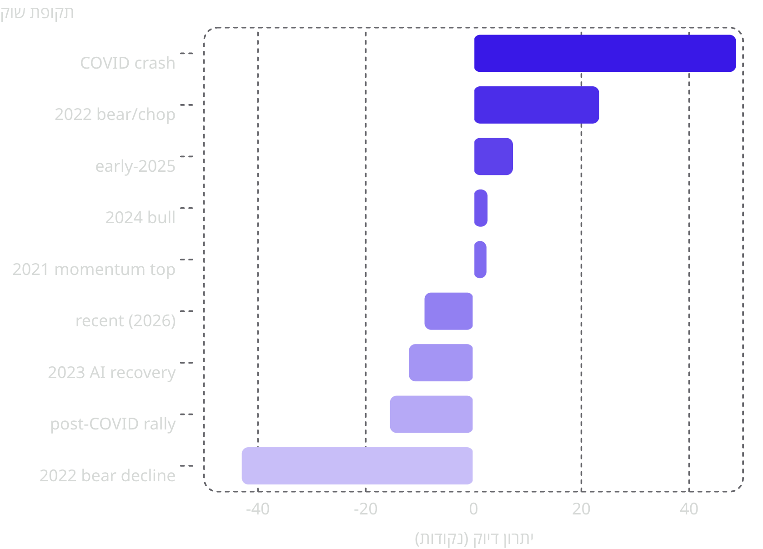
Global Results: Regime-Dependent Edge
Key takeaway
The new metric wins at turning points and in volatile markets, and loses in persistent trends. The pattern is not random — it is the signature of a mean-reversion signal versus a momentum signal.
The new metric wins
Classic ratios win
Reversals + volatile markets
Persistent trends

Slide 7
Case Studies A and B — The New Metric Wins
CASE A — COVID CRASH REBOUND
CASE B — 2022 CHOPPY BEAR TAPE
Directional accuracy: 96.9% vs 9.2%
Directional accuracy: 90.0% vs 22.6%
The training window ended near the March 2020 bottom. Almost all ETFs sat below their exponential trend → large positive diff → predicted UP. The classic ratios, depressed by catastrophic returns, forecast continued decline. Long/short portfolio return: +10.9% vs −8.8%.
Q4 2022 — a market with no clear direction, mean-reverting. Extended names below trend snapped back, names above it faded. Long/short portfolio return: +8.1% vs +2.4%. This shows the advantage is not unique to a single crash.

Slide 8

Case Studies C & D — Classical Ratios Win
CASE C — POST-COVID MOMENTUM RALLY
CASE D — 2022 SUSTAINED DECLINE
Directional accuracy: 2.0% vs 93.9%
Directional accuracy: 8.1% vs 79.0%
End of 2020 — the market had risen for months. Most ETFs were above their trend → negative diff → predicted pullback that never came. Momentum continued. The classical ratios (momentum signals) were right in almost every case.
Prolonged, directional decline. Names below trend kept falling — the mean-reversion signal "caught a falling knife." Long/short portfolio return: −6.4% vs +7.8%.
When the trend persists, mean-reversion forecasting is systematically wrong — this is the mirror image of case A.

Slide 9
Discussion: Two Complementary Signal Types
The new metric — Mean-Reversion
The classic ratios — Momentum
Positive when price is below a stable trend. Predicts a return to trend. Wins in reversals and volatile markets.
Large after strong risk-adjusted returns. Predict continuation. Win in sustained trends.
The literature (Jegadeesh & Titman, 1993; Daniel & Moskowitz, 2016) documents "momentum crashes" in reversals — Case A is a classic example. The takeaway: regime-aware combination — switching between the two types according to volatility, trend strength, or the size of diff — is expected to outperform either family on its own.

Slide 10
Future Work and Conclusions
Next Step: Walk-Forward Backtest
Research Conclusions
The current experiment uses static windows. A natural extension is a rolling training window day by day/month by month, recalculating metrics and rebalancing portfolios — to create a continuous equity curve.
The \text{diff} \times r \times b metric is a mean-reversion signal, not a replacement for the classic ratios
The classic ratios behave in practice as momentum signals — direct empirical evidence
The two types of metrics are complementary, not competing
Regime-based combination outperforms any single metric on its own
Testing whether the regime-dependent edge survives sequential rebalancing
Evaluating regime filters (volatility, trend strength, diff size) cycle by cycle
Exposure to transaction costs, turnover, and short-borrow constraints

