Slide 1
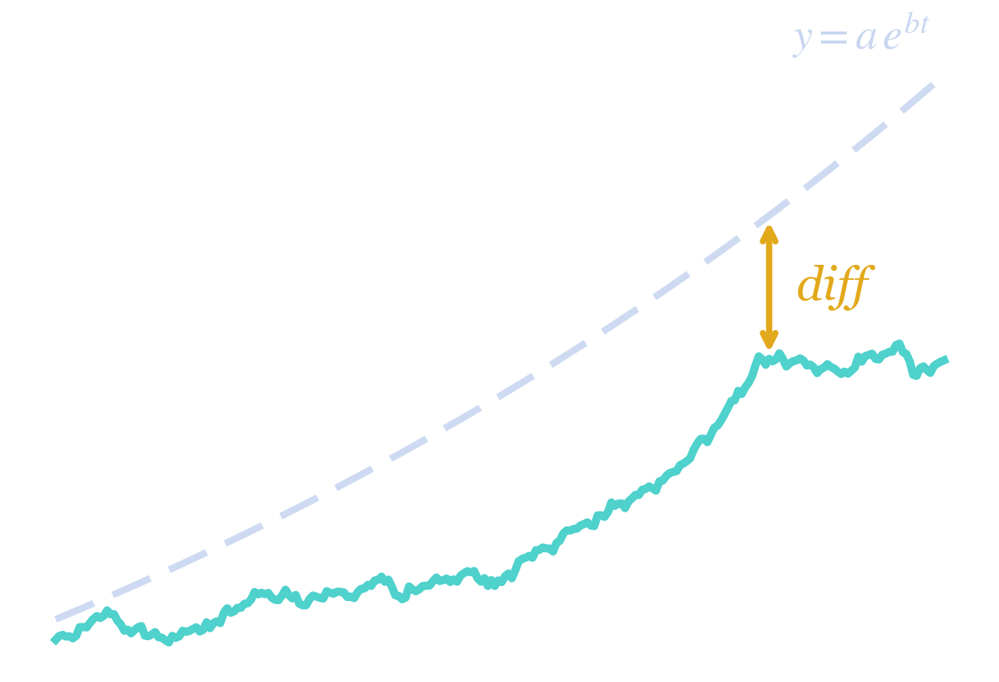
B.SC. RESEARCH PROJECT · SUMMARY REPORT
Risk-Adjusted Performance Analysis Based on Data
Five classic ratios, one new metric — diff × r × b — tested across 100 ETFs and 9 market regimes.
Nehoray Sade · Aviv Asraf
Supervised by Dr. Dvir Ross · Department of Computer Science, Sami Shamoon College of Engineering, Be'er Sheva · June 2, 2026

Slide 2
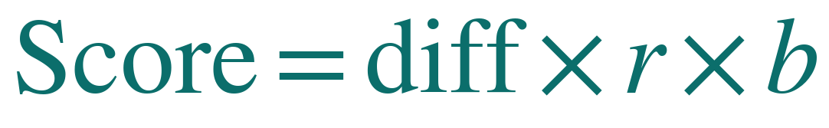
ABSTRACT
One new metric against five classics
The project examines the Sharpe, Treynor, Calmar, Sortino and Information ratios, and proposes a new metric derived from an exponential regression on the asset price.
Price deviation
diff
Distance of the current price from the trend line
Fit quality
r
Correlation coefficient — quality of fit to the trend
Across 100 ETFs and 9 market regimes, the new metric acts as a mean-reversion signal, while the classic ratios behave as momentum signals.
Combining them according to the market regime outperforms each one individually.
Growth slope
b
Daily growth rate of the fitted trend
2

Slide 3
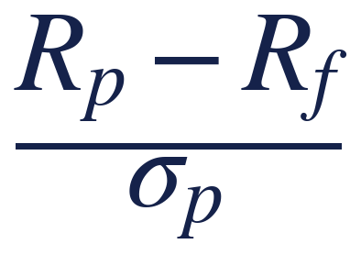
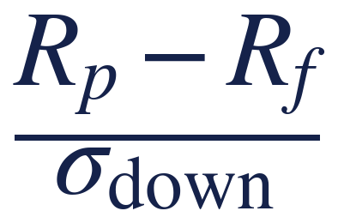
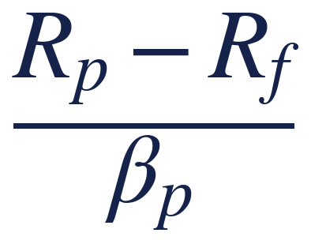
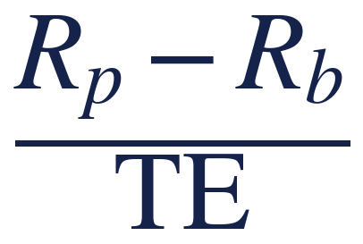
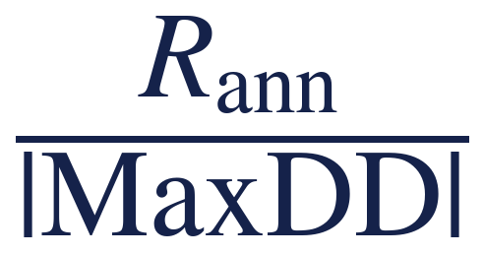
THE MOMENTUM FAMILY
The five classic ratios
Each ratio highlights a different aspect of risk — and all five reward strong recent risk-adjusted returns.
Sharpe · 1966
Sortino · 1994
Treynor · 1965
Excess return per unit of total volatility
Excess return per unit of downside volatility only
Excess return per unit of systematic risk (β)
Information · 1989
Calmar · 1991
Consistency of outperformance versus benchmark
Annual return relative to maximum drawdown
3

Slide 4
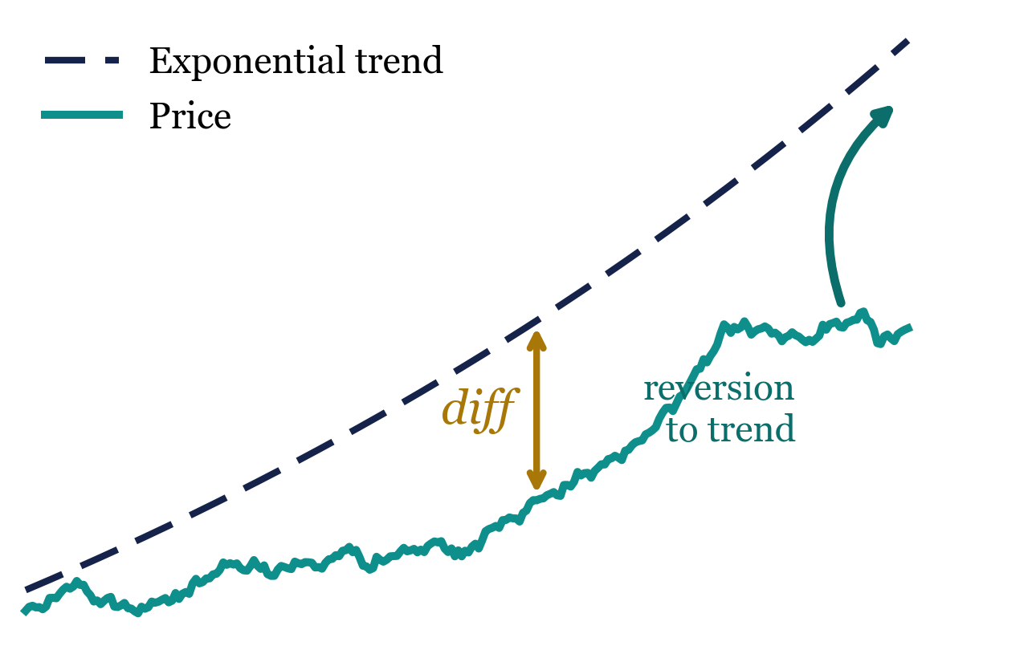
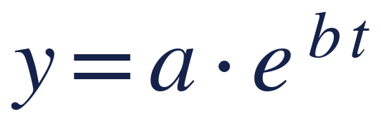
THE NEW METRIC
Score = diff × r × b
We fit an exponential model to the historical price — an OLS regression on log-price:
r
Fit quality
Pearson correlation between log-price and time (|r| ≤ 1)
b
Growth slope
Daily growth rate (log-growth rate)
diff
Price deviation
Price below the trend + positive trend → positive score → predicted UP (mean reversion).
ExpReg(last) − Price(last): signed distance from the trend
4

Slide 5
METHOD
Experiment design
100
180
9
5 × 4
exchange-traded funds
configurations scanned
market regimes
training × test windows
1
Training window
2
Test window
3
Evaluation
Compute all 6 metrics on each of the 100 funds.
→
Observe direction and realize returns.
→
Directional accuracy and long/short portfolio return.
Each metric is converted into a directional forecast: a positive score predicts an increase, a negative score predicts a decrease.
In addition, a dollar-neutral long/short portfolio is constructed — 10 assets on each side, weights proportional to |score|, with a strict cap on the short side.
5

Slide 6
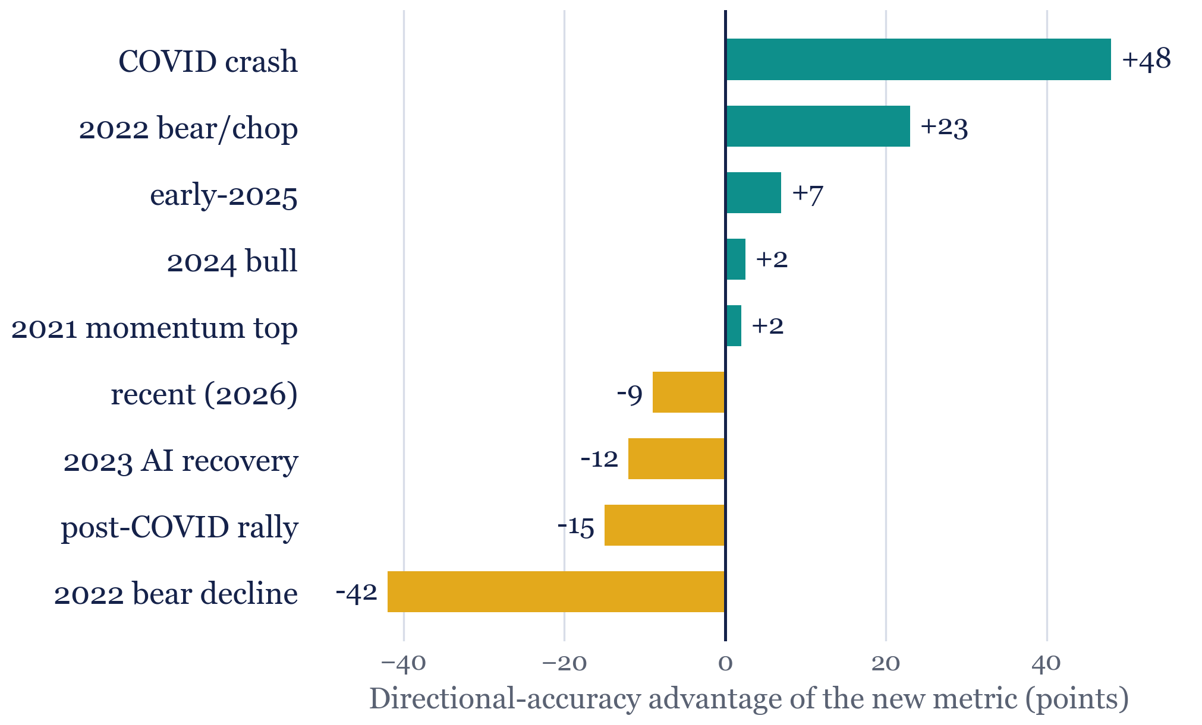
RESULTS
A regime-dependent edge
The new metric wins
Reversals and volatile markets
Classic ratios win
Persistent trends
Key takeaway
The pattern is not random — it is the signature of a mean-reversion signal versus a momentum signal.
6

Slide 7


CASE STUDIES · THE NEW METRIC WINS
When reversion pays
CASE A · COVID CRASH REBOUND (2020)
CASE B · 2022 CHOPPY BEAR TAPE (Q4)
96.9% vs 9.2%
90.0% vs 22.6%
directional accuracy — new metric vs classic ratios
directional accuracy — new metric vs classic ratios
The training window ended near the March 2020 bottom. Almost all ETFs sat below their exponential trend → large positive diff → predicted UP. The classic ratios, depressed by catastrophic returns, forecast continued decline.
A market with no clear direction — mean-reverting. Extended names below trend snapped back; names above it faded. The advantage is not unique to a single crash.
Long/short return: +10.9% vs −8.8%
Long/short return: +8.1% vs +2.4%
7

Slide 8


CASE STUDIES · THE CLASSIC RATIOS WIN
When the trend persists
CASE C · POST-COVID MOMENTUM RALLY
CASE D · 2022 SUSTAINED DECLINE
2.0% vs 93.9%
8.1% vs 79.0%
directional accuracy — new metric vs classic ratios
directional accuracy — new metric vs classic ratios
End of 2020 — the market had risen for months. Most ETFs were above their trend → negative diff → predicted a pullback that never came. Momentum continued; the classic ratios were right in almost every case.
A prolonged, directional decline. Names below trend kept falling — the mean-reversion signal “caught a falling knife.”
Long/short return: −6.4% vs +7.8%
When the trend persists, mean-reversion forecasting is systematically wrong — the mirror image of Case A.
8

Slide 9
DISCUSSION
Two complementary signal types
The new metric
MEAN REVERSION
Signal positive when price sits below a stable trend
Predicts a return to the trend
Wins in reversals and volatile markets (Cases A, B)
The classic ratios
MOMENTUM
Signal large after strong risk-adjusted returns
Predicts continuation of the move
Wins in sustained trends (Cases C, D)
The literature (Jegadeesh & Titman, 1993; Daniel & Moskowitz, 2016) documents “momentum crashes” at reversals — Case A is a textbook example.
Takeaway: a regime-aware combination — switching between the two signal types according to volatility, trend strength, or the size of diff — is expected to outperform either family on its own.
9

Slide 10
CONCLUSIONS · FUTURE WORK
Complementary, not competing
1
diff × r × b is a mean-reversion signal — not a replacement for the classic ratios.
NEXT STEP
Walk-forward backtest
So far we tested each period separately, like snapshots. The next step is to run the test the way a real investor would: move forward one day at a time, recalculate the metrics, and update the portfolio as we go. This gives one continuous performance line over the years.
It will show two things:
· does our edge survive real, ongoing trading
· does the profit hold up after trading costs
2
The classic ratios behave as momentum signals — direct empirical evidence.
3
The two families are complementary — each wins where the other fails.
4
Regime-based combination outperforms any single metric on its own.
Nehoray Sade · Aviv Asraf | Supervised by Dr. Dvir Ross | Sami Shamoon College of Engineering

