Slide 1

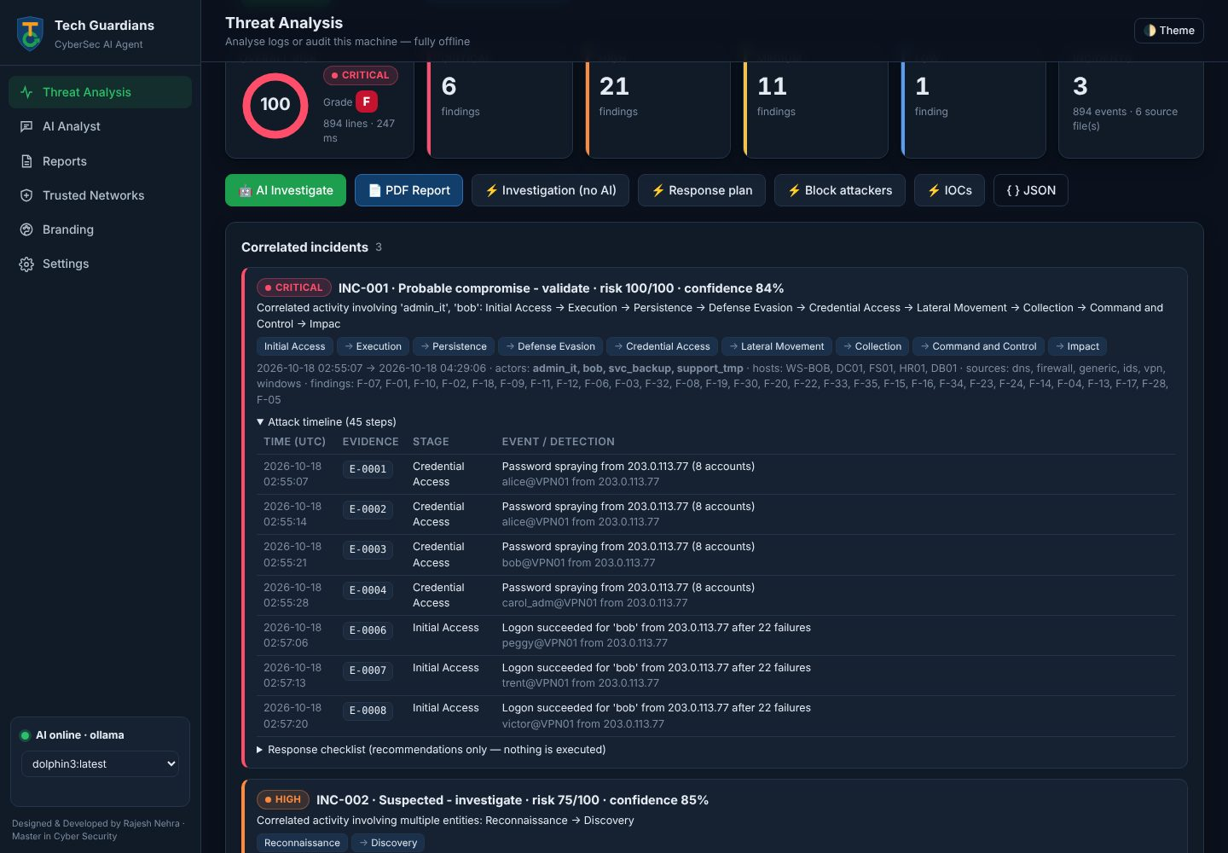
CyberSec AI Agent
Offline, AI-powered SIEM log analysis, investigation and forensics platform
Tech Guardians · Designed & developed by Rajesh Nehra, Master in Cyber Security
Notes:
Introduce the CyberSec AI Agent: a self-hosted platform that analyses security logs, correlates attacks, investigates them with a local uncensored AI model and produces branded forensic reports - fully offline.

Slide 2




Why we built it
Alert overload
SIEMs raise thousands of events; analysts lose the real attack in the noise.
Our answer
One portable tool that turns raw logs into a verified attack story in minutes:
Detects, correlates and scores attacks with explainable rules
Investigates with a local, uncensored AI - nothing leaves the server
Shows what each firewall, server and machine did, step by step
Produces branded A4 reports, forensic guides and live alerts
Logs are sensitive
Credentials, IPs and customer data must not be sent to a cloud AI.
No GPU, small budget
Most SOC servers are CPU-only; commercial AI SOC tools are costly.
Slow investigations
Correlating firewall, VPN, Windows and web logs by hand takes hours.
Notes:
The problems: noise, privacy, no GPUs, and slow manual correlation. The agent solves these locally.

Slide 3
The agent at a glance
70+
10+
8
detection rules
log formats
threat-intel sources
signatures, correlation, UEBA, network, forensics
CSV, JSON, JSONL, Windows XML, syslog, CEF, LEEF, web, .gz
OTX, AbuseIPDB, VirusTotal, URLhaus, ThreatFox, MalwareBazaar, PhishTank, CVE
15
152
0
report sections
automated tests
cloud dependencies
branded A4 PDF with attack diagram and forensic steps
incl. 39 security regression tests
runs offline on a 64 GB, CPU-only Linux server
Notes:
Key numbers. Everything runs on the customer's own server; the only optional online feature is the threat-intelligence look-up, which is off until keys are added.

Slide 4







Working process: from raw logs to a verified story
1
2
3
4
5
6
7
Ingest
Parse
Detect
Correlate
Score
Investigate
Report
Upload, paste, SIEM forward (HTTPS / syslog), host audit
Auto-detect format, map fields, normalise time zones
70+ rules: signatures, thresholds, UEBA, threat intel
Link findings by actor into incidents and kill chains
Severity, confidence, risk, trust context - kept separate
Local AI writes the story, citing evidence IDs
PDF, forensics guide, live alerts, history
Evidence-first: every finding, timeline row and AI statement points to an evidence ID (E-0001…) that maps to the original file and line. Trusted networks are context, never an exemption - nothing is hidden.
Notes:
Seven stages. Analysis is streaming, so multi-GB exports are processed without loading everything into memory (about 9,000 events per second on a CPU).

Slide 5






How detection works
Signatures
Correlation
UEBA
SQLi, XSS, traversal, Log4Shell, web shells, encoded PowerShell, mimikatz, reverse shells
Brute force → success, password spraying, lateral movement, kill-chain ordering
Per-account baselines: hours, sources, hosts, privileges, peers - explainable scores
Network & statistics
Threat intelligence
Forensic integrity
Port scans, beaconing, exfiltration volume, DNS tunnelling, DGA, gaps
Offline IoC feeds, learned indicators and 8 optional online sources
Log clearing, audit-policy changes, time anomalies, telemetry gaps
Notes:
Every rule carries severity, confidence, ATT&CK mapping, false-positive guidance and the telemetry needed to validate it.

Slide 6
Behind the agent: architecture
Inputs
Analysis engine
Context & intelligence
Outputs
Upload / paste
parsers.py
trust.py (your assets)
Web UI + Live window
SIEM → HTTPS ingest
detector · engine · rules
memory.py (learning)
A4 PDF report
Syslog UDP / TCP
pipeline.py (correlate, score)
reputation.py (8 sources)
Forensic guide / JSON
Linux host audit
flow.py · forensics.py
investigator.py + local LLM
History (logs + SHA-256)
Data stays on the server: config/ and data/ are owner-only (0700/0600); the AI model is reached on 127.0.0.1 only.
Notes:
Four lanes: inputs, the deterministic engine, context and intelligence, outputs. The AI never sees raw logs - it receives a compact case file built by investigator.py.

Slide 7
Inside the code: what each module does
Module | Responsibility
agent.py | Web server, API, login (password / token), HTTPS, CLI
parsers.py | Format detection, streaming readers, field mapping, time zones
detector.py · engine.py · rules.py | Signature rules, structured rules, UEBA, statistics, rule catalogue
pipeline.py | Evidence register, correlation into incidents, risk scoring, SOAR checklist
flow.py · forensics.py | Action taken per device, attack flow & diagram, forensic playbooks
investigator.py | AI case file, deterministic investigation, answer validation
trust.py · memory.py | Trusted networks & assets, learning memory (verdicts, IoCs, sightings)
reputation.py · live.py | Threat-intel sources, live SIEM receiver and rolling analysis
history.py · report_pdf.py | Stored analyses with original logs, 15-section A4 PDF
Notes:
About 12,800 lines of Python and HTML in a dozen modules - each one testable on its own.

Slide 8






Front of the agent: the web interface
Threat Analysis
risk, findings, incidents, IOCs, reputation
AI Analyst
chat and one-click AI investigation
Forensics
tabs per attack type + attack diagram
History & Learning
stored logs, re-analyse, what was learned
Live analysis
separate window for SIEM-forwarded logs
Trust · Branding · Settings
your assets, logo, AI and intel keys
Notes:
Single-file web app: no build step, dark and light themes, works in any modern browser, protected by a strict Content-Security-Policy.

Slide 9
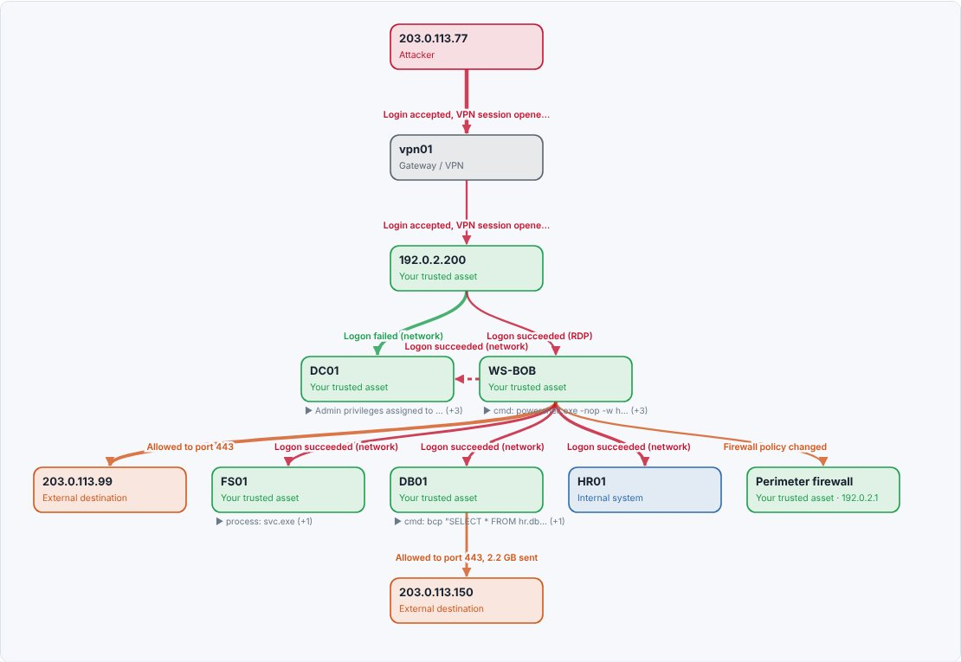
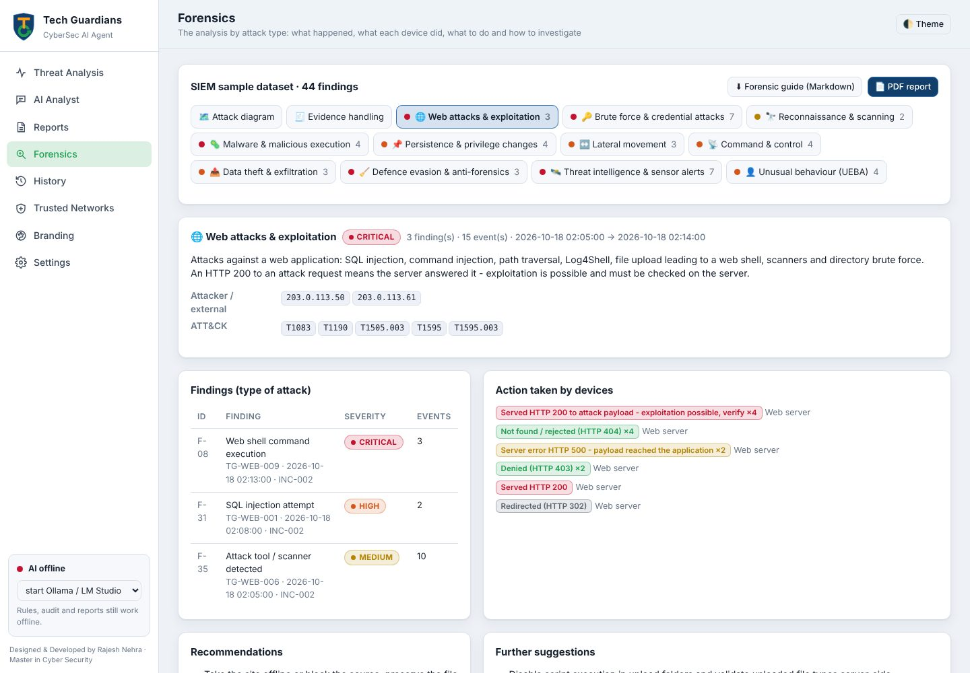
See the attack: action taken, diagram, forensics
Attack diagram: attacker → VPN → workstation → servers → C2 / exfiltration, coloured by outcome
Forensics tab: type of attack, action taken by devices, recommendations, forensic steps, read-only commands
Notes:
Every event records what the firewall, IDS, VPN, server or machine did - allowed, blocked, served HTTP 200, executed. Red means the attacker succeeded; green means blocked.

Slide 10




The AI investigation agent
Case file
Local LLM
Validation
Report
Compact facts: incidents, flow, findings, trust, memory, reputation
Ollama / OpenAI-compatible: dolphin3, qwen3:30b-a3b - on CPU
Checks cited evidence IDs, flags 'confirmed' and claimed actions
Narrative, attack flow, benign explanations, queries, priorities
Ground rules for the AI
Cites evidence IDs for every claim - never invents evidence
Incidents are 'suspected' or 'probable' until an analyst validates them
Recommends only: it never blocks, disables or executes anything
Works without AI too: a deterministic investigation with Splunk, KQL and grep queries
Notes:
The model is uncensored so it explains attacker techniques openly, but its output is validated against the evidence register.

Slide 11

Threat intelligence: 8 sources, privacy first
AlienVault OTX
AbuseIPDB
VirusTotal
URLhaus
IP · domain · URL · hash
IP
IP · domain · URL · hash
URL · host · payload
pulses, malware families
abuse confidence, reports
engine detections
malware distribution URLs
ThreatFox
MalwareBazaar
PhishTank
CIRCL CVE
IP · domain · URL · hash
file hash
URL
CVE ID
C2 & botnet IOCs
malware family / signature
verified phishing sites
CVSS, affected products
Off by default and on request only. Only the indicator value is sent - never log lines. Private, internal and your own (trusted) addresses are refused. URLs are looked up, never submitted. Responses are size-capped, cached and rate-limited; redirects are refused so API keys can't leak.
Notes:
Malicious results automatically join the local IoC feed, so the next analysis matches them offline.

Slide 12
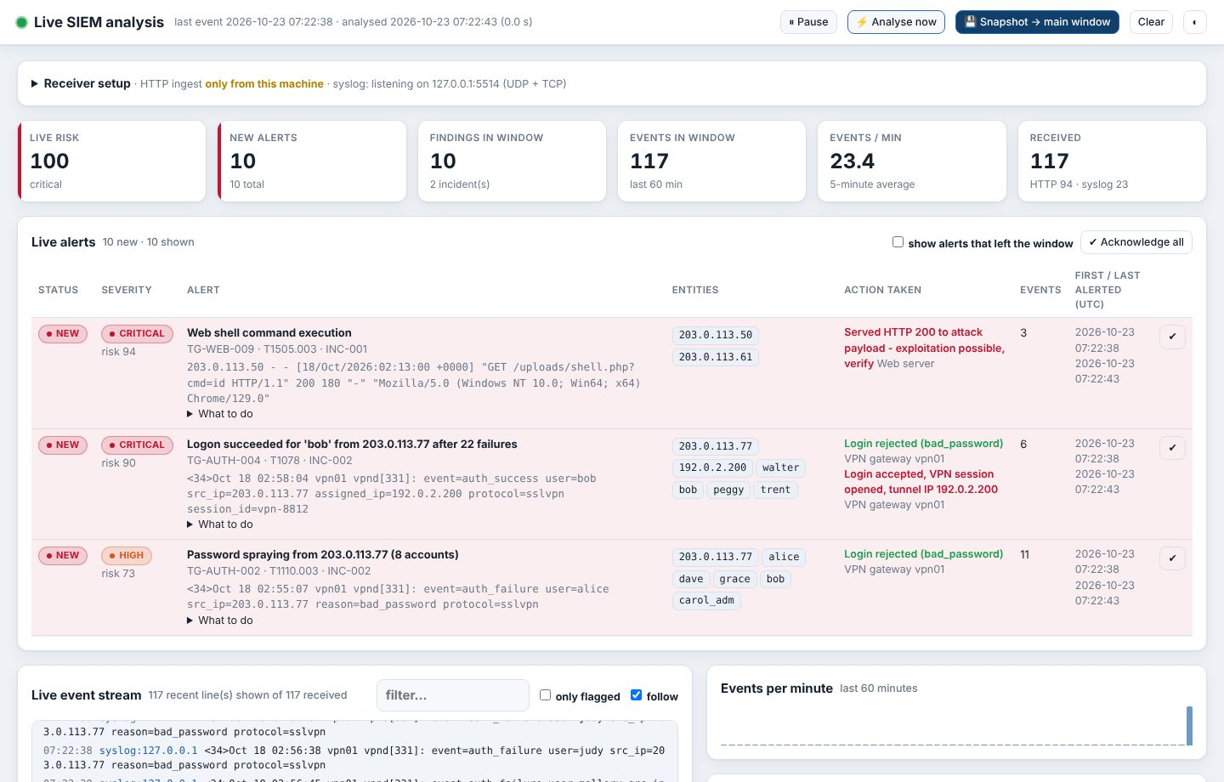
Live analysis of SIEM-forwarded logs
SIEM
Splunk · Wazuh · Graylog · Elastic · rsyslog
Receiver
HTTPS + ingest token, or syslog UDP/TCP
Rolling window
last 60 min re-analysed every 20 s
Live alerts
new / acknowledged, action taken, flagged stream
Snapshot
to History → diagram, forensics, AI, PDF
Notes:
A separate window. The receiver has a token, an optional source allow-list, memory and disk budgets, and keeps a 7-day raw spool that survives restarts.

Slide 13




The agent learns from your data
Analyst verdicts
Learned IoC feed
True / false positive on a finding adjusts confidence and risk for the same rule and entity next time
Confirmed and reputation-malicious indicators are matched offline in every later analysis
Sightings & prevalence
UEBA baselines
"Seen in 3 earlier analyses" and "this rule never fired before" from the history
Normal behaviour per account, learned from stored logs - each log set once
No model retraining: a CPU can't fine-tune, and weights trained on attacker-controlled logs could be poisoned. The memory is reviewable and removable in the UI, it never hides a finding, and severity never changes.
Notes:
The AI case file includes this organisation memory, so the local model answers with what the team already knows.

Slide 14





Framework & technology stack
Backend
AI
Frontend
Python 3.8+ standard library
http.server, ssl, threading, socketserver
No web framework, no database
Ollama or any OpenAI-compatible server
dolphin3 (uncensored), qwen3:30b-a3b
CPU-tuned, model kept in RAM
Single-file HTML / CSS / JavaScript
Inline SVG charts and diagrams
No build step, strict CSP
Reporting
Operations
Quality
ReportLab (optional)
15-section A4 PDF, branded
Markdown and JSON exports
Linux + systemd service
HTTPS on 443, http→https redirect
One-command setup script
152 unittest tests (3.10 + 3.13)
Playwright UI checks, PDF layout checks
bandit static analysis + manual VAPT
Notes:
Deliberately dependency-light: the whole core runs on the Python standard library, which makes it portable (USB stick, air-gapped networks) and easy to audit.

Slide 15
Security of the tool: VAPT results
33 findings from a structured code review and attack tests - all fixed and covered by regression tests
1
7
14
10
1
Controls now in place
HTTPS (TLS 1.2+), HSTS, Secure / HttpOnly / SameSite cookies
Strict nonce-based CSP, anti-clickjacking, no-sniff headers
DNS-rebinding and CSRF protection on every request
Atomic login rate limit, PBKDF2 passwords, session revocation
SSRF guard, response caps, no redirects with API keys
XXE refusal; linear-time patterns; line, record and gzip caps
Hostile records isolated; per-analysis memory budget
Thread, memory and disk budgets for the live receiver
Critical
High
Medium
Low
Info
fixed
fixed
fixed
fixed
fixed
Method
OWASP-style review of every endpoint, the web UI, parsers and file / network handling; attack reproduction (DNS rebinding, CSRF, XSS, SSRF, slowloris, login brute force, XXE, ReDoS, decompression, disk / memory exhaustion); bandit static analysis; 39 security regression tests run on every change.
Notes:
No tool can honestly be called 100% secure; what matters is a repeatable process: review, attack, fix, test. Re-test after every release and before exposing the agent beyond a trusted network.

Slide 16
Deployment in five steps
1
Install
./scripts/setup-linux.sh --model dolphin3 --service
Reference server
2
Secure the login
CPU: 8-16 cores, no GPU needed
RAM: 64 GB (models stay loaded)
Disk: 1 TB HDD (SSD optional)
OS: Ubuntu / Debian / RHEL
Speed: ~9,000 events/s; 8-20 tokens/s AI
python3 agent.py set-password
3
Turn on HTTPS
python3 agent.py make-cert --port 443
4
Describe your network
Trusted Networks & Assets → import your ranges and servers
5
Connect the SIEM
Live window → turn on → point Splunk / Wazuh at the ingest URL
Notes:
The setup script tunes Ollama for CPU speed (model kept in RAM, flash attention, one request gets all cores) and installs the agent as a systemd service allowed to bind port 443 without root.

Slide 17
What we can do next
Next 3 months
3-6 months
6-12 months
Sigma rule import & export
Email / Slack / Teams alerting from the Live window
Multi-user roles (admin, analyst, viewer)
Docker image and Windows installer
STIX / TAXII and MISP threat-intel feeds
Case management: assignments, notes, SLA
MITRE ATT&CK Navigator export
GPU acceleration and larger models
SOAR actions with an approval workflow
EDR / firewall API integrations
ML anomaly models trained on your history
Multi-tenant MSSP mode with per-client branding
Notes:
The core is in place; the roadmap adds team features, integrations and automation - always with a human approval step.

Slide 18
Thank you
CyberSec AI Agent - offline detection, AI investigation, forensics and reporting on your own server. github.com/nehraeduhub/CyberSecuirty
Notes:
Questions. Demo: upload the sample SIEM dataset, open the incident, the attack diagram, the Forensics tabs and the PDF.

