Slide 1
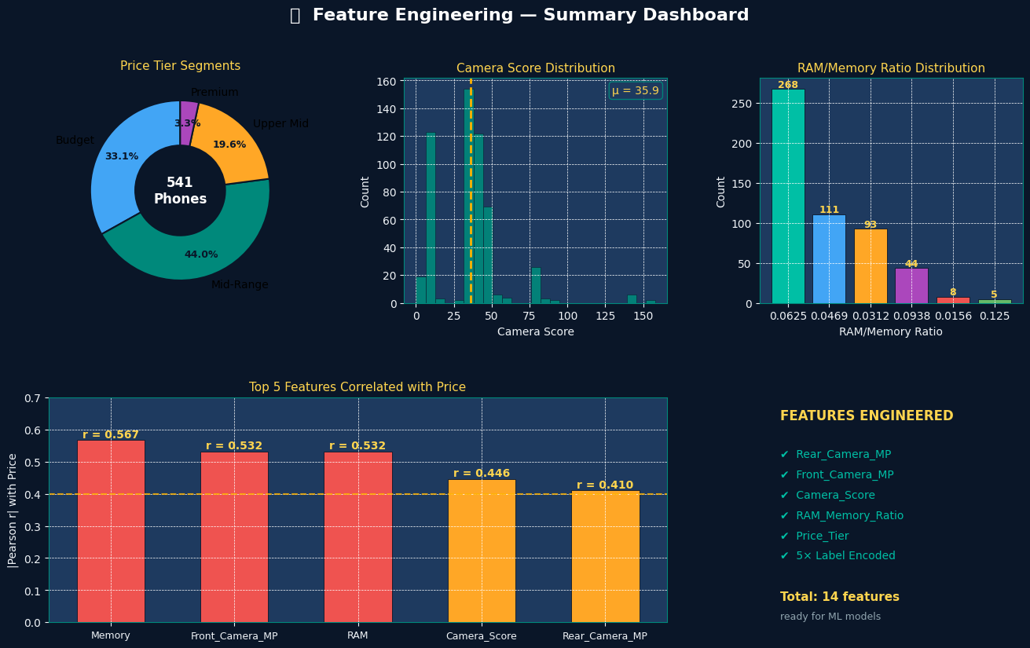
NHIS Project 4
Feature Extraction & Price Prediction Readiness for Mobile Phones
Top-tier final submission prepared for Ma'am
Neha Chhapariya
NHIS Internship Programme
Dataset: Flipkart Mobile Phones • Focus: EDA + Feature Engineering + Model readiness
NHIS Project 4 • Neha Chhapariya • 1

Slide 2
Project framing, workflow, and analytical objective
What the notebook does and how the analysis was structured.
Project objective
Workflow
• Transform raw product attributes into clean, model-ready numeric features. • Study which specifications actually explain mobile-phone prices. • Separate high-signal variables from weak or misleading marketing features. • Finish with a feature set ready for the first regression model.
01
Load and inspect data
04
Visualize pricing behavior and segment shape
02
Fix and clean price / camera fields
05
Rank variables by pricing strength
Dataset snapshot
541 mobile phones were analyzed across pricing, RAM, memory, processor, battery, camera, and other secondary attributes. The notebook also engineers extracted and derived features such as Camera Score, Price Tier, and RAM-Memory Ratio.
03
Detect outliers and build engineered features
06
Prepare final ML-ready dataset
Submission standard
Every key chart is followed by an interpretation that goes beyond description: observation, analytical insight, business meaning, and recommended action.
NHIS Project 4 • Neha Chhapariya • 2

Slide 3
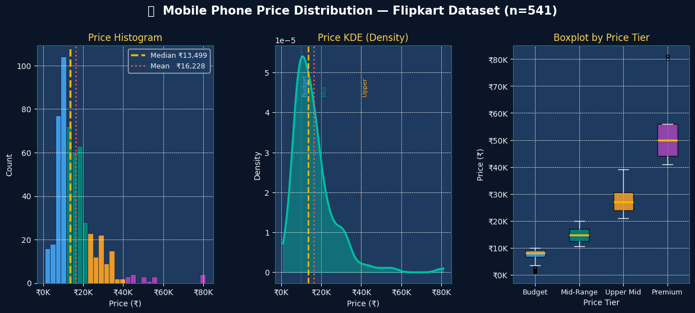
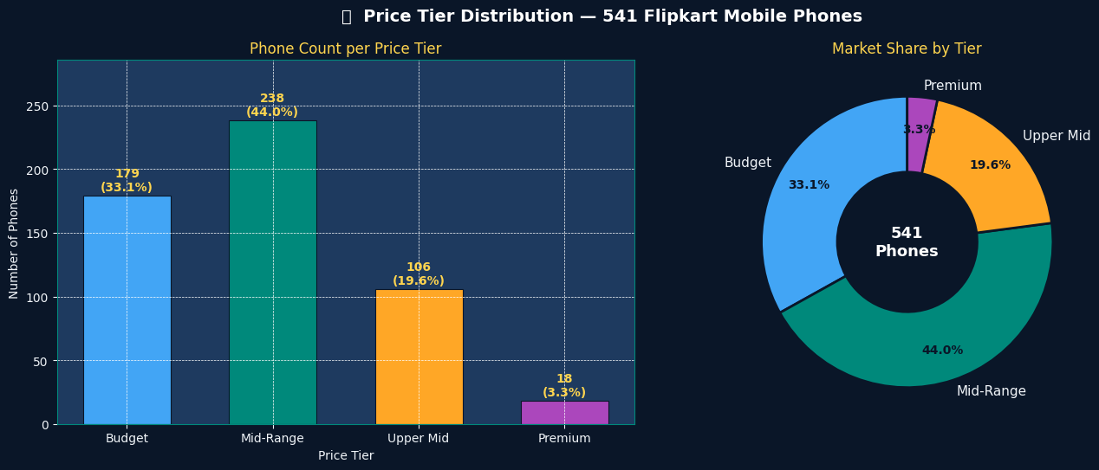
Market shape and pricing landscape
The market is broad in the budget and mid-range bands, while premium remains a narrow tail.
Price distribution
Price tier distribution
What stands out
Commercial reading
Decision implication
Most listings are concentrated below ₹20K. The distribution is right-skewed, which means premium models pull the average upward but do not represent the typical phone in the dataset.
Mid-Range is the center of gravity, Budget is the volume floor, and Premium is a halo segment. This is a classic pyramid market rather than a balanced price spread.
Pricing strategy should be optimized for the ₹10K–₹20K zone first. Premium positioning matters, but mainly for prestige and margin rather than scale.
NHIS Project 4 • Neha Chhapariya • 3

Slide 4
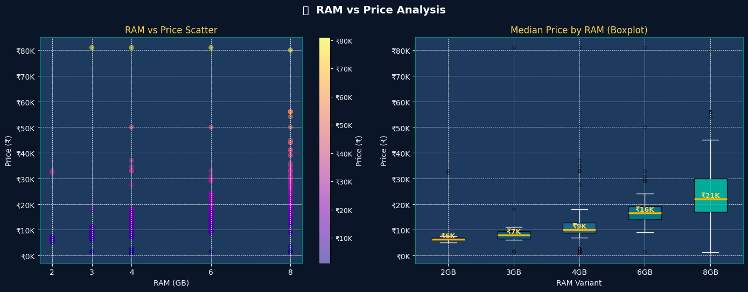
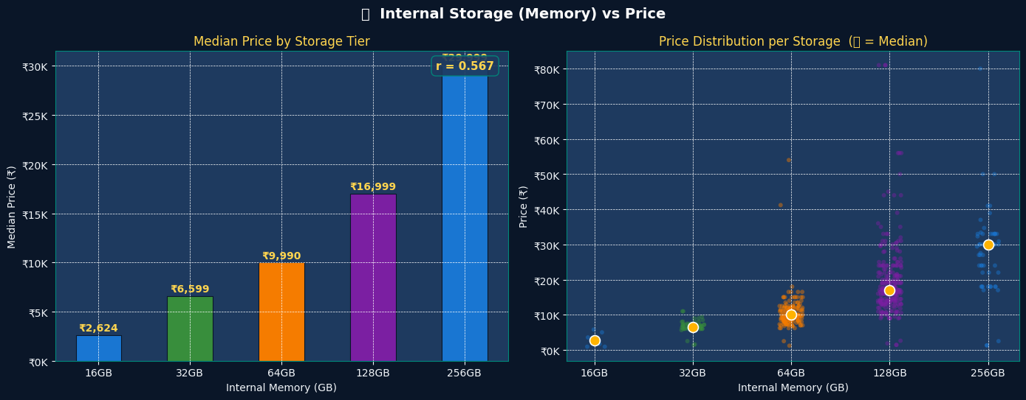
Core price drivers: RAM and internal storage
Configuration variables explain pricing much more clearly than cosmetic or commodity features.
RAM vs price
Storage vs price
Key takeaway
Why it matters
Practical action
RAM is a strong pricing anchor, but storage is the single strongest individual predictor. Consumers reward performance-memory bundles with clean step-up pricing.
4GB and 6GB sit in the volume bands, while 128GB acts like the market sweet spot and 256GB strongly signals premium positioning.
Use RAM + Memory as the main commercial ladder for variant strategy, pricing design, and the first-pass ML feature set.
NHIS Project 4 • Neha Chhapariya • 4

Slide 5
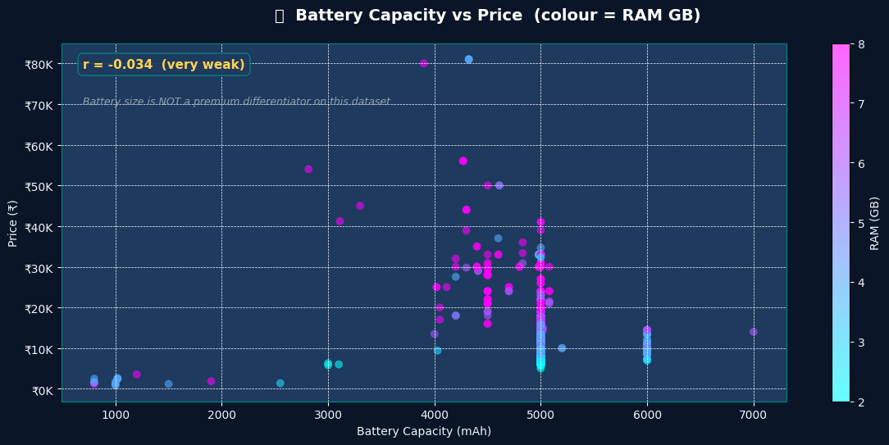
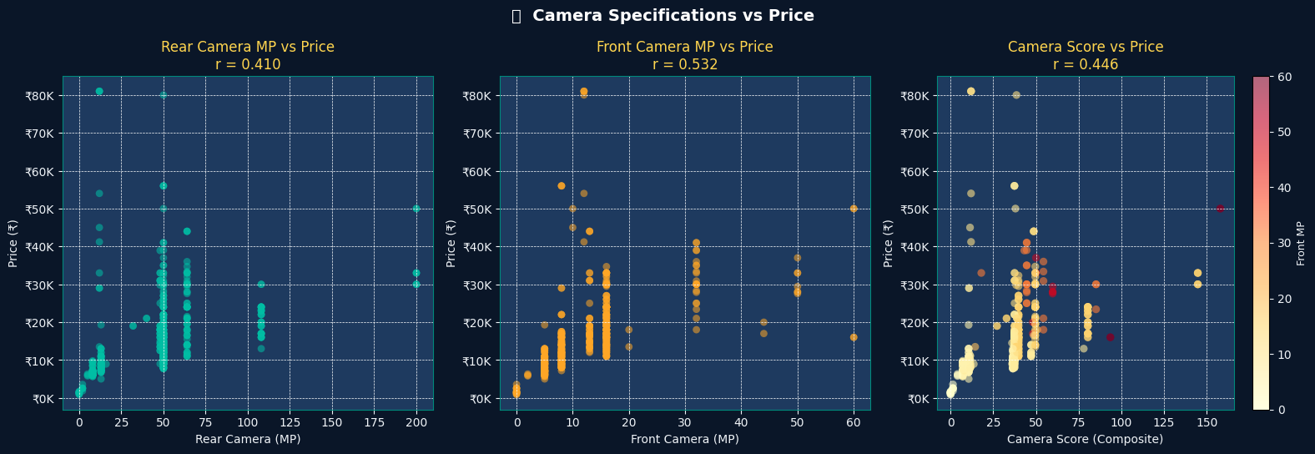
Signal versus noise: battery does not price the market, camera does
This slide separates baseline expectations from true premium signals.
Battery vs price
Camera specifications vs price
Battery finding
Camera finding
Decision implication
Battery capacity is practically neutral in pricing terms. Large batteries now exist everywhere, so they behave like a category-standard feature rather than a price lever.
Camera variables matter. Front camera is especially strong in this dataset, and the engineered Camera Score validates the usefulness of feature engineering.
Message battery as reliability, but use camera quality to support premium storytelling and modelling.
NHIS Project 4 • Neha Chhapariya • 5

Slide 6
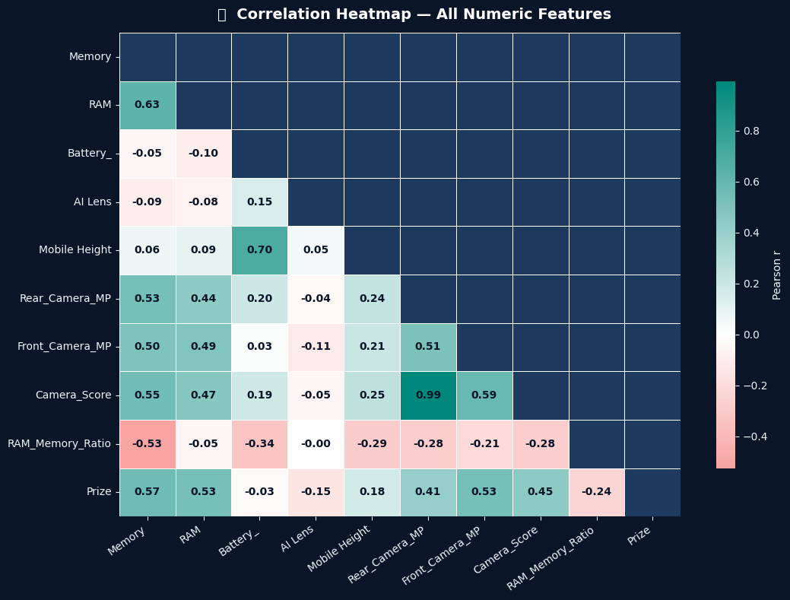
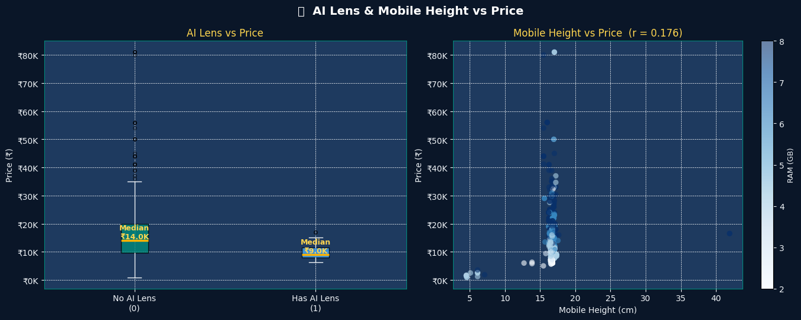
Secondary features and variable relationships
Useful for context, but not all features deserve equal weight in the pricing model.
AI Lens & mobile height
Full correlation heatmap
Secondary-signal lesson
Model design lesson
Recommendation
AI Lens behaves like a budget-marketing label rather than a premium feature. Mobile Height adds only weak signal and should remain secondary.
Memory, RAM, and camera variables form the real premium cluster. Because some of them move together, multicollinearity must be watched in linear models.
For interpretability, monitor overlap among top variables. For prediction strength, tree-based models are naturally well suited here.
NHIS Project 4 • Neha Chhapariya • 6

Slide 7
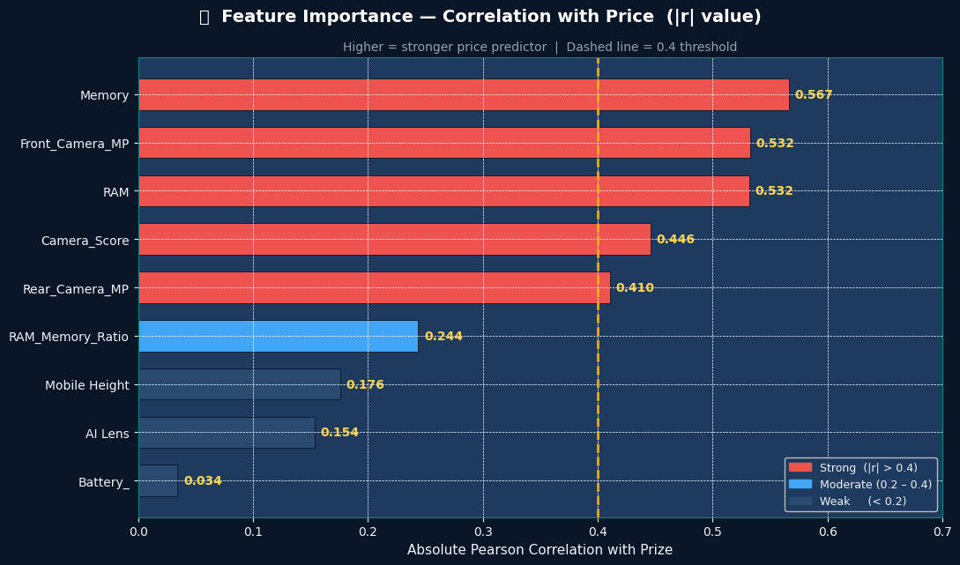
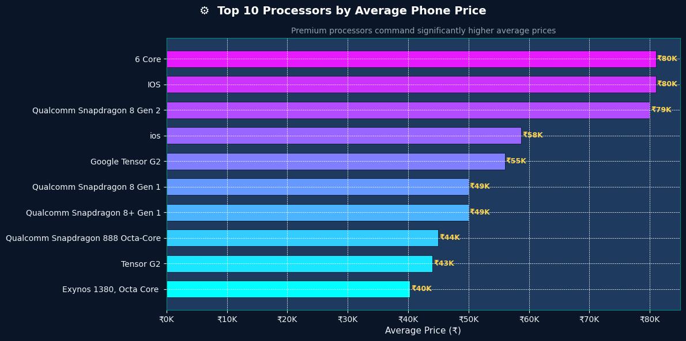
Final ranking of what matters most
The strongest variables are concentrated and interpretable.
Feature importance
Processors by average price
Top predictors
Processor reading
Action
Memory ranks first, followed by Front Camera MP and RAM. Camera Score also performs strongly, which proves the engineered features added analytical value.
Processor family acts as a reliable price-tier proxy. Premium chipsets align with premium positioning, while entry-level chipsets cluster in value-first devices.
Build the first model around the top six features and improve processor encoding in later iterations.
NHIS Project 4 • Neha Chhapariya • 7

Slide 8
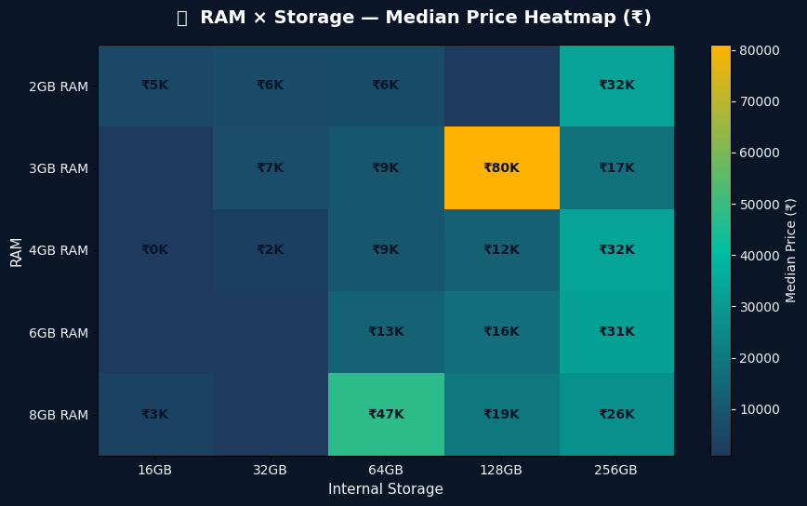
Interaction effects and engineered dataset readiness
The project ends with a dataset that is not just clean, but modelling-ready.
RAM × storage heatmap
Feature engineering summary
Interaction insight
Engineering outcome
Readiness
The highest prices occur when RAM and storage rise together. Balanced high-end configurations matter more than isolated specification upgrades.
Raw text features were converted into structured predictors such as Rear_Camera_MP, Front_Camera_MP, Camera_Score, Price_Tier, and RAM_Memory_Ratio.
The notebook successfully finishes as an ML-ready feature layer, not just a visualization exercise.
NHIS Project 4 • Neha Chhapariya • 8

Slide 9
Model-ready conclusion
A concise view of what should go into the first price-prediction model.
Recommended feature set
Suggested modelling path
Business recommendation
• Memory • RAM • Front_Camera_MP • Rear_Camera_MP • Camera_Score • Mobile Height • Processor_ (improve encoding later)
• Start with Random Forest Regressor as the baseline. • Compare with Linear Regression for interpretability. • Use train/test split and cross-validation. • Evaluate with R², MAE, and RMSE. • Test interaction-aware models if accuracy plateaus.
• Win the Mid-Range tier with clear RAM + storage ladders. • Use camera quality as a premium storytelling lever. • Treat battery as a baseline expectation, not a premium claim. • Design coherent variant bundles, not isolated spec jumps.
Why these features
Expected benefit
They combine strong signal, good business meaning, and practical interpretability. Weak variables such as Battery and AI Lens should not dominate the first model.
The engineered feature set should outperform raw text-heavy inputs and reduce manual preprocessing in the modelling stage.
Bottom line
This project converts descriptive specifications into a commercial pricing logic that is both explainable and ready for machine learning.
NHIS Project 4 • Neha Chhapariya • 9

Slide 10
NHIS Project 4 — Final Presentation
Thank you
Prepared by Neha Chhapariya
Submission note
This deck aligns with the notebook and uses the actual project visuals, refined interpretations, and business-ready recommendations so the final submission reads like a complete analytical story.
Closing message
The project demonstrates end-to-end thinking: data cleaning, feature extraction, EDA, commercial interpretation, and readiness for predictive modelling.
NHIS Project 4 • Neha Chhapariya • 10

