Slide 1
SecureLoop: Design Space Exploration of Secure DNN Accelerators
NEHWS 2024
Kyungmi Lee, Mengjia Yan, Joel S. Emer*, Anantha P. Chandrakasan
MIT, *MIT/NVIDIA

Slide 2

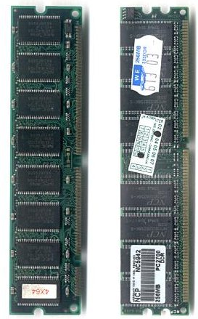

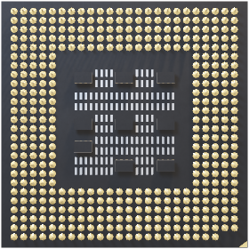
Problem: Off-chip Memory
Off-chip DRAM acts as the main memory for DNN accelerators with large storage footprint
DRAM security vulnerability affecting confidentiality & integrity
Accelerator
DIMM
011001111
Confidentiality
0 1 0 1 0 1 0 1
Integrity
0 1 0 1 1 1 0 1
Monitor metadata
Image source: https://upload.wikimedia.org/wikipedia/commons/b/bc/DIMMs.jpg
Notes:
Off-chip memory: more vulnerable compared to on-chip structures

Slide 3
SecureLoop
A framework for design space exploration of secure DNN accelerators equipped with hardware cryptographic engines
~33% faster,
~50% better EDP
Energy
Secure w/ baseline mapper
Secure w/ our mapper
Unsecure
#Cycles

Slide 4
Source of Overhead: Data Access Granularity Tile != Authentication Block
Tensor Data
Tile
Auth
Block
Tile
Tile
hash
DNN Accelerator
Off-chip Memory
Redundant reads
Can’t get a hash only with this tile data
Fetch extra “redundant” data for hash
additional off-chip traffic
Tile
Secure Accelerator
Tile
Baseline
hash

Slide 5
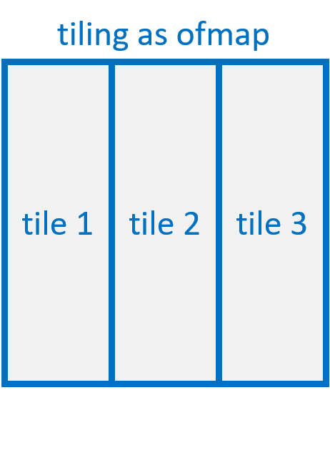
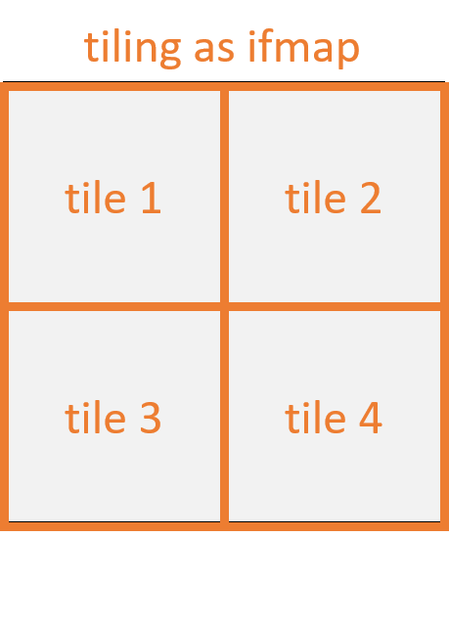
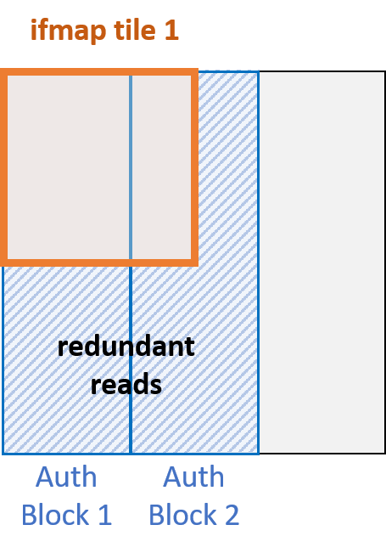
Tile-as-an-AuthBlock is not optimal
Cross-layer dependency of intermediate tensors
Option 2: Rehash ☹
Tile organizations are determined by mapping of each layer
Option 1: Assign one output tile as an AuthBlock ☹
Notes:
What is the cost of using this baseline strategy?
Example layer? (layer 2 -> layer 3 in ResNet18; very small input tile shape; very large output tile shape in both layers → redundant reads can blow up if use tile-as-an-AuthBlock w/o rehashing; even with rehashing, rehash cost is xxx)
AuthBlocks are assigned when generating output in more fine-grained manner, knowing the next layer’s input tiles? No need to rehash / no large redundant reads

Slide 6
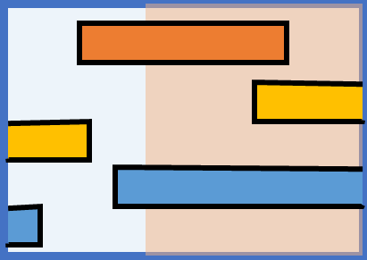
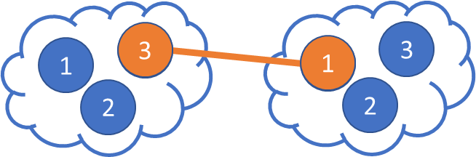
Two key techniques
Analytical approach to identify the optimal AuthBlock assignment
Cross-layer fine tuning from the loopnest mapping

Slide 7
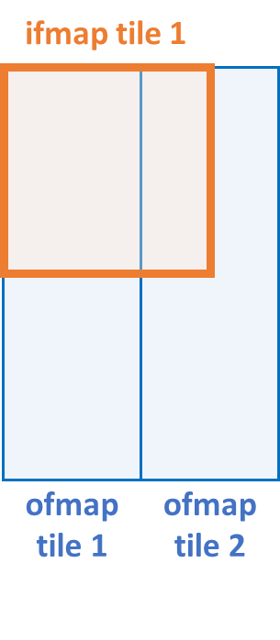
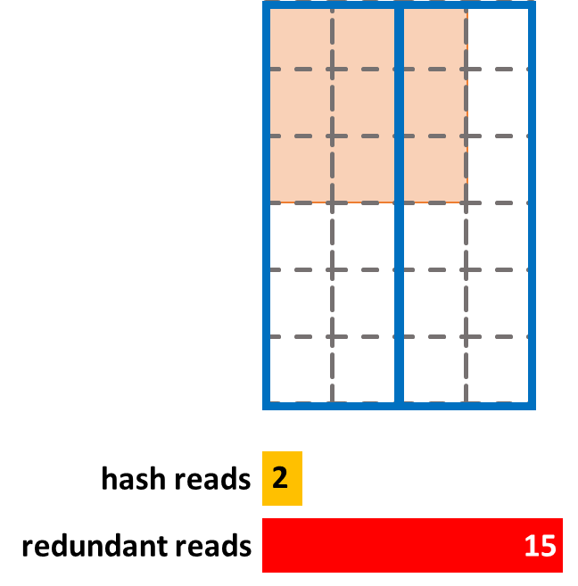
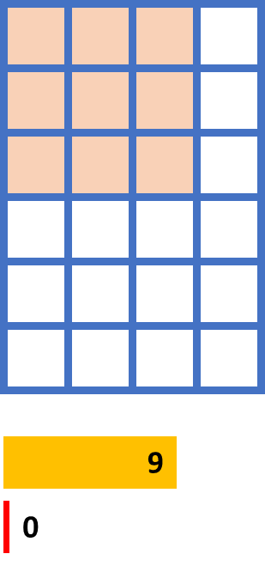
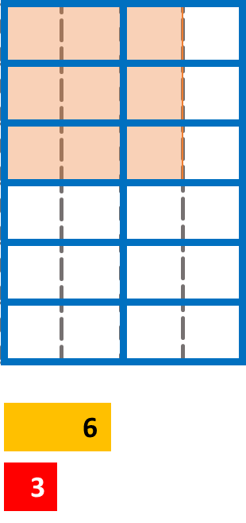
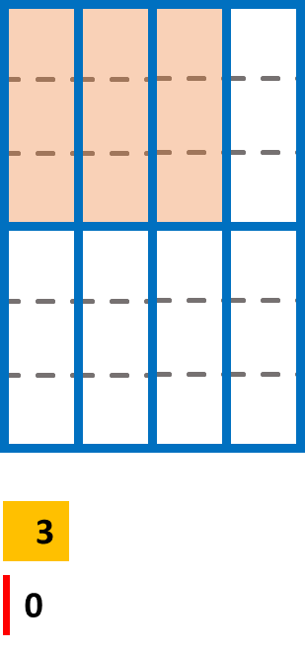
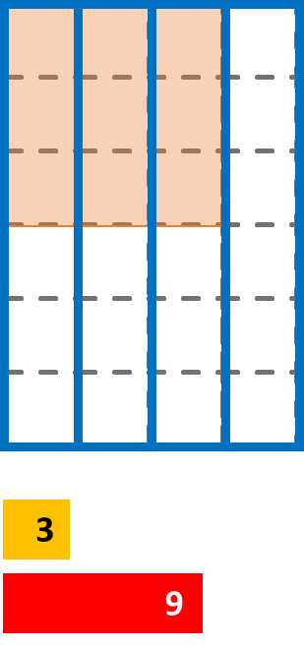
AuthBlock Assignment: Search Space
Goal: minimize the additional off-chip traffic
Determine both the size and the orientation of AuthBlocks
tile-as-an-AuthBlock
Horizontal, 1
Horizontal, 2
Vertical, 3
Vertical, 6
Optimal

Slide 8
Global Mapping Strategy
Joint search from loopnest mapping level? Exponential increase in search space
Layer i
Layer i+1
Conventional Mapping Tools
Conventional Mapping Tools
Individually Optimal
Loopnest
Loopnest
AuthBlock
Assignment
Find “globally”
optimal loopnests
Cross-layer Dependency
Loopnests optimal for individual layer $↛$ globally optimal

Slide 9

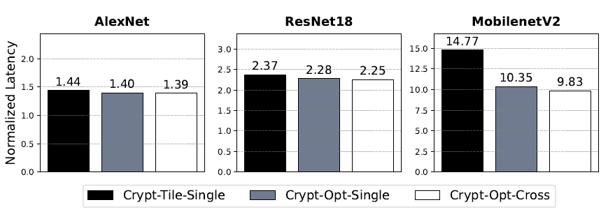
Impact of Mapping
Check our paper: https://dl.acm.org/doi/pdf/10.1145/3613424.3614273
Setup
Eyeriss-like architecture + Energy-efficient AES-GCM
2D convolution workloads
Different mapping algorithms
30%
33%
shallow,
unavoidable rehashing
deeper, ↑ opportunity
Step 1 only
+ tile-as-an-AuthBlock
Step 1 + Step 2
All three steps
Summary: ~33% faster, ~50% better in EDP compared to the “tile-as-an-AuthBlock”

