Slide 1
Software Power Side-channel Assisted Model Extraction of Deep Neural Networks
Xiang Zhang, Adam Ding*, and Yunsi Fei
Department of Electrical and Computer Engineering
*: Department of Mathematics
Northeastern University
This work was supported in part by National Science Foundation under grants CNS- 2212010 and SaTC-1929300 and presented at ICCAD 2023
Notes:
Hello everyone, This is xiang Zhang from ECE department of northeastern university, working with Professor Yunsi Fei.
Here we are going to present our recent work: Software Power Side-channel Assisted Model Extraction of Deep Neural Networks
This work was supported by NSF grants and presented in ICCAD 2023.

Slide 2
Outline
Introduction
Software-based power side-channel
DNN Model extraction attack based on software power side-channel and input gradients
Experimental results
Notes:
We will first introduce the background of the deep learning model extraction and software-based power side channel.
Then present the power leakage on deep learning model.
After that, I will present the model extraction method based on the power leakage and input gradients.
The last is experimental results.

Slide 3
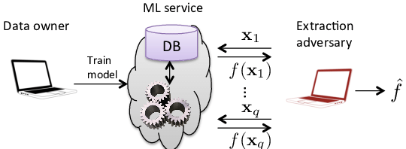
Model Extraction of Deep Neural Networks
The structure and parameters of DNNs are important intellectual property
Model extraction is a common IP-stealing attack
Existing model extraction methods are mostly algorithmic
Notes:
Deep learning has been widely applied in various application domains. However, DNN models and their implementations are facing increasing threats.
Model extraction is one of IP stealing attacks. It aims at recovering the Oracle deep-learning model (structure, parameters).
The existing model extraction methods are mostly algo'rithmic.

Slide 4
Existing Model Extraction Methods
Learning-based model extraction
Querying the oracle model and using machine learning on the query results to obtain an approximate model.
Cryptanalytic model extraction ^{[1]}
Prior work formulates the DNN model extraction into a cryptanalytic problem
Find special inputs that set the model execution in a certain state (critical condition: a neuron output is zero), and rely on equation solving to recover the model parameters
[1] N. Carlini, M. Jagielski, and I. Mironov, “Cryptanalytic extraction of neural network models,” in Advances in Cryptology – CRYPTO 2020
Notes:
Deep learning model extraction has two typical methods generally:
Learning-based model extraction
Cryptanalytic model extraction
Learning -based model extraction, which relies on querying the oracle model and using machine learning methods on the query results to obtain an approximate model. Some prior works could get a very similar accuracy and fidelity of oracle model.
Cryptanalytic model extraction will treat the DNN model extraction as a cryptanalytic problem.
With finding some special inputs that set the model in critical condition, which is making a neuron output as zero, and get the model output, then recover the model parameters by equation solving.
In this work, we want to get the exact model, not just an approximate model. So we improve the cryptanalytic model extraction algorithm, assisted by side channel, to extract multi-hidden layer deep learning model.

Slide 5
Our Contributions
Software-based power side-channel to monitor the activation direction of neurons
Using activation directions to extract model parameters considering input gradients
Neurons do not need to reach the critical condition (output zero) as required by the previous work
Requiring much fewer queries
Our new model extraction is much more efficient than the prior cryptographic method, with high fidelity to the oracle model!
Notes:
Our contributions
The first is, we are using software-based power side channel, to monitor the activation direction of neurons in deep learning model.
The second is:
Using activation directions to extract model parameters
Neurons do not need to reach the critical condition (such as output zero) and we requires much fewer queries.
generally, Our new model extraction is much more efficient than the prior work, with high fidelity to the oracle model!

Slide 6
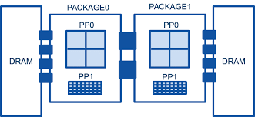
RAPL-based Power Side-channel
Intel Running Average Power Limit (RAPL) interface
Reporting accumulated energy consumption of various system-on-chip (SoC) power domains
On-chip power sensors, model-specific Registers (MSRs) – user-level software access
4 Power domains
Package (PKG): the entire processor
Power Plane 0 (PP0): all cores
Power Plane 1 (PP1): on-chip GPUs
DRAM: off-chip DRAM
Prior work^{[2]} adopts the software power side-channel to break cryptography algorithms including AES.
[2] M. Lipp, A. Kogler, D. Oswald, M. Schwarz, C. Easdon, C. Canella, and D. Gruss, “PLATYPUS: Software-based Power Side-Channel Attacks on x86,” in 2021 IEEE Symposium on Security and Privacy (SP).
Notes:
Next Let’s introduce the RAPL-based power side channel.
RAPL, which is the running average power limit, is a technique that provides an interface for users to read computer energy consumption at run-time.
It reports the accumulated energy consumption of various power domains.
Intel RAPL provides 4 power domains for measuring energy consumption.
We are using the energy consumption of PP0, as the corresponding register has been observed to be updated frequently.
A prior work adopts this RAPL-based side channel to break cryptography algorithms by repeating the instructions in Intel SGX.
In this work, we apply a similar method for measuring DNN model and detect the neuron activation direction.

Slide 7
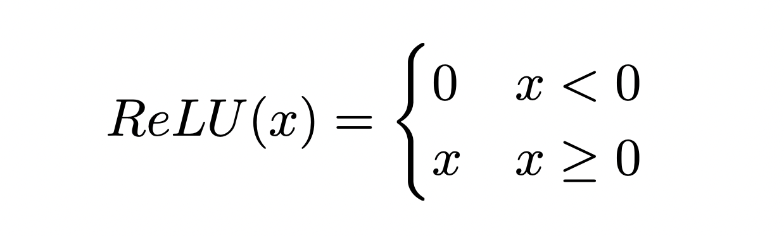
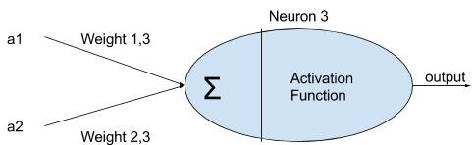
Neuron and Activation Function
Each neuron summation goes through a non-linear activation function
Rectified Linear Unit (ReLU) is the most popular activation function
Implementation varies in different DL frameworks
TensorFlow/Aten: std::max() or std::clamp()
Caffe: (X > 0) ? X : 0
Darknet: (X) * (X > 0)
Notes:
Here is the power leakage of DNN
ReLU activation is the most popular activation function nowadays as it is very simple.
It is a piece-wise function, that will set the output as 0 if the input is less than 0.
It varies in implementation
Native Tensorflow implements relu with max or clamp function in standard C++ library.
Some implementations are using the unbalanced branch, which is vulnerable to the side channel attack. We are going to focus on those vulnerable implementation.

Slide 8
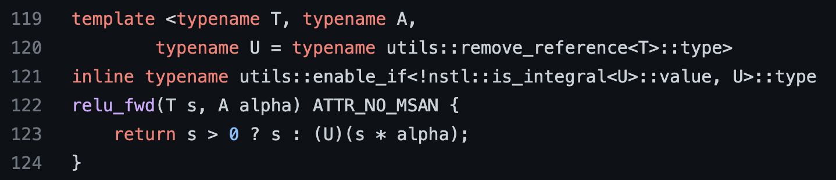
Leaky ReLU Implementation
Leaks information if the implementation includes unbalanced branches
oneDNN ReLU implementation
The function is used by all variants of ReLU in oneDNN.
Notes:
This ReLU implementation in oneDNN is vulnerable . oneDNN is the common DNN library, which is deeply optimized by Intel. It has been widely used as the computational backend of Tensorflow and Pytorch on Intel Processors.
The ReLU in oneDNN is implemented in unbalanced branches. All relu variants are using this function in oneDNN.
As we can see from the piece of code, when the input is less than 0, the output is the product of input and a parameter alpha. However, when the input is greater than 0, the output is the input itself.
So when the input is less than 0, the program is expected to consume more energy as it contains a floating point multiplication.
After we check the corresponding assembly code, we confirm that it is an unbalanced branch to power side channel. Next we show the energy consumption of relu branches.

Slide 9
Power Leakage of ReLU (Intel SGX)
SGX-Step is an attack framework, allowing us to automatically repeat instruction execution without changing the data flow.
Energy consumption (J) of ReLU branches in Intel SGX (10M).
Notes:
The same as prior work, we are using SGX-Step to repeat the instruction execution of ReLU. SGX-Step is an attack framework, allowing us to automatically repeat instruction execution without changing the data flow
This density plot shows the energy consumption in SGX enclave. We can also get 2 distributions of negative and positive branches. But the result shows the positive branch is consuming more energy compared with the negative branch.
We attribute this to complex operations in Intel SGX enclave, such as encryption and decryption.
Now we can get the ReLU direction from the RAPL-based power side channel. Next, we are going to apply such leakage on model extraction algorithm.

Slide 10
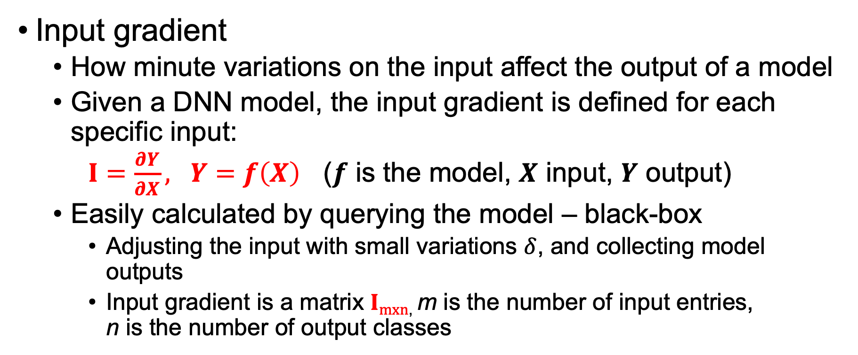
Our Approach: Model Extraction based on Software Power Side-channel and Input Gradients
Input gradient
How minute variations on the input affect the output of a model
Given a DNN model, the input gradient is defined for each specific input:
$I=\frac{∂Y}{∂X}, Y=f\left(X\right)$ ($f$ is the model, $X$ input, $Y$ output)
Easily calculated by querying the model – black-box
Adjusting the input with small variations $δ$, and collecting model outputs
Input gradient is a matrix $Imxn$, m is the number of input entries, n is the number of output classes
Notes:
Our Approach is: Model Extraction based on Software Power Side-channel and Input Gradients
Input gradient describes how minute variations in the input can affect the output.
It can be defined as the Differentiation of Y over X, where Y is the output and X is the input.
The input gradient can be obtained easily by querying the model, adjusting the input with small variations, and collecting model outputs.
Input gradient is a m by n matrix, m is the number of input entries and n is the number of output classes.

Slide 11
Key Insights
For a model execution, the input and the weights determine current activation pattern (including all the neurons)
The input gradient is determined by the model activation pattern
Our software power side-channel leaks model execution run-time information: can capture the entire model activation pattern at once
The prior work ^{[1]} can only determine the direction of a single neuron activation (based on the model inputs and outputs)
Our work searches the desired model activation pattern by varying the input queries to find certain input gradients
Notes:
The key insights is:
the input and the weights determine current activation pattern
The input gradient is determined by the model activation pattern
In our work, Our software power side-channel can capture the model activation pattern accurately. So we can search our desired activation pattern by querying the model.
In the prior work, they only rely on the input and output. So they are trying to set the activation in a critical condition, then solving the weights.
We are trying to solve the weights from input gradients, by searching special activation patterns.

Slide 12
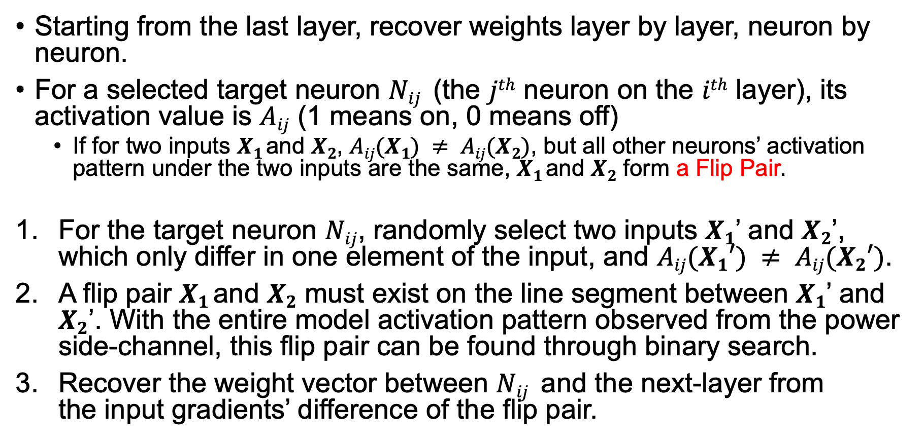
Weight Recovery Algorithm
Starting from the last layer, recover weights layer by layer, neuron by neuron.
For a selected target neuron $Nij$ (the $jth$ neuron on the $ith$ layer), its activation value is $Aij$ (1 means on, 0 means off)
If for two inputs $X1$and $X2$, $Aij(X1) ≠ Aij(X2)$, but all other neurons’ activation pattern under the two inputs are the same, $X1$and $X2$ form a Flip Pair.
For the target neuron $Nij$, randomly select two inputs $X1$’ and $X2$’, which only differ in one element of the input, and $Aij(X1′) ≠ Aij(X2′)$.
A flip pair $X1$and $X2$ must exist on the line segment between $X1$’ and $X2$’. With the entire model activation pattern observed from the power side-channel, this flip pair can be found through binary search.
Recover the weight vector between $Nij$ and the next-layer from the input gradients’ difference of the flip pair.
Notes:
Here is our weights recovery algorithm, starting from the last layer and recover weights layer by layer, and neuron by neuron.
Generally, we pick a neuron Nij as target neuron, which is jth neuron in the ith layer.
Select two inputs X1 and X2, if the activation on the target neuron is not the same, but activation of other neurons are the same. We say they form a flip pair.
We want to find such flip pairs to help us in weights recovery.
we can do, Randomly select two inputs $X1$’ and $X2$’, which only differ in one element of the input, and their activation differs on the target neuron.
A flip pair $X1$and $X2$ must exist on the line segment between $X1$’ and $X2$’.
With activation patterns observed from side-channel, the flip pair can be found through binary search.
Once we find the flip pair on the target neuron, The weights can be calculated by the difference in input gradients of the flip pair.

Slide 13
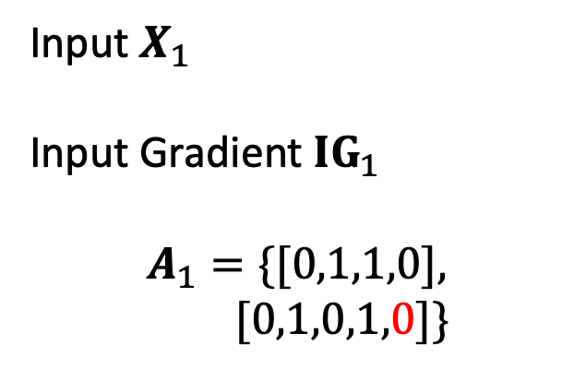
Illustrative Example of the Last Layer (The Bottom Neuron) – Output of Binary Search
Input $X_{1}$
Input Gradient ${IG}_{1}$
$$A_{1}=\{[0,1,1,0],$$
$$[0,1,0,1,0]\}$$
Notes:
Let use a toy example to illustrate:
Assume we have an input X1, with corresponding Input Gradient IG1,
and the activation pattern of ReLU is A1. As shown in the first part, we can get the activation pattern with the help of side channel.

Slide 14

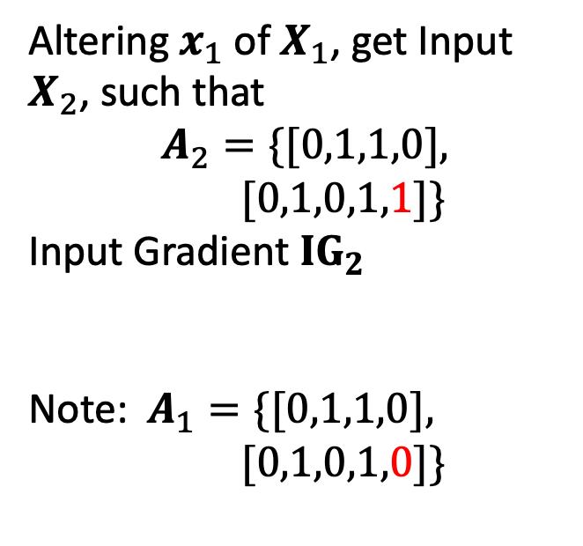
Illustrative Example of the Last Layer (The Bottom Neuron) – Contd.
Altering $x_{1}$ of $X_{1}$, get Input $X_{2}$, such that
$$A_{2}=\{[0,1,1,0],$$
$$[0,1,0,1,1]\}$$
Input Gradient ${IG}_{2}$
Note: $A_{1}=\{[0,1,1,0],$
$$[0,1,0,1,0]\}$$
$X_{1}$ and $X_{2}$ are a flip pair!
Notes:
Then altering the first element of input X1, we have another input X2, with input gradient IG2, and activation A2,
Compared with A1 and A2, there is only one element different, as shown in the figure, which is the bottom neuron in the last hidden layer. so It is the target neuron. And input X1 and X2 are a flip pair on the target neuron.
From the target neuron to the output neuron, there are 2 weights, w1 and w2.

Slide 15
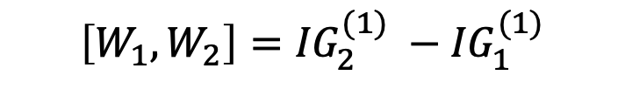
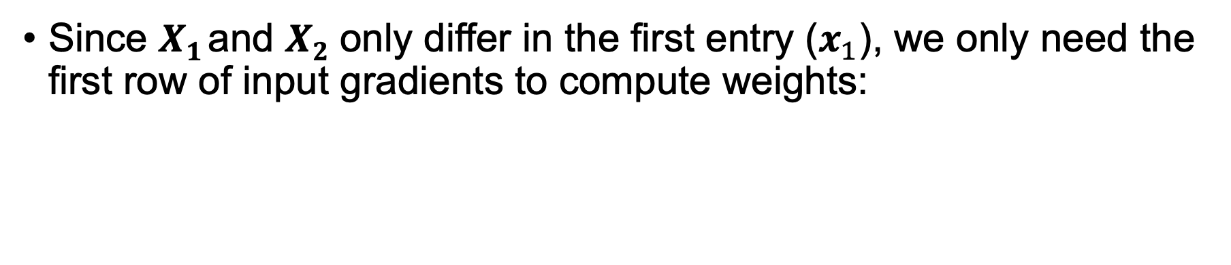
Weight Recovery
Since $X1$and $X2$ only differ in the first entry ($x_{1}$), we only need the first row of input gradients to compute weights:
$$\left[W_{1}, W_{2}\right]={IG}_{2}^{(1)} −{IG}_{1}^{(1)}$$
Notes:
The reason of input gradient changing is the target neuron is triggered, which means w1 and w2 were added to the input gradient IG2.
Since 𝑿_{𝟏} and 𝑿_{𝟐} only differ in the first entry, we only need the first row of input gradient:
The difference of input gradients, IG2 – IG1 of the first row, is the w1 and w2.
By enumerating all neurons in the model, we can get all weights.

Slide 16
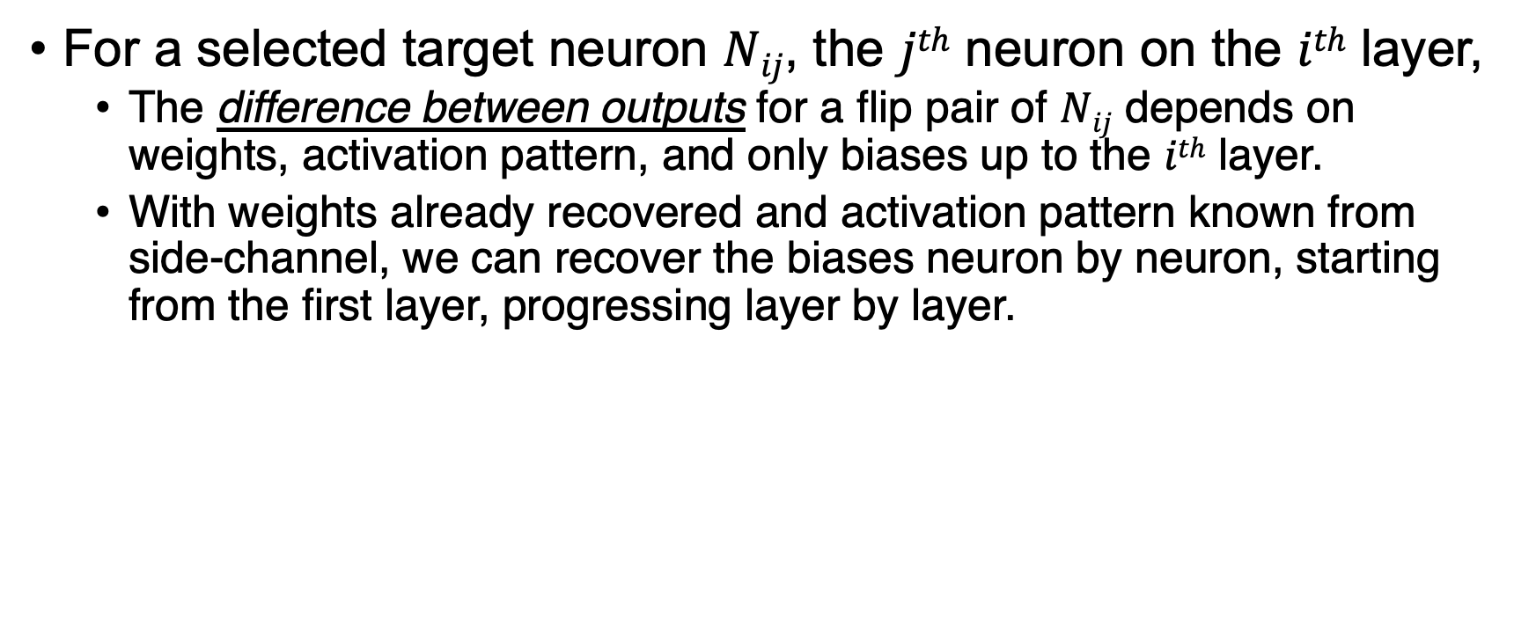
Biases Recovery
For a selected target neuron $Nij$, the $jth$ neuron on the $ith$ layer,
The difference between outputs for a flip pair of $Nij$ depends on weights, activation pattern, and only biases up to the $ith$ layer.
With weights already recovered and activation pattern known from side-channel, we can recover the biases neuron by neuron, starting from the first layer, progressing layer by layer.
Notes:
Then we do bias recovery. When recovering weights, we got a set of flip pairs. So in the biases Recovery, we can reuse the same set of flip pairs, but using raw output rather than input gradient.
Same as the weights recovery, for a selected target neuron $Nij$
The difference between outputs for a flip pair of $Nij$ depends on weights, activation pattern, and only biases up to the $ith$ layer.
With weights already recovered and activation pattern known from side-channel, we can recover the biases neuron by neuron, starting from the first layer, progressing layer by layer

Slide 17
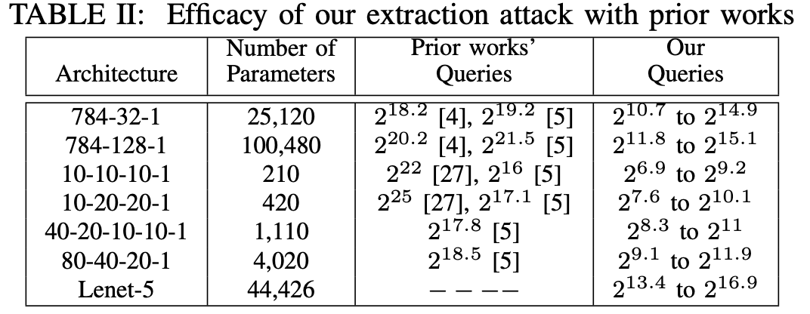

Results
To extract a 5-layer MLP, less than 0.8% of queries (compared to the previous work) are required.
Extract Lenet-5(CNN) in $2^{17}$queries.
Notes:
Finally, we evaluate our method by the requirement of queries.
Compared with prior works, we only require 0.8% queries to extract a 5-layer MLP.
We also make model extraction of CNN possible. We extract a lenet-5 within 2 to 17 queries.

Slide 18
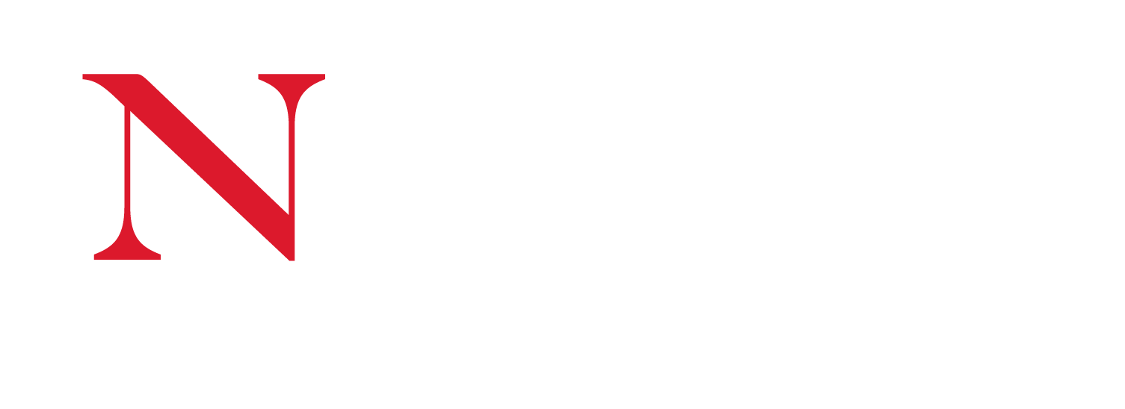
Thank You
Notes:
Ok that is all of the presentation.
Thank you for your attention.

Slide 19
Power Leakage of ReLU
Energy consumption (J) of ReLU branches (Repeating 10B)
Notes:
This slide shows the density plot of ReLU energy consumption.
In this plot, the x-axis is the energy consumption over 10B execution of ReLU.
We can easily differentiate the positive branch and the negative branch from energy consumption.
We can see that there is a clear boundary between them. As we expected, the negative branch is consuming more energy than positive branch.

Slide 20
Key Insights
Input
Activation Patterns
Input Gradients
Weights
Weights
Our Work
Our software power side-channel can accurately capture/observe the model activation pattern under an input
Notes:
The key insights is:
The specific model activation pattern is determined by the input and weights.
The model activation pattern and weights determine the input gradient.
In the prior work, they only rely on the input and output. So they are trying to set the activation in a critical condition, then solving the weights, which is the first weights in the figure.
In our work, Our software power side-channel can capture the model activation pattern accurately. So we can search our desired activation pattern by querying the model.
We are trying to solve the weights from input gradients, by searching special activation patterns.

