Slide 1


NEHWS 2024
A Full-Stack Approach for Side-Channel Secure ML Hardware

Slide 2
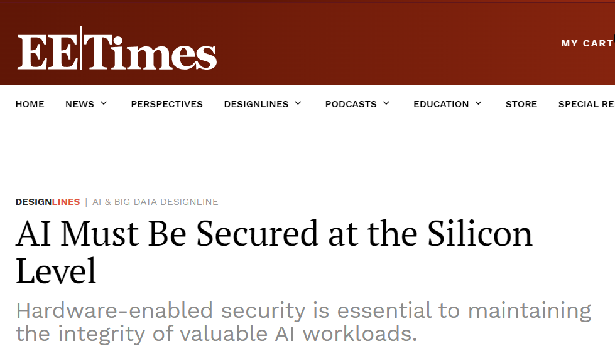
The Problem: Hardware Security from Crypto to AI/ML

Slide 3
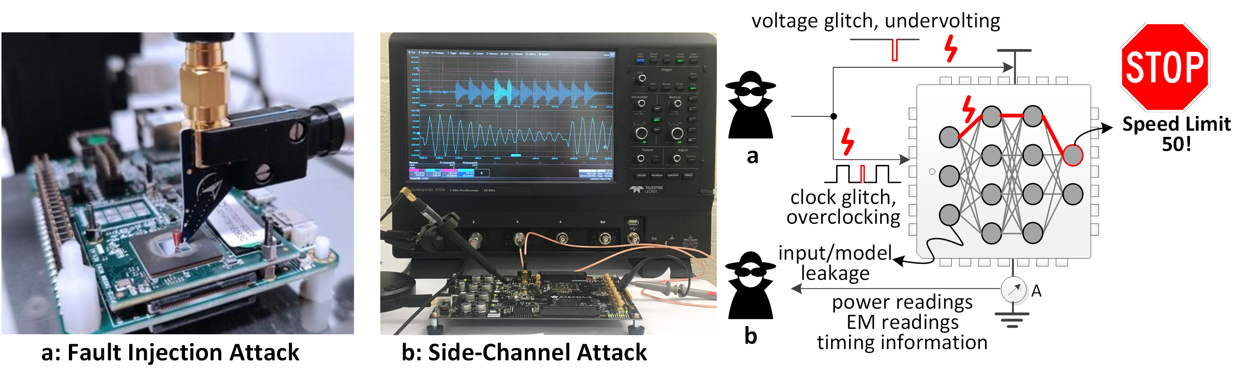
The Problem
Side-channel attacks can steal trained AI model
Fault injection can cause a critical in computations

Slide 4
The Solution
Secure multi-party computation in hardware
Computed values and their order is randomized, functionality kept
Extended this from cryptography circuits to AI/ML circuits
F1
x1
y1
F
x
y
y=y1+y2
F2
x2
y2

Slide 5
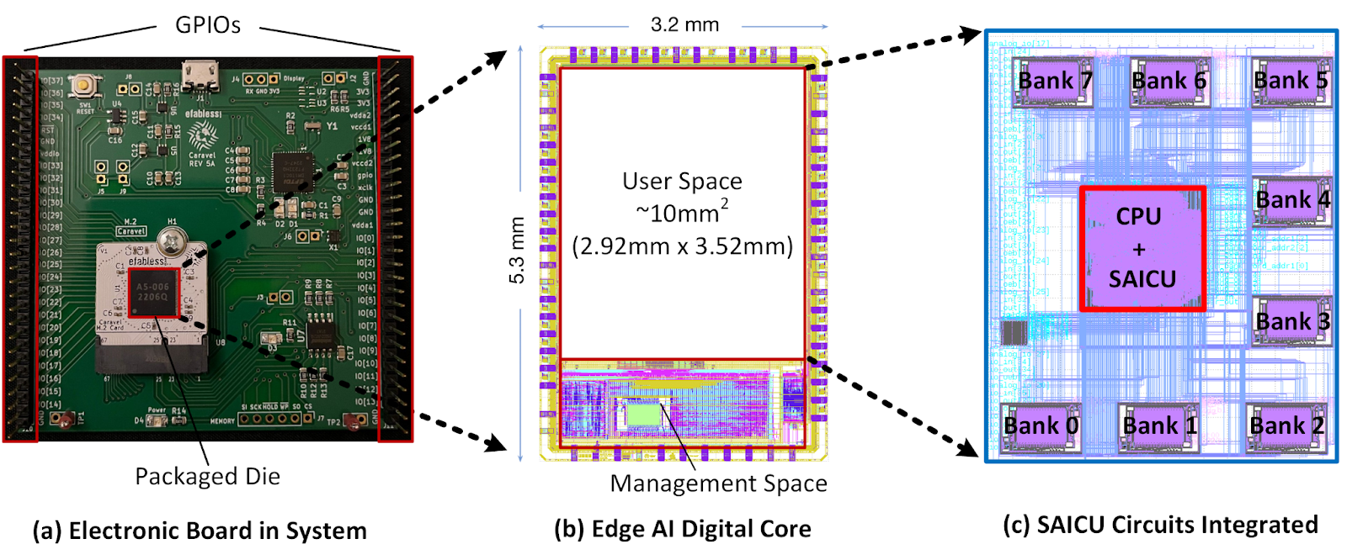
The Solution: The Hardware Stack
Silicon-proven in 130nm SkyWater technology

Slide 6
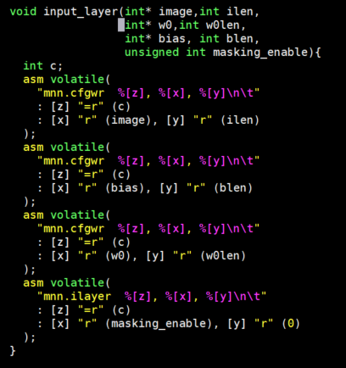
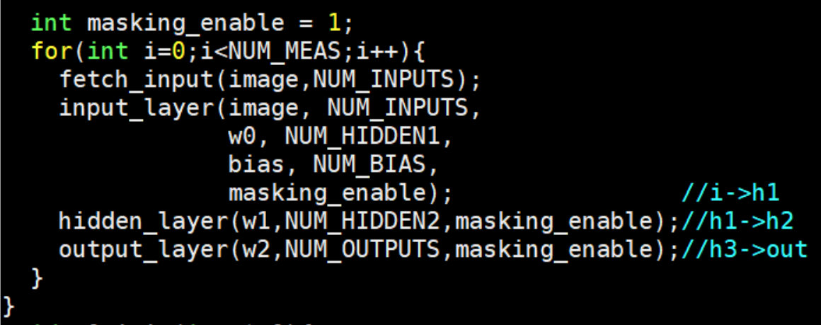
The Solution: Software Stack with Security API
First, configure the hyperparameters via mnn.cfgwr
Second, trigger the input layer computations via mnn.ilayer

