Slide 1
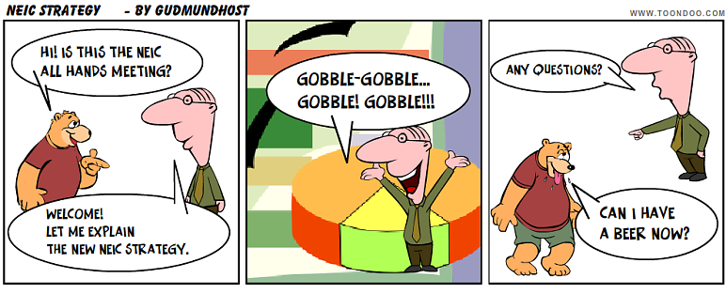

Slide 2
Nordic e-Infrastructure Collaboration
Pooling Competencies and Sharing Resources
Gudmund Høst
Director

Slide 3
History
Nordic Data Grid Facility (NDGF) pilot project started in 2003
Operational NDGF hosted by NORDUnet from 2006
Nordic e-Infrastructure Collaboration (NeIC) hosted by NordForsk from 2012
NeIC initially governed by national e-Infrastructure providers and research councils
NeIC governed by national providers from June 2015
Notes:
This is tentatie new procedure, deviatons: smaller projects within budget

Slide 4





NeIC Governing Partners (Board)
2
Notes:
Revised governance:
- Reduced size board, governance is trusted to NeIPs

Slide 5
Organisation
NordForsk is hosting organisation and legal entity
NeIC has separate board with strategy and funding authority
NeIC Director is employed by NordForsk
NordForsk provides admin support and office space
NeIC personnel are contracted from partner organisations to provide services in 2-4 year increments
NeIC Executive Team (Director + 5 Coordinators) handles daily operations, stakeholder engagement, coordination of activities
Notes:
This is tentatie new procedure, deviatons: smaller projects within budget

Slide 6

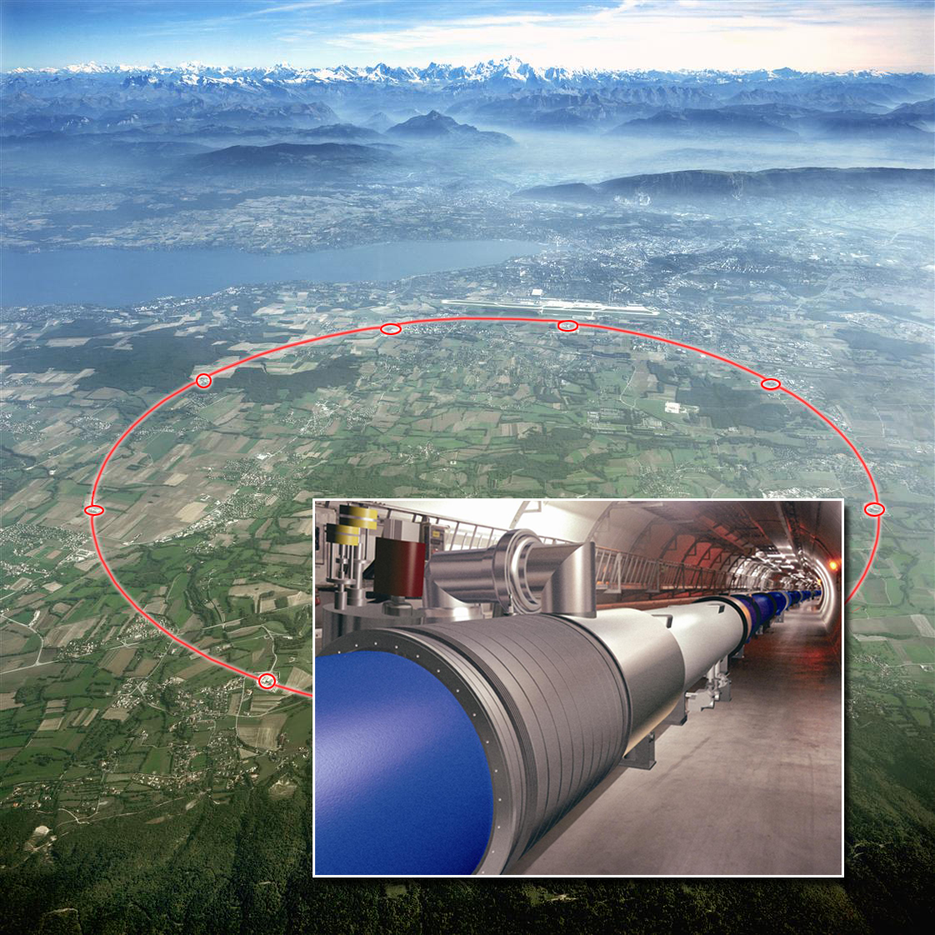
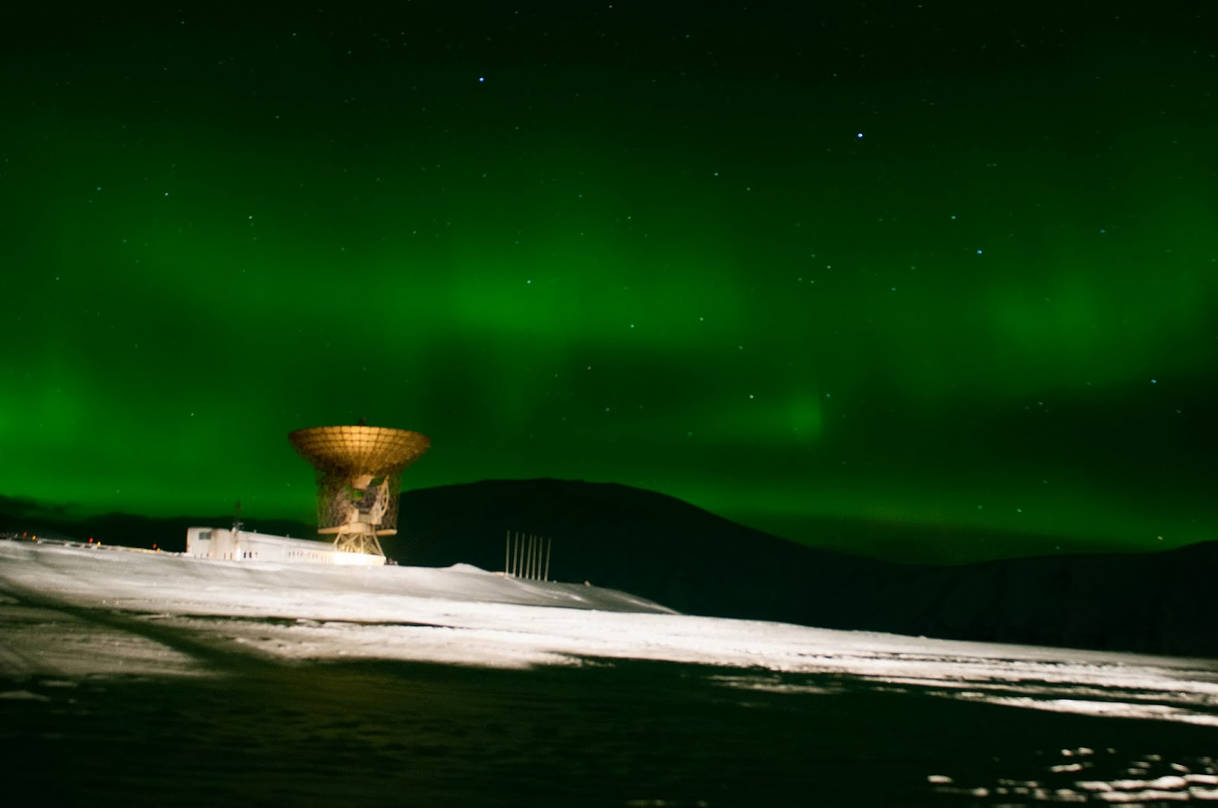
NeIC - Facilitating develpment and operations of e-Infrastructure solutions in areas of joint Nordic interest
Some activities
Contributing to CERN World-wide Large Hadron Collider Computing Grid
Sharing sensitive data across the Nordics
Federated Cloud services
Support for EISCAT_3D data handling
~50 persons at 20-100%
Notes:
Alternatively, one slide each

Slide 7
NeIC operates through collaborative projects
General procedure:
Projects may be proposed by NeIC partners or by NordForsk
Projects are approved by NeIC Board
Notes:
This is tentatie new procedure, deviatons: smaller projects within budget

Slide 8
Project Collaboration Model
Partner
Service Agreement
Service Agreement
Employer Institutions
Employer Institutions
Partner
Partner
Collaboration Agreement
NeIC – Project Owner
Partner
Notes:
This is new, we used to contract personnel directly from centers

Slide 9
NeIC Projects
Collaboration Agreement governs partner contributions
Co-funding by partners, generally 50/50, usually in-kind
Partners govern through Project Steering Group
NeIC appoints Project Manager and chairs Steering Group
One project management model for all NeIC projects (currently based on Tieto PPS)
One common project-language and project-culture for NeIC

Slide 10
Funding Distribution 2015^{*)}
^{*)}Predicted
Notes:
Nordic Golden Rule: 1/3 from NCM, 2/3 from national co-funding

Slide 11
NeIC Funding 2012-2015
Notes:
Nordic Golden Rule: 1/3 from NCM, 2/3 from national co-funding

Slide 12
New NeIC Strategy
Based on common interest of national provider organsations
With a view to opportunities provided by NordForsk strategy
Developed 2H 2015

Slide 13
NeIC and NordForsk
Research collaboration AND research infrastructure collaboration are main pillars of NordForsk strategy
Interfaces to e-Infrastructure collaboration
Nordic research communities and centers of excellence need e-services
Nordic research infrastructures need e-services
International research communities need services
International RIs (ex. ESFRI) need e-services
Some NordForsk supported initiatives are of e-type
Notes:
Researchers shop for cheapest services, and create consortia to circumvent policies and paywalls

Slide 14
The Nordic e-Science Action Plan 2.0
Solicited by Nordic Council of Ministers to Working Group (2015)
10 Actions:
A-6: Nordic Sharing and Exchange of e-Infrastructure Resources
A-7: A Nordic Federated Cloud
A-8: Nordic High Performance Computing Collaboration
A-9: Nordic e-Infrastructure for Sensitive Data
A-10: Nordic infrastructure for Scientific Software
Nordic Council of Ministers have requested NordForsk to implement the plan
NeIC may come to assistance

Slide 15
In 2020, NeIC is a global role model for cross-border distributed and sustainable e-infrastructure services
Share Resources
Launch pilot projects to establish ambition levels
Pool Competencies
Map skills, identify and prioritise needs
Strengthen Stakeholder Dialogue
Map stakeholders and partnerships
Secure Long-Term Funding
Map funding sources, modalities and application mechanisms
Establish NeIC and cross-border training programmes
Make NeIC more attractive to competent personnel
Create framework agreement (scope, CPU/storage)
Establish enabling processes and technologies
Agree on total funding and share from each funding source
Adapt to unaligned funding periods
Create engagement plan (frequency, means)
Implement stakeholder and partnership monitoring (incl. surveys)
Accelerate development and provisioning of cost-effective, best-in-class e-infrastructure services beyond national capabilities
Notes:
NeIC Strategy 2016-2020: Building long-term partnerships – btw nat’l providers
Vision (Where)
NeIC is a global role model for cross-border distributed and sustainable e-infrastructure services.
Strategy 2020 (How)
Pool and Share
Enhance the productivity of researchers in the Nordic region beyond national efforts through new services, pooling competencies and sharing the resources of national e-infrastructure providers. Strengthen partnerships and prospects for long-term funding through active stakeholder dialogue to promote sustainable services.
Values (Guiding our work)
Motivated by providing added value to researchers and engaging actively with our stakeholders. Open, reliable and continuously striving to improve in our work.

Slide 16
Strategy Implementation in the organisation
We will still have an Executive Team, tasks relating to ‘big four’:
Pool Competencies
Share Resources
Secure Long-Term funding
Strengthen Stakeholder Dialogue
We will still run projects, maybe fewer and larger
We will still operate a Nordic Tier-1

Slide 17
Proposed Major NeIC Projects 2016-2020
 | Project
1 | Nordic Tier-1 operations
2 | Nordic Sharing and Exchange of e-Infrastructure Resources (A-6), including Nordic High Performance Computing Collaboration (A-8) and data management collaboration
3 | A Nordic Federated Cloud (A-7)
4 | Nordic e-Infrastructure for Sensitive Data (A-9)
5 | Nordic Infrastructure for Scientific Software (A-10)
6 | EISCAT_3D Support Project

Slide 18
Some planned activites in 2016
Collaboration Infrastructure for Scientific Software (1+1 FTEs, 4 partners)
Project Manager Radovan Bast, UiT, Feb 1st.
Resource Sharing (building up towards 4+4 FTEs, 5 countries)
Planning to start “soon”
Training (? FTEs, 5 countries)
Various smaller efforts (ENV)
The 2nd Nordic Data Management Workshop

Slide 19
Resource Sharing Project – Ideas
National providers have strong engagement and presence (1+1 FTE/year each, 3 years)
Policy, technology, use cases (HPC, data, included)
Will enhance long-term collaboration between nat’l providers
Establish planning/steering group to design project plan
Project to be managed by Superman

Slide 20
In Conclusion
NeIC is growing and maturing
New directions for collaboration to be explored
Continue the good work!
… and promise to meet new colleagues this week!

