Slide 1
The Glenna Project
AHM 2016
January 26th 2016
Dan Still (CSC)

Slide 2

Glenna – Design in 5 Minutes
The goal of the project is to share knowledge and set best practices on managing cloud services and to create a Nordic federated cloud service, driven by the need of the Nordic researchers.
Notes:
Share knowledege – rapid development still in the cloud space :
like interfaces for federated services
Cloud storage
Define best practices on managing cloud services.
Ease operation. Guys at CSC spending a lot of time on administering the cloud, Uwe is probably going to tell more .
Create a nodic federated cloud service
the ultimate goal which will enable researchers throughout the Nordics to run images on distant nodes accessing local data as if they were running their apps in their own datacenter

Slide 3
Glenna Project Objectives
Enable easy access through the KALMAR2 federated trust service
Sharing technologies to improve quality and security of cloud services
Sharing user experiences on a Nordic level to improve quality and to increase the available set of services
Sharing cloud administrative work – improving the service availability to the users
Enable data sharing (enabling new research) and – increasing overall availability and security of data (avoiding data loss)
Create a resource sharing solution to simplifying the usage and sharing of Nordic Cloud resources
Enable billing and accounting within the Nordic Cloud – to create a fair sharing of resources and funding. This will also simplify for external funding of research.
Notes:
Here I need to expand on the rationale for the project because there is a grander vision here
The notion to begin with was that we have these cloud services and there will be more of them, but most likely they will be available only to the members of the national federations. Wouldn’t it be great if these services could be available to a wider spectrum of users within the Nordics meaning that the user base would be larger i.e. research users out of 26 million. In the case of Finalnd this would in theory mean a 5 fold increase in user base. Well , the immediate followup question is who’s actually going to pay for this obviously traditional buying and selling would be difficult to implement but there are other ways to even out compensation through resource sharing and here the idea would be that well what if we can find services in all countries that are about equal in value and what If they would even be equally attractive to the users could we by sharing services over time reach an even state meaning that no actual funds would have to be transferred. This is of course an utopian vision but to even out the peaks and valleys NeIC has some funding set aside as sort of a guarantee that no individual center would go deeply in to the red if their service would happen to become much more attractive than the others. To get here however the centers need to be able to price and bill their services and we try to address this question within the project.
I also want to make the point that a lot of money has been invested in some of these services the combined wotrh of the services we’ve identified for Glenna accounting for development costs is easily in the millions of euros mostly taxpayer funded. Clearly it would be a worthwhile effort to expand usage.
Part of the goal is also to aid collaboration with European initiatives like the EGI federated cloud.

Slide 4

Workpackages
WP0 Project mgmt
WP1 Cloud Storage
WP2 Federated resources (accounts, billing (technical
aspects), data transfer)
WP3 VM mgmt (security, image banks, configuration mgmt, automated building)
WP4 SaaS and PaaS development (initial focus on data analytics (Hadoop, Spark))
WP5 Policy / SLA / Legal (billing and accounting policy)
WP6 User training, Documentation and Dissemination (including scientific portals?)

Slide 5
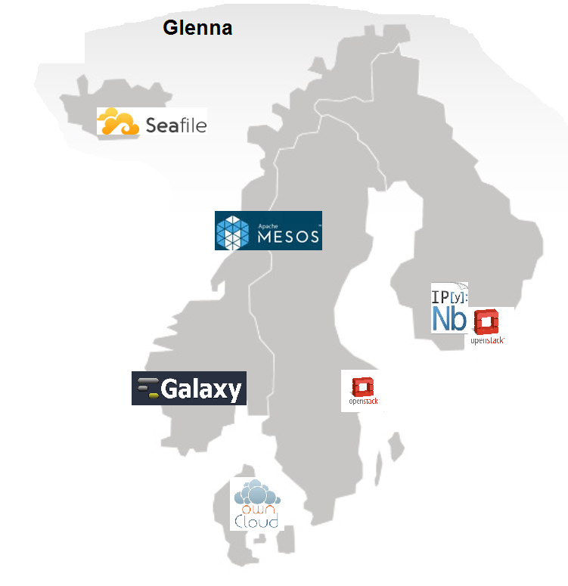
The Glenna Environment
Glenna image bank:
MUSC (use case)
SaaaS (use case)
Pouta Blueprints
Chipster
OpenFoam

Slide 6
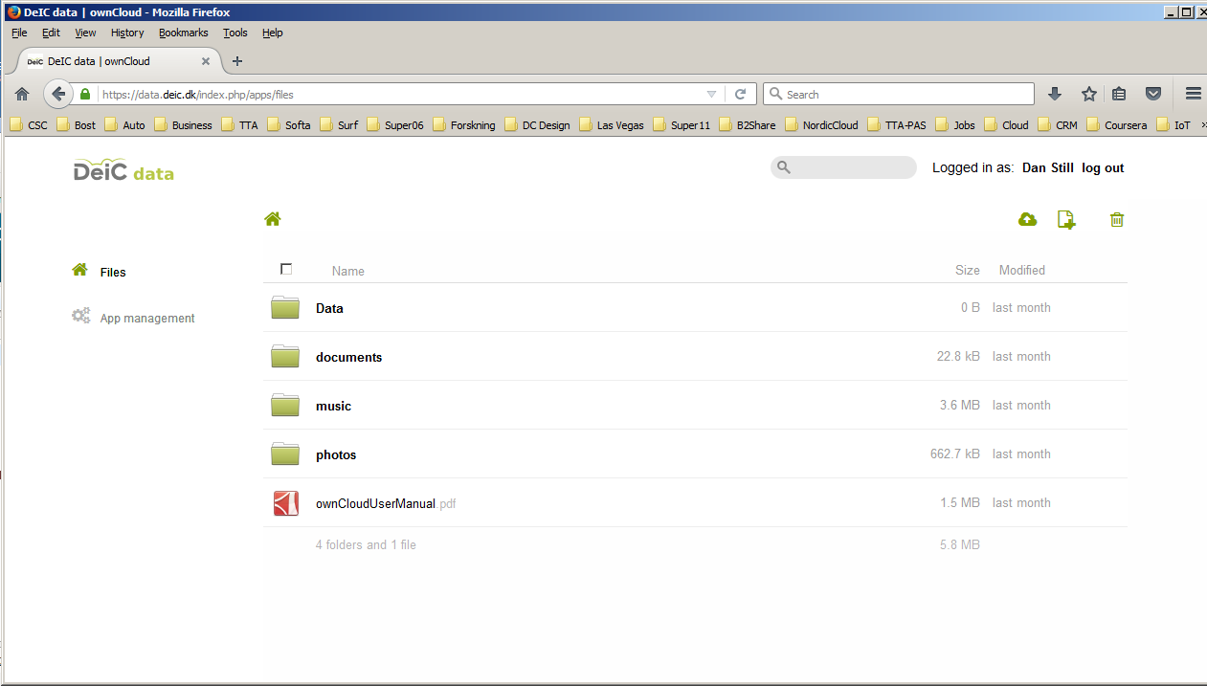
DeIC Data Service: data.deic.dk

Slide 7
Data.deic.data
data.deic.dk – an online data storage and synchronization service for secure sharing and accessing active research data and store large data sets. The service in in pilot-production.
OwnCloud based service
Command line tools for file transfer
Single sign-on through Kalmar2 (works from Finland, Select Norwegian and Swedish universities)
2dkr per GB

Slide 8
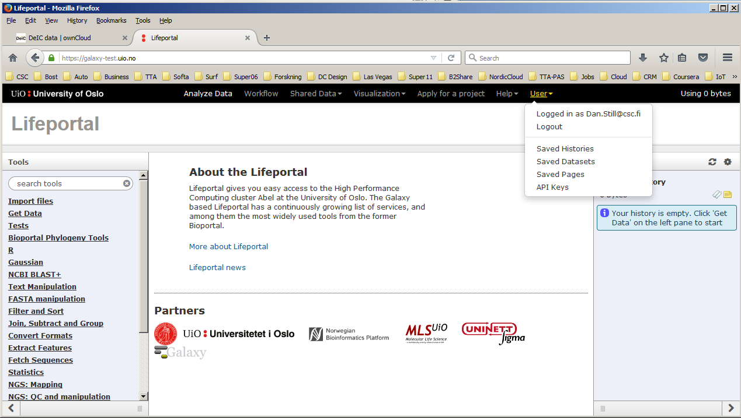
UiO Lifeportal – Bioinformatics (Galaxy)

Slide 9
UiO Lifeportal
The Lifeportal at UiO is a (bioinformatics) portal service to ease the access to high performance computing resources for researchers.
Galaxy based (https://galaxyproject.org/)
Long history at UiO
Lifeportal testserver currently accessable from Finland, Sweden(edugain)
Pricing still open

Slide 10
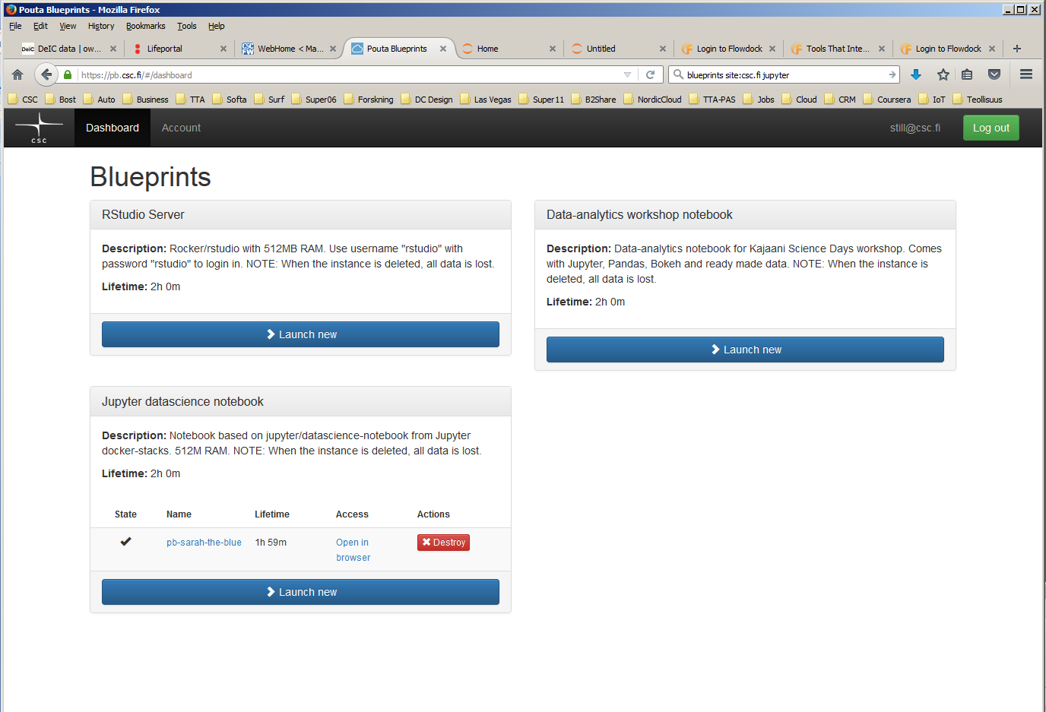
CSC cPouta Blueprints: iPython, R (JuPyter) Notebooks

Slide 11
Blueprints JuPyter: iPython, R notebooks
Jupyter Notebook is a web application that allows you to create and share documents that contain live code, equations, visualizations and explanatory text. Uses include: data cleaning and transformation, numerical simulation, statistical modeling, machine learning etc.
Runs on cPouta – dynamic allocation of computing resources
When the VM dies data is lost
Successful transfer of data to data.deic.dk
Behind the HAKA federation, Kalmar2/EduGain to be added soon

Slide 12
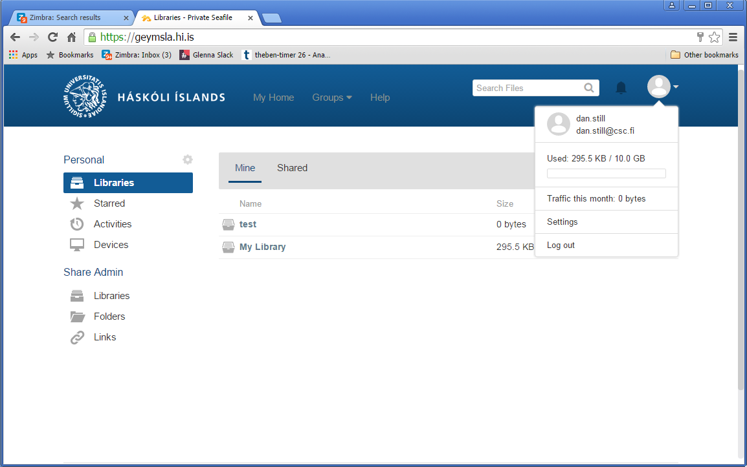
University of Iceland: SeaFile Cloud Data Service

Slide 13
University of Iceland: Cloud Data Service
Based on the opensource SeaFile project
DropBox style service (as deic.data.dk)
In use at the University of Iceland
Currently using AD for authentication
Should be possible to add SAML authentication i.e. Kalmar2

Slide 14
Google Kubernetes /Apache Mesos at UiT
Kubernetes is a system for managing containerized applications across multiple hosts, providing basic mechanisms for deployment, maintenance, and scaling of applications.
Mesos is built using the same principles as the Linux kernel, only at a different level of abstraction. The Mesos kernel runs on every machine and provides applications (e.g., Hadoop, Spark, Kafka, Elastic Search) with API’s for resource management and scheduling across cloud environments.
PI: Gurvinder Singh
Experimental environments particularly geared towards analytics
Plan to get federated access if applicable (may prove too experimental)

Slide 15
Future targets:
Feb 2016 (was Nov 2015): Demonstration of concept with selected pilots from 2-5 Nordic countries.
Demonstrations run by end-user, showing the functionality of all needed steps.
Demonstrator of funding scheme process.
June 2016: Fully functional infrastructure
Nordic Cloud infrastructure services operational with Nordic users, including the AAI, monitoring, billing and balancing of resources needed. Including defined and agreed organization of responsibilities between the national resource providers and NeIC.

Slide 16
Planned for Demo in February 2016
Enhanced access to the presented services
Federated access to SNIC-Cloud and cPouta
Federated access to Apache Mesos/Kubernetes (may be too experimental service)
Use case demos (SaaaS case running over multiple OpenStack clouds)
Preliminary sketch of contractual structure for fair share and compensation. Discussion on funding schemes.

Slide 17
Challenges
SAML authentication works in OpenStack Kilo but not authorization. Planned for next release of OpenStack but may prove too late for the Glenna project
Kubernetes and Mesos can be considered too experimental to warrant general ”Glenna” use
June 2016: Fully functional infrastructure: contractual commitments, funding and compensation will be difficult topics to address

