Slide 1
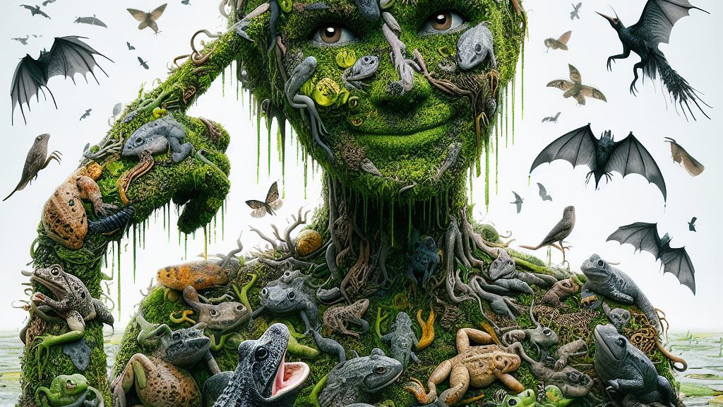
Evolution of digital image generation
Pixel possibilities: 2020s to present
Group 4:
Niki Vahdati Panah
Jonathan Smith
Tolulope Ogundeji
Neida Guzman

Slide 2
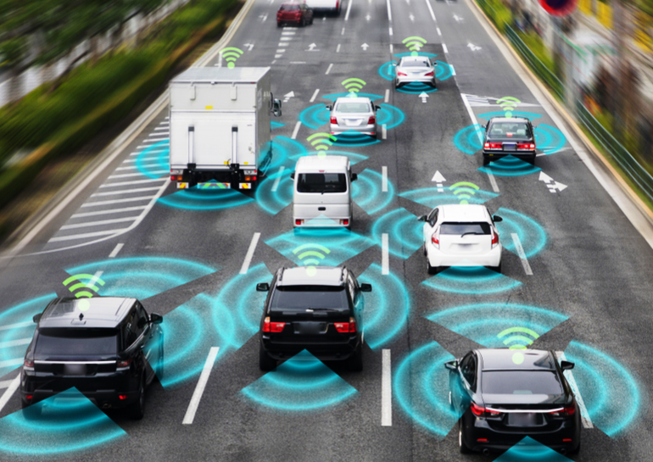
Image generation and computer vision are closely related fields, computer vision serves as the foundation for image generation, and in recent years, both technologies have been integrated in many applications such as:
Autonomous vehicles
Medical imaging
Creative arts.

Slide 3
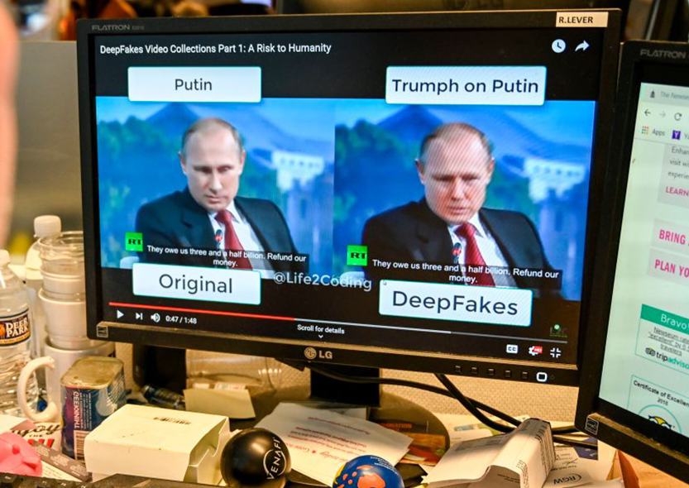
2020: Deepfakes and CNNs
At the start of our current decade, deepfake technologies had improved, slightly due to the global reliance on computers during the pandemic. The popularity of convolutional neural networks (CNNs) also arose.

Slide 4

Video links regarding deepfake technology:
https://www.youtube.com/watch?v=CDMVaQOvtxU
https://www.youtube.com/watch?v=cZFqcvhHkcI

Slide 5
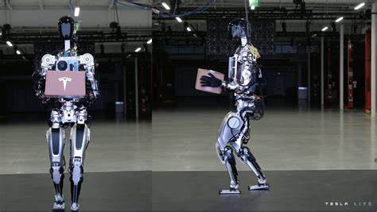
2021
The humanoid robot is the first prototype introduced by Tesla’s CEO Elon Musk. It is a Optimus robot that has a central computer powered by an AI chip containing a trained neural network. This bot relies on deep learning and computer vision with sensors and autopilot sensors to navigate around the area. It has human motions designed to perform tasks that people would find boring for example moving boxes, mowing the lawn, and even going grocery shopping.

Slide 6
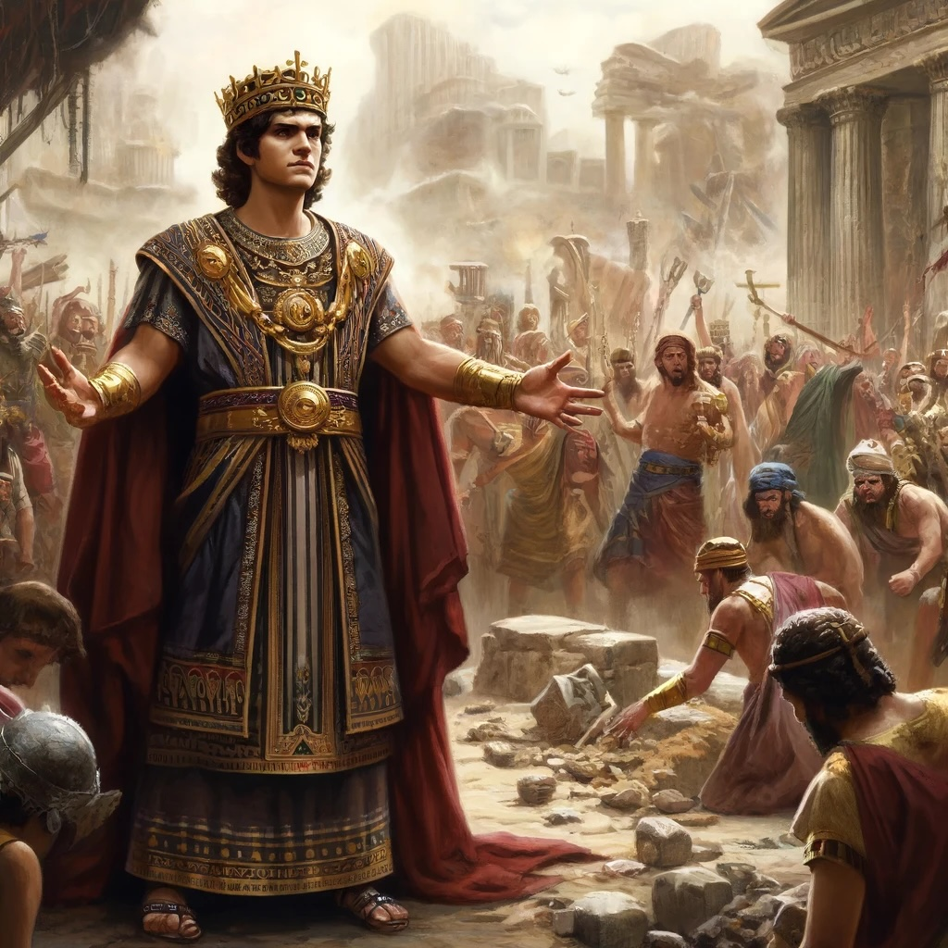
2022
Midjourney: Has the ability to generate extremely detailed images, Dall-E 2 was also released in 2022, with improved quality and extremely detailed images.
Attached is an image of medieval times by Dall-E 2.

Slide 7

2023
Generative Adversarial Networks (GANs): This technology had some major advancements recently that improved realism of generated images and videos.
Adobe firefly: Adobe launched its own generative AI tools, integrating image and video generation features into their creative applications.
This Photo by Unknown Author is licensed under CC BY-NC-ND

Slide 8

2024
Stable diffusion xl: Revolutionized pixel classification which can be used to edit anything out of or onto an image.
Google’s Imagen 3: Advanced image generation model that also generates high quality images from text prompts.

Slide 9
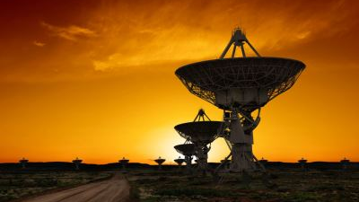
Industries where computer vision can be applied.
Content creation
Military weapons
Space research

Slide 10
Works Cited
Biba, Jacob. “The Tesla Robot Explained | Built In.” Builtin.com, 7 Nov. 2023, builtin.com/robotics/tesla-robot. Accessed 28 Aug. 2024.
“Elon Musk Reveals Tesla Is Building a Humanoid Robot.” Www.cbsnews.com, www.cbsnews.com/news/elon-musk-tesla-humanoid-robot/. Accessed 28 Aug. 2024.
"What Are SAE Levels of Autonomous Driving?" Top Gear, BBC Studios, 2024, www.topgear.com/car%20news/what-are-sae-levels-autonomous-driving-uk. Accessed 28 Aug. 2024.
Goodnight, Mark. "What Is a Deepfake?" IEEE Spectrum, IEEE, 25 Jan. 2023, https://spectrum.ieee.org/what-is-deepfake. Accessed 28 Aug. 2024.

