Slide 1
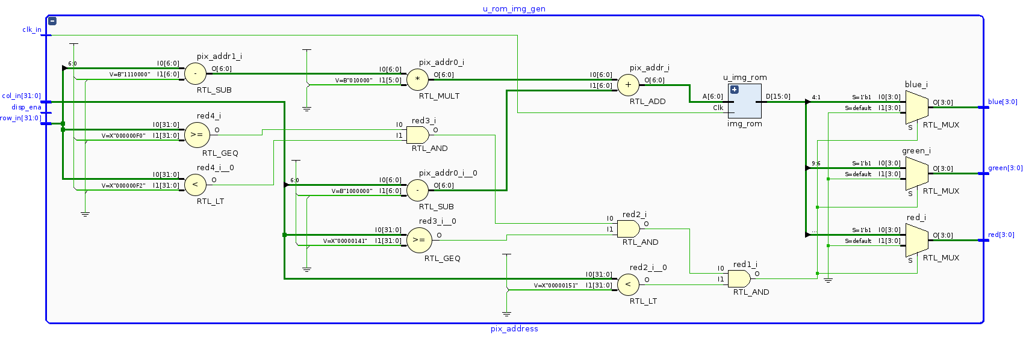

VHDL Coding
Bitmap ROM Generation
G. Neidermeier
04-September-2023

Slide 2
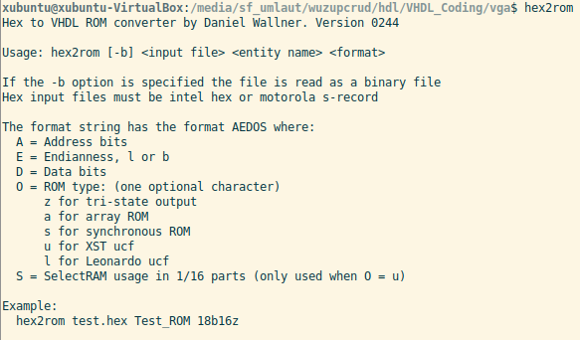
Loading External Data
Converting binary to ASCII hex and using VHDL file IO functions to load and process data (previous tutorial)
Convert binary data directly to VHDL ROM using an external program (e.g. hex2rom)

Slide 3
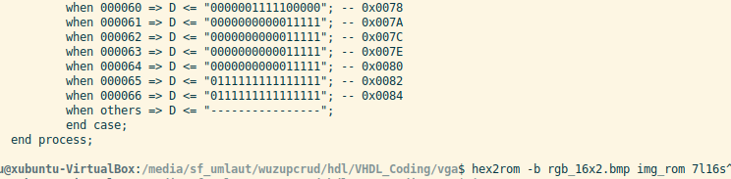
Bitmap Prep and Conversion
16-bit data, X1 R5 G5 B5
hex2rom -b rgb_16x2.bmp img_rom 7l16s

Slide 4
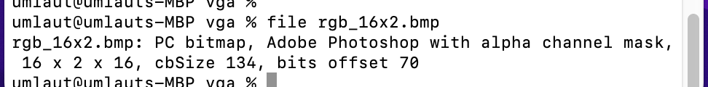
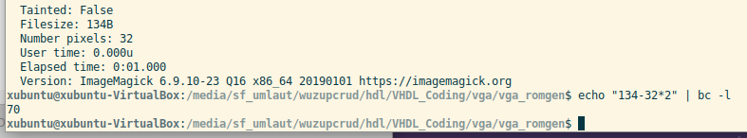
Bitmap Prep and Conversion
16-bit data, X1 R5 G5 B5
Confirm bitmap header size and encoding
hex2rom -b rgb_16x2.bmp img_rom 7l16s

Slide 5
Address Generator
pix_addr <= to_unsigned(
BMP_HDR_SZ +
(
(row_r - imgRow0) * imgW +
(col_r - imgCol0)
),
pix_addr'length );

Slide 6
Sync ROM
Example hex2rom command with option ‘S’ emits ROM that registers the address
Advantage is the tool may be able to infer a BRAM as opposed to a distributed RAM (async RAMS always infer a D-RAM, which are LUT based and limited too much smaller size than BRAM resources)
hex2rom -b rgb_16x2.bmp img_rom 7l16s
No the fun starts!

Slide 7
Pixel address and data out of sync
The pixel data lags the intended screen location (column) by 1-clock cycle

Slide 8
Synthesis Tool Emits DRC Warnings
The Synthesis tool does its thing based on how it interprets the VHDL code describing the circuit design – the tool makes the final decision as to whether the design is going to result in a properly functioning circuit – for BRAM resources it means the synth tool must see that the inputs will be properly synced to the output
Consult XST User Guide: BRAMS must be synchronous, i.e. must have registered inputs (or registered outputs, or both depending on the style of RAM that the tool infers)
Generally the tool can be “coaxed” to infer the desired BRAM by “by the book” VHDL (or Verilog!) coding style.

Slide 9
Sim waveform with DRC Errors

Slide 10
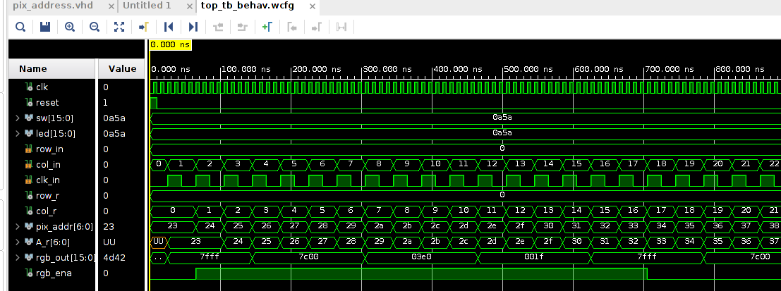
Simulation Analysis
Registered ROM address, offset on Column so line displays correctly
(technically, is offset 1 pixel to right, so at column 1 not 0)

Slide 11
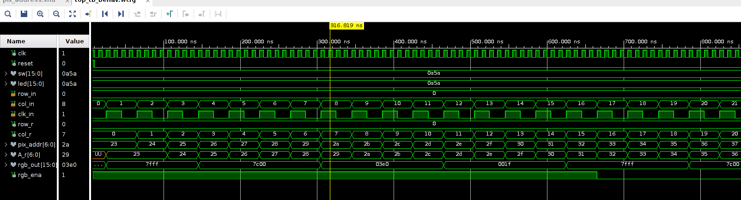
Simulation Analysis
Displayed image row sis distorted, the rgb_ena signal is not in sync with image row

