Slide 1
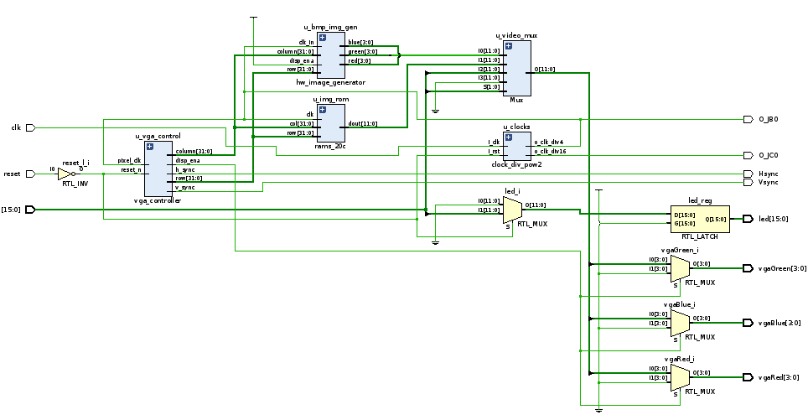

VHDL Image Generator
BMP Image Loader
- G. Neidermeier 19-Feb-2023

Slide 2
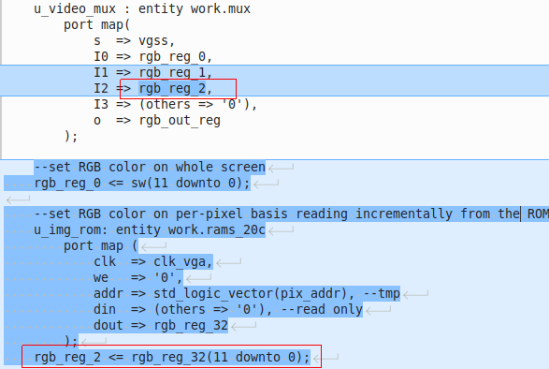
Loading RAM from File
HDL_Coding_Techniques/rams/rams_2oc.vhd
ROM wired into mux as new image gen block
Use as ROM instance, no-write (Din and WE are grounded)

Slide 3
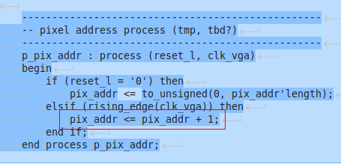
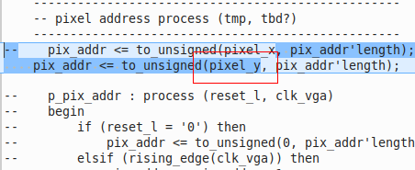
Simplified Example of Pixel Addresser
Pixel address is simply a free running counter and makes a rolling pattern when used this way but adequate for initial test
Using pixel_y or pixel_x directly needs no additional computation logic and makes a reasonable test of RAM interface

Slide 4
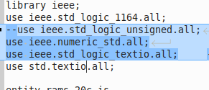
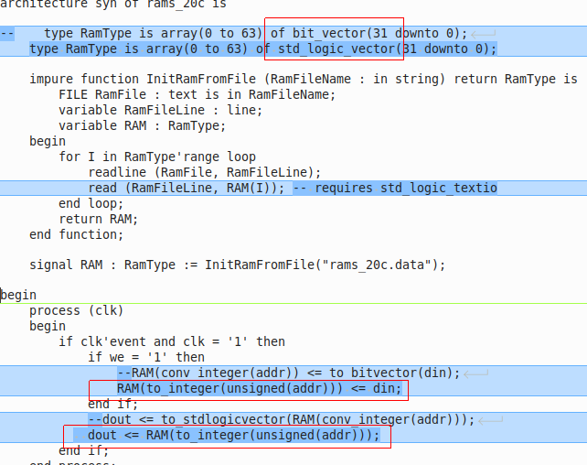
Reading file into std_logic_vector
Modified template with ram type std_logic_vector (instead of bit_vector)
use ieee.numeric_std instead of std_logic_unsigned
In addtion to std.textio use ieee.std_logic_textio is also necessary
read() from input buffer to std_logic_vector
https://vhdlguide.readthedocs.io/en/latest/vhdl/testbench.html

Slide 5
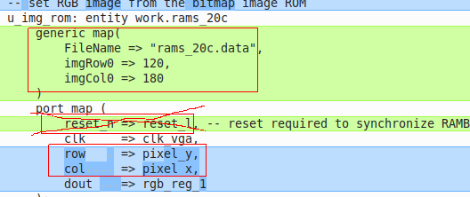
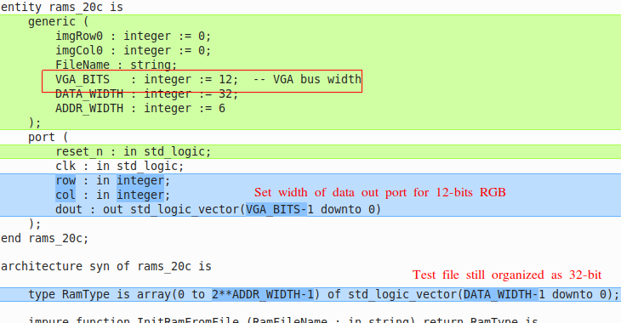
New Component Interface
Reset was wrong way to fix RAM synchronization
row and col registered for correct BRAM synchronization

Slide 6
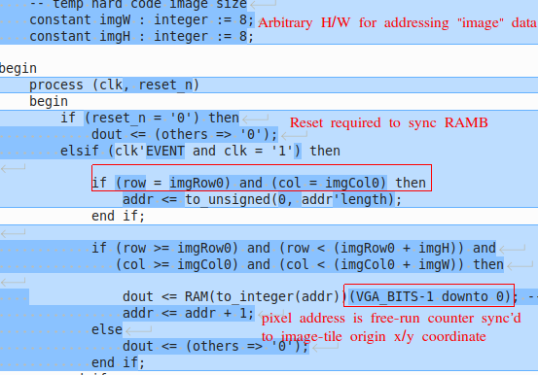
Pixel Addresser

Slide 7
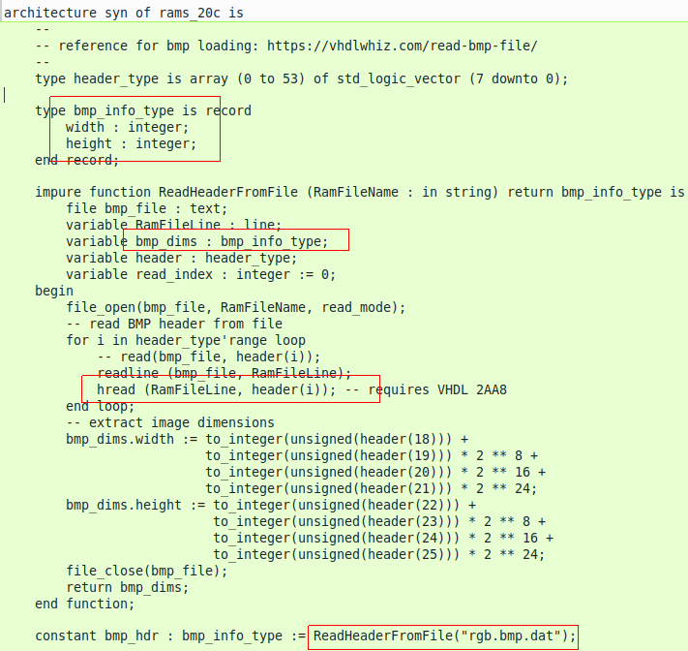
Loading Bitmap Header
Only the width and height are read from header (color space etc. assumed)

Slide 8
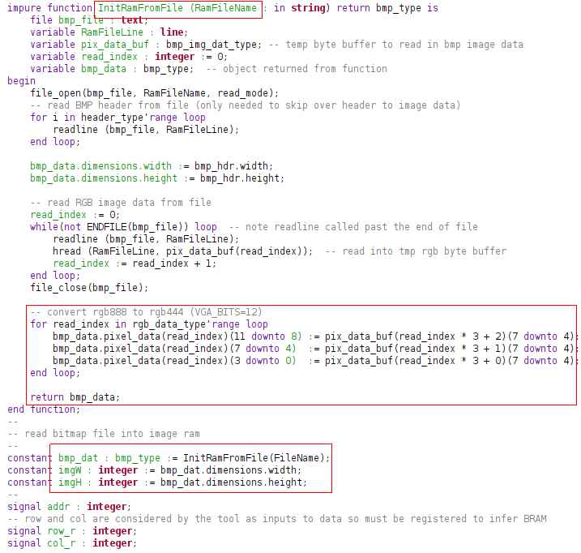
Load Bitmap Image Data to Array
function InitRamFromFile use width and height info obtained from bmp header

Slide 9
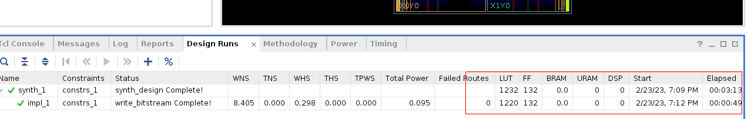
Using Utilization Reports
Tool seems to have some limitation in how large the RAM can be if inferred from LUTs
Longer time to synthesize with larger image data

Slide 10
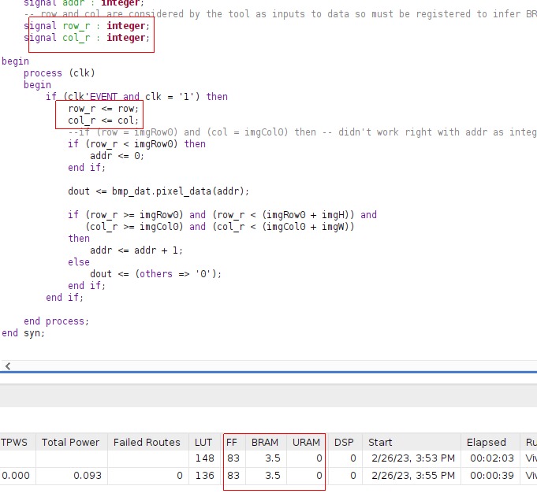
Block RAM Inference
Inputs to dout must synchronize in order for the tool to infer BRAM
Tool warns when any input to the RAM could be asynchronously reset
Required row and col to be registered as they are basically the address input to the BRAM

