Slide 1
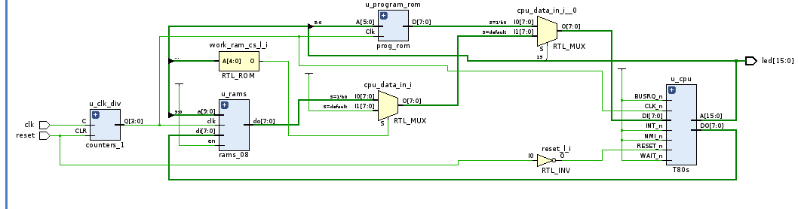
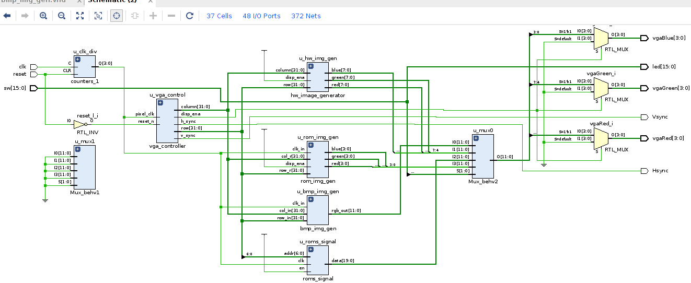

VHDL Coding t80 VGA Interfacing
G. Neidermeier 16-August-2023

Slide 2
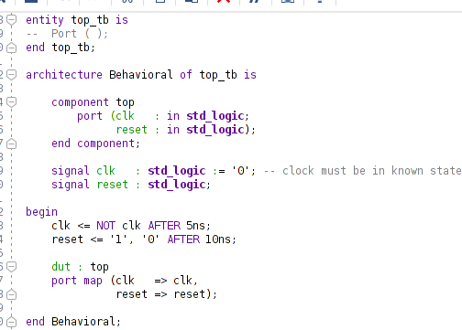
New Project Setup
New project, top.vhd, import constraints .xdc
Import clocks_1.vhd
Create new testbench top_tb.vhd (no ext. I/O ports for testbenches)

