Slide 1
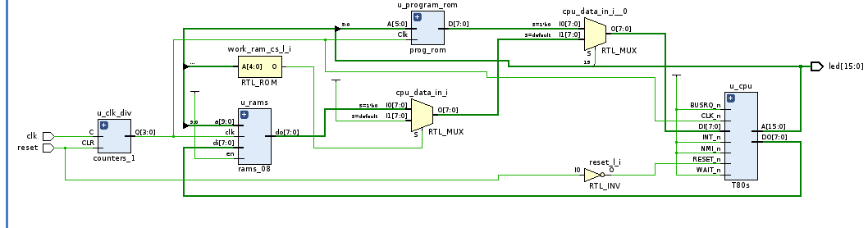
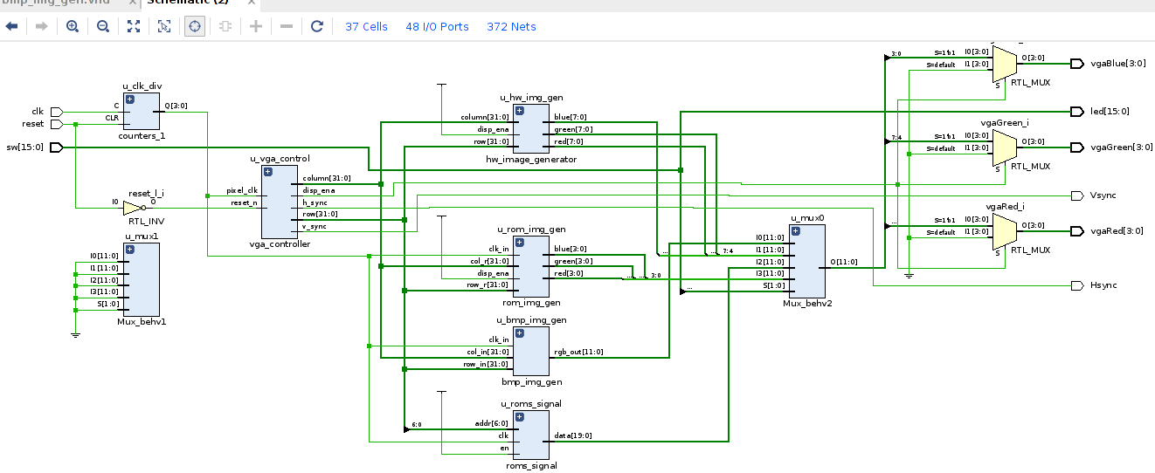

VHDL Coding t80 VGA Interfacing
G. Neidermeier 16-August-2023

Slide 2
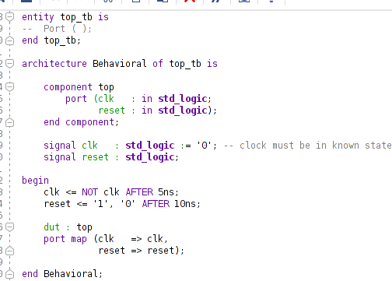
Z80 Interrupts
This project will have: time based interrupts (Vsync, 60Hz to time s/w operation) and also interrupt handler to service switch inputs.
Z80 NMI non-maskable is edge triggered, IRQ @ $66
Z80 INT, this project use Mode 0 to vector $38
Edge triggered requires additional circuit to latch/un-latch interrupt action
Use VGA controller to harness Vsync signal for INT source.
Verify Vsync by deriving 1Hz signal that can be approximately verified with stop watch (so no sophisticated test equipment required).

Slide 3
New Project Setup
New project, top.vhd, import constraints .xdc
Import clocks_1.vhd
Create new testbench top_tb.vhd (no ext. I/O ports for testbenches)

Slide 4
Counter
Clock/counter ……….
signal clk_cntr : STD_LOGIC_VECTOR(3 downto 0);
...
clk_vga <= clk_cntr(1); -- vga clock 25 Mhz
u_clk_div: entity work.counters_1
port map(
C => clk,
CLR => reset,
Q => clk_cntr
);

Slide 5
VGA Controller
VGA controller ……….
signal clk_vga : STD_LOGIC;
signal video_on : STD_LOGIC;
signal pixel_x : INTEGER;
signal pixel_y : INTEGER;
u_vga_control : entity work.vga_controller
....
GENERIC map (
h_pulse => 96,
h_bp => 46,
h_pixels => 640,
h_fp => 16,
h_pol => '0',
v_pulse => 2,
v_bp => 33,
v_pixels => 480,
v_fp => 10,
v_pol => '0')
port map(
pixel_clk => clk_vga, -- 25 Mhz
reset_n => reset_l,
h_sync => Hsync,
v_sync => Vsync,
disp_ena => video_on,
column => pixel_x,
row => pixel_y,
n_blank => open,
n_sync => open
);

Slide 6
Sync Signals
External sync signal definitions
set_property -dict { PACKAGE_PIN P19 IOSTANDARD LVCMOS33 } [get_ports Hsync]
set_property -dict { PACKAGE_PIN R19 IOSTANDARD LVCMOS33 } [get_ports Vsync]
Vsync : out STD_LOGIC;
Hsync : out STD_LOGIC;
....
u_vga_control :

Slide 7
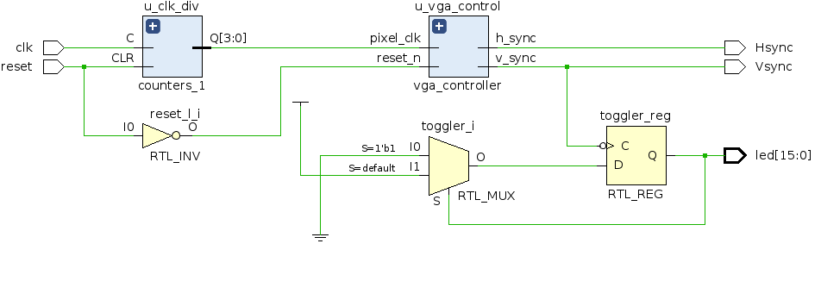
Vsync Signal
Toggle a register on falling edge of Vsync
Drive LED with test pulse
--------------------------------------------------
-- toggle signal on vsync (active-low falling edge)
--------------------------------------------------
process (vsync_int)
begin
if vsync_int'event and vsync_int = '0'
then
if toggler = '1'
then
toggler <= '0';
else
toggler <= '1';
end if;
end if;
end process;
led(15) <= toggler;

Slide 8
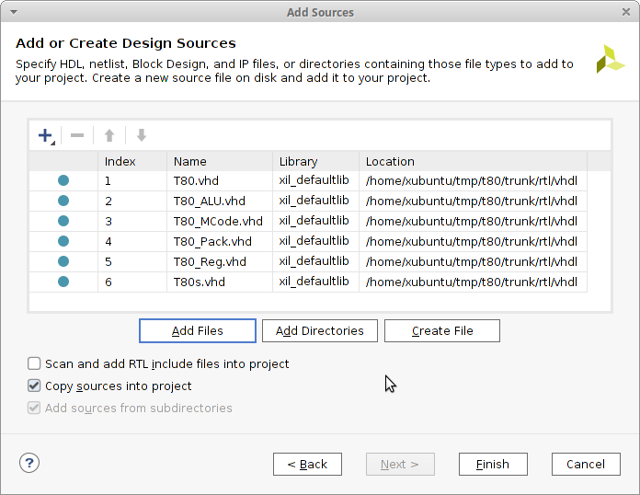
Import T80 Sources
T80 configuration used is synchronous (T80s.vhd) and no extended registers (T80_Reg.vhd)
Copy sources into project!
--------------------------------------------------
-- toggle signal on vsync (active-low falling edge)
--------------------------------------------------
process (vsync_int)
begin
if vsync_int'event and vsync_int = '0'
then
if toggler = '1'
then
toggler <= '0';
else
toggler <= '1';
end if;
end if;
end process;
led(15) <= toggler;

Slide 9
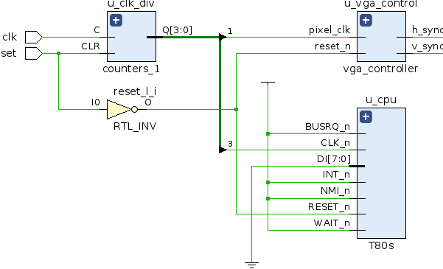
Minimal T80 Circuit
T80 entity instantiation
Unused outputs can be left open in VHDL
Inputs tied to 1 (Vdd) or 0 (GND)
T80 shows in RTL schematic but synthesis tool will disregard (optimize away) components that have no effect on circuit (i.e. doesn’t drive any outputs)
u_cpu : entity work.T80s
port map(
RESET_n => reset_l,
CLK_n => clk_cpu,
WAIT_n => '1', -- cpu_wait_l,
INT_n => '1', -- cpu_int_l,
NMI_n => '1', -- cpu_nmi_l,
BUSRQ_n => '1', -- cpu_busrq_l,
M1_n => open, -- cpu_m1_l,
MREQ_n => open, -- cpu_mreq_l,
IORQ_n => open, -- cpu_iorq_l,
RD_n => open, -- cpu_rd_l,
WR_n => open, --cpu_wr_l,
A => open, -- cpu_addr,
DI => (others => '0'), -- cpu_data_in,
DO => open --cpu_data_out
);

Slide 10
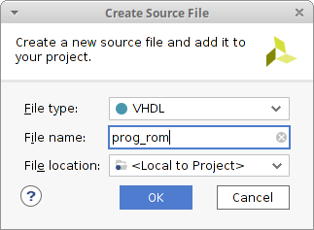
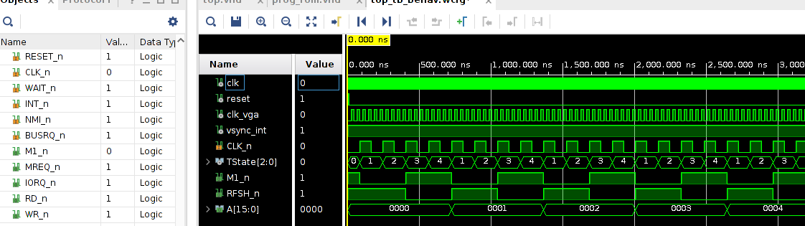
Program ROM
Create the new prog_rom VHDL file in Vivado (no need to populate IO port definitions)
prog_rom.vhd is added to the project, but will be overwritten by script converting z80 binary to VHDL array
Internal T80 signals shown in simulation: TState, M1, RFSH, Address
ROM connected to T80 address bus (ROM data out is still N.C.)
--------------------------------------------------
-- internal program ROM
--------------------------------------------------
u_program_rom : entity work.prog_rom
port map (
Clk => clk_cpu,
A => cpu_addr(5 downto 0),
D => open
);

Slide 11
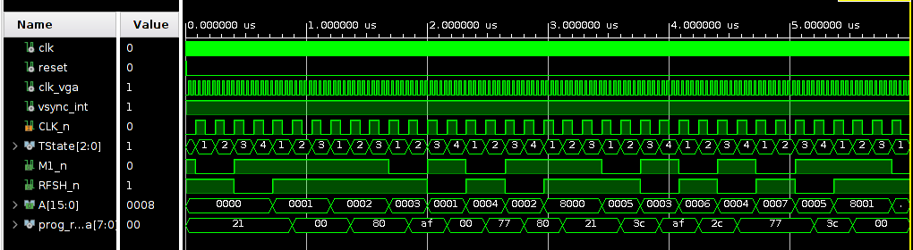
Data Bus
Data bus signal prog_rom_data from ROM to CPU
u_cpu : entity work.T80s
port map(
RESET_n => reset_l,
CLK_n => clk_cpu,
WAIT_n => '1',
INT_n => '1',
NMI_n => '1',
BUSRQ_n => '1',
M1_n => open,
MREQ_n => open,
IORQ_n => open,
RD_n => open,
WR_n => open,
A => cpu_addr,
DI => prog_rom_data,
DO => open --cpu_data_out
);
--------------------------------------------------
-- internal program ROM
--------------------------------------------------
u_program_rom : entity work.prog_rom
port map (
Clk => clk_cpu,
A => cpu_addr(5 downto 0),
D => prog_rom_data
);

Slide 12
Chip Select and Data Bus Mux
Minimal address decode to mux data bus
--------------------------------------------------
-- address decode (chip selects) and data mux
--------------------------------------------------
prog_rom_cs_l <= '0' when cpu_addr(15) = '0' else '1'; -- ROM at $0000, RAM at $8000
work_ram_cs_l <= '0' when cpu_addr(15 downto 11) = "10000" else '1'; -- Work RAM at $8000 (1k or 2k)
cpu_data_in <=
prog_rom_data when prog_rom_cs_l = '0' else
ram_data_out(7 downto 0) when work_ram_cs_l = '0' else
x"FF";
--------------------------------------------------
-- work RAM
--------------------------------------------------
work_rams_we <= not (cpu_wr_l or cpu_mreq_l); -- WR_n==0 AND MREQ_n==0
ram_data_in(7 downto 0) <= cpu_data_out; -- 16-bit data bus
u_rams : entity work.rams_08
port map (
a => cpu_addr(5 downto 0), -- RAM maps to $8000 (see z80.asm)
di => ram_data_in,
do => ram_data_out,
we => work_rams_we, -- write enable, active high
en => '1', -- chip enable, active high
clk => clk_cpu
);

Slide 13
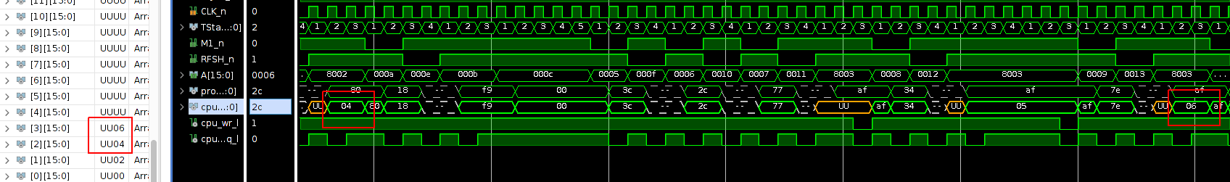
Writing and reading RAM
Simulation plot showing reads from RAM
; Count by 2, each result stores in successive RAM address.
org 0
ld hl, l_ram_start ;
xor a ; a=0
ld (hl), a ; *($8000) = 0
l_loop:
inc a ; A=0+1
inc l ; L==1
ld (hl), a ; *($8001) = 1
inc (hl) ; *($8002) = 1+1
ld a, (hl) ; A=2
jr l_loop
org 0x8000
l_ram_start:
db 0xA5 ; todo initializing A

