Slide 1
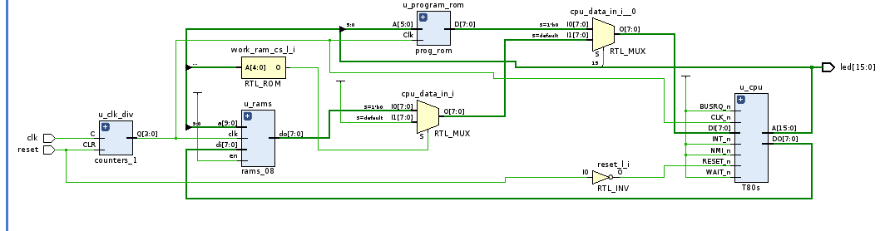
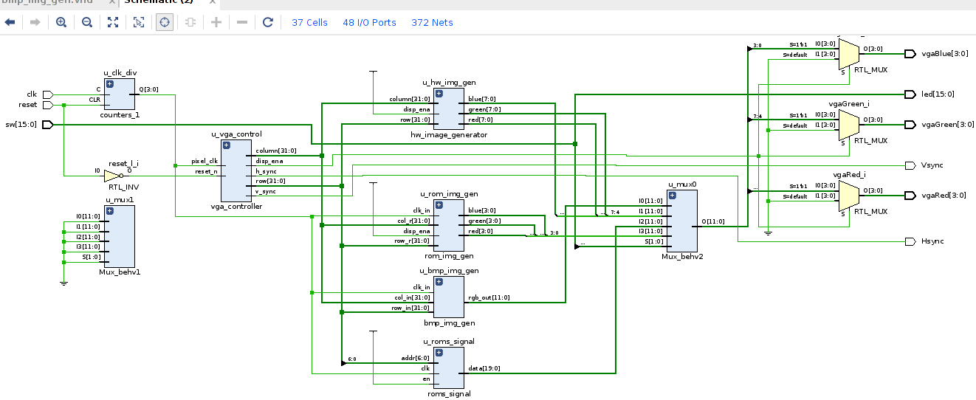

VHDL Coding
Z80 Simulation
G. Neidermeier 06-August-2023

Slide 2
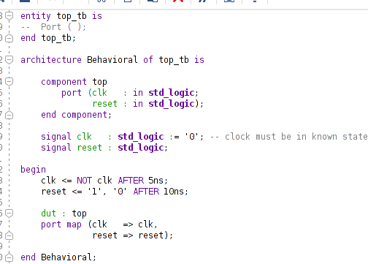
New Project Setup
New project, top.vhd, import constraints .xdc
Import clocks_1.vhd
Create new testbench top_tb.vhd (no ext. I/O ports for testbenches)

Slide 3

Import T80 VHD Files
T80 CPU core “Official” (v247) from OpenCores.org (free reg. Req’d)
Newer versions updated by 3rd parties are to be found in various online FPGA projects and repositories
Download “Latest version” and unpack .tgz in temp directory
Import files from trunk/rtl/vhdl/:
  T80s.vhd (synchronous version)
  T80.vhd
  T80_MCode.vhd
  T80_ALU.vhd
  T80_Reg.vhd (not extended register set)
  T80_Pack.vhd (T80 package library)

Slide 4
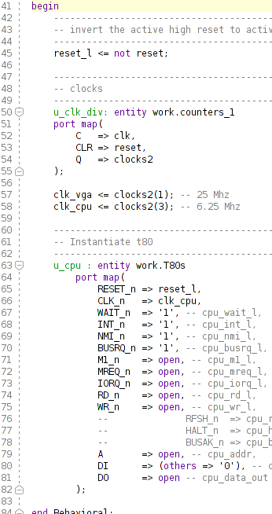
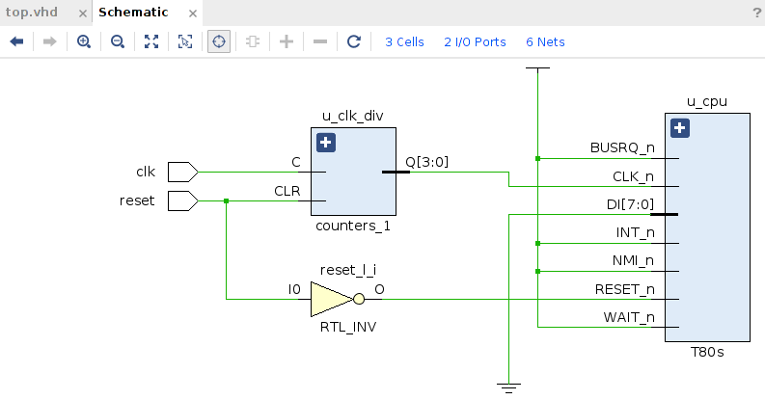
Instantiate T80 Minimal Connections
T80 can be seen in the RTL schematic at this point
Synthesis run can complete but Run Implementation (Place Design) ends in error all leaf cells are optimized away

Slide 5
Code to VHDL ROM
Loading external data to RAM array within VHDL (textio) – slow to synthesize
Generating RAM/ROM .vhdl entity directly from bin, hex or srec: synthesize time is shorter
See t80/trunk/sw/hex2rom.cpp
In Ubuntu, z80asm and z80dasm can be installed into the environment with apt package manager
org 0
ld hl, ram_start ;0100 21 00 80
ld a, 55 ;0103 3e 37 a:=37h
l_loop:
ld (hl),a ;0105 77
inc a ;0106 3c
inc hl ;0107 23
jr l_loop ;0108 18 fb (jr $-3)
org 0x8000
ram_start:
db 00

Slide 6
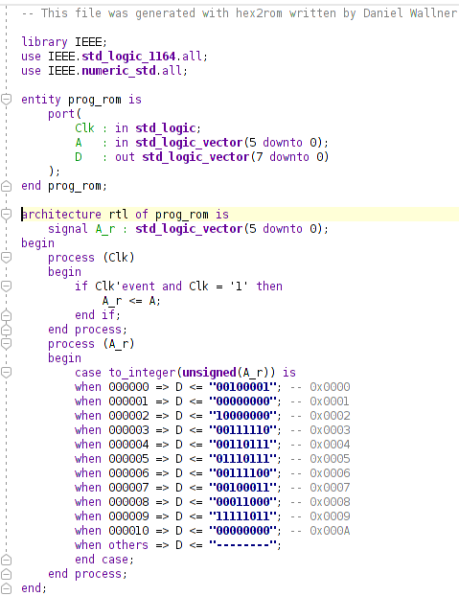
Code to VHDL ROM
org 0
ld hl, ram_start ;0100 21 00 80
ld a, 55 ;0103 3e 37 a:=37h
l_loop:
ld (hl),a ;0105 77
inc a ;0106 3c
inc hl ;0107 23
jr l_loop ;0108 18 fb (jr $-3)
org 0x8000
ram_start:
db 00
6l8s:
6-bit address
LSB-first
8-bit data
Synchronous RAM (registered address)
Generate new VHDL entity prog_rom:
hex2rom -b a.bin prog_rom 6l8s > t80_vga/t80_vga.srcs/sources_1/new/prog_rom.vhd
Example VHDL entity has been written to prog_rom.vhd
Import prog_rom.vhd into Vivado project

Slide 7
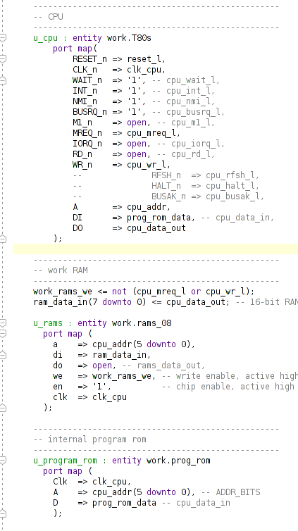
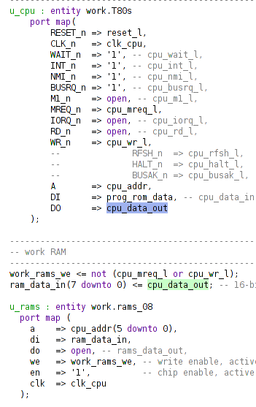
RAM and Address Map
Import rams_08.vhd
Use simplest set of signals to read code from ROM and write test pattern (counter) to RAM
No address decoding (memory mapping) is used
RAM is written when WE (logic high)
MREQ_n == 0 AND WR_n == 0
Boolean logically equivalent to !(mreq_l or wr_l) because WE is logic high input signal to RAM

Slide 8
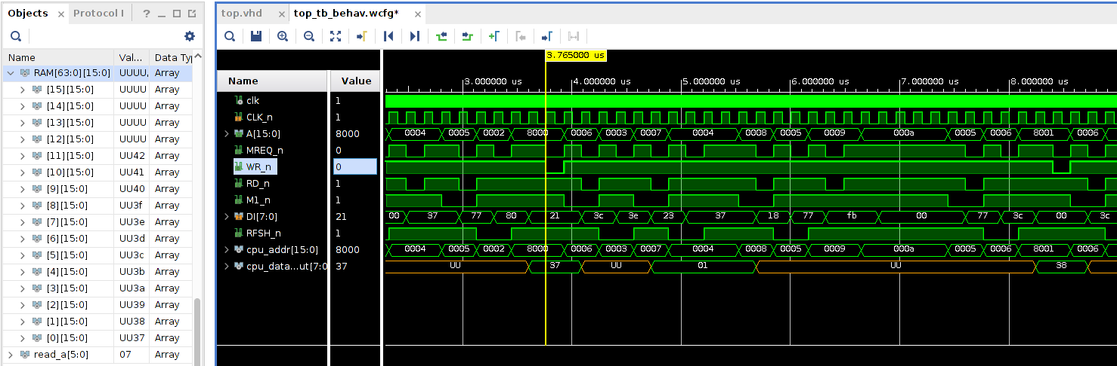
RAM and Address Map
RAM is written when WE (logic high)
MREQ_n == 0 AND WR_n == 0
Demonstrates rams_08 used "as-is" 16-bit data
ram_data_in(7 downto 0) <= cpu_data_out;

Slide 9
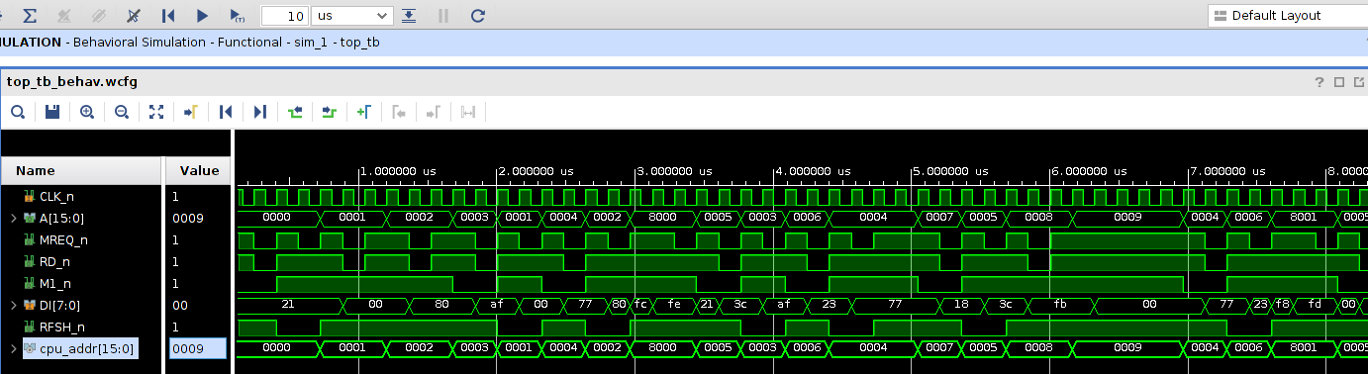
T80 Timing Analysis
5 op-codes in loop code, but R cycles add to total operations (clock cycles) in loop
4.16 us loop execution time
OSC = 1/100Mhz = 100Ns
CPUclk = 160nS = 1/6.25Mhz
About 26 clock cycles: 4.16us / 160ns
.00000416ns x 65536 = 0.273 s (A15 blinks ~ 3.7 Hz)
org 0
ld hl,ram_start ;0000 21 00 80
xor a ;0003 af a := 0
loop:
ld (hl),a ;0004 77
inc a ;0005 3c
inc hl ;0006 23
jr loop ;0007 18 fb (jr $-3)
org 0x8000
ram_start:
db 00

Slide 10
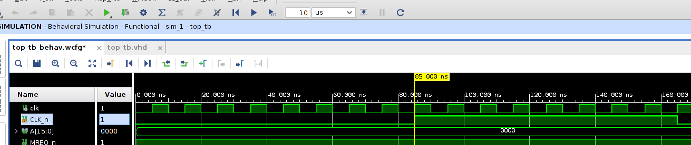
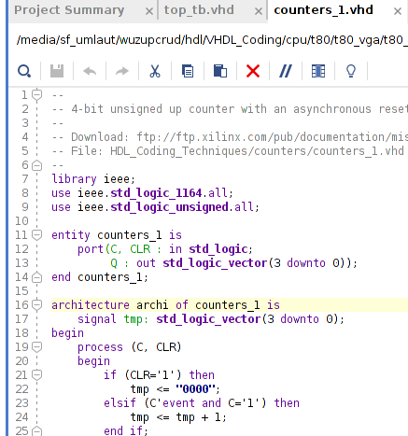
CPU Clock Detail
½ CPU clock = 80 ns but propogation/gate delay 5ns ?
Counter increments on rising edge of Clock

Slide 11
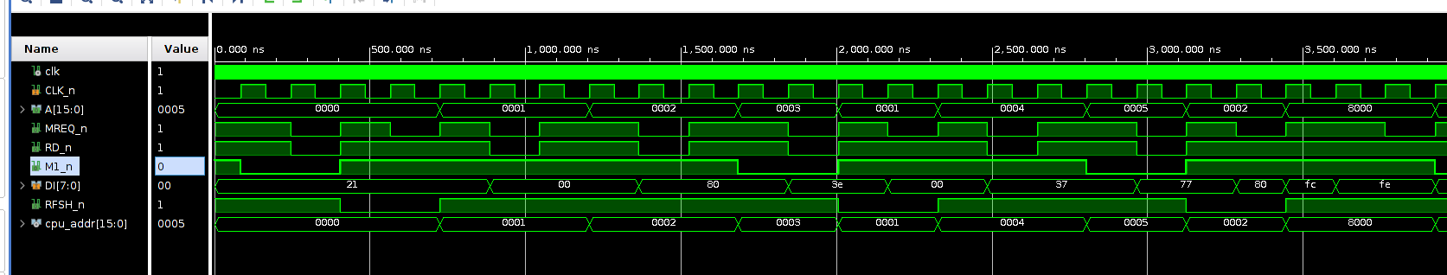
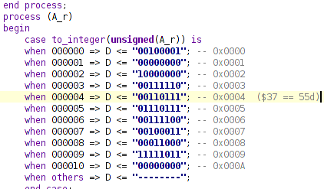
M-cycle, Op-code Fetch (i)
org 0
ld hl,ram_start ;0100 21 00 80
; xor a ; af a := 0
ld a, 55 ;0103 3e 37 a:=37h
loop:
ld (hl),a ;0105 77
inc a ;0106 3c
inc hl ;0107 23
jr loop ;0108 18 fb (jr $-3)
org 0x8000
ram_start:
db 00

Slide 12
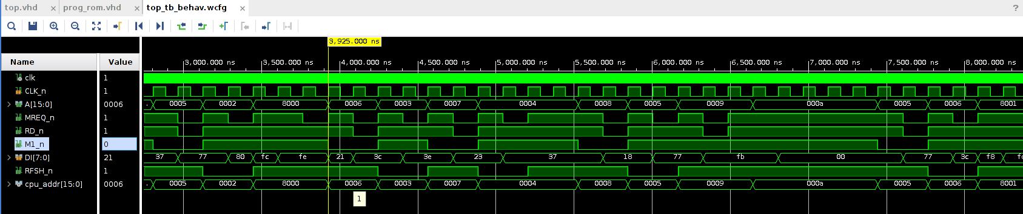
M-cycle, Op-code Fetch (ii)
org 0
ld hl, ram_start ;0100 21 00 80
ld a, 55 ;0103 3e 37 a:=37h
l_loop:
ld (hl),a ;0105 77
inc a ;0106 3c
inc hl ;0107 23
jr l_loop ;0108 18 fb (jr $-3)
org 0x8000
ram_start:
db 00

