Slide 1
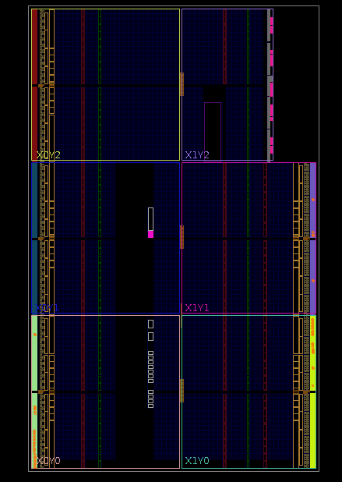

VHDL Image Generator
Project Setup
- G. Neidermeier 2/2023

Slide 2
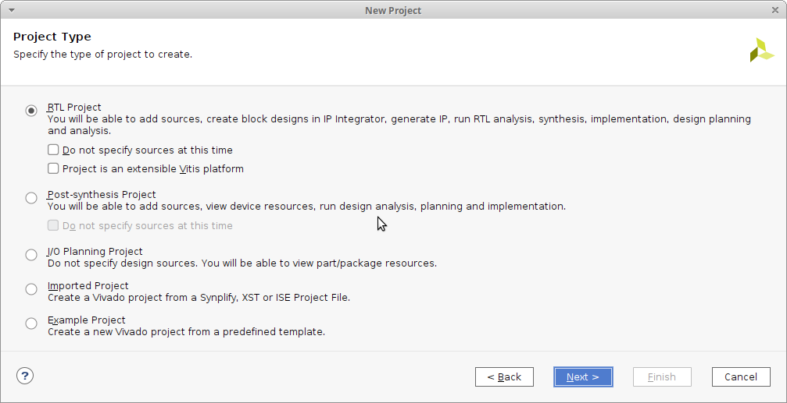
Create New RTL Project

Slide 3
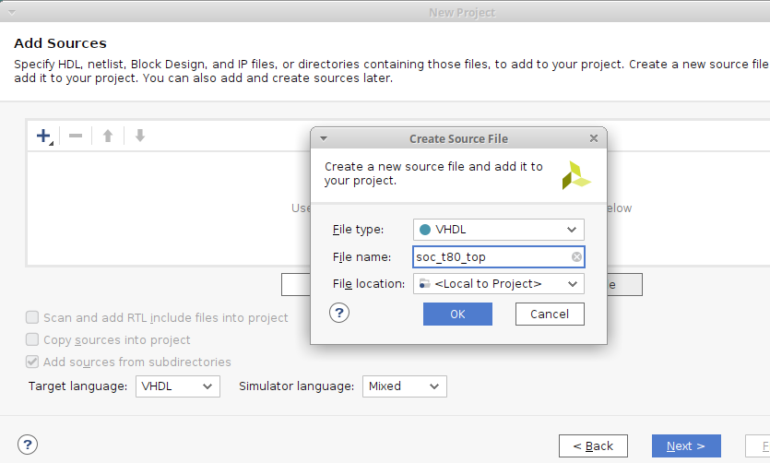
Create Top Source Module

Slide 4
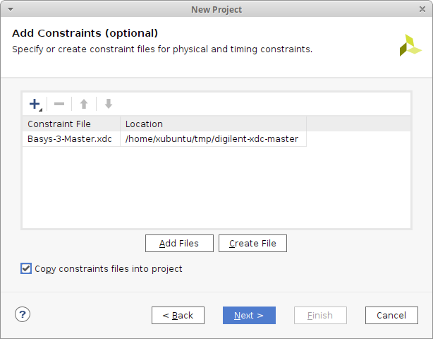
Add Constraints Files
https://github.com/Digilent/digilent-xdc
Copy to project!

Slide 5
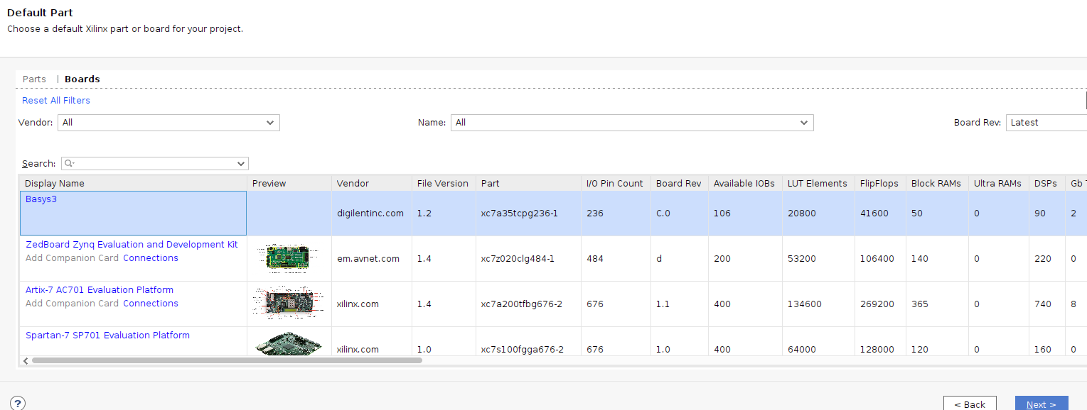
Board File Selection

Slide 6
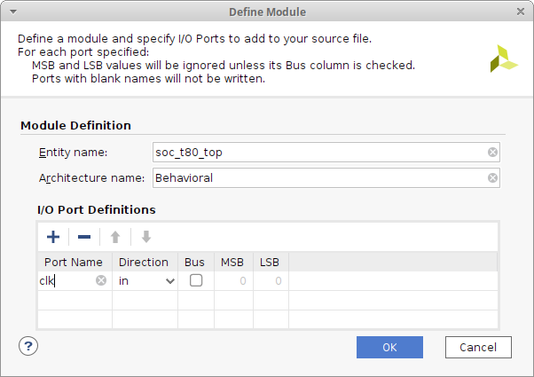
Define top Module
TODO: uncomment clk and IO pins in constraints file
Note: Architecture name can be left default Behavioral (Arch name has implications but they are not binding or concerning for the moment)

Slide 7
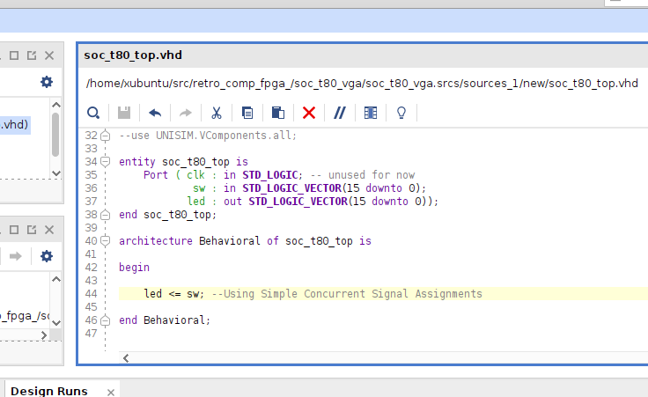
Add VHDL Source to new Module
Logically the LED pins are connected directly to the switches so are updated to the switch states continuously

Slide 8
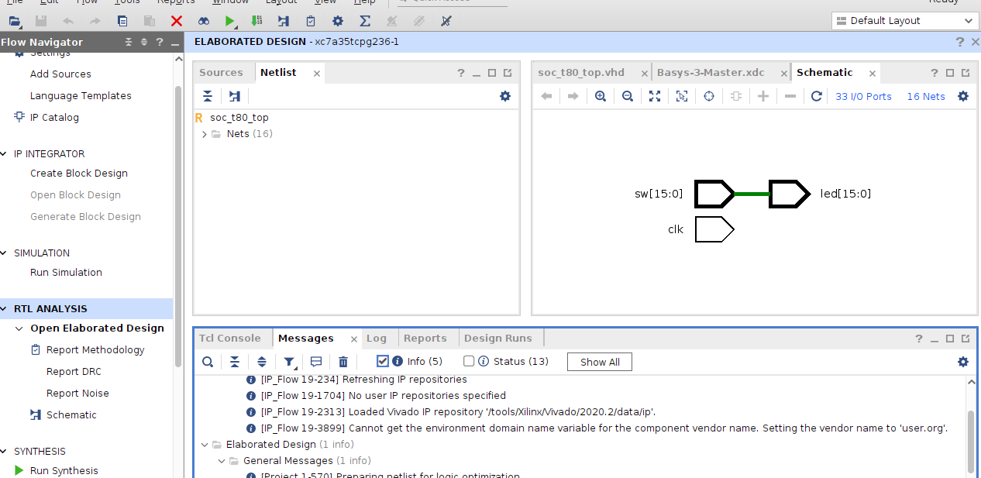
Write Bitstream
Open RTL Analysis | Schematic
Select Generate Bitstream to implement synthesized design
Open Hardware Manager, Open Target, Program Device

Slide 9
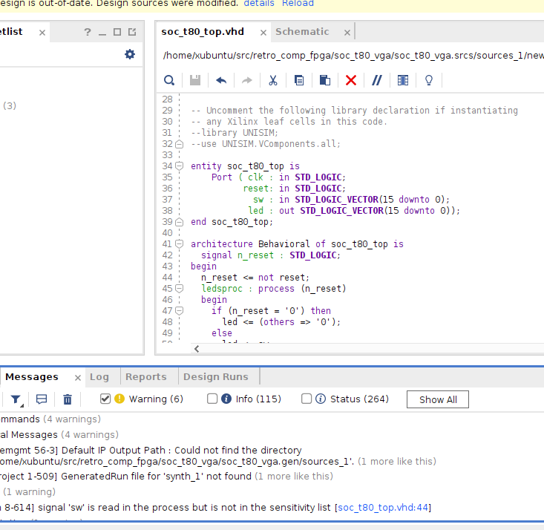
Process and Reset
The synthesis tool warns when signals should be added to the process sensitivity list

