Slide 1
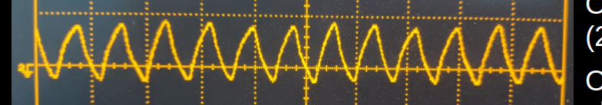

VHDL Image Generator
Clock Generator and External Signal Testing
G. Neidermeier 11-FEB-2023

Slide 2
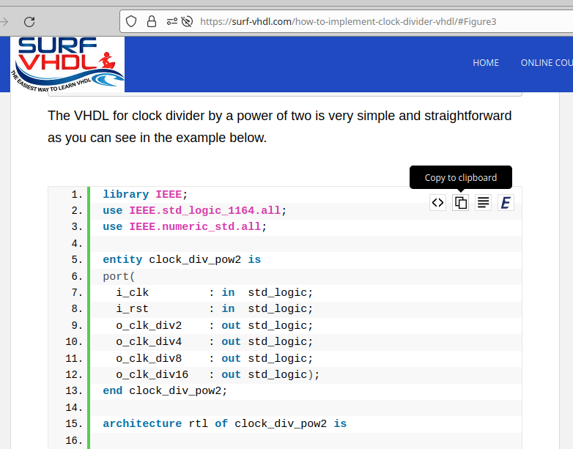
Clock Generator Component
https://surf-vhdl.com/how-to-implement-clock-divider-vhdl/#Figure3
Create a new VHDL file clock_div_pow2
Module Definition not required

Slide 3
Code Formatter
https://g2384.github.io/work/VHDLformatter.html
Check \t 4 space
Module Definition not required
Keyword Case lower

Slide 4
Component Instantiation
Use work library to create instance of clock_div_pow2 Component (more compact syntax)
--------------------------------------------------
-- clocks
--------------------------------------------------
u_clocks : entity work.clock_div_pow2
port map(
i_clk => clk,
i_rst => reset_l,
o_clk_div2 => open,
o_clk_div4 => clk_vga,
o_clk_div8 => open,
o_clk_div16 => clk_vga
);

Slide 5
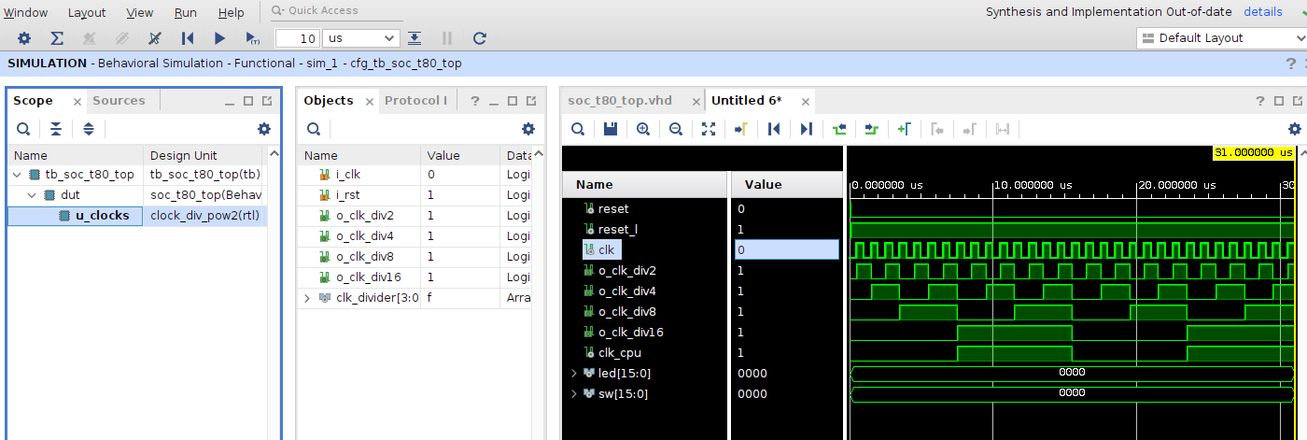
Simulation of Clock Divider
Simulation Result
Re-arranged traces show signals under subcomponents

Slide 6
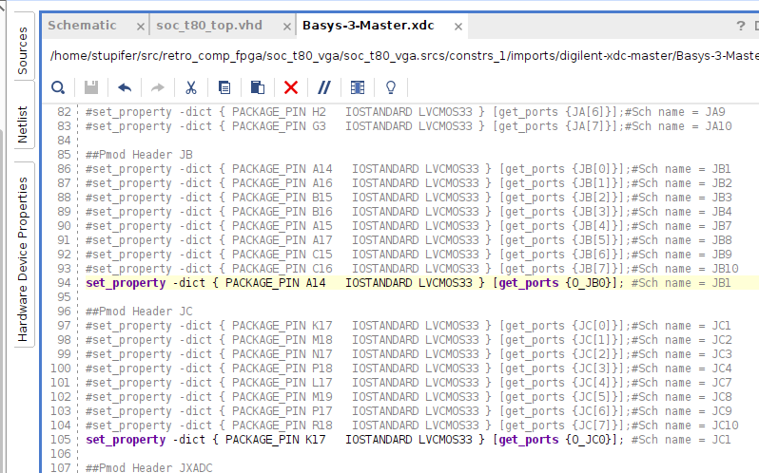
Measure Clock Signals
Define output pins in constraints file

Slide 7
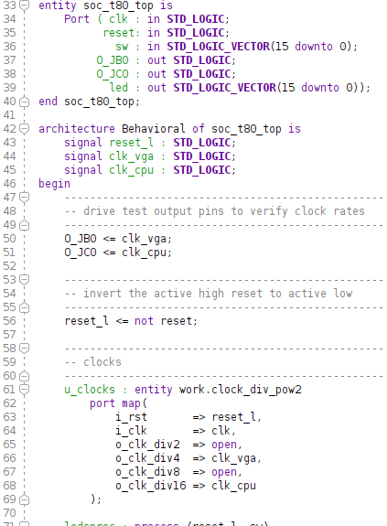
Measure Clock Signals
O_JB0 and O_JC0 Out ports added in entity
Drive O_JB0 and O_JC0 from VGA clock (25 Mhz) and CPU clock (6.25 Mhz)

Slide 8
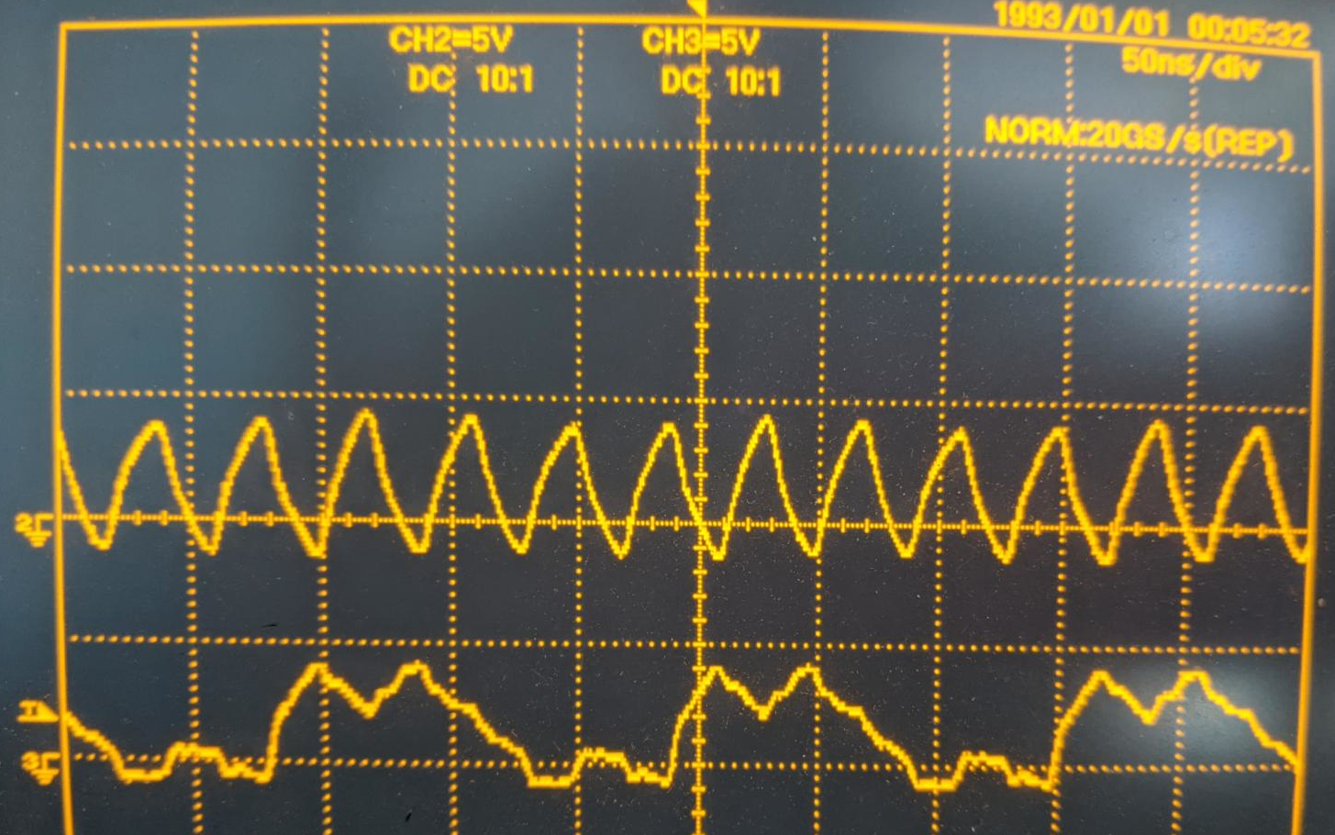
Measure Clock Signals
Scope bandwidth is just barely adequate to verify signal frequencies:
O_JB0 <= VGA clock (25 Mhz)
O_JB0 <= CPU clock (6.25 Mhz)

