Slide 1
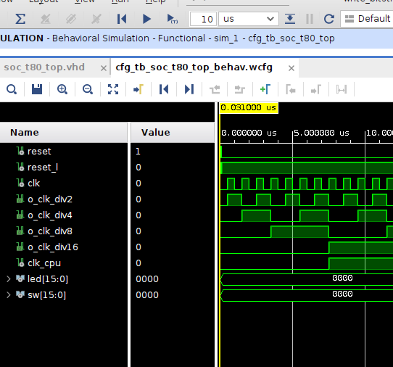

VHDL Image Generator
Test Bench
- G. Neidermeier 11-Feb-2023

Slide 2
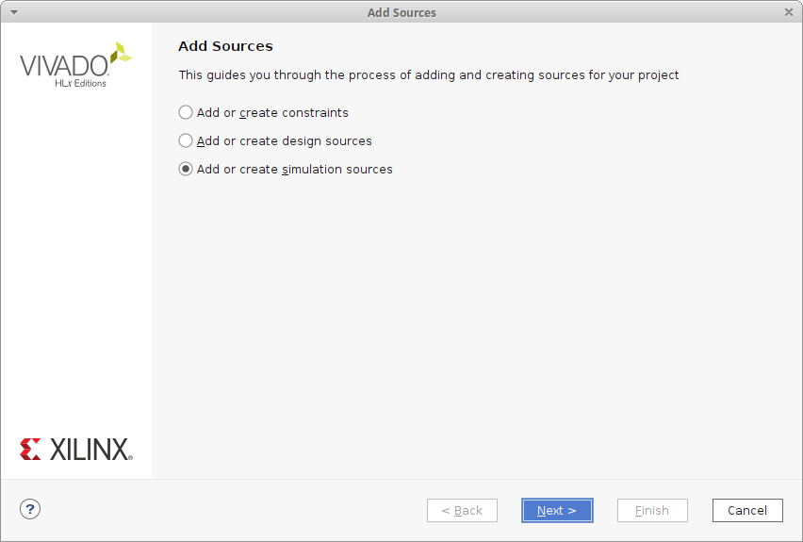
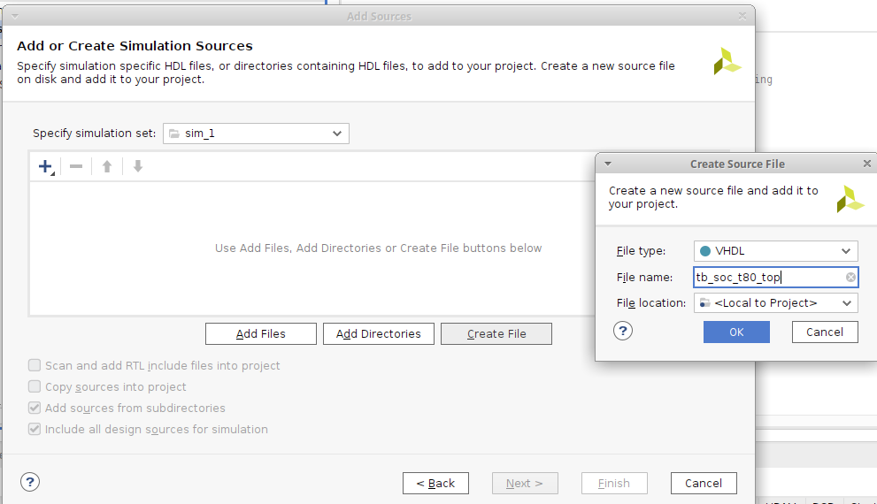
Add New Simulation Source
Add or create simulation sources
Create new VHDL source tb_soc_t80_top
Simulation source has no ports so Module Definition can be left default

Slide 3
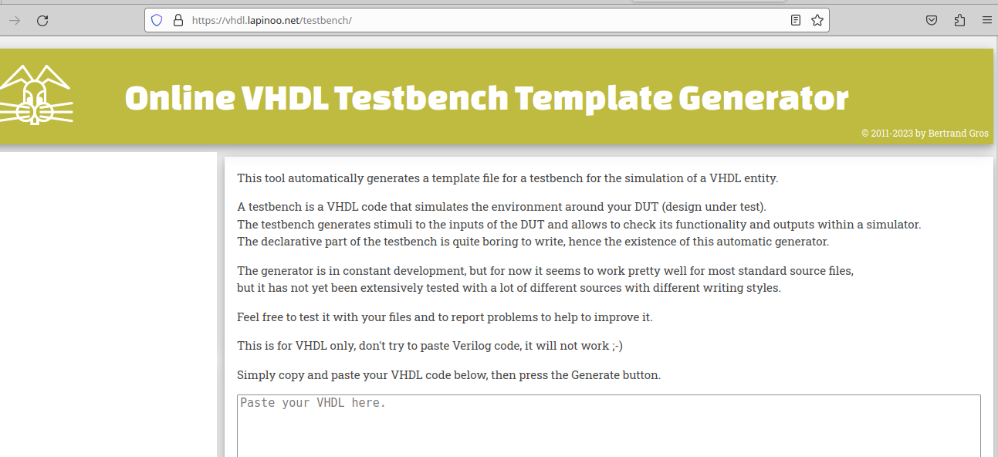
VHDL Test Bench Template
Online generator
https://vhdl.lapinoo.net/testbench/

Slide 4
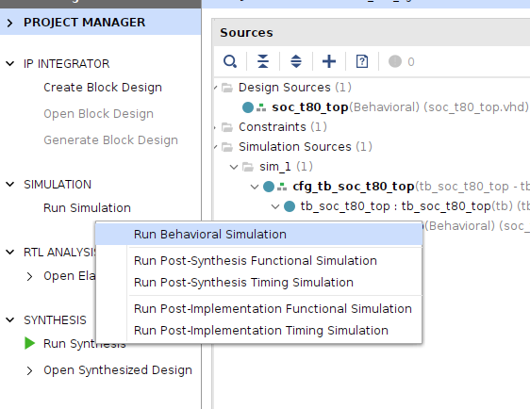
Behavioral Simulation

Slide 5
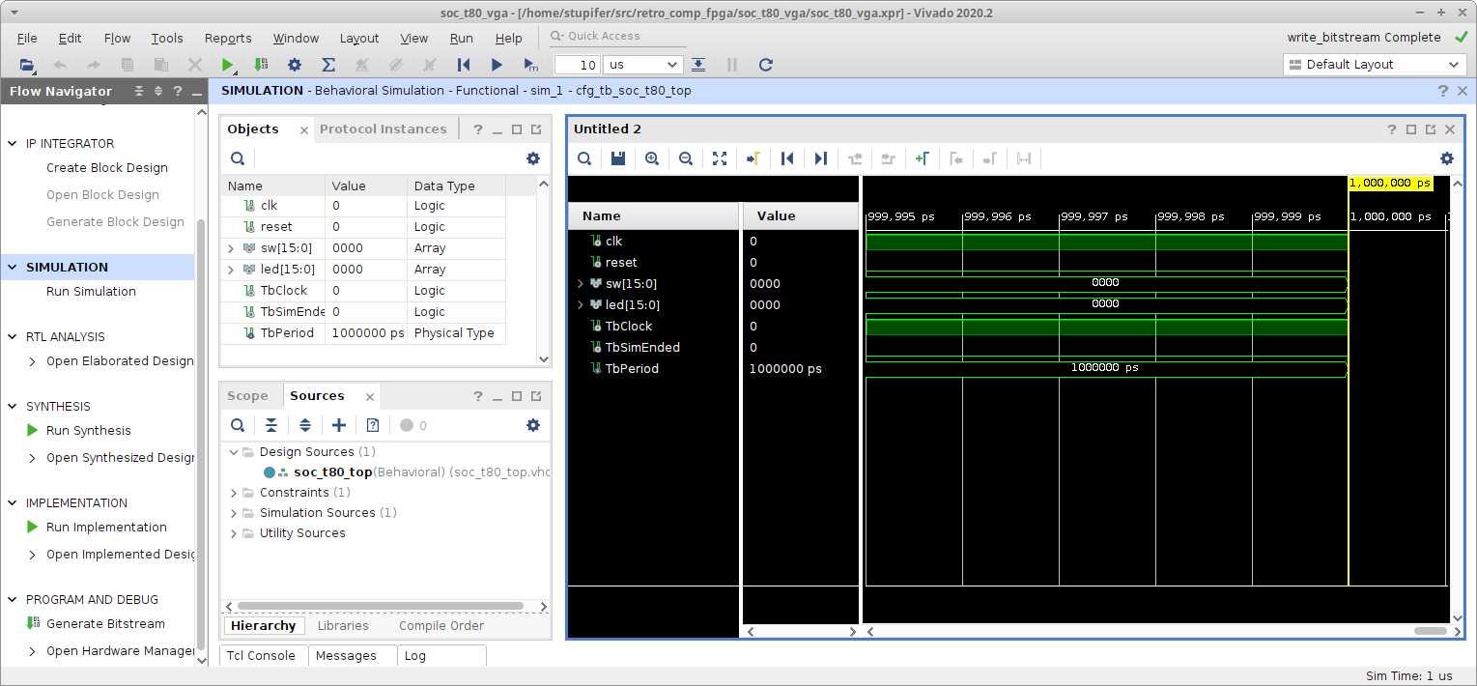
Behavioral Simulation
Default sim runtime is 1000 ns

Slide 6
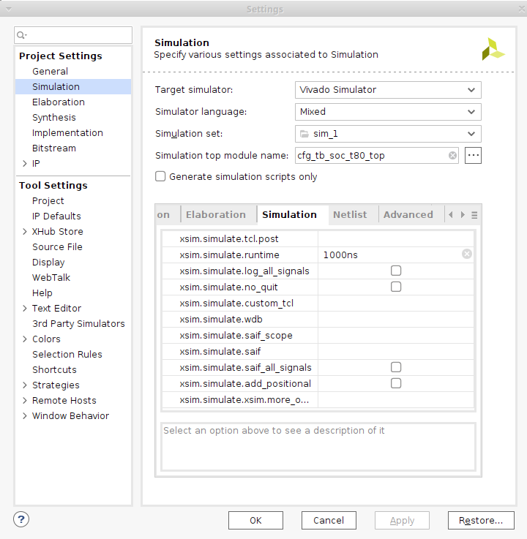
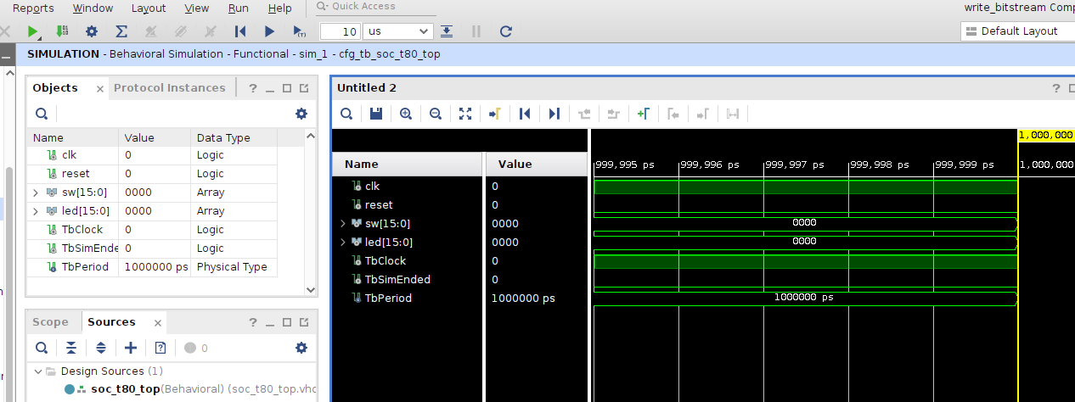
Behavioral Simulation
Default sim runtime is 1000 ns
Default sim runtime is 1000 ns

Slide 7
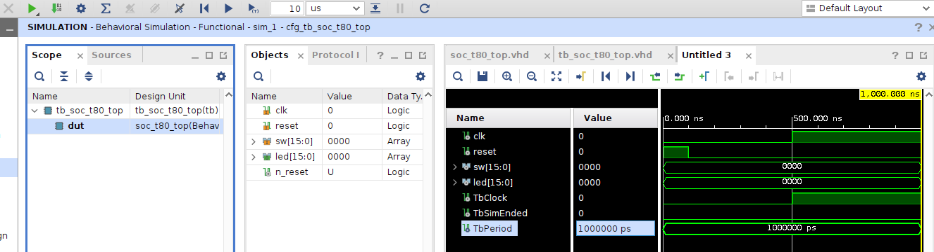
Behavioral Simulation
not TbClock after TbPeriod/2
TbPeriod = 1000nS
N reset after 100 ns;

Slide 8
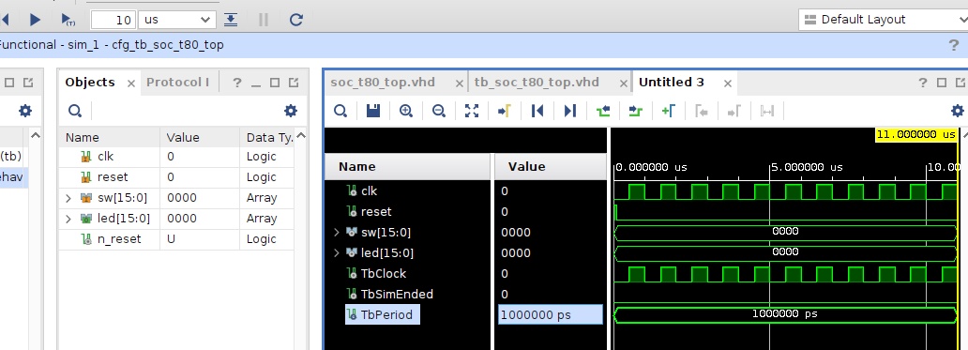
Behavioral Simulation
Shift+F2 runs +10 uS
Zoom In/Out/Fit, Next/Previous Transition

