Slide 1
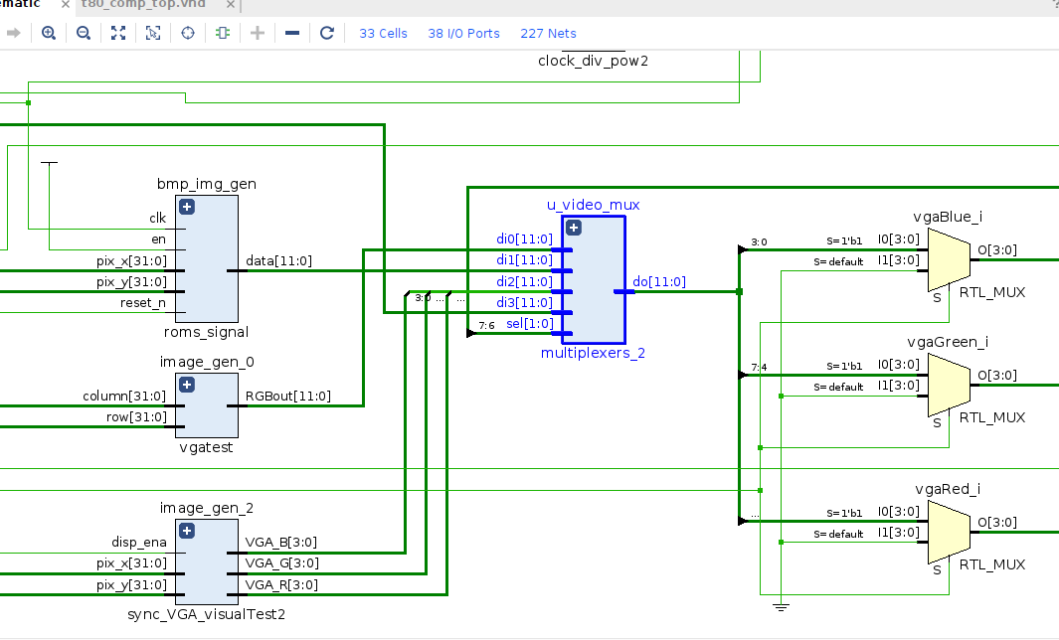

VHDL Image Generator
Video Signal Mux
- G. Neidermeier 12-Feb-2023

Slide 2
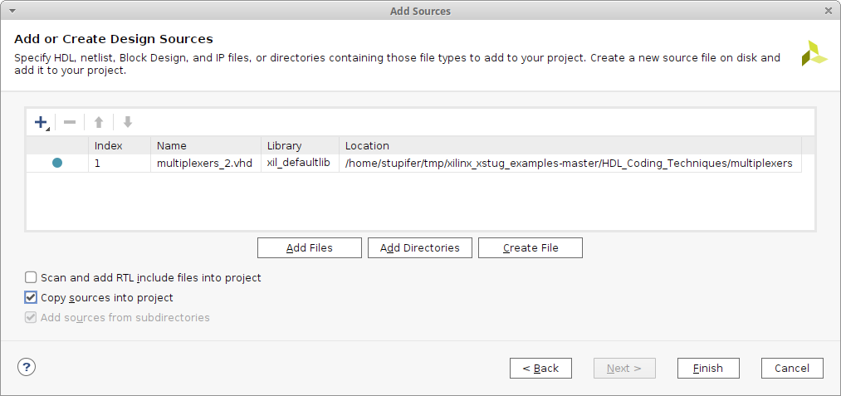
Import Multiplexer Template
Import mux example from xstug_examples.zip
File: HDL_Coding_Techniques/multiplexers/multiplexers_2.vhd
Imports to sources_1/imports/multiplexers
Be sure to check Copy sources into project

Slide 3
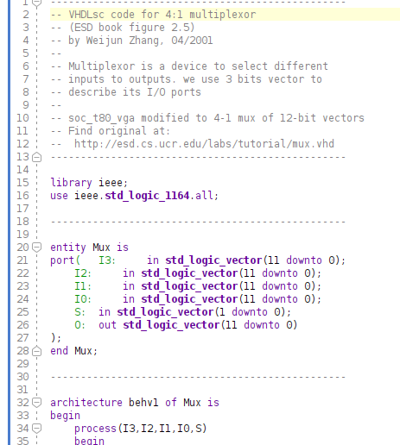
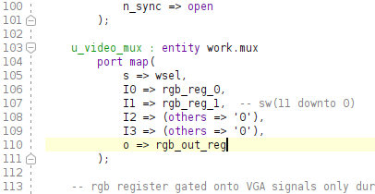
Modify Mux for Video Data Bus
4-1 mux example:http://esd.cs.ucr.edu/labs/tutorial/mux.vhd
Modified to 12-bit vectors
Instantiated with active inputs to I0 and I1 (I2 and I3 are grounded)

Slide 4
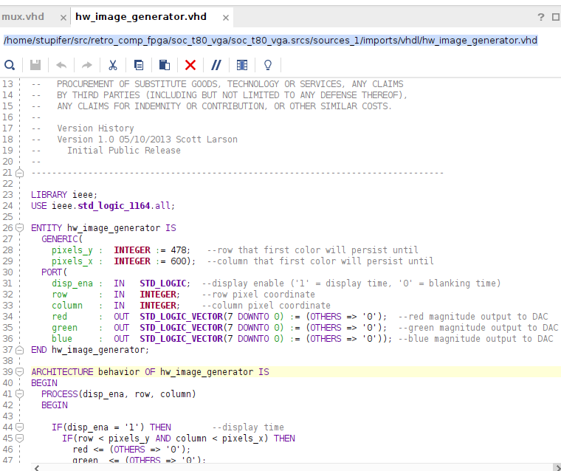
Create Additional Image Source
https://forum.digikey.com/t/vga-controller-vhdl/12794
Import Downloads/vhdl/hw_image_generator.vhd
Imports to sources_1/imports/vhdl/

Slide 5
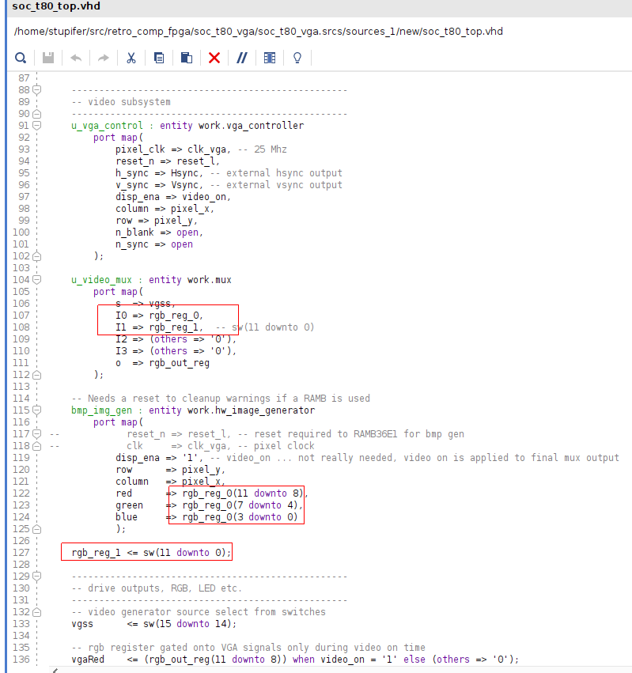
Video Data Select Source
Video source 0 is rgb_reg0 from bmp_img_gen
Video source 1 is rgb_reg_1 from switches
I0 and I1 inputs to mux from video data bus signals 0 and 1
Video source select from sw14+sw15

Slide 6
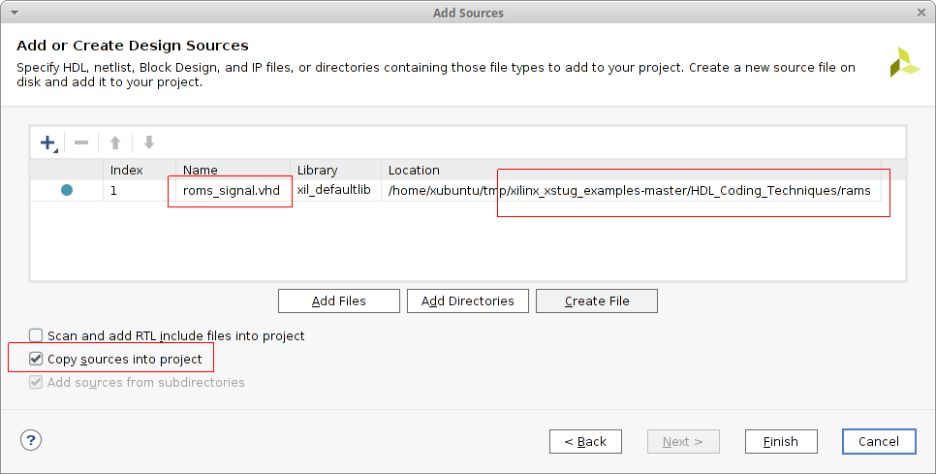
Add Source File for ROM
Xilinx xstug example roms_signal.vhd
Imports to soc_t80_vga/soc_t80_vga.srcs/sources_1/imports/rams/

Slide 7
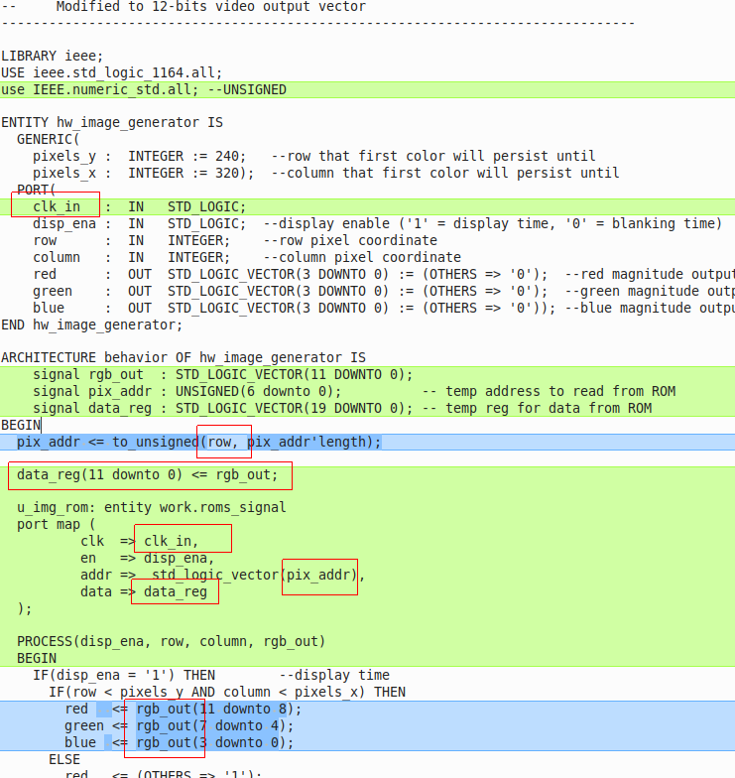
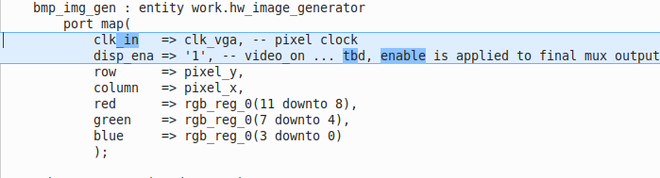
VGA Pixel Data from ROM
to_unsigned() converts integer row to unsigned which is the type of pix_address (indexes into ROM)
clk_in is required port input to clock the ROM
roms.signal is 20-bitsx128 but only 12-bits are connected to VGA signal output
Reference for conversions: https://nandland.com/common-vhdl-conversions/#Numeric-Integer-To-Std_Logic_Vector

Slide 8
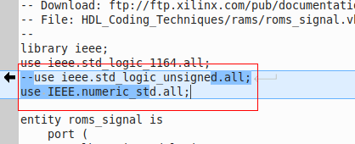
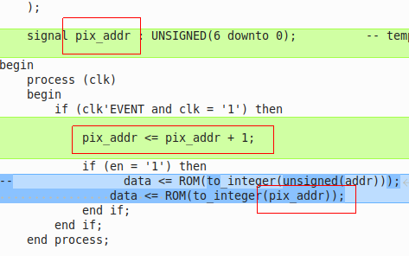
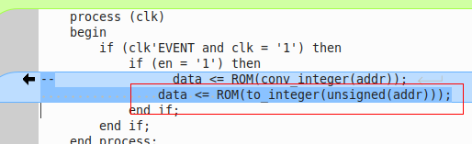
More ROM Addressing
Define pix_addr as integer
ROM address from simple counter

Slide 9
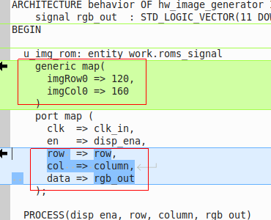
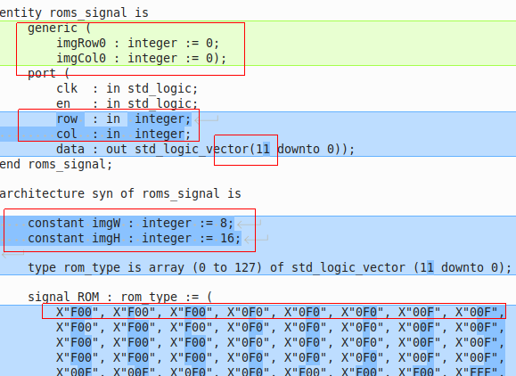
New and Improved Image Generator
Add Generic row/column image placement parameters
Add row/column parameters in place of address
Generic inputs are initialized to 0 to illustrate that the map assignments take precedence
Data vector length changed to 12 bits (RGB bus width)
RGB 8x16 test pattern in ROM size

Slide 10
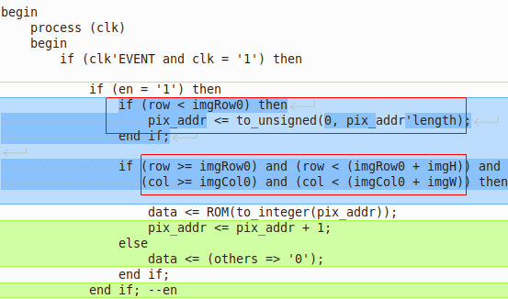
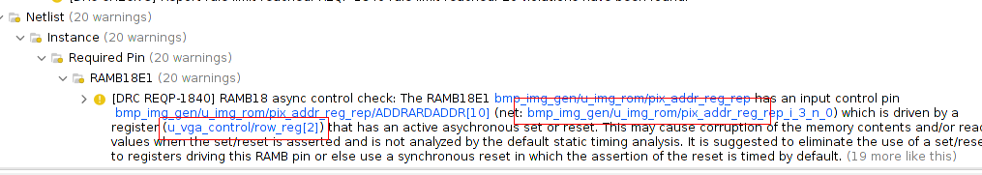
Pixel Address Calculation
When row is less than imgRow0 then pix_setaddr is reset
Pixel address increments and data is clocked from ROM when row and column are within image display boundary
Pixel data is reset to 0 when row and column are outside of image display boundary
But the DRC warning needs to be investigated!

Slide 11
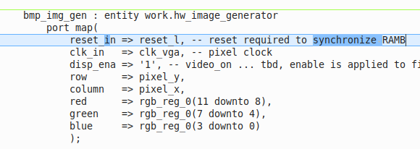
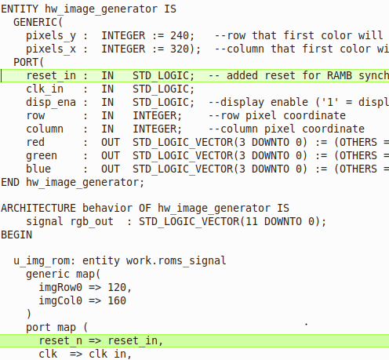
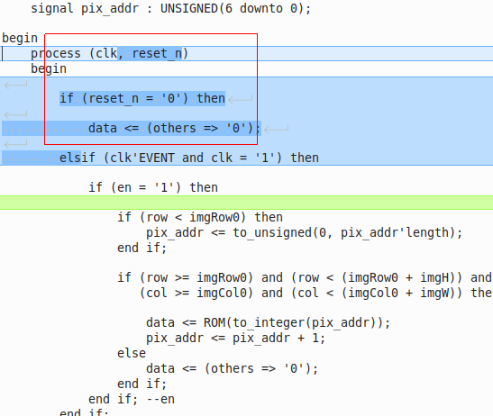
Reset RAMB - Design Rule Check Warning
VGA sync component output signals row, column etc. to ROM which must be sync’d to the same reset
The reset conditional block clears the data register and the DRC message goes away

