Slide 1
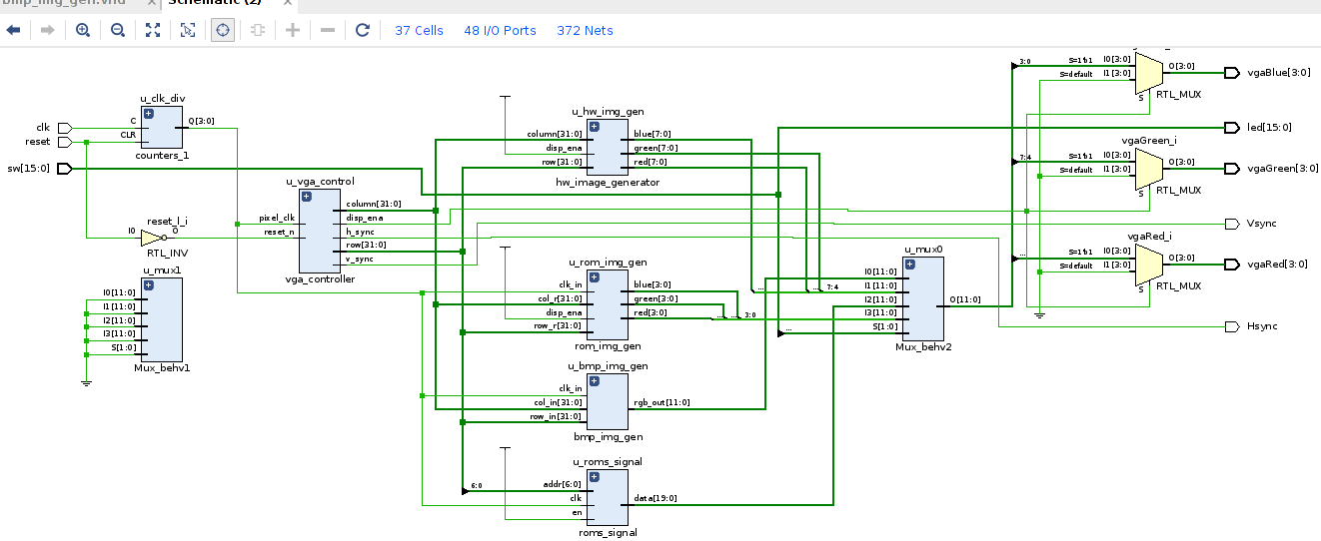

VHDL Coding
Bitmap File Loader
G. Neidermeier 06-August-2023

Slide 2
Bitmap File Format
Device independent, uncompressed RGB raster data
See https://vhdlwhiz.com/read-bmp-file/ and others
Simple example, 24-bit color (3-byte (24-bit) RGB per pixel)
Only needs to parse the image W and H from the header and then read in the pixel data to populate an array of std_logic_vector

Slide 3
Loading Text Files in VHDL
Refer to soc_t80_bmp_file.odp and rams_20c.vhd
Convert .bmp (binary) to text-hex (note: HREAD appears in VHDL-2008 prior to which there is not a hex option with READ)
Data is read into an array which is then inferred as a memory (LUT based or BRAM depending upon the memory configuration and other details)
od -v -t x1 $RGB_IN | cut -c 9- | tr '\ ' '\n' > $RGB_OUT
use ieee.std_logic_textio.all;
use std.textio.all;

Slide 4
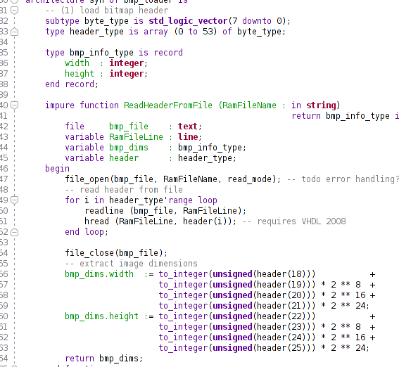
Parsing BMP Header
subtype byte_type
type header_type is array
type bmp_info_type (record)
impure function (as opposed to pure, i.e. no side-effects)
readline, then hread into header(i)
Parse bitmap dims from header array (unsigned 32-bit) into bmp_dims.width and bmp_dims.height

Slide 5
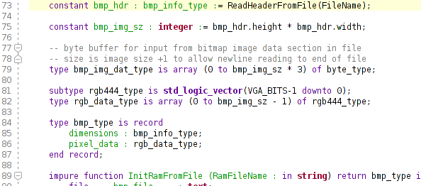
BMP Image Supporting Data Structures
bmp_hdr returned from ReadHeader function
bmp_img_sz from bmp_hdr (to size the array exactly to the image tile size)
Array of byte_type (8-bit std_logic_vector) is sized bmp_img_sz * 3 (24-bit RGB)
24-bit to be converted to 12-bit RGB (rgb444_type) specific to Basys 3 VGA.
bmp_type to be returned from InitRamFromFile(), providing caller with BMP image dimensions and pixel_data

Slide 6
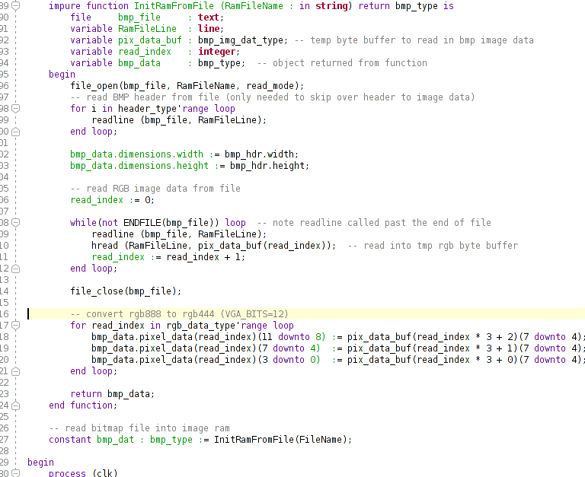
Reading BMP Image Data
Needs to (re)open the BMP file and “seek” past the header again (no VHDL fn to do this?)
Read image data - disregard color-depth BPP at this point
Copy “raw” BMP image data into bmp_data (organized as array of 12-bit vectors)
Note 12-bit RGB triples take thee 4-most-significant-bits of from 24bpp data
Return value of function to bmp_data

Slide 7
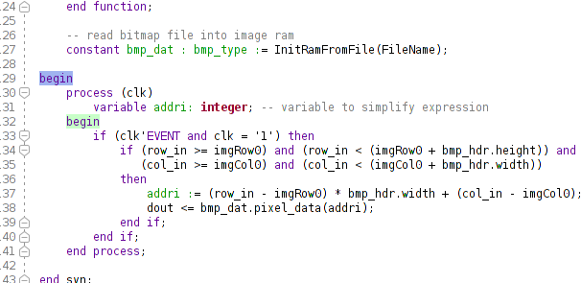
Adress Generator and Pixel Output
Declare a VHDL variable to simplify integer address generation
VHDL process sensitive to clk signal
Test if current pixel location is within desired image boundaries
dout from .pixel_data array

Slide 8
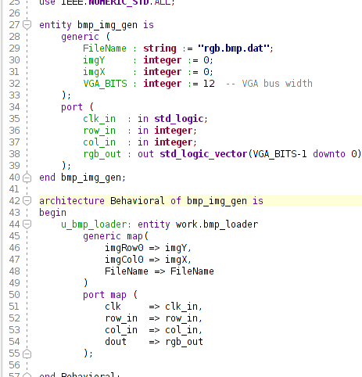
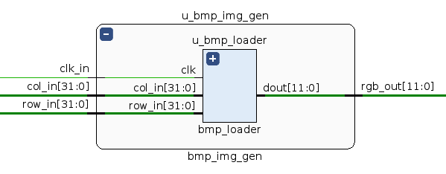
bmp_loader entity Instiantiation
bmp_loader as sub-component of bmp_img_gen

