Slide 1
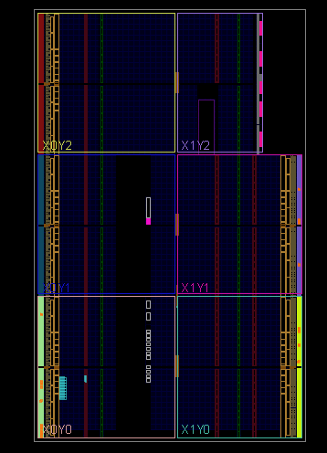

VHDL Coding
Seven Segment Display
G. Neidermeier 22-July-2023

Slide 2
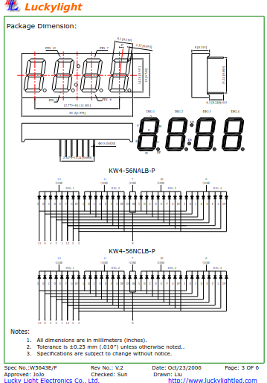
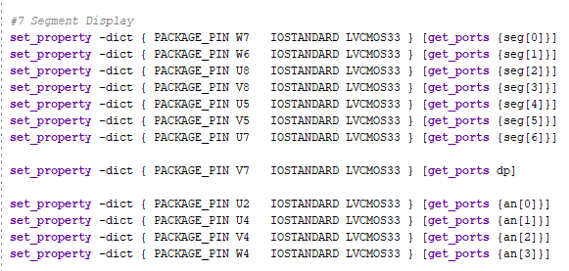
Principle of SSD
Multiplexed operation, only 1 digit at any time is being driven
Common anode and common cathode flavors
Each SSD digit common anodes (anodes) connect together so 1 anode (cathode) drive signal per digit
7 segments are controlled by individual cathode (or anode) driver signals
Decimal point has own anode and cathode signals

Slide 3
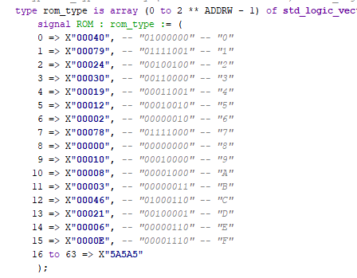
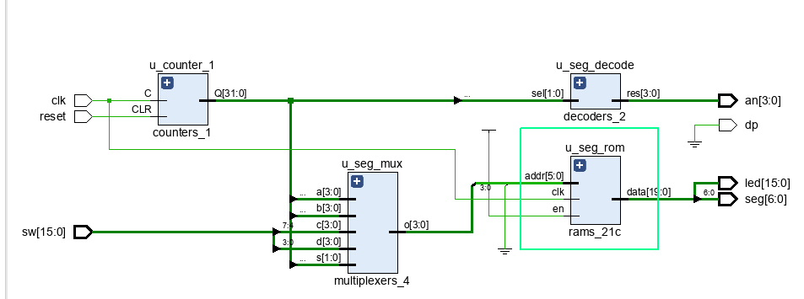
Hex to Segment Translation
Each of the possible 16 hex characters needs to know what cathodes (segments) are active
Table lookup 16 sets of anode configurations
Using an array is one approach, another is a case statement, which the tool likely emits the same RTL either way.

Slide 4
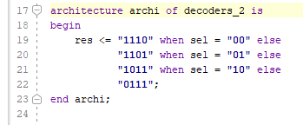
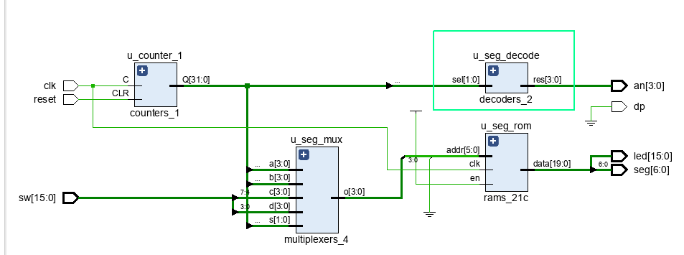
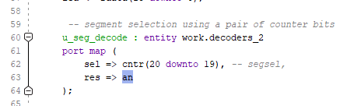
Anode Drive Selection
Only 1 digit active at any time because of multiplexing – the 1 of 4 active digit expressed as 2-bit vector (2^2)
A decoder enables only 1 of it’s 2^[width of select bus] which we express in VHDL as a vector of width [2^[width of select bus]]
SSD requires decoder with 4 output signals selected by input bus of 2^2 bits
The signal to the anodes is active low so the the decoder referred to as “one cold” (as opposed to one hot)
The 2-bit output-select vector to the decoder is sourced from 2 bits of a free-running counter that fast enough to multiplex the 4-digits of the SSD

Slide 5
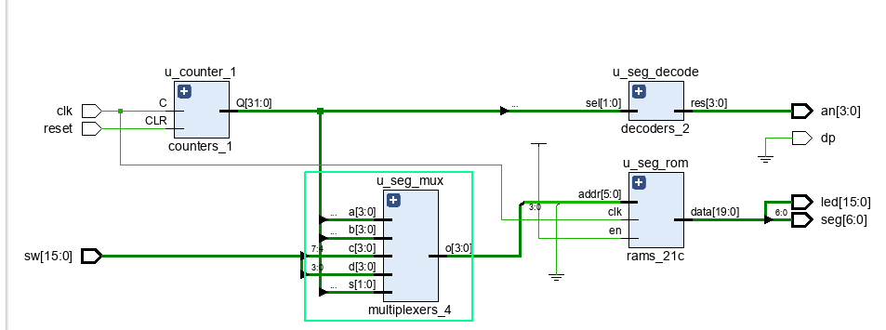
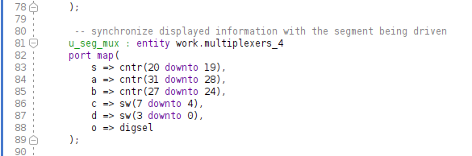
Digit Selection
Multiplexer, 4 ports, 4-bits wide
Displays 8-bit count on 2 SSDs
8 switches control 2 SSDs

Slide 6
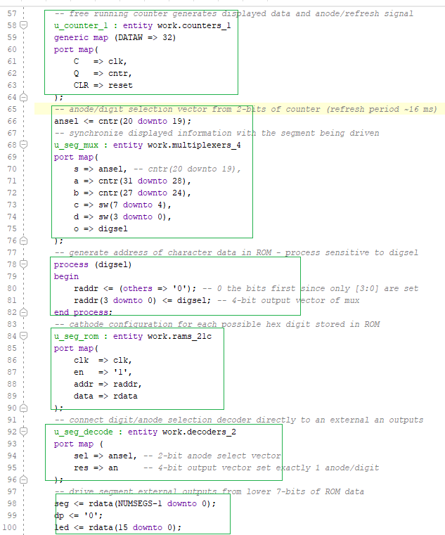
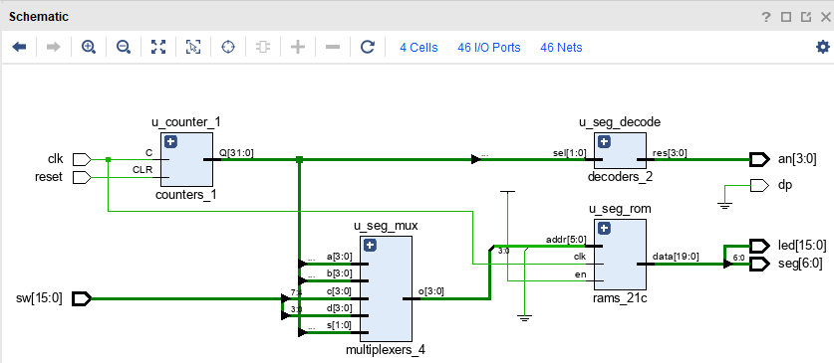
Finished Circuit
4 entity instantiations and 1 process

