Slide 1
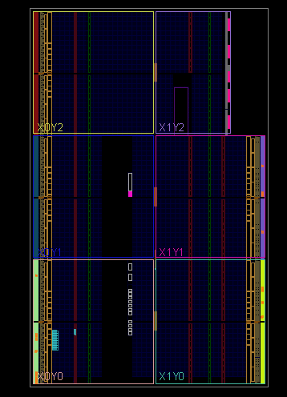

VHDL Image Generator
BRAM Content from External Data File
G. Neidermeier 18-July-2023

Slide 2
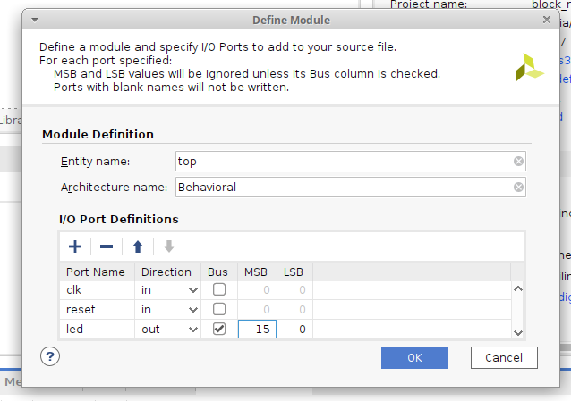
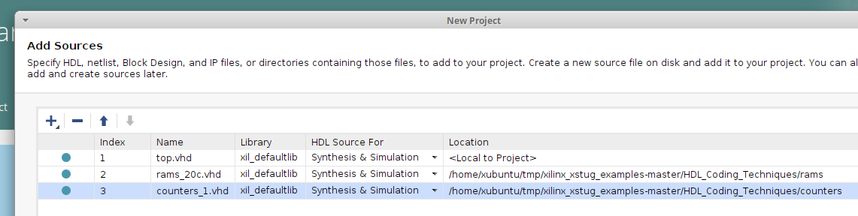
Inferenced BRAM
New project:
HDL_Coding_Techniques/rams/rams_20c.vhd
HDL_Coding_Techniques/counters/counters_1.vhd
Copy HDL_Coding_Techniques/rams/rams_20c.data (do not import into project)
Optional – populate I/O Port Definitions

Slide 3
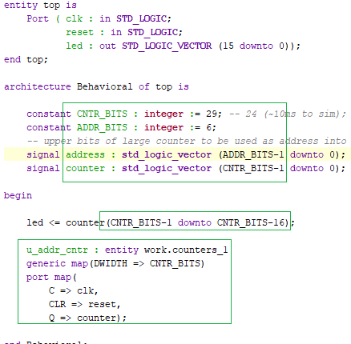
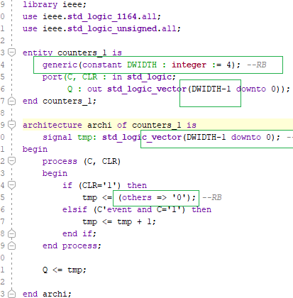
Instantiate Counter
New project:
HDL_Coding_Techniques/rams/rams_20c.vhd
Added generic bus size and data width in counters_1.vhd

Slide 4
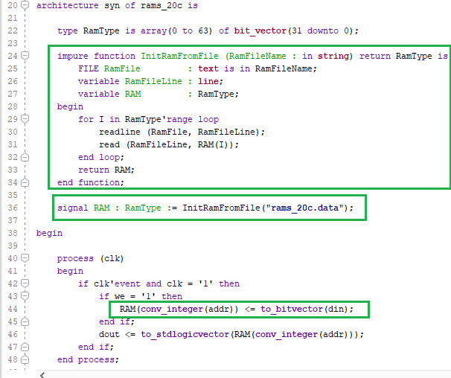
BRAM Content from File
VHDL impure function
The impure function runs during synthesis
Can be thought of as a “preprocessor”
Large data file slows the synthesis tools - better to convert directly to .vhd with some external script/tool/program outside of Vivado

Slide 5
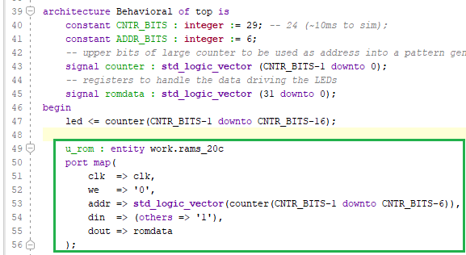
Instantiate RAM
u_rom
Connect addr input to counter (converted to std_logic_vector)
Connect dout to romdata register

Slide 6
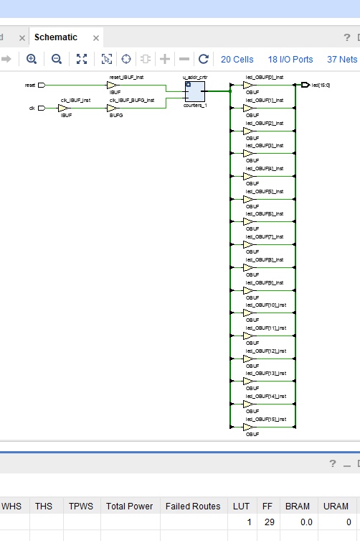
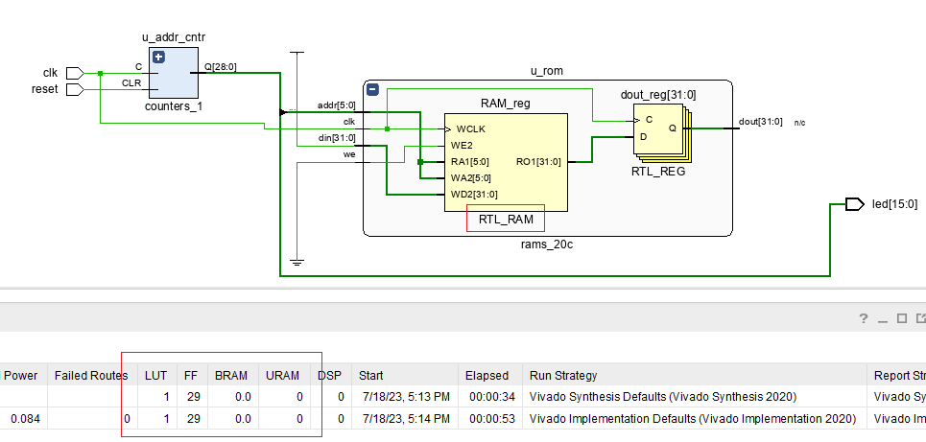
RTL Schematic
dout is n/c
RTL schematic shows an RTL_RAM and RTL_REG to dout (n/c)
Synthesis schematic reveals that the tool optimizes away the RAM that is not connected

Slide 7
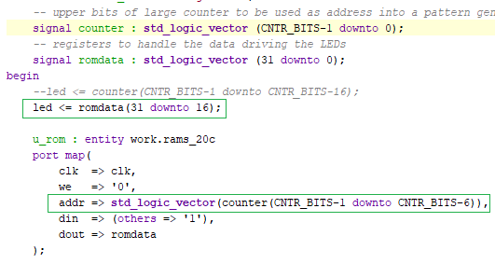
Connect RAM Data
u_rom
Connect addr input to counter (converted to std_logic_vector)
Connect led ports to romdata

Slide 8
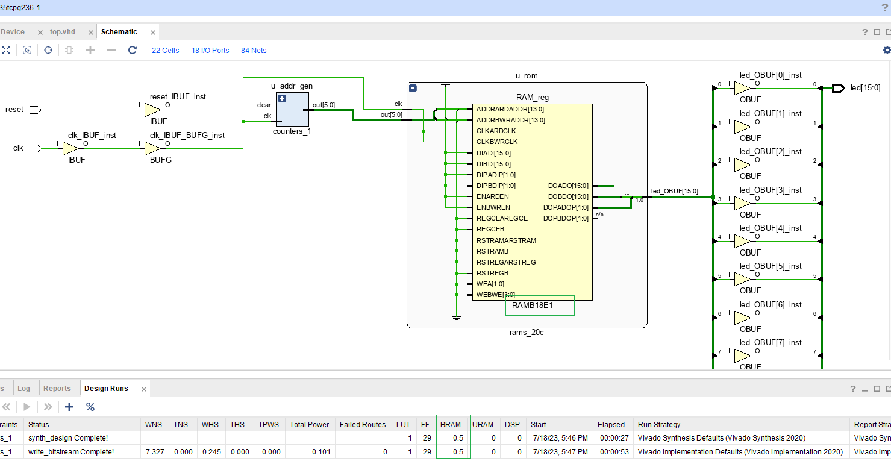
Synthesis Tool Infers RAM
The RAMB18E1 can be invoked explicitly but then the VHDL code is vendor/tool dependant.

