Slide 1


VHDL Image Generator Project
Xilinx Vivado Installation Guide
- G. Neidermeier Feb-15-2023
Revised July-13-2023

Slide 2
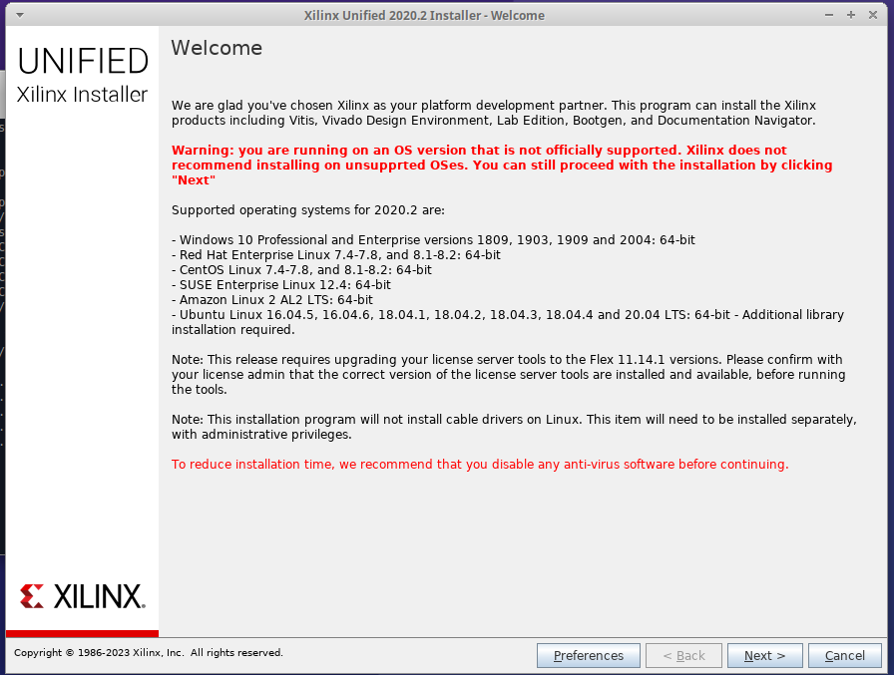
Install Notes for Xilinx Vivado
Vivado Download – requires Xilinx/AMD account registration with email.
Vivado 2020.2 release (support of Artix-7 supports ends thereafter).
Unified Windows/Linux installer (45Gb): Xilinx_Unified_2020.2_1118_1232.tar.gz
Plan 60 Gb installation size (can be local to user)
Note Vivado 2020.2 support stops at Ubuntu 20.04
Prerequisites on Ubuntu 20.x:
  apt install build-essential libtinfo5 picocom

Slide 3
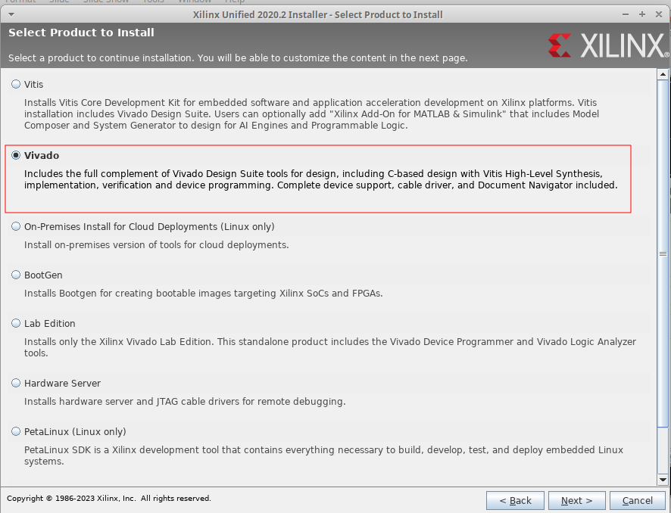
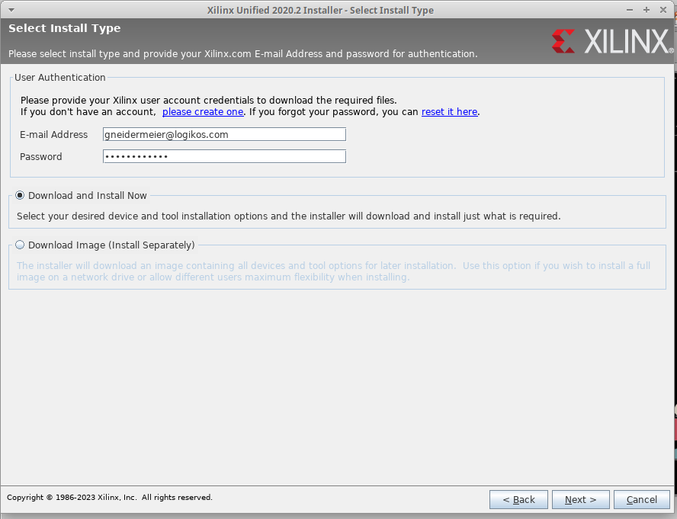
Install Type and Product Selection
The Unified Installer will go directly to Select Product. The web install client requires login to Xilinx account.
Web Install client options to Download Image Install Separately or Download and Install Now
The web installer does a good job of resuming broken downloads, but could be an all-niter depending on your Internet!
Selected Vivado (Vitis Design Suite is not covered in this presentation)

Slide 4
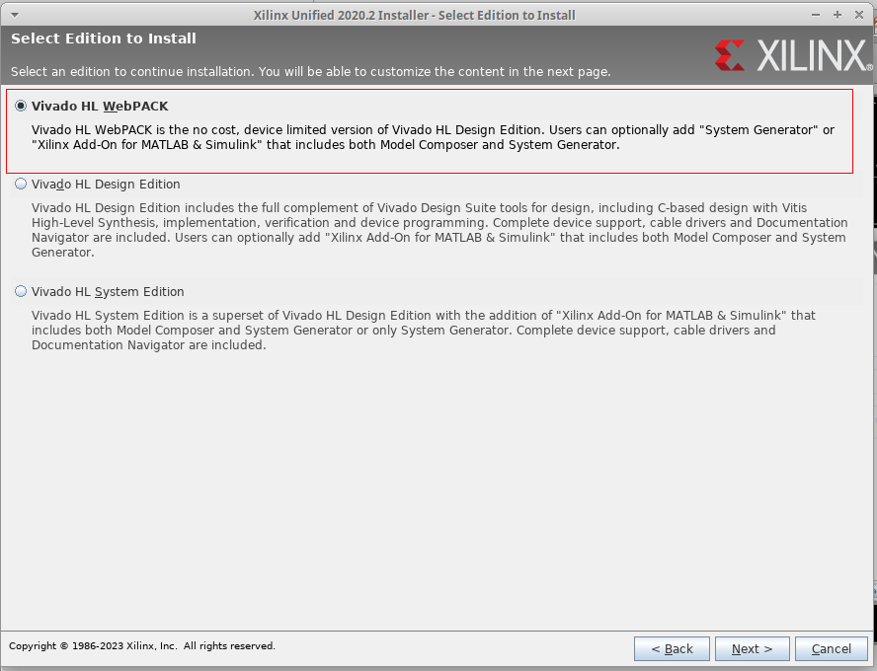
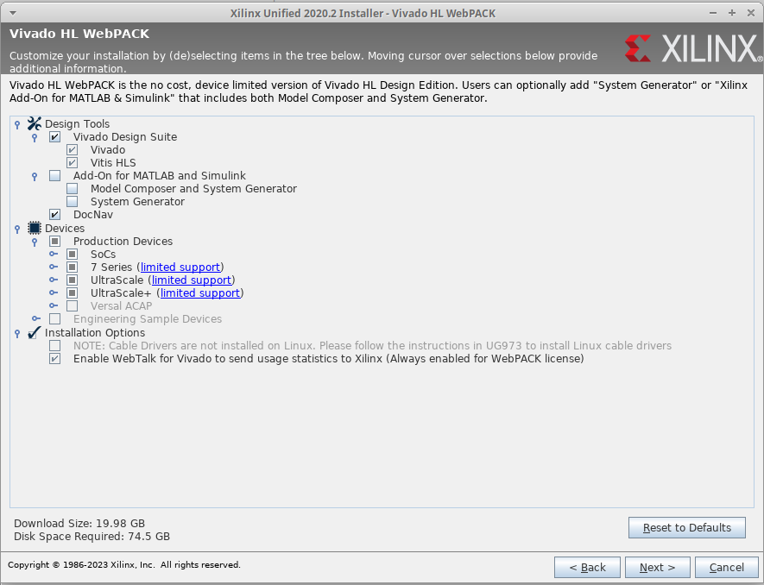
Install Vivado HL WebPACK
Installation options mostly fixed - DocNav can be unchecked to cut down the install size very slightly
Basys 3 board requires 7 Series support (Artix 7)
Note disk space requirements
Only option is Vivado HL WebPACK (unless licensed for upgraded Editions)

Slide 5
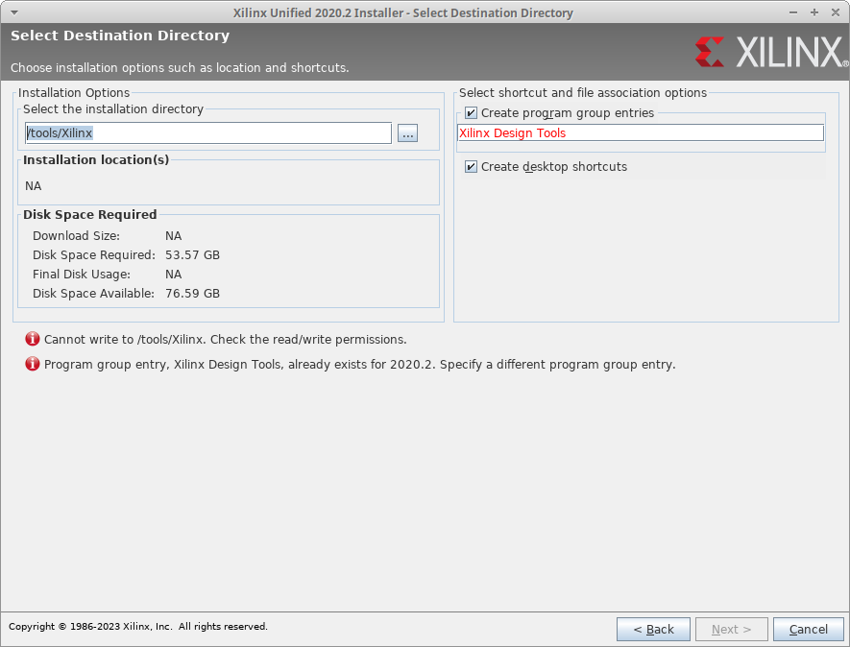
Installation Directory
Installs to /tools/Xilinx by default (requires running installer as sudo/root)

Slide 6
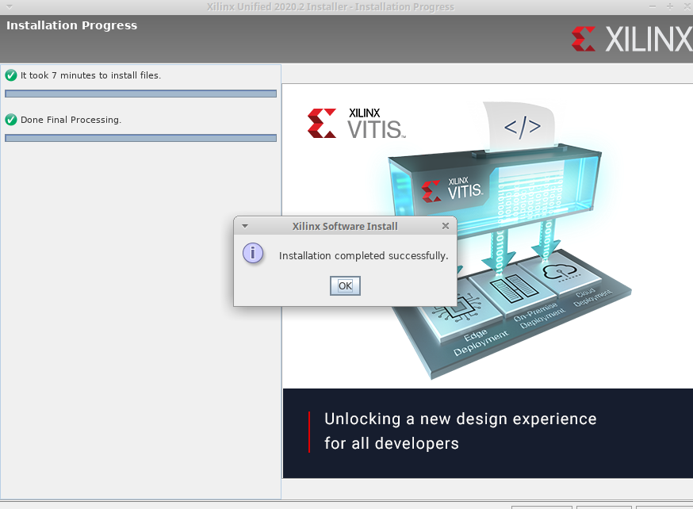
Install Complete!
You Rock!

Slide 7
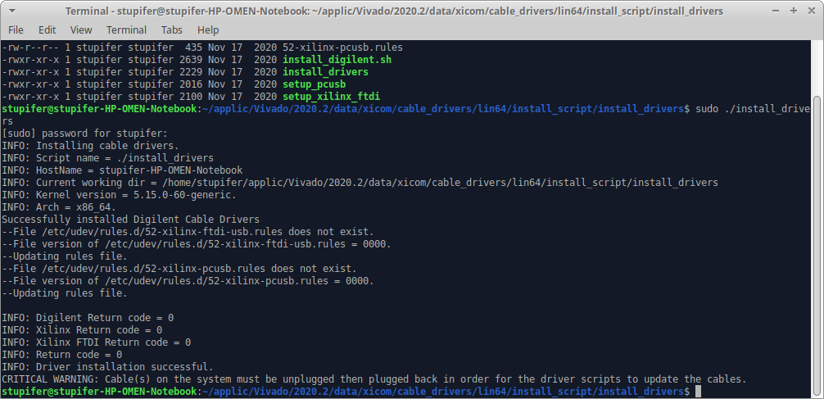
Install Vivado Cable Drivers
Install Xilinx cable drivers (updates udev rules, requires root)
cd /Tools/Vivado/2020.2/data/xicom/cable_drivers/lin64/install_script/install_drivers/
sudo ./install_drivers
/etc/udev/rules.d/52-xilinx etc.
sudo usermod myuser -G dialout -a

Slide 8
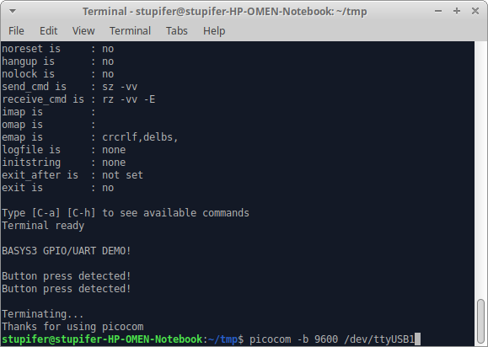
Test Vivado Serial Port Device
Test port driver with serial com:
Basys 3 ships with a demonstration design programmed to flash that echoes button presses etc. on serial port (/dev/ttyuSB1)

Slide 9
Install Vivado Board Files
Install Digilent board file configurations
git clone https://github.com/Digilent/vivado-boards.git
cp -r ~/vivado-boards/new/board_files/basys3/ /Tools/Vivado/2020.2/data/boards/board_files/

Slide 10
Additional Packages for New Install
net-tools git meld geany picocom geany-plugin-vc openssh-server
Code::Blocks
pinta (less-complexity-than-GIMP-graphic-edit-program)
dos2unix

