Slide 1
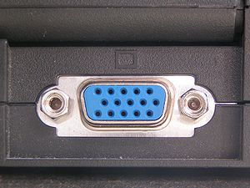

VHDL Image Generator
Sync Pulse and Test Pattern
- G. Neidermeier 11-Feb-2023
Revised 13-July-2023

Slide 2
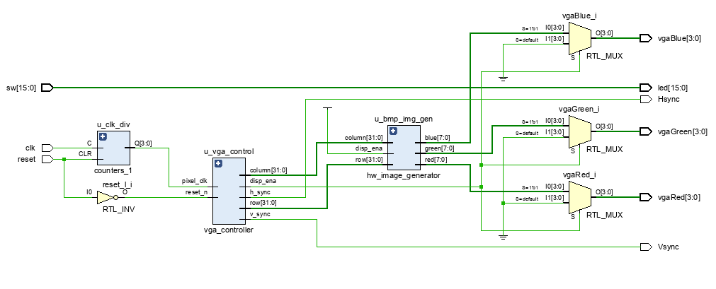
VGA Controller in VHDL
VGA … blah blah blah
In the previous tutorial a VHDL counter module was integrated and provides series of clock divisions including a 25 Mhz clock reference suitable for 640x480 VGA pixel clock
https://forum.digikey.com/t/vga-controller-vhdl/12794
VGA sync @ ~25 Mhz
Basys3 has 100 Mhz system clock
There are 2 VHDL files to download from the project website.
vga_controller sets up the pixel_clock and sync timing
hw_image_generator sets up a circuit to put a simple image pattern on the VGA display

Slide 3
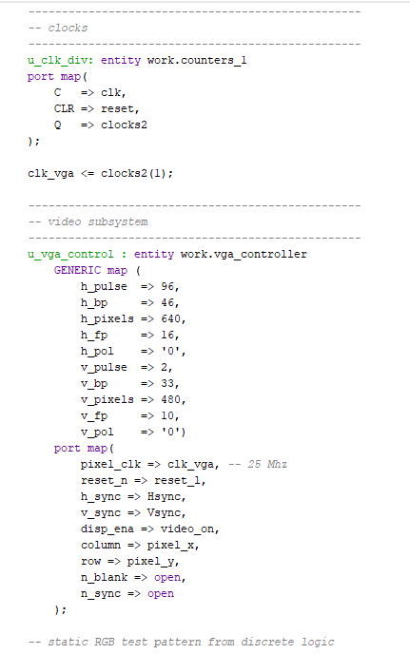
VGA Controller and Image Generator
There are 2 VHDL files to download from the project website.
vga_controller sets up the pixel_clock and sync timing
vga_controller uses generics to specify the desired video timing (defaults to HD)
hw_image_generator sets up a circuit to put a simple image pattern on the VGA display

Slide 4
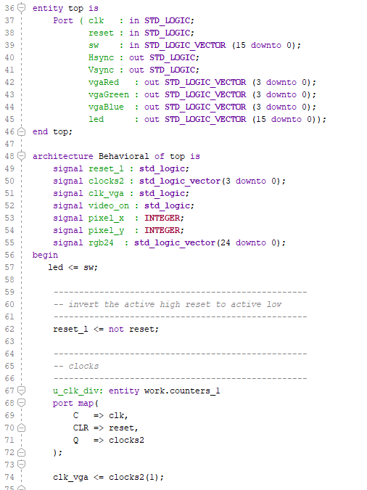
Clocks and External IO
Define Hsync, Vsync, and RGB output ports
Hsync, Vsync are std_logic while RGB are std_logic_vector (4-bits per color)
Define signals for video_on , pixel_x, pixel_y
VGA clock is 100 Mhz / 4, derived from counters_1.vhd (from xilinx_xstug_examples-master/HDL_Coding_Techniques/counters)
External reset signal from BtnC input port

Slide 5
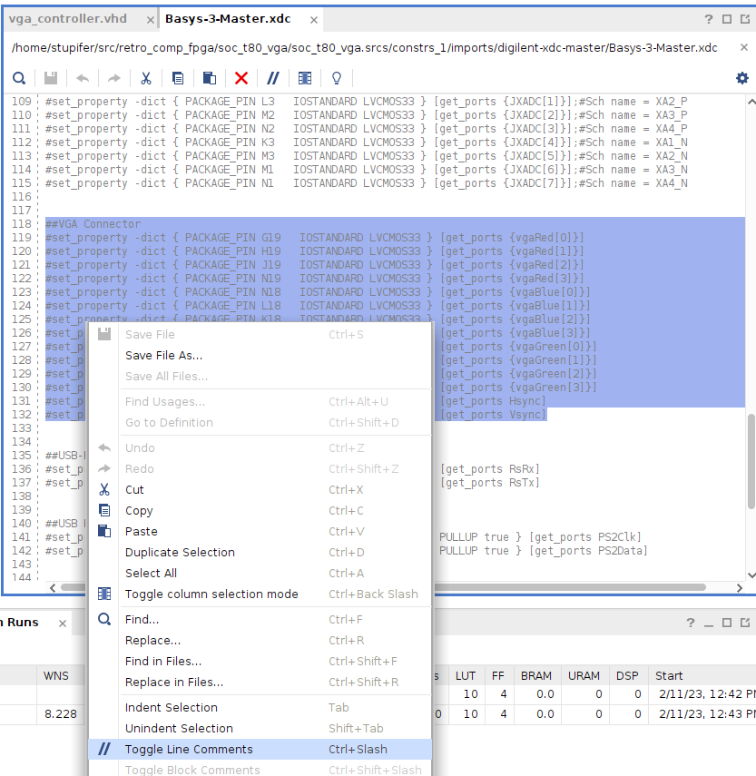
IO Constraints
Enable external Hsync, VSync and RGB ports

Slide 6
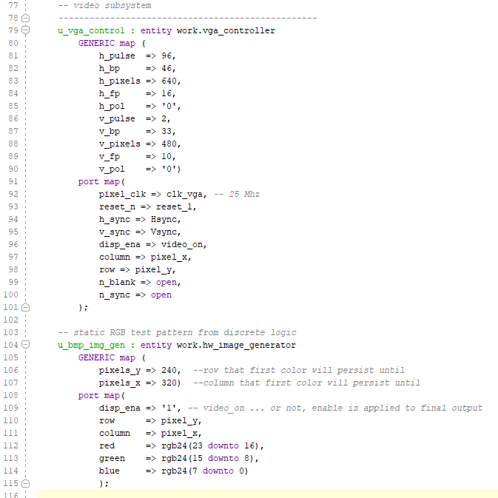
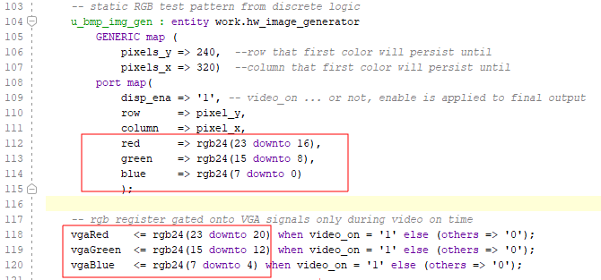
Component Instantiation
Use entity-instantiation to create instance of vga_controller and hw_image_gen
https://vhdlwhiz.com/entity-instantiation-and-component-instantiation/
Image generator output is 24-bit RGB – rgb24 is “adapter” to 12-bit RGB ports on Basys3

Slide 7
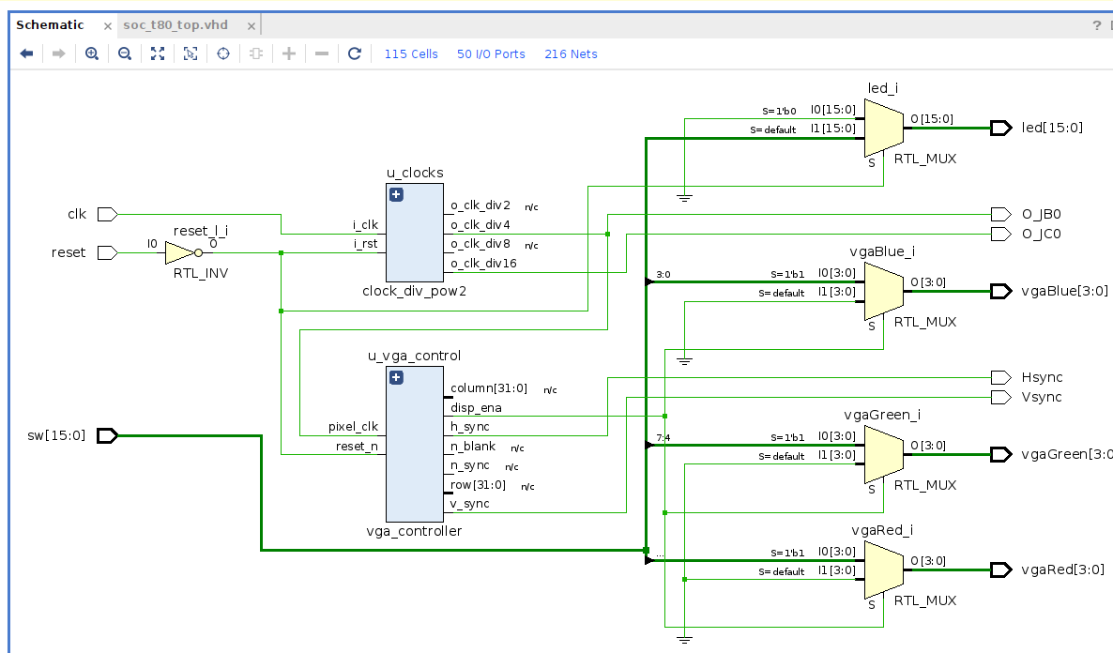
RTL Schematic
Runtime Logic portrays logically equivalent circuit layout for design analysis but doesn’t account for real signal physics i.e. propagation delay
Synthesized logic is reduced to equivalent of FPGA fabric which is lookup tables and registers (and then other things such as BRAMs, DSP slices etc.)

