Slide 1
Geisbert lab’s basic analysis
In vivo, virology, and immunology

Slide 2
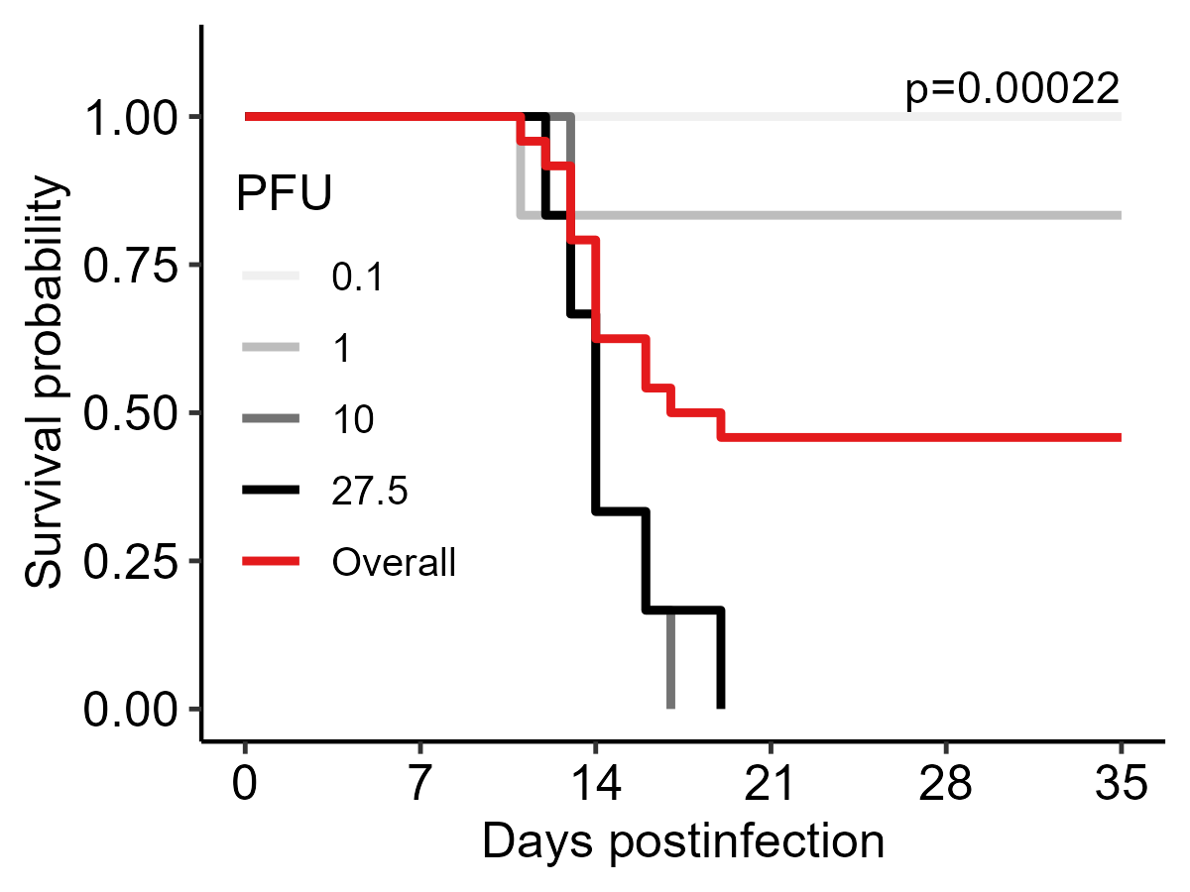
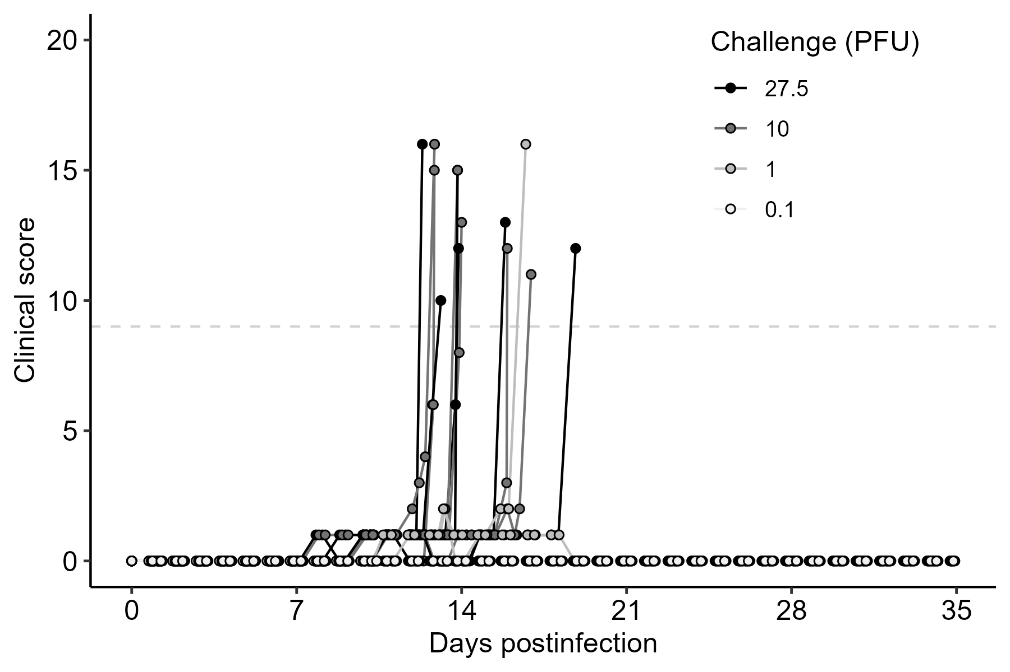
KM curve & scores
27.5 and 10 PFU challenge doses uniformly lethal
1 PFU dose partially lethal
0.1 PFU dose uniformly nonlethal
n=6 each dose

Slide 3
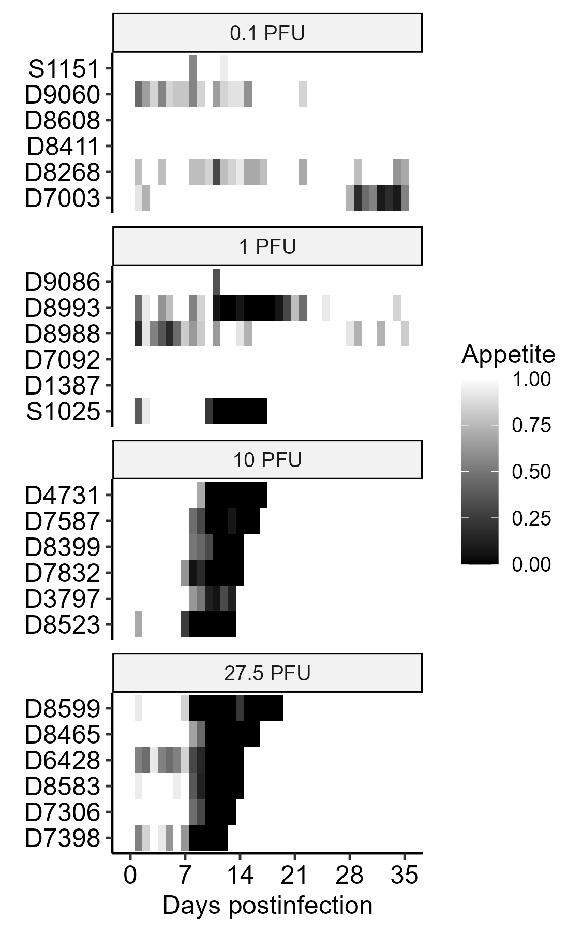
Decreased appetite as a marker of symptomatic illness

Slide 4
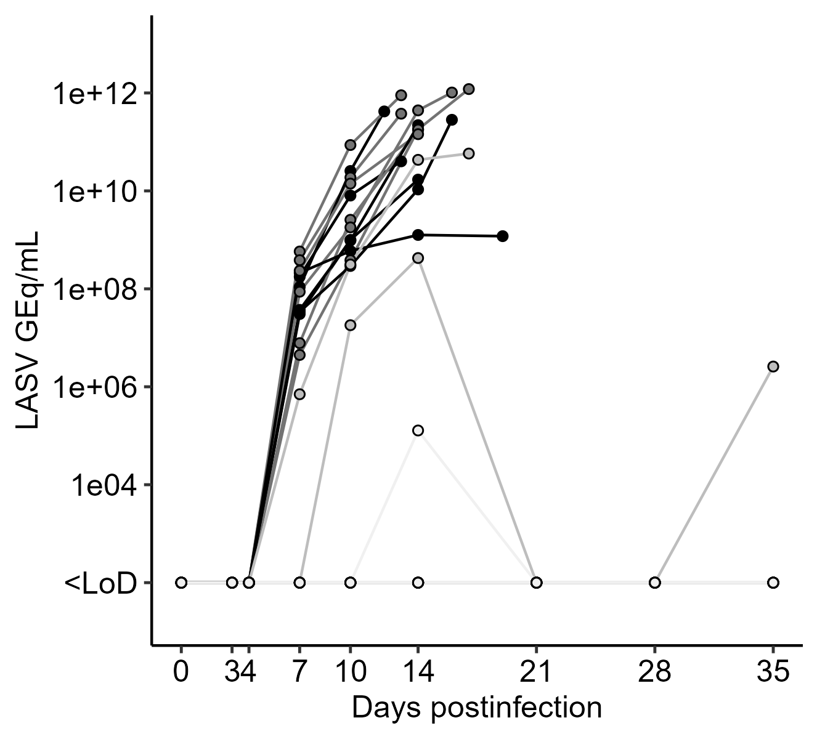
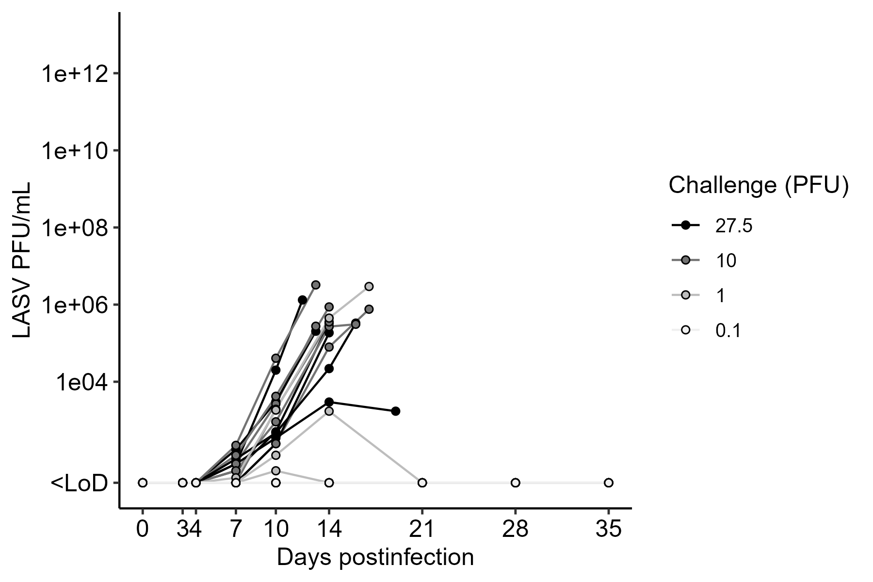
Viremia
Detectable by qPCR by 4 DPI
Most have infectious virus in circulating blood by 4 DPI
qPCR + at 35 DPI?

Slide 5
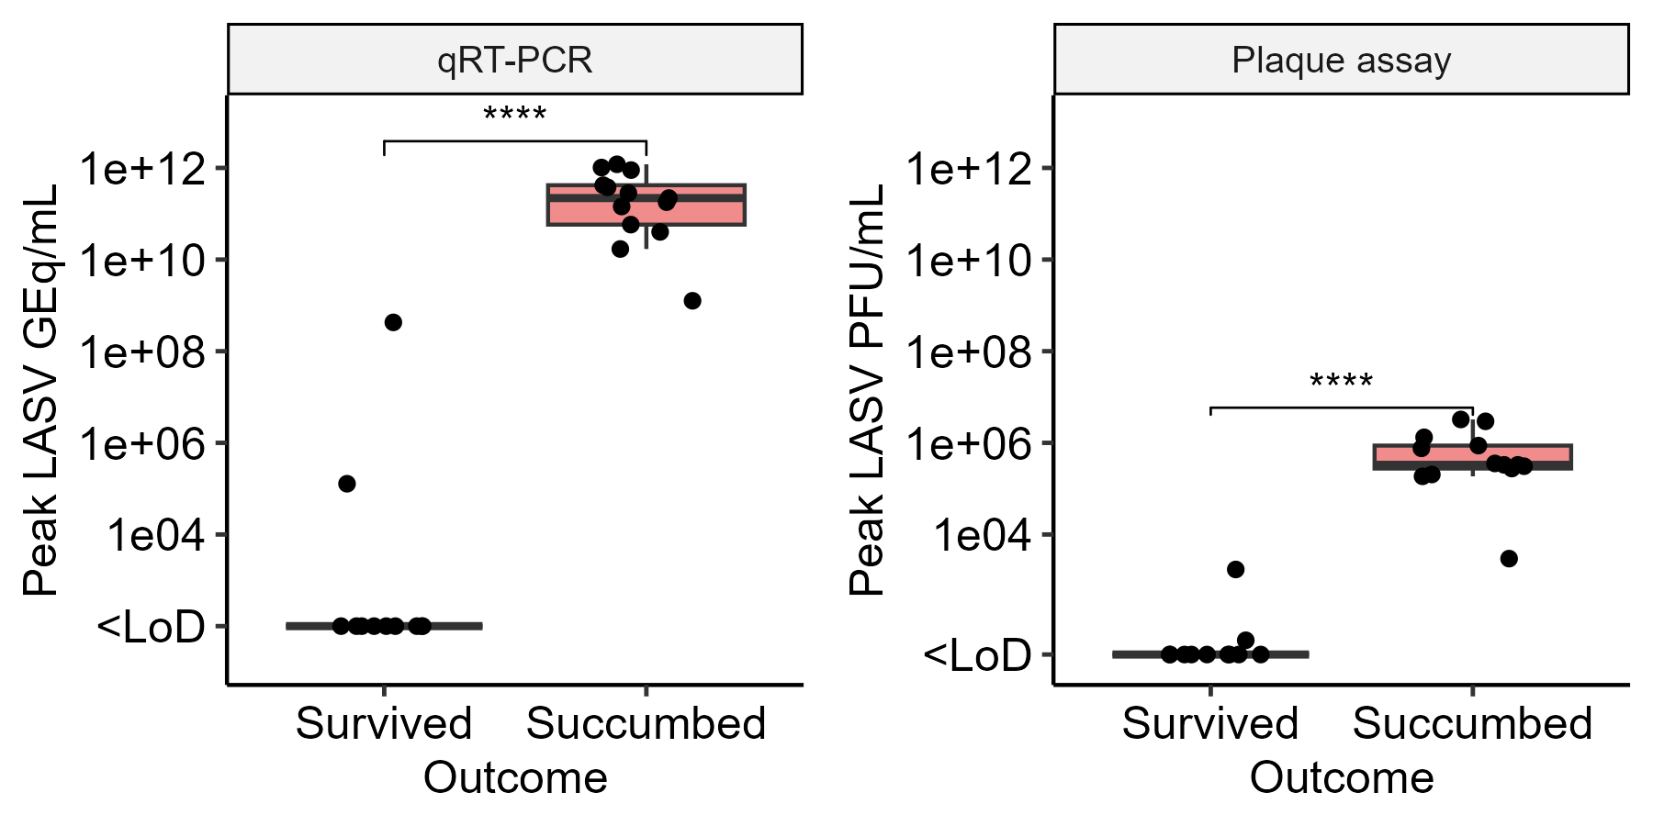
Is there a difference in peak viremia by outcome?
This aligns with viremia being correlated with outcome in human patients.

Slide 6
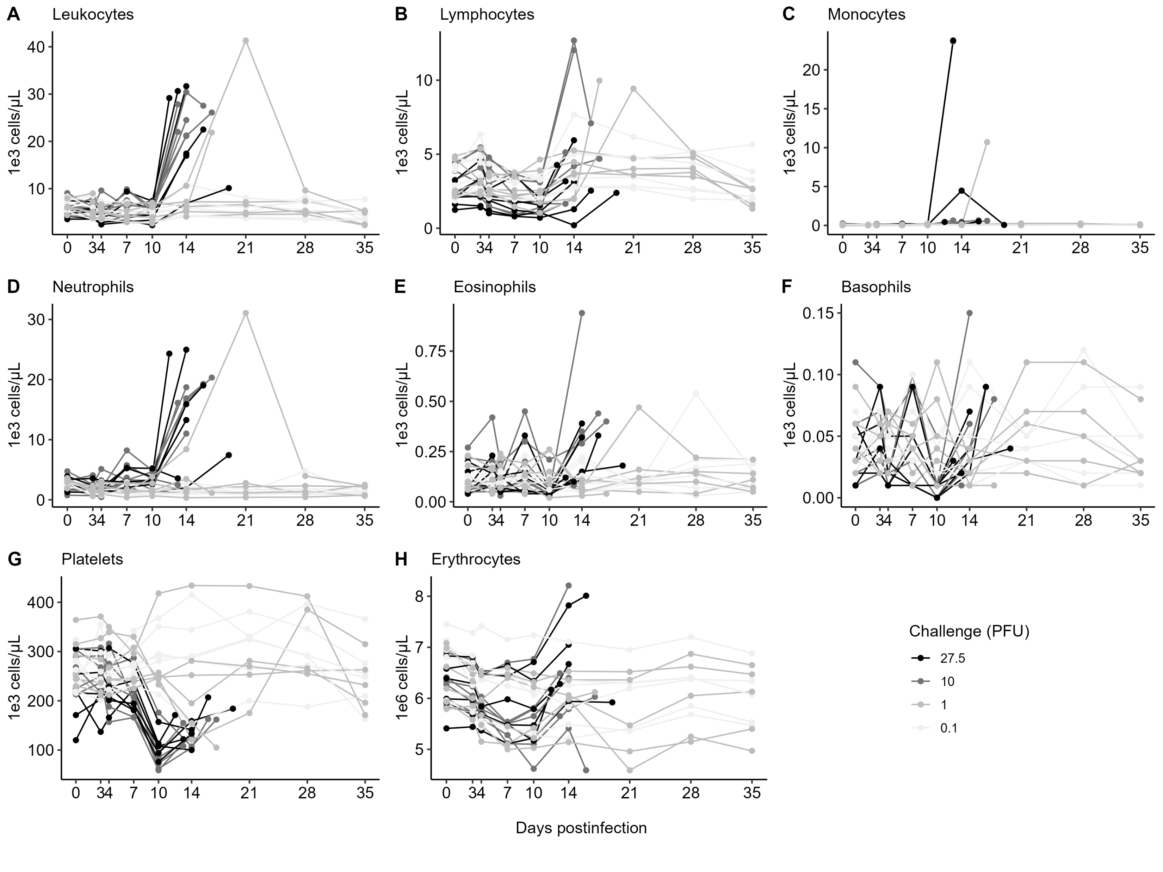
Hematology
Quantify basic cell types in circulating blood over time
Classically, we expect lymphopenia, thrombocytopenia, and neutrophilia
Do the min/max values differ by outcome?

Slide 7
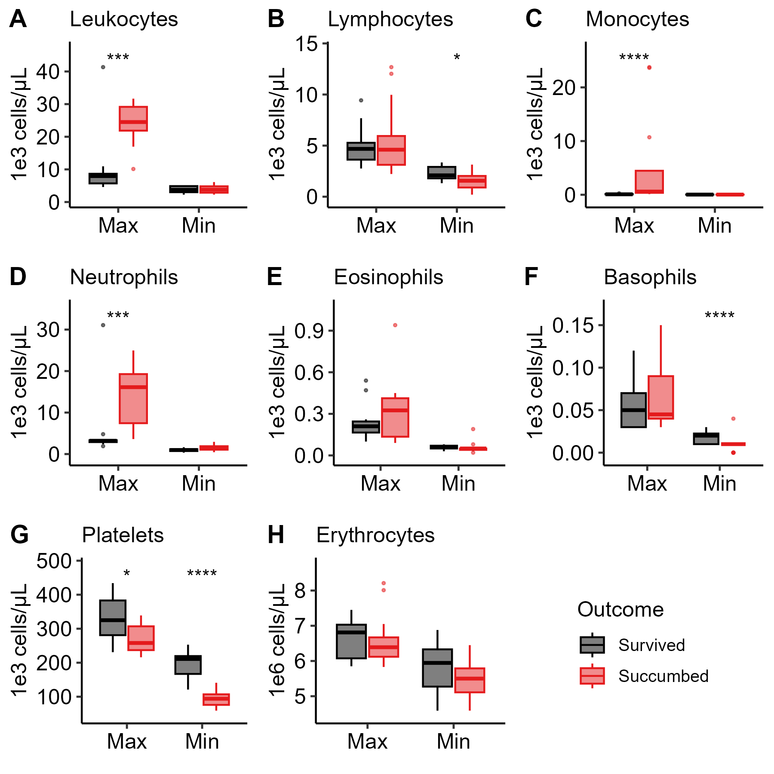
Hematology
Quantify basic cell types in circulating blood over time
Classically, we expect lymphopenia, thrombocytopenia, and neutrophilia
Do the min/max values differ by outcome? Yes!

Slide 8
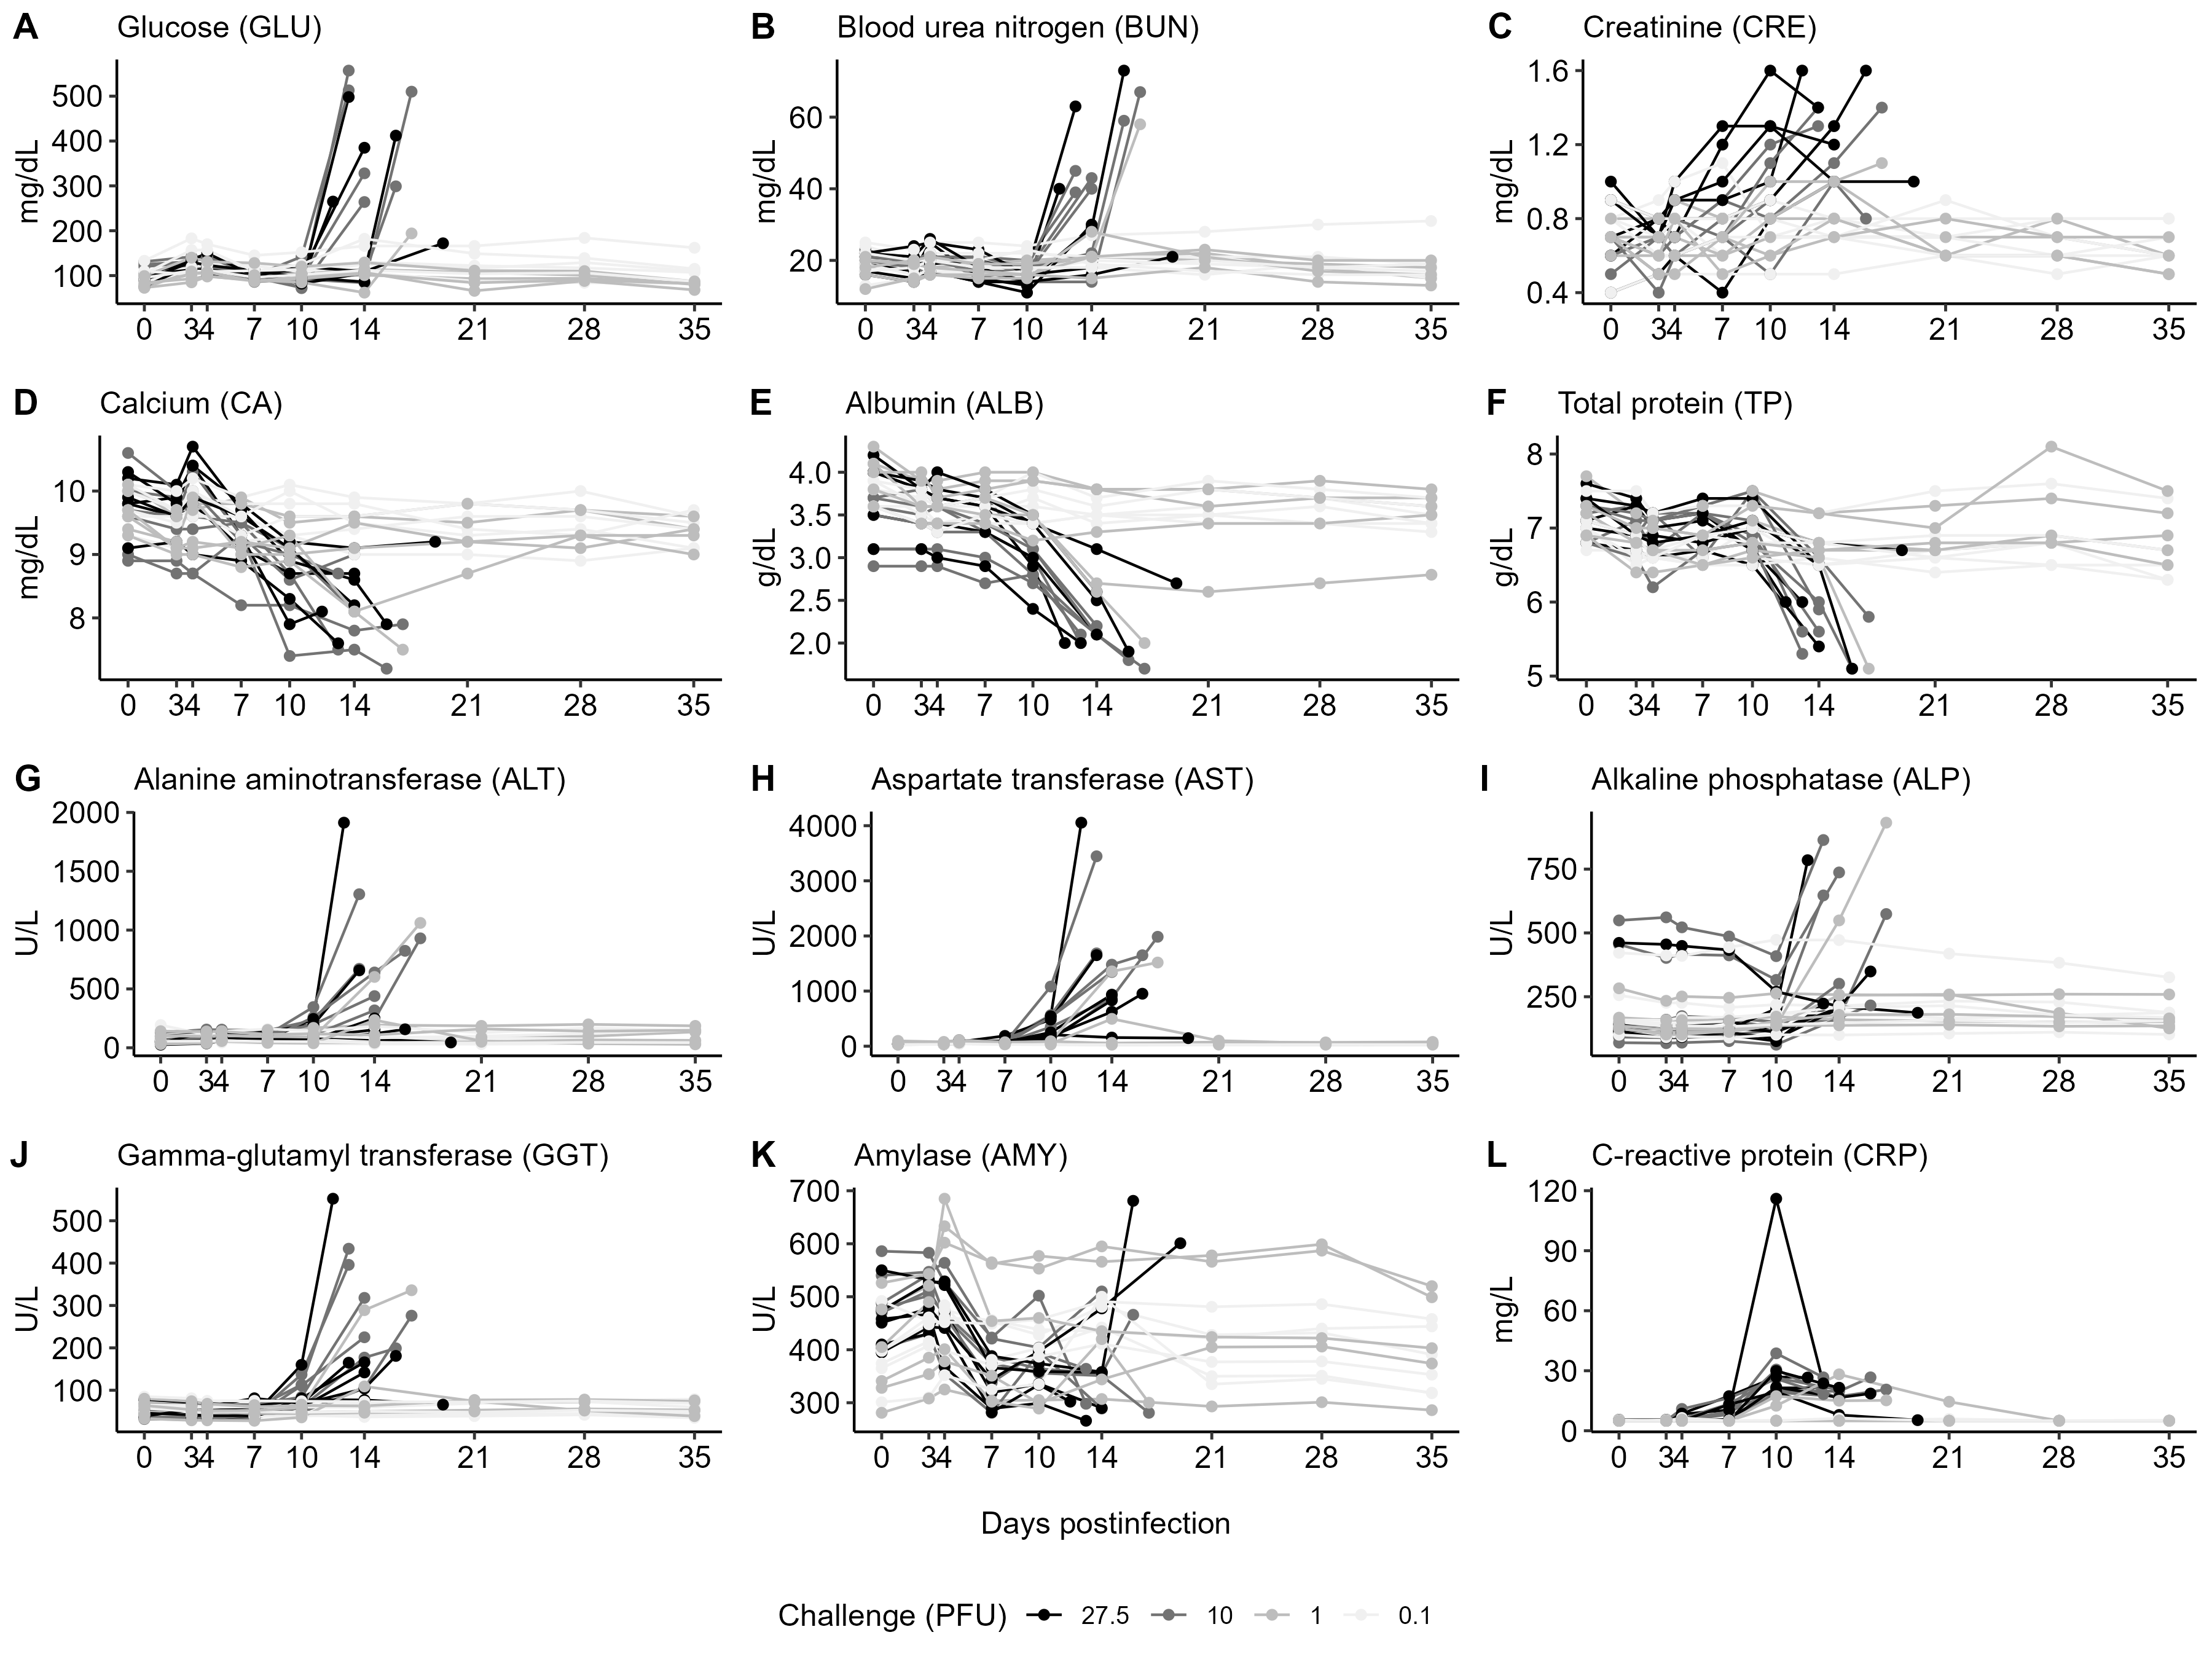
Clinical chemistry
Quantify key markers in circulating blood over time
Expect ↑ AST, ALT, BUN, & CRP, and ↓ ALB, TP, & AMY
Do the min/max values differ by outcome?

Slide 9
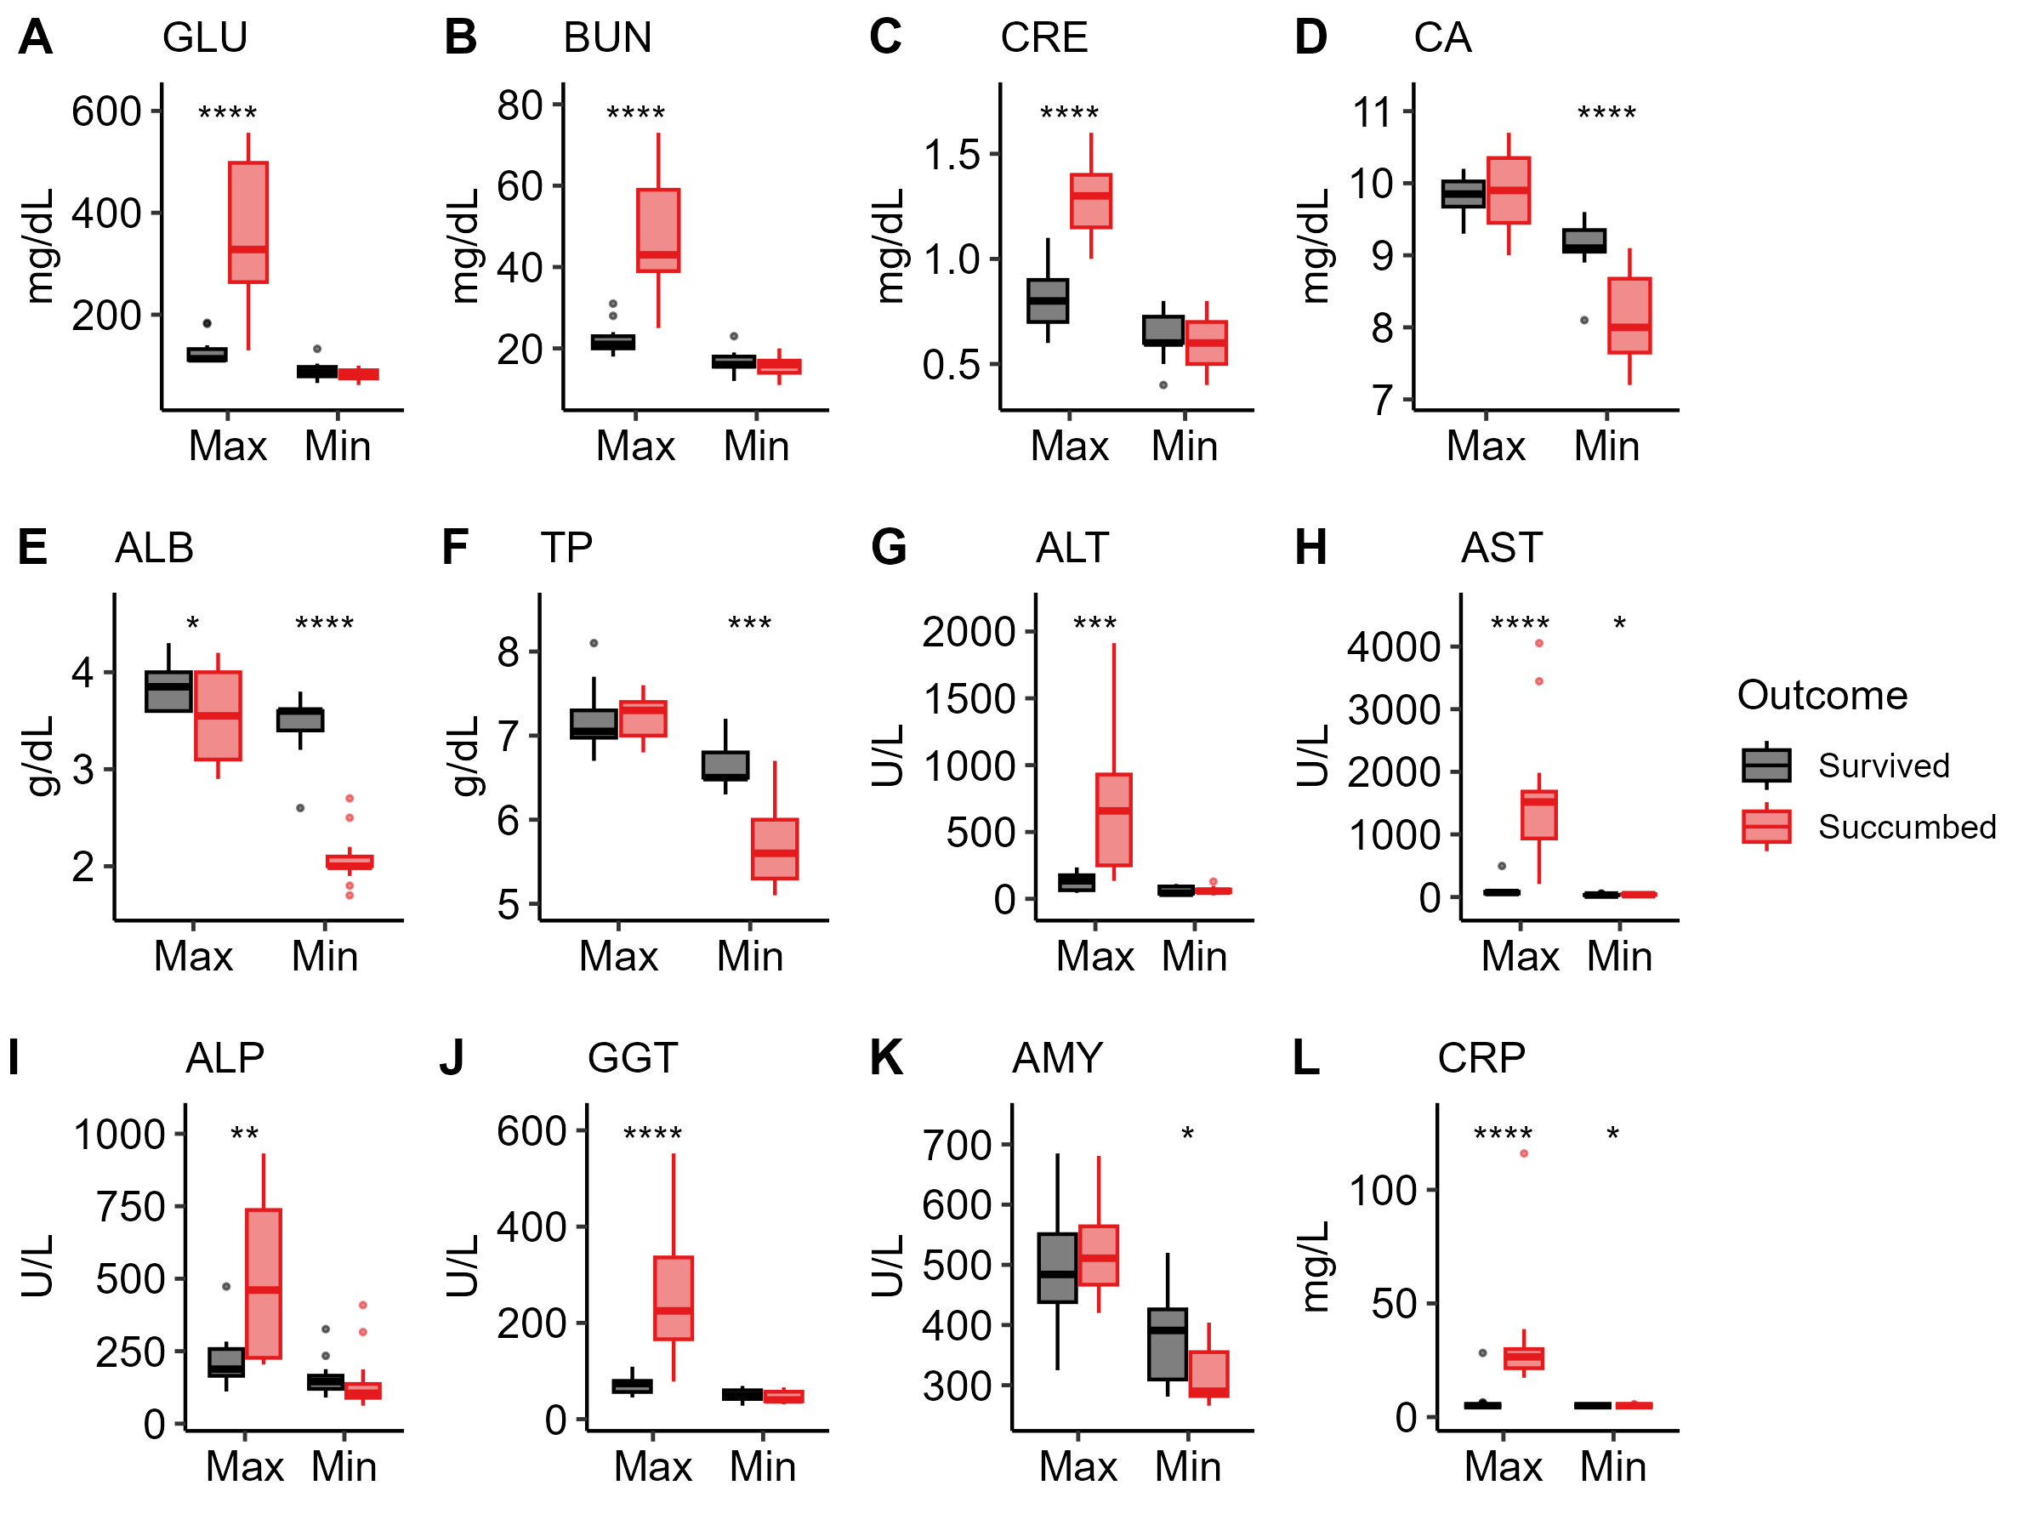
Clinical chemistry
Quantify key markers in circulating blood over time
Expect ↑ AST, ALT, BUN, & CRP, and ↓ ALB, TP, & AMY
Do the min/max values differ by outcome? Yes!

Slide 10
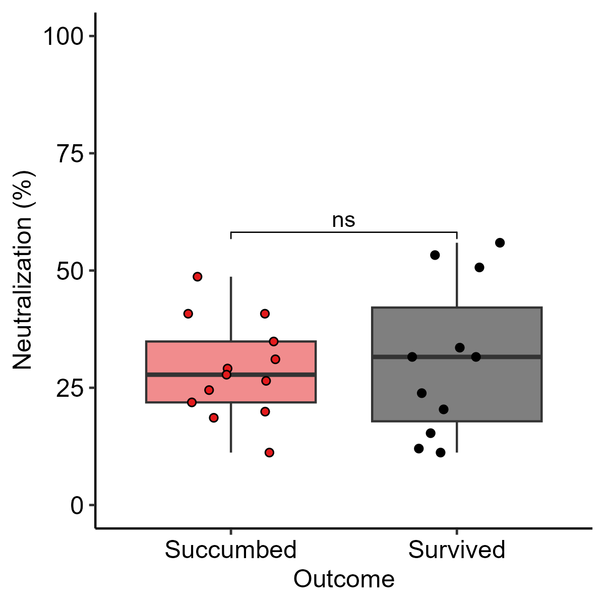
Neutralization (PRNTs)
Compared the maximum neutralization between outcomes
Neutralization measured at 0, 14, terminal, and 35 DPI
No difference, but this is expected

Slide 11
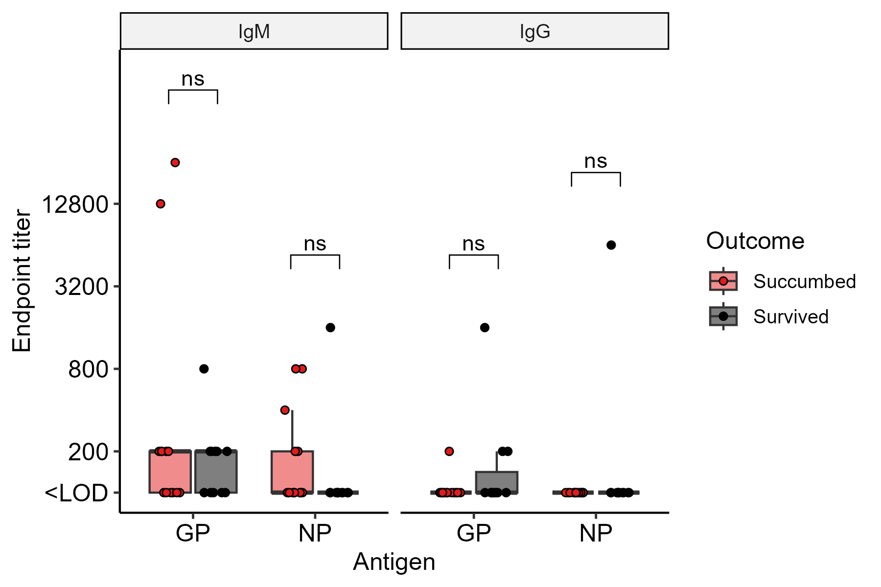
ELISAs
Measured IgG and IgM titer vs. LASV clade II GP and LASV NP
Very little change over time
Plotted succumbed terminal vs. survived D35 – no statistical difference

Slide 12
D8993: acute disease survivor
Target challenge dose 1 PFU; actual dose 0.54 PFU
Inappetence D11-23; no other clinical signs documented
Peak score = 2 at the D13 night check
Leukocytes, neutrophils, and total protein peak at D21; CRP and other liver chemistry markers peak at D14; albumin decreases at D14 and stays down until depop
Infectious virus detected D10 and D14; nearly all tissues + including gonad & eye
Viral genome detected D10, 14, and 35; nearly all tissues are PCR+
High IgG titers against LASV GP and NP at D35

Slide 13
Data In process
LegendPlex: On Declan’s list.

