Slide 1
Estimating the Impact of Varying Multi-family Assessment Rates on Current and Future Tax Revenue
October 9, 2018

Slide 2
Methodology
This project was undertaken to explore the potential impact on property tax revenue should the rate at which property is assessed value decreased from the current rate of 40% for commercial multi-family units. The project was divided into two main sections: 1) Impact on current revenue, 2) Impact on future revenue.
For the first section, only multi-family properties that are currently taxed at the commercial rate of 40% (CLASS = ‘C’) were considered, and only properties whose current land use matched one of 5 multi-family codes (see table right) were selected for analysis.
For an estimate of current revenue, the total assessed value (RTOTASMT) for these properties were added together and then multiplied by either/both the City of Memphis and Shelby County tax rates of 3.20% or 4.05% respectively.
The analysis was structured in such a way that the impact on revenue could be evaluated by passing in a list of potential tax rates and a list of living units. While it’s possible to run the analysis with a different set of values, for the purpose of this study, the list of living units ranged from 2 to 20, increasing by one unit for each iteration and the assessment rates varied from 25% to 40% in increments of 2.5% (i.e. 25%, 27.5%, 30%, 32.5%, 35%, and 40%).
Different permutations of each list were evaluated to determine the impact on revenue. A single iteration would multiply a lower assessment rate against the total appraised value (land and improvements, RTOTAPR) for one group of properties with a specified number of living units. This total, which represented the adjusted total assessment was then multiplied against a municipal rate or county rate. The Assessor’s total assessed value for remaining properties was then multiplied against the municipal rate and then added to the adjusted tax for a total estimated value.
Land Use Codes | Descriptions | Median Number of Units
003 | APARTMENT HIGH RISE | 52.5
002 | APARTMENT COMPLEX | 32
067 | APRT GARDEN | 6
061 | TRIPLEX | 3
059 | DUPLEX | 2

Slide 3
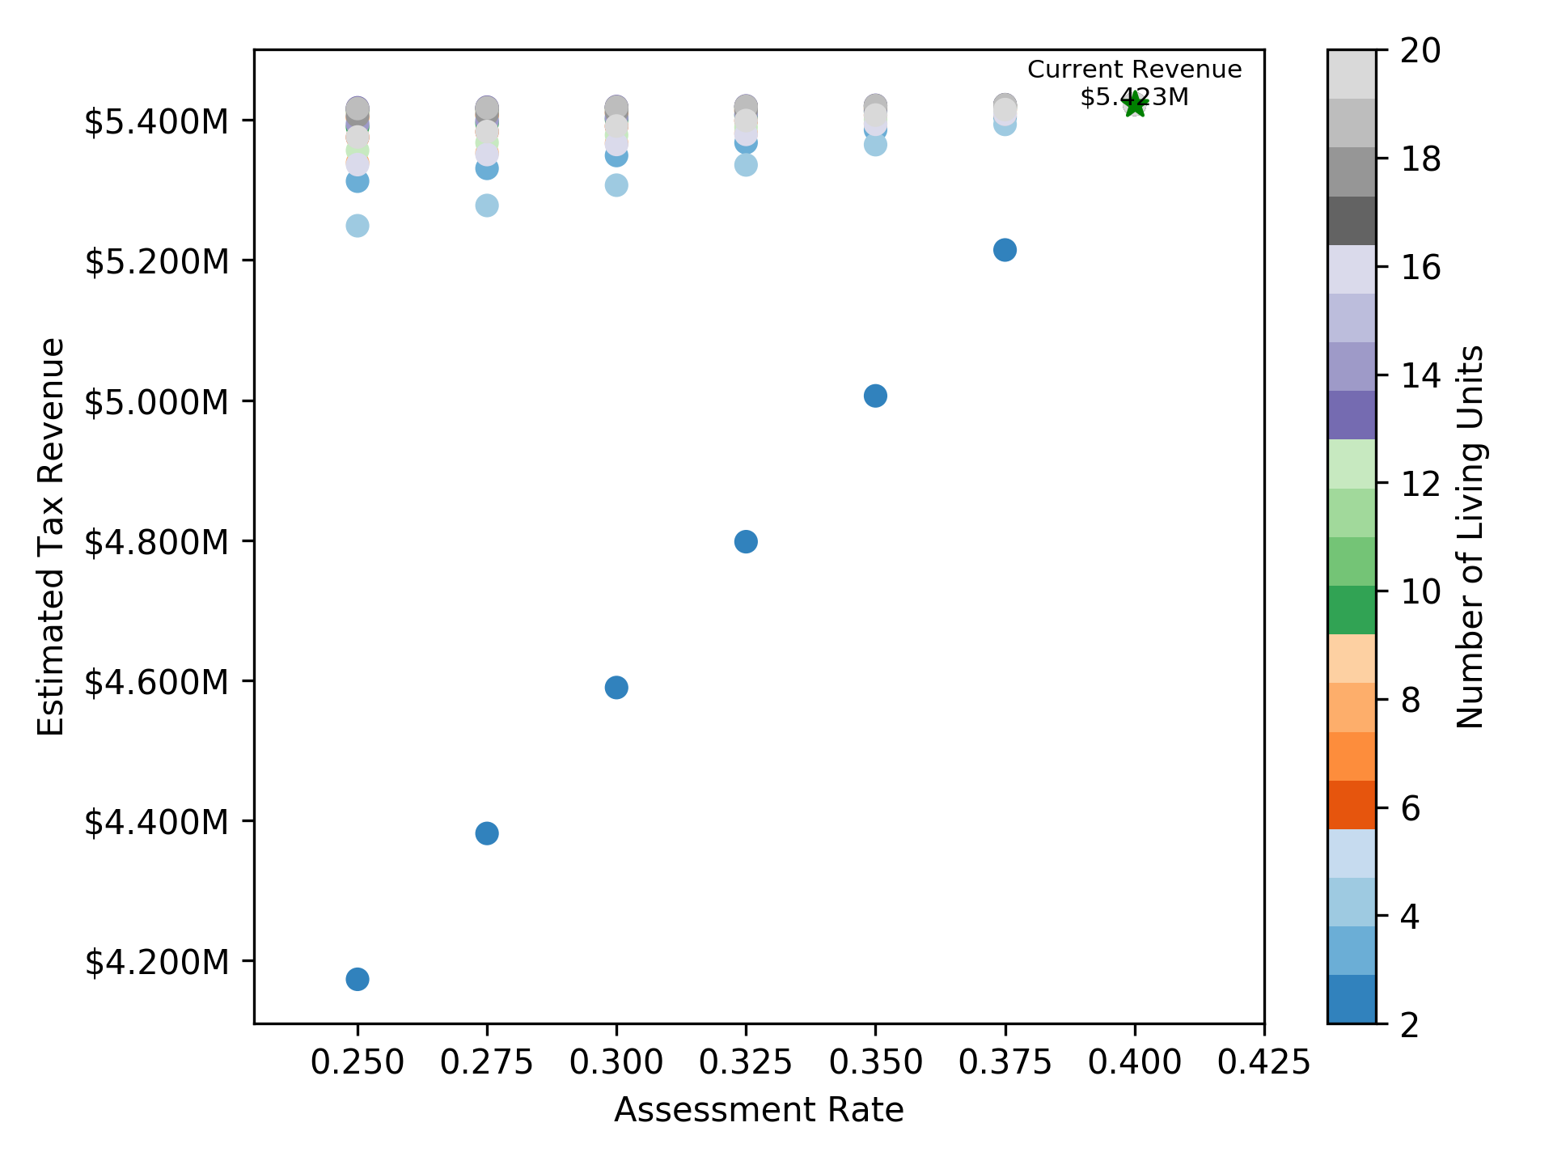
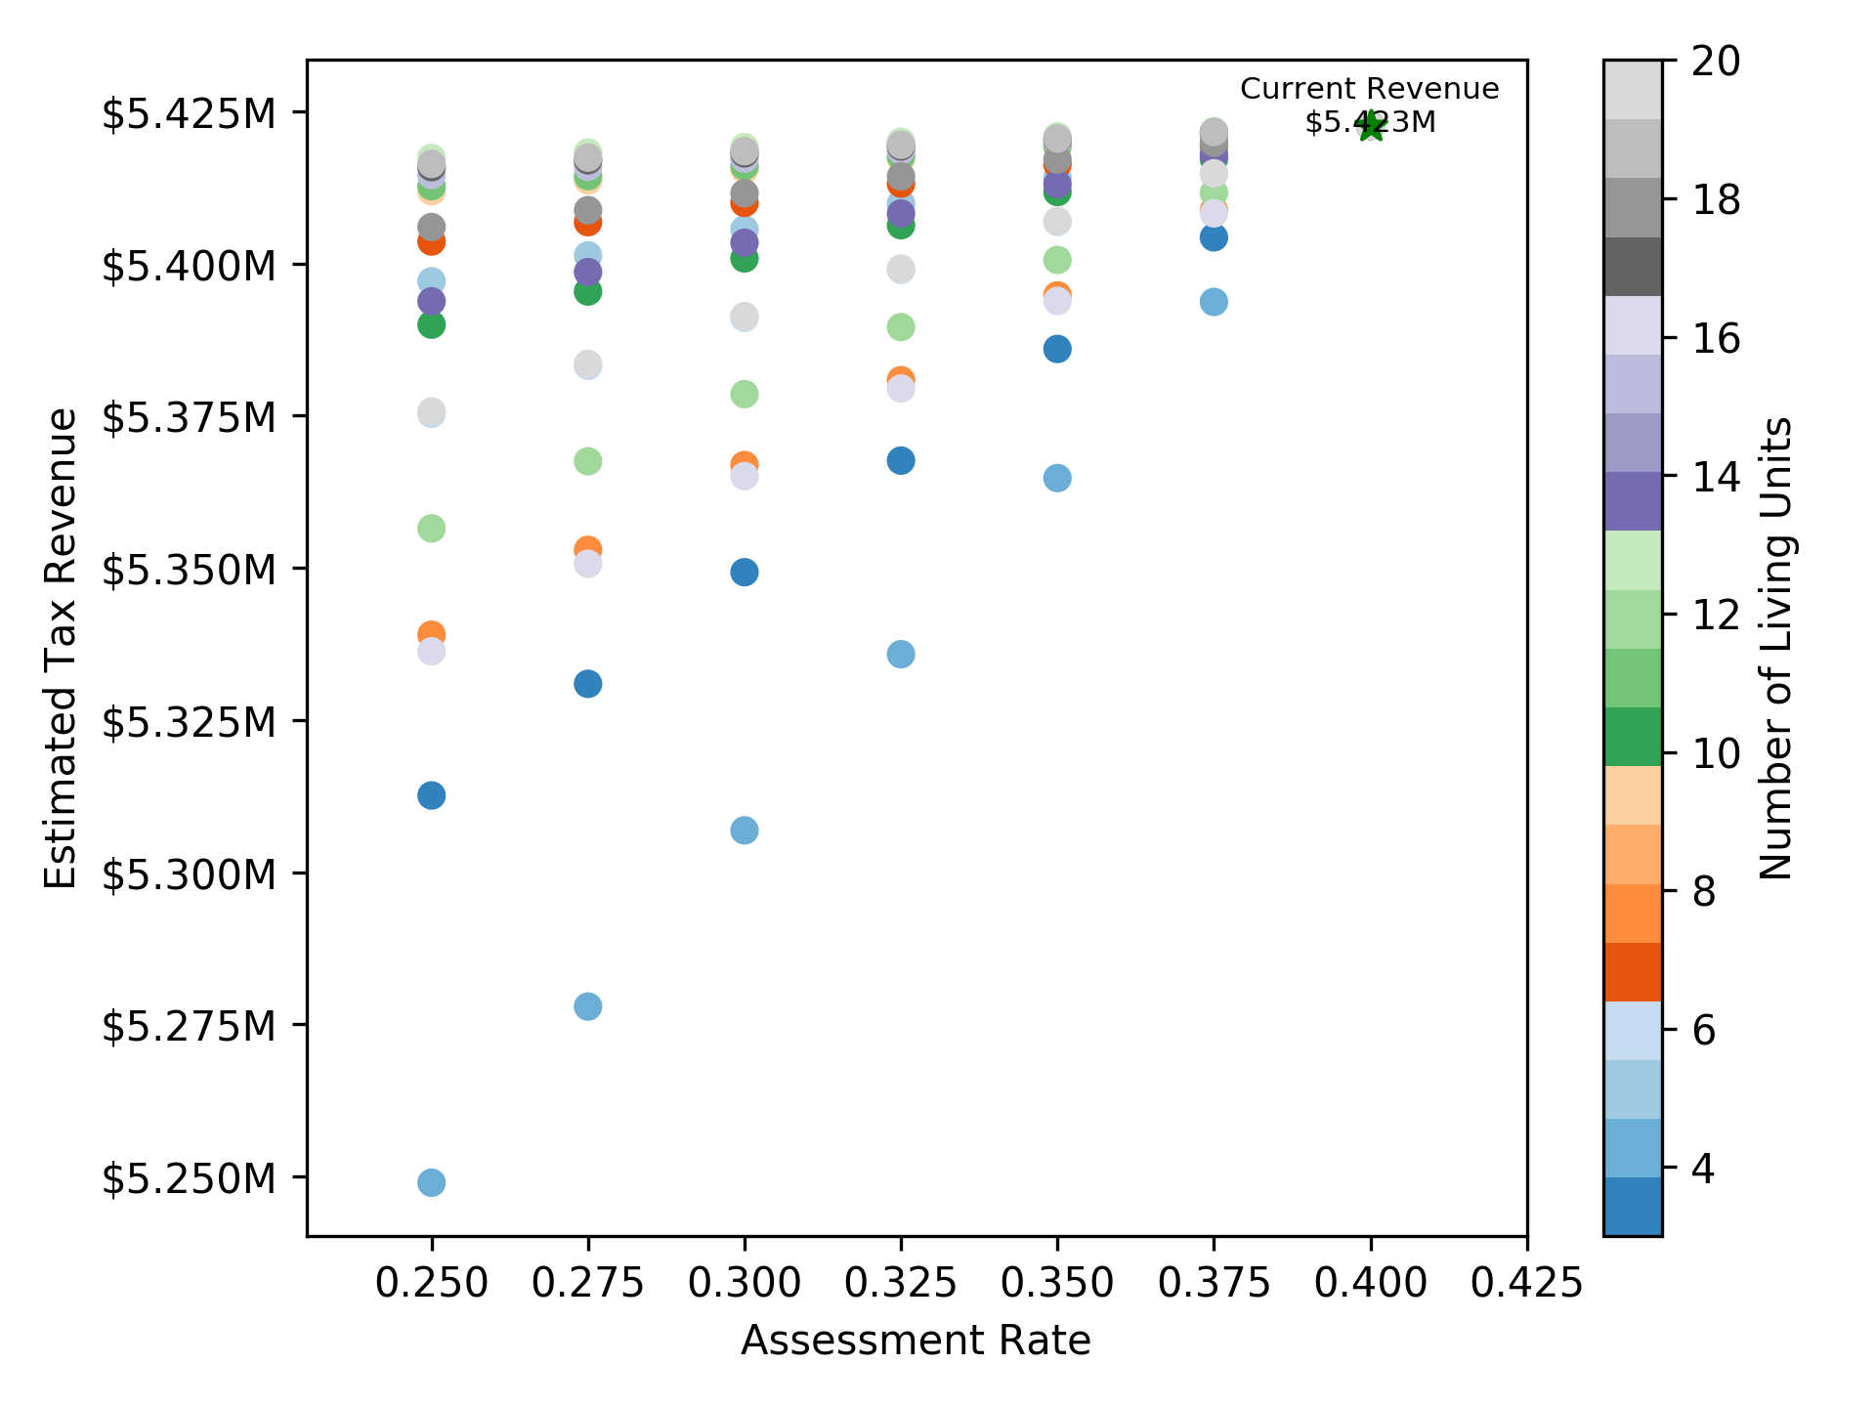
Current Revenue
The two charts to the right show the results of this analysis. The top shows the results for a range of living units between 2 and 20 while the bottom focuses on a range of living units between 3 and 20. As can be seen from the charts, structures containing 2 living units contribute the greatest amount of decrease in potential tax revenue. The reduction in potential revenue for 2-unit structures ranges from a high of 26.04% at a rate of 25% to a low of 3.92% at 37.5%.
For all other units (3 to 20), the range of impact ranges from a high of 3.2% for 4-unit structures at 25% to a low of 0.02% for 19-unit structures at 37.5%. While there is some variation in impact for all units at each hypothetical tax rate, the trend overall is linear with the median difference between for all units at each assessment rate ranges from 0.53% at 25% to 0.09% at 37.5%.

Slide 4
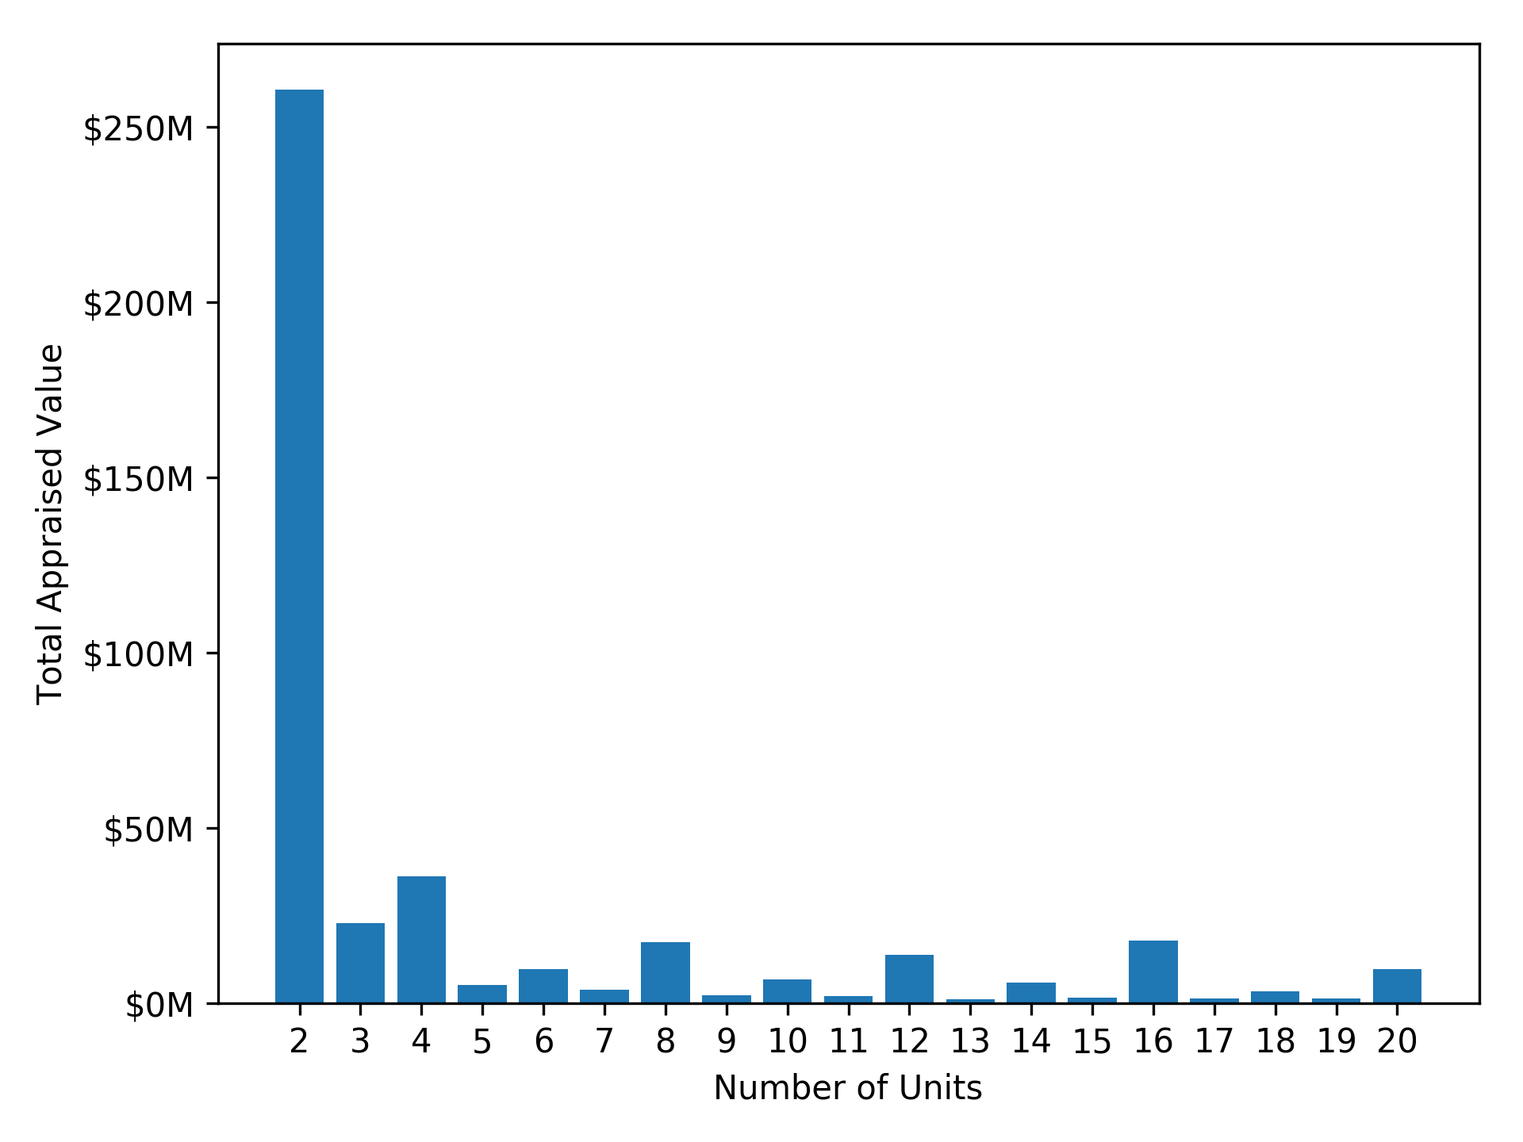
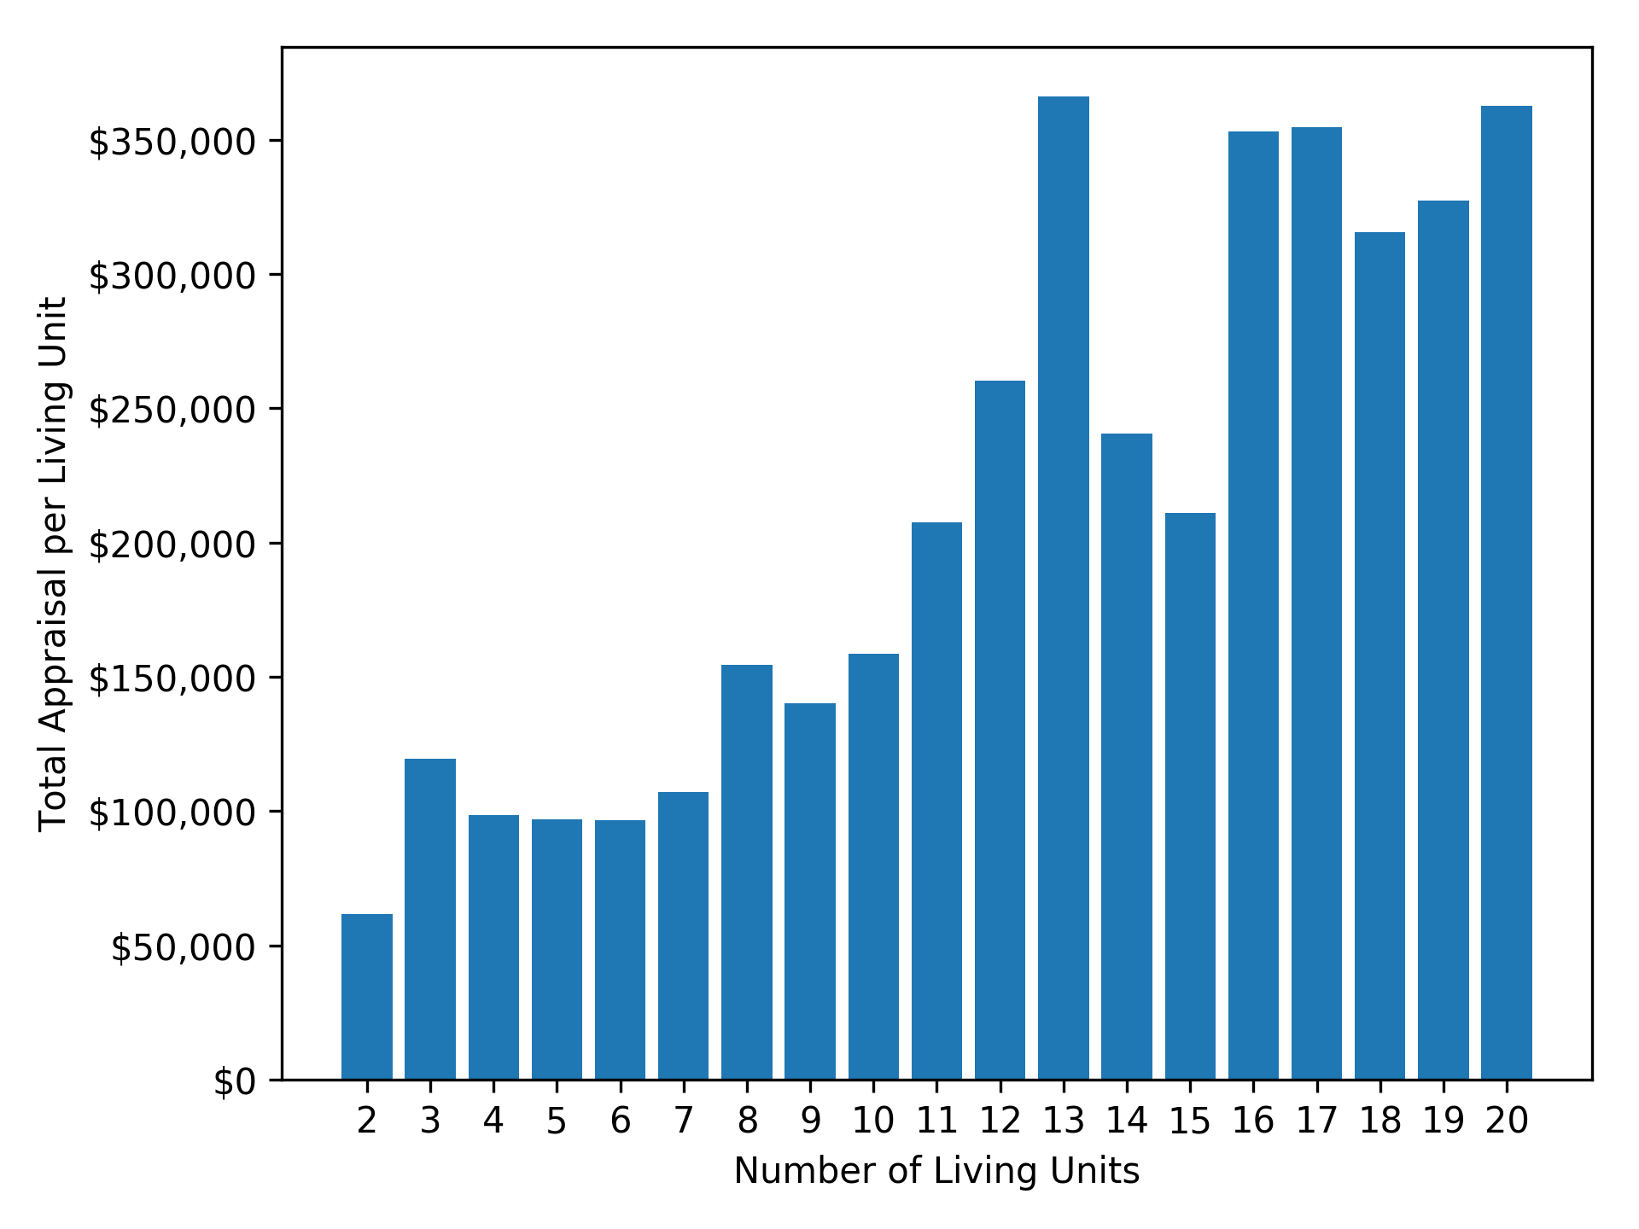
While the results of the analysis may lead to a belief that 2-unit structures are the most valuable in terms of tax revenue, the impact on revenue is mostly the result of a low density development pattern prevalent throughout the region.
The top chart to the left shows the total appraised value by living units. The total value for all 2-unit structures is not so much a reflection of the value of these properties as it is a indication of the total number of properties properties. If the same chart is displayed after normalizing the appraised value by the number of units, the shape of the chart shifts dramatically towards properties with a greater number of living units as shown to the left below.
What these two charts demonstrate in tandem, is that while 2-unit structures represent a disproportionate contribution to the overall amount of revenue generated by multi-family properties, that total is in fact much lower than it would be were a greater emphasis placed on the construction of larger buildings with a greater number of living units throughout the region.

Slide 5
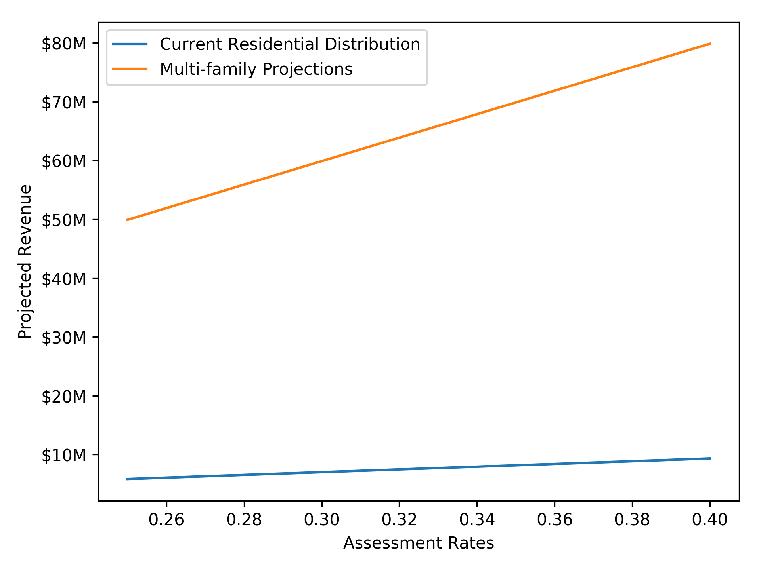
Projected Revenue
This leads to the final half of the study, the potential revenue that could be generated with the addition of new multi-family units.
Rather than focusing on the number of living units, this analysis instead looked at the current zoning for vacant properties throughout the city. Zones in turn were matched to multi-family residential land use codes in decreasing order of density so that the land use codes that represented the greatest number of living units were allocated first to all vacant property according to what its respective zoning would allow (see table on next page).
To better reflect the true value of these properties throughout the city, the median value for each land use type was calculated using Census tracts as neighborhood proxies so that the estimated revenue more accurately reflected regional differences. If a particular land use did not exist within a given neighborhood for a property’s current zoning, the median value for the entire city was used in its place.
The median value was then applied to each vacant property to represent its total appraised value and then multiplied against both the adjusted assessment rate and city tax rate to estimate total potential revenue.
A second estimate was then made that looked at the potential revenue should all available vacant land be developed using patterns similar within each neighborhood. For this analysis, single family residential properties (Land Use Code 062) were included to better reflect local development patterns and while the frequency varies across neighborhoods, city-wide they comprise over 95% of all residential properties (see table bottom right).
The results of these two analyses can be seen to the upper right where the orange line reflects a preference for multi-family density over current development patterns and the blue reflects current development preference for single family over multifamily. The values comprising the blue line range from a minimum of $5.8 million to a maximum of $9.3 million while the orange line ranges from $49.9 million to $79.9 million.
Land Use Codes | Percent of Total
003 | 0.02%
062 | 95.80%
067 | 0.42%
061 | 0.10%
059 | 3.18%
002 | 0.48%

Slide 6
RU-1 | RU-2 | RU-3 | RU-4 | RU-5 | RW | OG | CMU-1 | CMU-2 | CMU-3 | CBD | CMP-1 | CMP-2
059 | 067 | 002 | 002 | 003 | 003 | 003 | 003 | 003 | 003 | 003 | 003 | 003
 | 061 | 067 | 067 | 002 | 061 | 067 | 067 | 067 | 067 | 002 | 067 | 067
 | 059 | 061 | 061 | 067 | 067 | 059 | 059 | 059 | 059 | 067 | 059 | 059
 |  | 059 | 059 | 061 | 059

