Slide 1
Impensa
Simple, effective expense management app.

Slide 2

Responsibilities

Slide 3

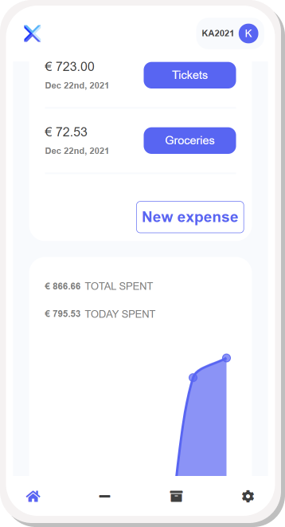
What is Impensa?
Impensa translates from Latin as expense, outlay, expenditure. The idea behind the website is to provide users with simple and effective expense management app.

Slide 4
What’s cool about it?
There are a couple of things:
See where all your money goes by easily adding and categorizing new expenses
Analyze your expenditure using data visualization tools
Export .xlsx report with all your expenses
Impensa is an open-source project, meaning you can easily access needed app functional and modify lines of code
It has been made with love

Slide 5
Functions
Registration
Login
Contact section on GitHub
Option to add a new expense
Option to create new expense categories

Slide 6
Functions
Opportunity to overview all added expenses
Multiple charts depicting user’s outlay
Option to remove or modify existing expenses
Opportunity to change existing user data

Slide 7
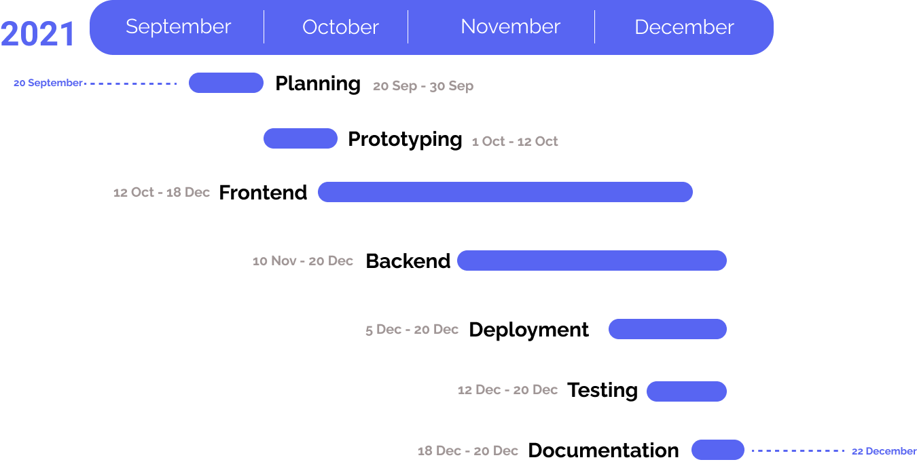
Development deadlines
Notes:
For Gantt diagram we used Figma

Slide 8
Used services
GitHub – to create and assign issues, work on the code as a team
Figma – to develop a preliminary prototype of the website
Discord – as a communication bridge

Slide 9

Initial homepage prototype

Slide 10
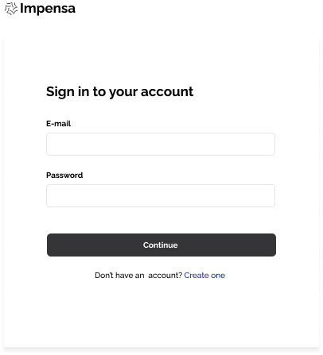
Initial login prototype

Slide 11
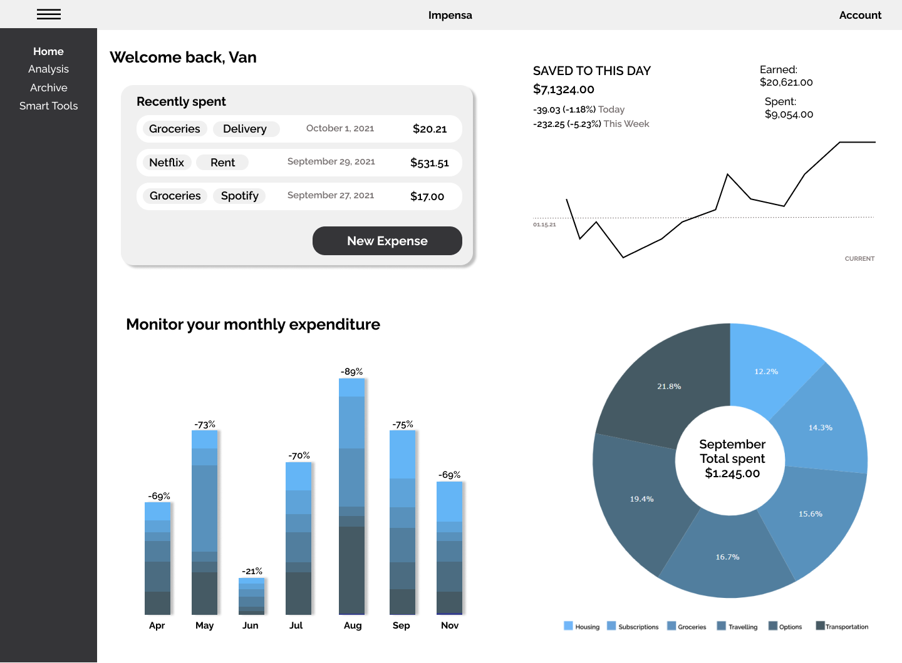
Initial dashboard prototype

Slide 12

Our stack of choice

Slide 13
Used technologies
Full-stack JavaScript: We use Node.js to power our servers and React to power our frontend. Almost all of the code you'll touch in this codebase will be JavaScript.
Here is a list of all the big technologies we use:
  PostgreSQL: Object-relational database
  Express JS: Our backend framework of choice
  React: Frontend framework
  React Chart.js 2: JavaScript library for Data Visualization
  DigitalOcean: To deploy React app

Slide 14
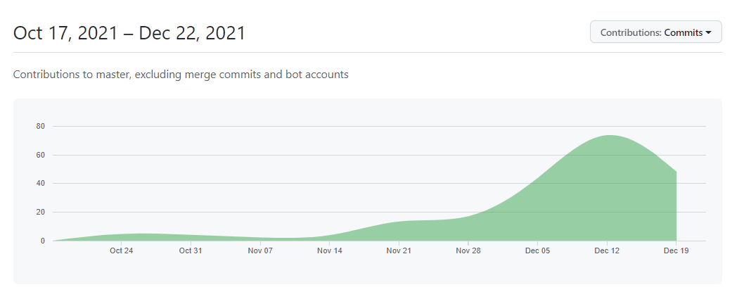
GitHub contributions

Slide 15
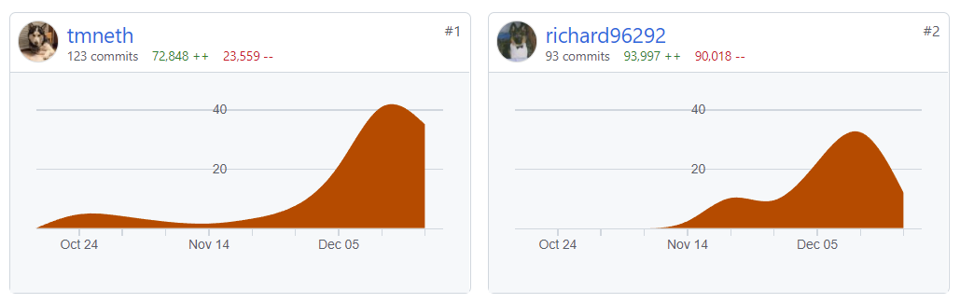
GitHub contributions

Slide 16
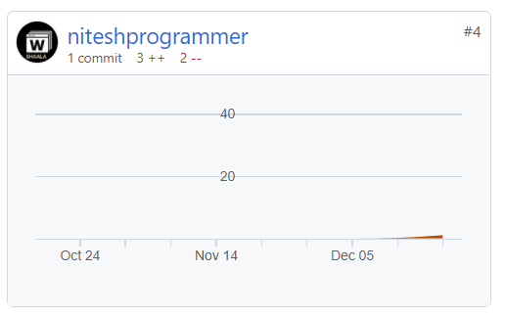
The power of open-source

Slide 17
Useful links
https://impensa.studio/
https://github.com/richard96292/impensa

Slide 18
Thank you for your time!

