Slide 1
Impact of Climate on Commodity Futures
By: Neil Menghani; nlm2138; CC ’19
Seung Ho (Steven) Lee; sl3944; CC’19
Professor Mikhail Smirnov
Technology Used: Excel, R
Rehearsal: 5/1/18 7 pm at Carman Lounge, Michael Tai CC’19 Present

Slide 2
Outline
Driving Question: Do various commodity futures contracts react to weather fluctuations and long-term climate change as we would expect?
Goal: Create an active investment strategy utilizing this relationship between weather and commodities that works more effectively than passive investing.
Strategy:
-Utilize a momentum-based strategy, weighting towards the biggest gainers over previous 30 days (rolling)
-Perform rolling 30-day time series regression of 5 different commodity futures on weather in the location of their top 3 biggest producers. Determine allocation toward each asset based on regression coefficients
-Perform rolling 30-day K-Nearest Neighbors (with cross-validation to determine K to prevent over-fitting) to determin based on K nearest points whether result will go up or down X%. Allocate weight
-Invest over 3 years and analyze returns/Sharpe Ratio of each strategy in relation to passive model
Create an optimal investment model

Slide 3
What are Commodity Futures Contracts?
Much like forward contracts, futures contracts allow investors to buy or sell an asset at a future time and agreed price
However, unlike a forward contract, which is a private agreement between two parties, futures contracts are traded on exchanges, meaning that transactions are guaranteed (cannot default)
Often, futures contracts are used for commodities (raw materials or any primary agricultural product that can be bought or sold)
Buyers use these contracts to avoid the risks associated with the price fluctuations of a futures' underlying product or raw material, and sellers use futures contracts to lock in guaranteed prices for their products

Slide 4
Correlation Between Weather and Commodity Futures
Within the past few decades, climate change has become a bigger issue in political and social environments, and now investors have become more concerned with the impact of weather patterns on making investment decisions, particularly in commodity futures
For example, recent monsoon seasons in India, one of the bigger sugar producers world wide, drove down sugar prices
According to Investopedia, nearly 20% of the U.S. Economy is directly affected by the weather
We chose the largest 3 producers, assuming they are the greatest influencers in the supply of the commodities

Slide 5
Passive Investing
Prioritizes long-term investments by minimizing the amount of buying and selling -> ‘buy-and-hold’ mentality
The usual strategy is to buy an index fund that follows one of the major indices like S&P 500 or Dow Jones. This way, when the indices switch up their constituents, the index fund that follow them automatically switch up their holdings by selling the stock that’s leaving and buying the stock that’s becoming part of the index
Historically, Commodity-Index Investing has shown to be largely ineffective
-Technological advances such as improved ways of growing crops boost production, driving prices down
-Commodities regularly go through boom-and-bust cycles
-Storage costs inflate futures prices
For this reason, we simply use the S&P 500 as our base index

Slide 6
Active Investing
Prioritizes short-term investments by actively making investments and monitoring activity to exploit profitable conditions
Despite the ability to minimize risk and customize the investor’s portfolios based on market conditions, there are higher fees than passive investing. We ignore this in our models for simplicity, but it is certainly something to be aware of
Essentially, the goal of active investing is to beat the stock market’s average returns and take advantage of short-term price fluctuations
Our goal is to create an active investment strategy that is better than passive investing strategy by establishing a daily long or short position in 5 commodities futures contracts
-Coffee, Corn, Sugar, Soybean, Wheat - March 2014 Contracts
-Because commodities contracts are not typically available many years in advance of the transaction date, we have data on these contracts ranging from February 2012 to February 2014. We test our various strategies against the S&P 500 on the 2 quarters between August 2013 and February 2014.

Slide 7
AQR Paper – Momentum Theory
AQR Research Paper Titled “Fact, Fiction, and Momentum Investing”
Sought to Dispel Various Myths
Conclusions
Momentum returns can yield profit: underweight losers and overweight winners
Momentum can be exploited on the long side, not just the short side
Momentum can be used for a wide variety of assets (allows us to apply this to commodity futures)
Use rolling previous returns and weight allocation accordingly

Slide 8
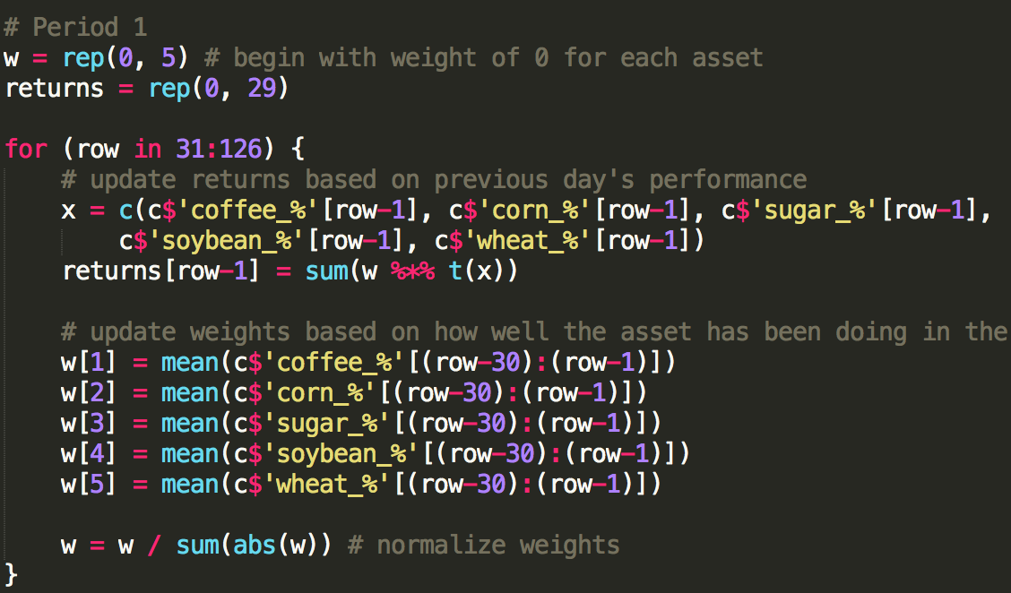
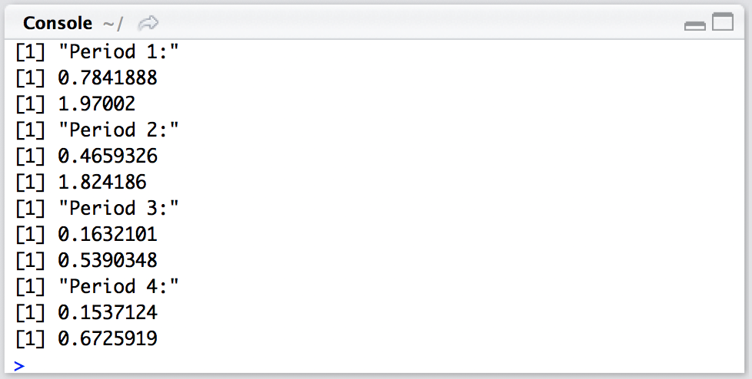
Momentum Model Results
Ran over four 6-month periods:
2/18/12 to 8/18/12
8/18/12 to 2/18/13
2/18/13 to 8/18/13
8/18/13 to 2/18/14
Momentum Model Returns:
Annualized Return
Sharpe Ratio

Slide 9
Regression Model Methods
As our primary goal was to explore the relationship between weather and commodity futures, our next strategies utilize weather in the regions where each commodity is produced to assign weights
Multivariate Linear Regression Model:
Based on rolling 30 days, assign weights to each asset according to a time series regression of the commodity future on the temperature in the regions of the 3 largest producers of the underlying asset
In this way, weather can act as a “signal” to determine the price of an asset. Since the markets react to a wide variety of information, perhaps this information on suppliers of the underlying can help us gain an edge.

Slide 10
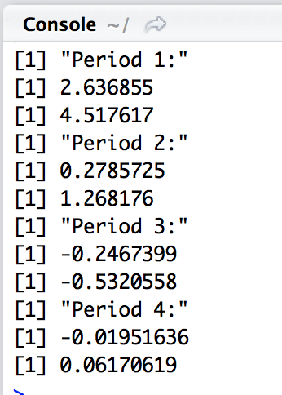
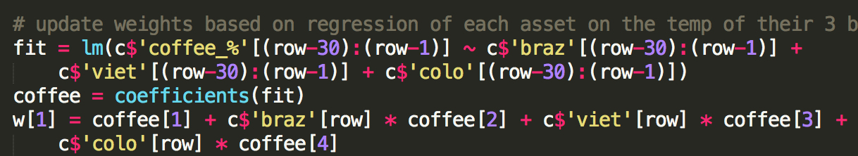
Regression Model Results
Ran over the same four 6-month periods as the momentum model:
2/18/12 to 8/18/12
8/18/12 to 2/18/13
2/18/13 to 8/18/13
8/18/13 to 2/18/14
We update weights via regression:

Slide 11
K-Nearest Neighbors Theory
KNN is a Machine Learning strategy by which predictions can be made based on Euclidean distance to similar points in the training set
KNN can be used for a wide variety of applications:
Image classification
Computer vision
Here we use KNN to make predictions
about commodity futures price, namely
how to weight each asset based on rolling data
It is important to employ cross-validation in order to
prevent overfitting.
We utilize cross-validation to determine the optimal K
before utilizing this K on our test set to make a prediction

Slide 12
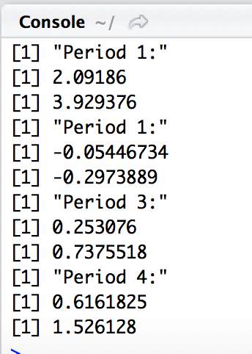
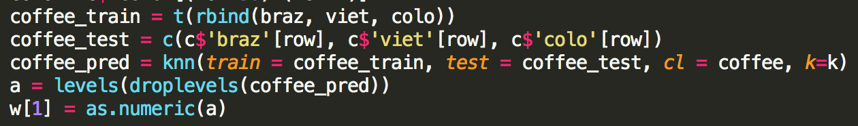
K-Nearest Neighbors Results
Ran over the same four 6-month periods as the momentum model:
2/18/12 to 8/18/12
8/18/12 to 2/18/13
2/18/13 to 8/18/13
8/18/13 to 2/18/14
We update weights via KNN:

Slide 13
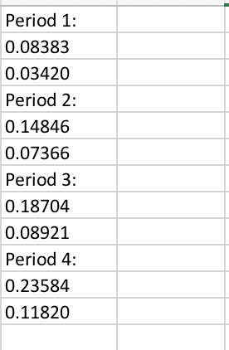
Active Strategies vs. Passive Index
Momentum Model:
Regression Model:
KNN Model:
S&P 500 Model:

Slide 14
Conclusion
Overall the Momentum strategy appears to perform the best, remaining consistently strong in returns and Sharpe ratio
The Regression and KNN models that utilize weather as a signal for commodity futures appear to have potential; over some periods they strongly outperformed the Momentum and Passive models (Period 1), while over other periods they performed poorly (Period 2-3)
Limitation: We had to use short time periods due to low availability of data, this inflated the Sharpe ratio when we annualized returns for Period 1
If we used longer periods, we would have a better idea of how our models would perform in the long run. We could resolve this by utilizing different contracts for which more data is available.

Slide 15
Sources
Quandl for data of Commodity Futures
United States National Climatic Data Center for data of weather
Investopedia for definitions
Article on Commodity-Index Investing:
https://www.wsj.com/articles/why-commodity-index-investing-may-be-futile-1491789841
AQR Paper:
https://www.aqr.com/Insights/Research/Journal-Article/Fact-Fiction-and-Momentum-Investing

