Slide 1
NU CIF Project
University of Nebraska – Omaha Capstone
Talon Flynn, Amber Makovicka, Neil Thorne, Jackson Urrutia

Slide 2
Milestone 2 Overview
Brief Overview
Research Question(s)
Methodology
Requirements
Current Status
Notes:
Why overview?
The direction of our project has changed slightly
Due to gaining a better understanding of the requirements from the stakeholder and strategizing how best to tackle the problem
It has also been a bit since we talked about the project, so we figured a quick recap wouldn’t hurt

Slide 3
Overview – Threat Landscape The Cost of CyberCrime Study by Accenture Security
2017
130 security breaches
$11.7 million average cyber crime costs
2018
145 security breaches
$13.0 million average cyber crime costs
Notes:
Kelly Bissell, Ryan Lasalle, Floris Van Den Dool, and Josh Kennedy-White. 2018. Gaining Ground on the Cyber Attacker: 2018 State of Cyber Resilence. (April 2018). Retrieved February 23, 2020 from https://www.accenture.com/in-en/insights/security/2018-state-of-cyber-resilience-index

Slide 4
Overview – Threat Landscape Global Application & Network Security Report Study by Radware
Average $1.1 million cost per cyber attack
Equifax
$430 million
$600 million Projected
Yahoo!
$1.3 billion
Sold to Verizon $350 million below initial offer
Notes:
Ezra, Y. B., Pariente, N., Zilberman, B., & Smith, D. (n.d.). Global Application & Network Security Report (pp. 1–64). Radware.

Slide 5
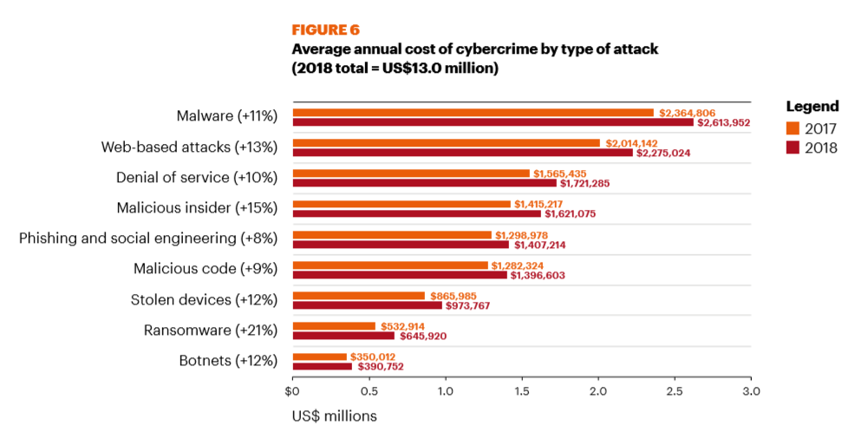
Overview – Threat Landscape The Cost of CyberCrime Study by Accenture Security
Notes:
Kelly Bissell, Ryan Lasalle, Floris Van Den Dool, and Josh Kennedy-White. 2018. Gaining Ground on the Cyber Attacker: 2018 State of Cyber Resilence. (April 2018). Retrieved February 23, 2020 from https://www.accenture.com/in-en/insights/security/2018-state-of-cyber-resilience-index

Slide 6
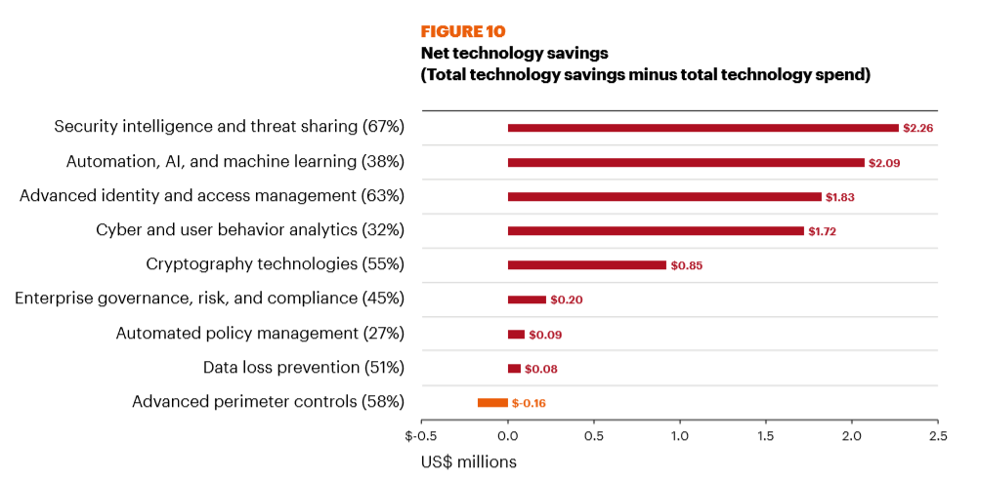
Overview – Threat Landscape The Cost of CyberCrime Study by Accenture Security
Notes:
Security intelligence and threat sharing has the highest cost savings. 67% respondents use it, average 2.26 million savings
Kelly Bissell, Ryan Lasalle, Floris Van Den Dool, and Josh Kennedy-White. 2018. Gaining Ground on the Cyber Attacker: 2018 State of Cyber Resilence. (April 2018). Retrieved February 23, 2020 from https://www.accenture.com/in-en/insights/security/2018-state-of-cyber-resilience-index

Slide 7
Collective Intelligence Framework (CIF)
Developed by REN-ISAC (Information Sharing Network for Higher Education)
Server that pushes/pulls threat feeds to/from internal database
Indicators: IPv4, IPv6, Email, URL, FQDN
Tags: botnet, exploit, hijacked, malware, phishing, scanner, search, suspicious, bruteforce, whitelist, uce, darknet, dns
Confidence Levels

Slide 8
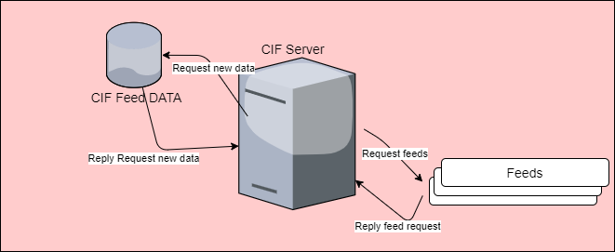
Collective Intelligence Framework (CIF)

Slide 9
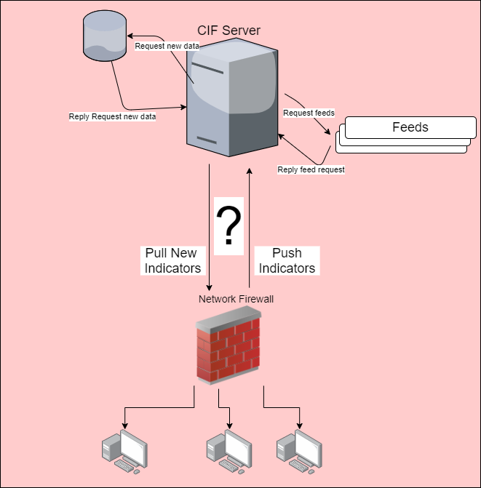
Implementing CIF Into Security Infrastructure

Slide 10
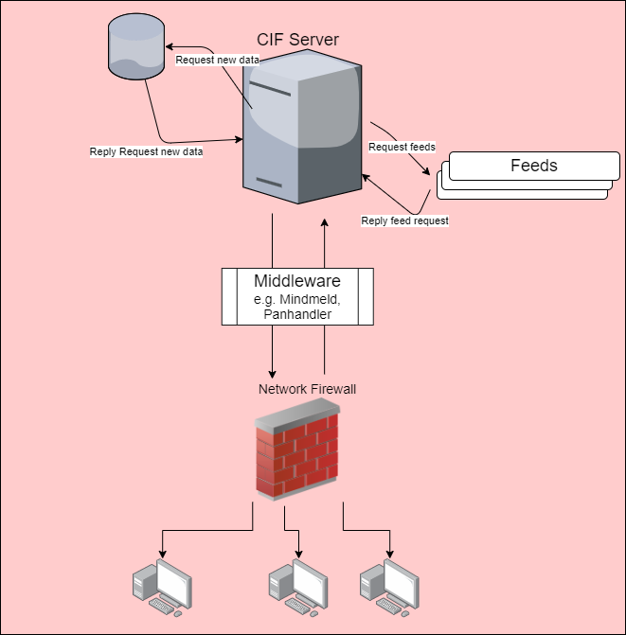
Implementing CIF Into Security Infrastructure

Slide 11

Implementing CIF Into Security Infrastructure

Slide 12
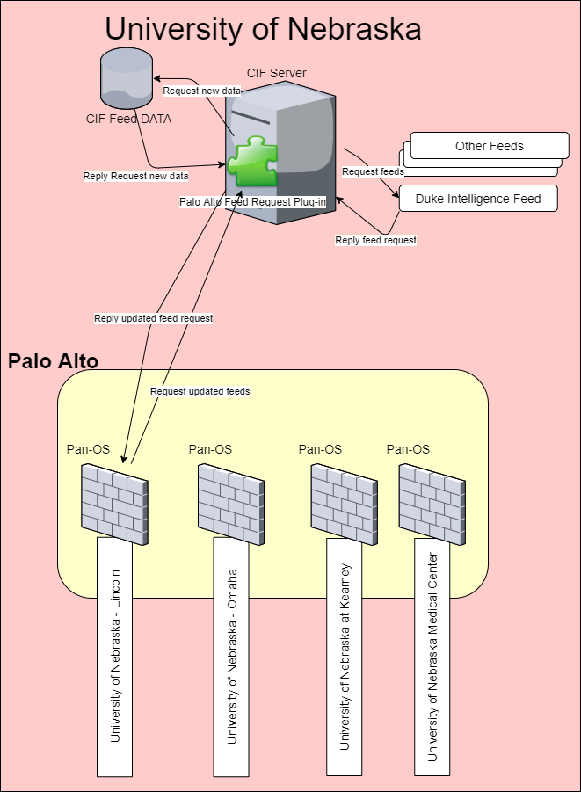
Implementing CIF Into Security Infrastructure: UN

Slide 13
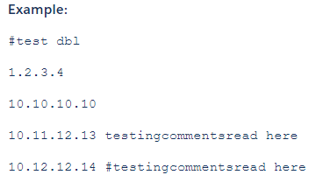
Palo Alto Constraints
External Block Lists: 5,000 maximum each
Maximum total: 150,000
Cannot process token in header
Format:
First 5,000 IPs
99.11.22.33
11.22.33.44
…
123.11.22.33/palo/1
123.11.22.33/palo/2
Second 5,000 IPs
99.11.22.33
11.22.33.44
…

Slide 14
Research Question(s)
To what extent does the timeliness of threat intelligence gathering, aggregation, and sharing affect risk profile reduction within a university enterprise setting?
If there are security efficacy outcomes, what are the costs?

Slide 15
Methodology
Pull report of IPs being blocked by Current CIF over 7-day period
Measure traffic
Implement Solution
Pull report of IPs being blocked by CIF over 7-day period
Measure traffic

Slide 16
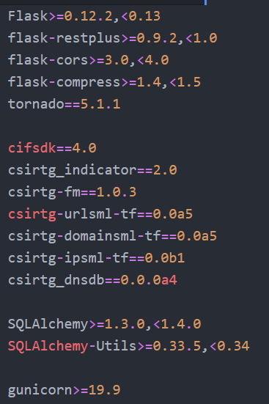
Requirements
Python Knowledge
Flask Web App Framework
CIF-related Packages

Slide 17
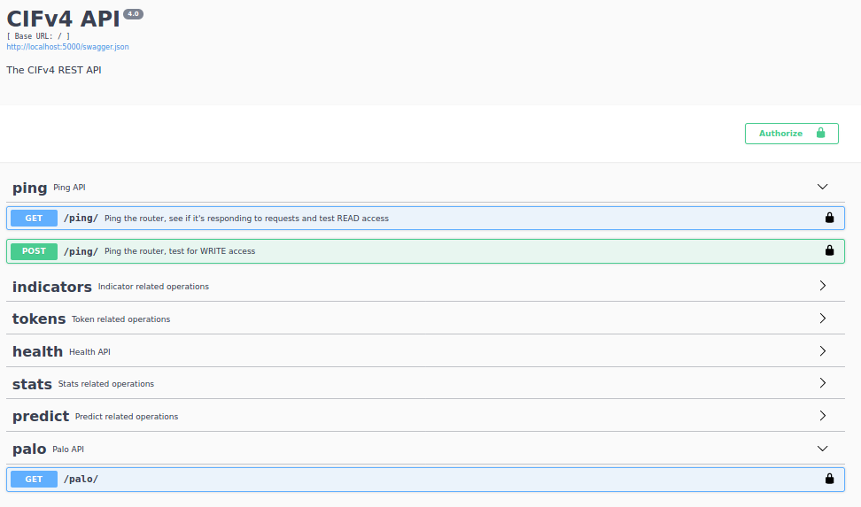
Current Status

Slide 18
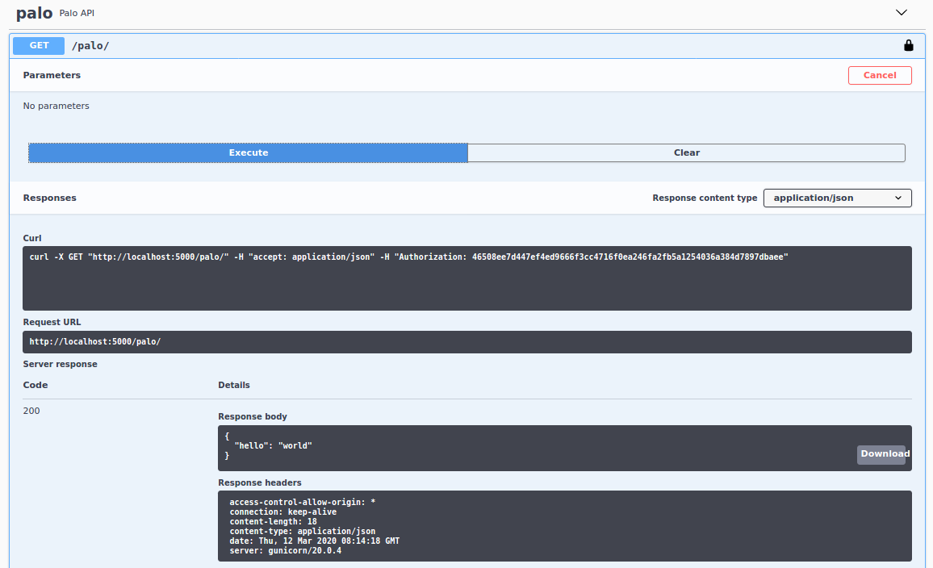
Current Status

Slide 19
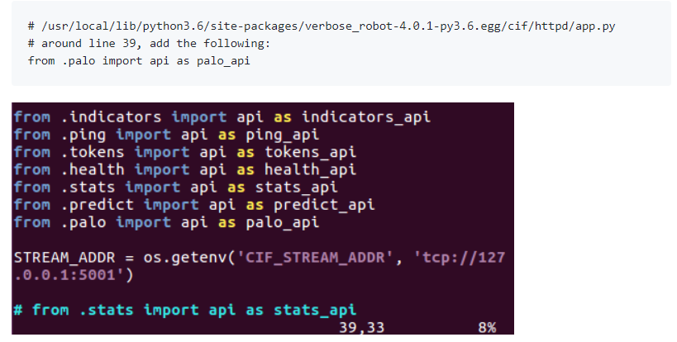
Current Status - Details

Slide 20
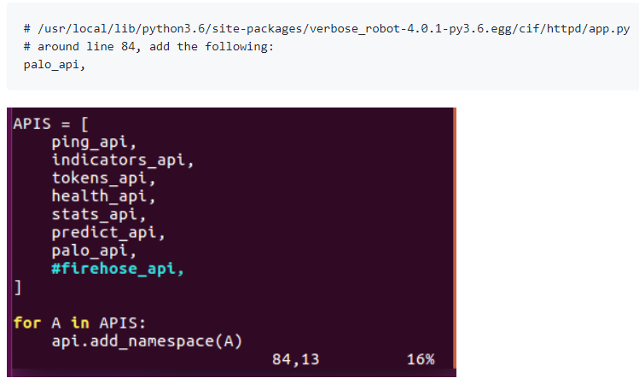
Current Status - Details

Slide 21
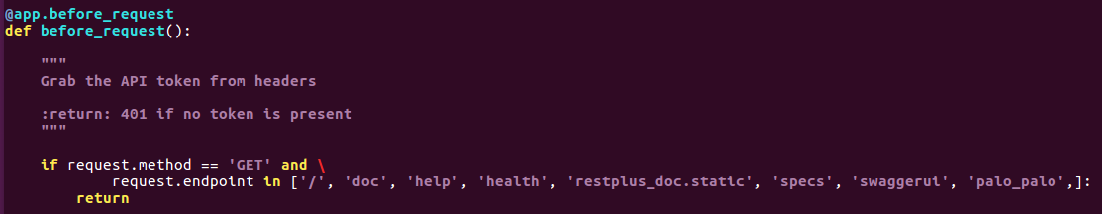
Current Status - Details
# /user/local/lib/pypthon3.6/site-packages/verbose_robot-4.0.1-py3.6.egg/cif/httpd/app.py
# Around #238 add to prevent need for authorization token

Slide 22
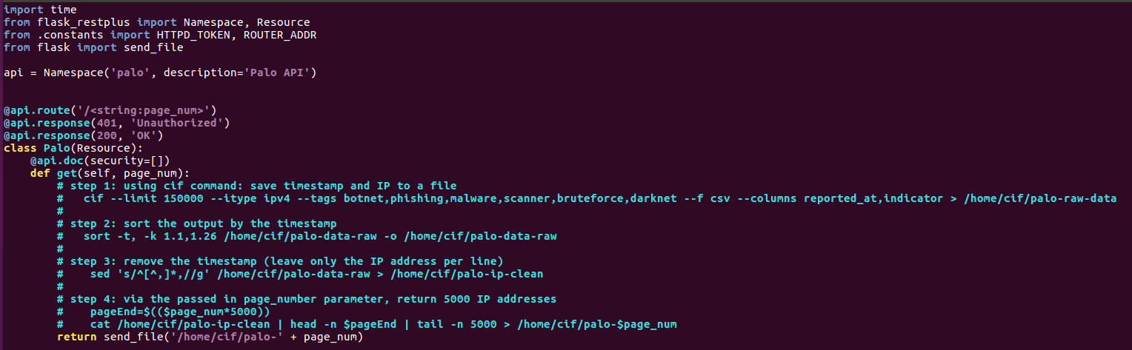
Current Status - Details
# /user/local/lib/pypthon3.6/site-packages/verbose_robot-4.0.1-py3.6.egg/cif/httpd/palo.py
# Around #238 add to prevent need for authorization token
os.system()
os.popen()
subprocess.Popen()

